Slide 1

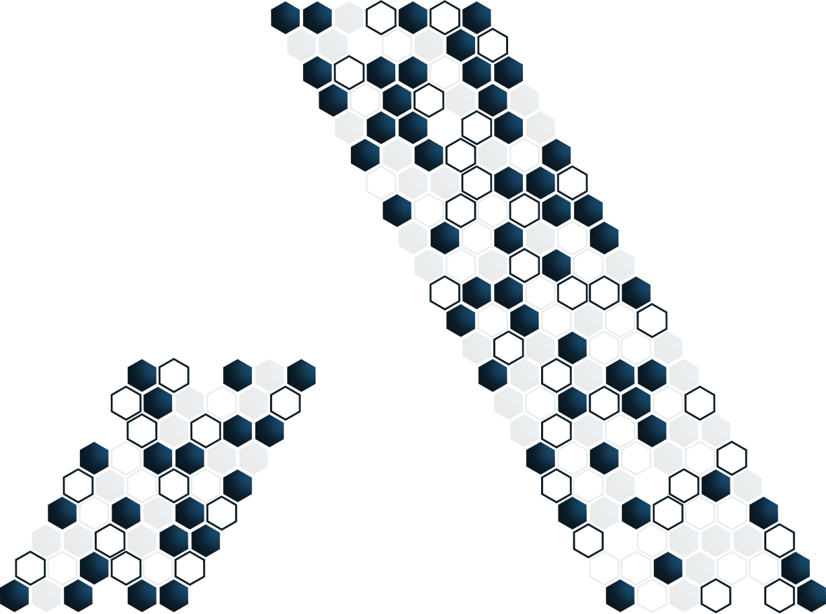


Slide 2

Model, View e Controller

Slide 3
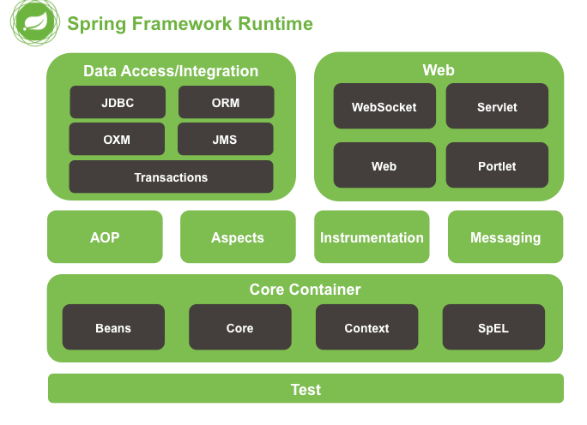

Arquitetura do Spring Framework
Notes:
http://docs.spring.io/spring/docs/4.3.7.BUILD-SNAPSHOT/spring-framework-reference/htmlsingle/#overview-modules
Explicar sobre a visão geral de cada módulo acessando o site oficial

Slide 4
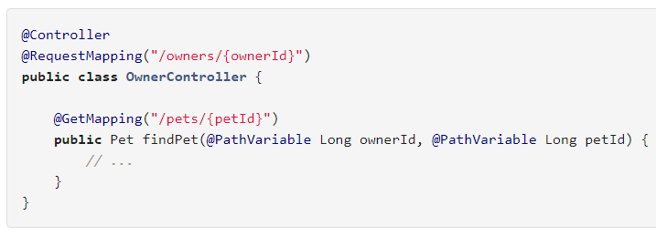
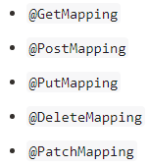
Spring MVC – Request Mapping
Notes:
https://docs.spring.io/spring/docs/current/spring-framework-reference/web.html#mvc-ann-requestmapping

Slide 5
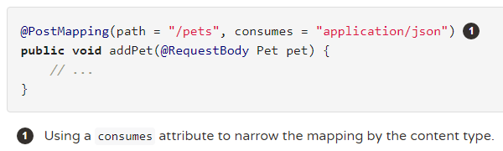
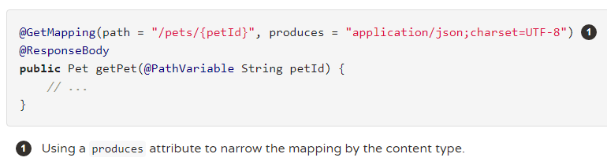
Spring MVC - Media Types
Notes:
https://docs.spring.io/spring/docs/current/spring-framework-reference/web.html#mvc-ann-requestmapping

Slide 6
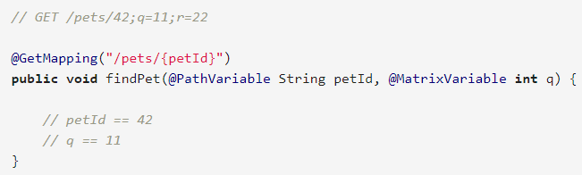
Spring MVC - Matrix Variables
Notes:
https://docs.spring.io/spring/docs/current/spring-framework-reference/web.html#mvc-ann-requestmapping

Slide 7
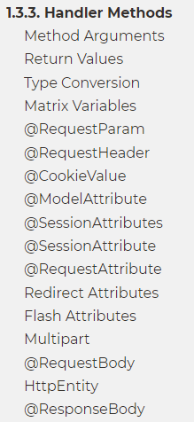
Spring MVC - Handler Methods

Slide 8
Spring MVC - Extras
https://domineospring.wordpress.com/2015/09/16/sera-que-voce-sabe-tudo-das-configuracoes-do-seu-projeto-com-spring/
Notes:
https://domineospring.wordpress.com/2015/09/16/sera-que-voce-sabe-tudo-das-configuracoes-do-seu-projeto-com-spring/

Slide 9
Model, View e Controller

