Slide 1
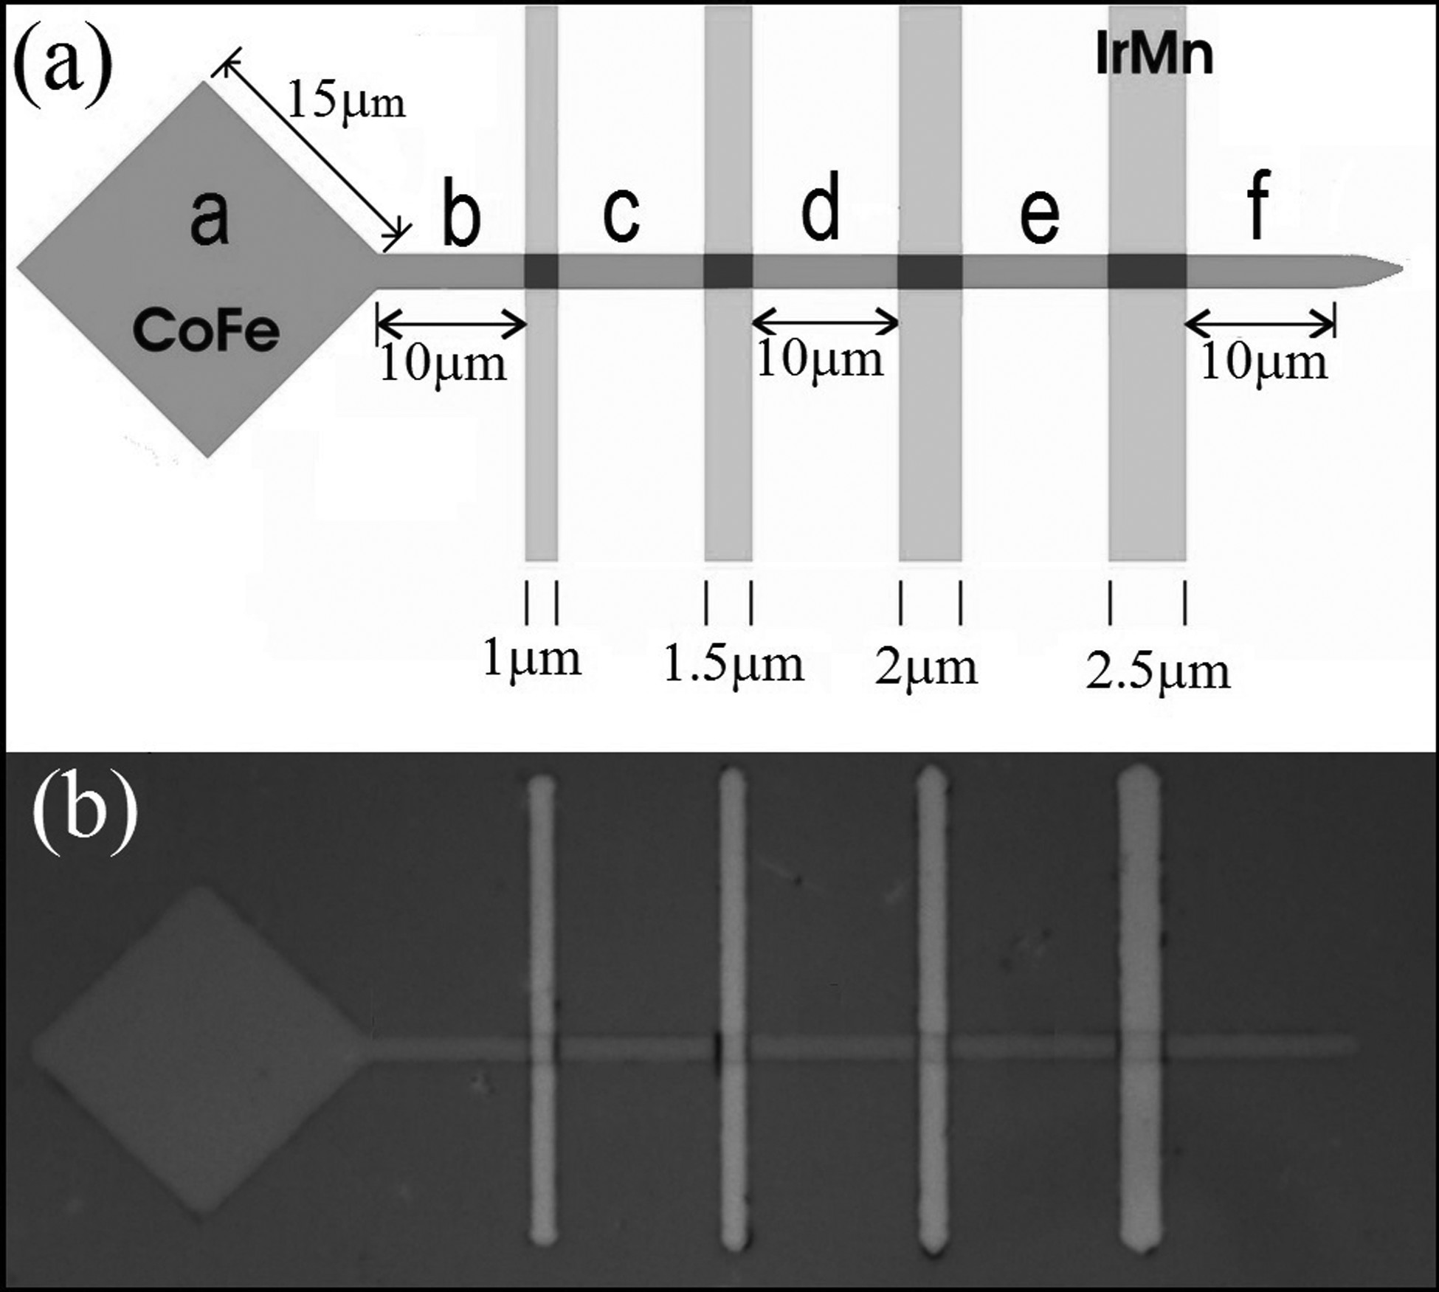
FIG. 2. (a) Schematic diagram and (b) optical micrograph of the device.
Published in: I. Polenciuc; A. J. Vick; D. A. Allwood; T. J. Hayward; G. Vallejo-Fernandez; K. O'Grady; A. Hirohata; Appl. Phys. Lett. 105, 162406 (2014)
DOI: 10.1063/1.4899134
Copyright © 2014 Author(s)

