Slide 1
MovieS
Data Science
Big Data
Challenges
Current Technology, availability of cloud power and AI now can be used to derive and drive customer engagement and business.
On the theory that some snowflakes may be alike, the movie industry tries out predictive analytics on creativity.
See Reference
MOVIES

Slide 2
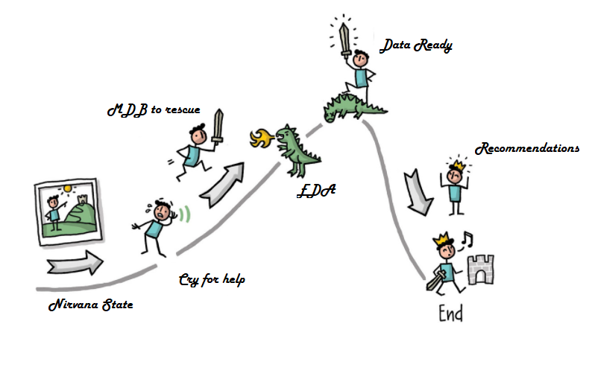
MDB uses art and science of data for movie earning recommendations.
Since the foraying of Netflix, Amazon and other Tech giants into movie content creation and the ease of watching the movie from the comfort of home, traditional studios bottom line is getting impacted. Studios and distributors have heard about data science and AI and are wondering if technology can help them in to understand the dynamics of movie numbers. They have hired a new Data Science CEO, Harold.
https://jenniferhaskin.files.wordpress.com/2019/02/herosjourney.jpg

Slide 3










Harold, who is representing the Movie Studio and Distributors has approached CDA (Central Data Agency) to help them out to do analysis on what factors are more likely to contribute to the success of a movie. Success of movie is defined as having earnings higher than the budget.
CDA has assigned the job to MDB (Movie Data busters) team who are movie enthusiasts and are experts in the art and science of Data. MDB team using Lean concepts have divided the work in multiple milestones. They are calling it HUD, Hollywood usable deliverables. MDB team shall be using various libraries of Python to do the EDA work and present initial recommendations.

Slide 4

Data Source
Hollywood Theatrical Market Synopsis 1995 to 2021 | Kaggle
IMDB 5000 Movie Dataset | Kaggle
These data sets were chosen as it provides a good summary of key metrics and the second data set has information about Facebook likes for each of the actors, director and the movie.
The Highest Grossers data lists the top grossing movie for each year based on the tickets sold for each movie during the course of that respective year and also its corresponding year 2019 valuation(adjusted for inflation), Only in North America
It also has a unique feature called Facebook poster faces, since we do not have the data for marketing, this can be used as a proxy.
This data set also has features like IMDB score, critical reviews and genres.
These data sets are a good set for HUD-1 to get a feeling of if we are moving in the right direction.

Slide 5
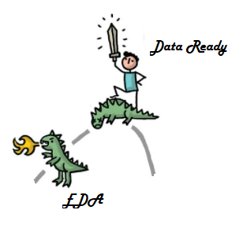
CDA has assigned the job to MDB (Movie Data busters) team within the organization who are movie enthusiasts and are experts in the art and science of Data.
MDB team using Lean concepts have divided the work in multiple milestones. They are calling it HUD, Hollywood usable deliverables.
Creative Algorithm
HUD - 1
EDA
HUD - 2
Feature Analysis
HUD - 3
CA

Slide 6
MDB team is aware that the initial data set may not be good enough to provide the final answer but will direct in the right direction. MDB team will have to eventually scrap more data and do transformations and using machine learning techniques to overcome the obstacles and be the **HERO ** for Harold.
HUD -1 answers the following key questions.
Compare total box office and total tickets sold compared to average price relationship.
Which genre grosses the higher for each studio? Show statistics for each studio and genre.
Top 5 Actors and Directors with highest grossing movies.
Poster vs grossing revenue and tickets sold relationship.
Generate ROI for the movies?
Facebook like compared to earnings?
MPAA Ratings vs Earnings comparison?
Correlation between IMDB score and Earnings?

Slide 7
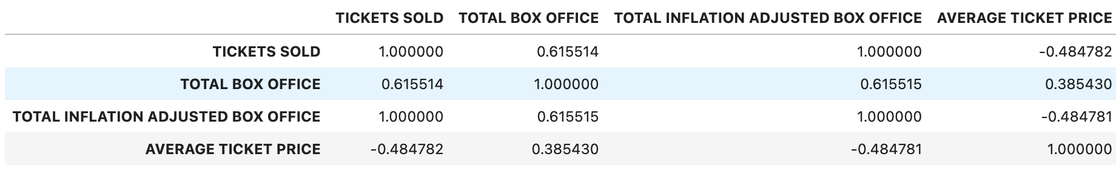
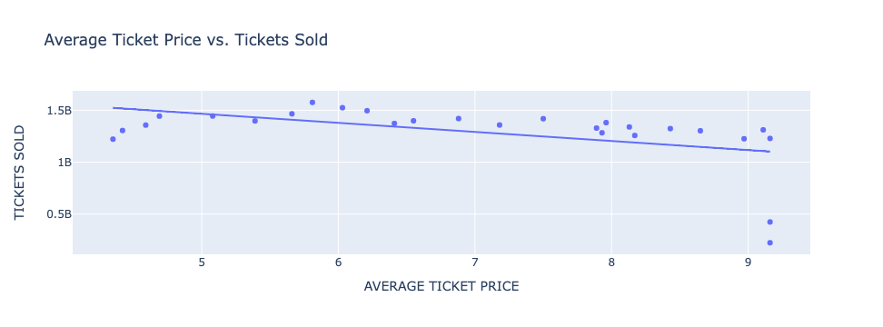
Compare total box office and total tickets sold compared to average price relationship
As you can see, the average ticket price has a negative correlation with the amount of tickets sold.
As ticket prices get higher, less tickets are sold, which will be shown below in a scatter plot.
However, as ticket prices get higher, the total box office gets higher, as seen in the correlations.
When excluding data from 2020 and 2021 the correlations are almost the same.
Conclusion: Studios would rather have less consumers but have increased ticket prices because the higher ticket price results in more money for the studio/theater.

Slide 8

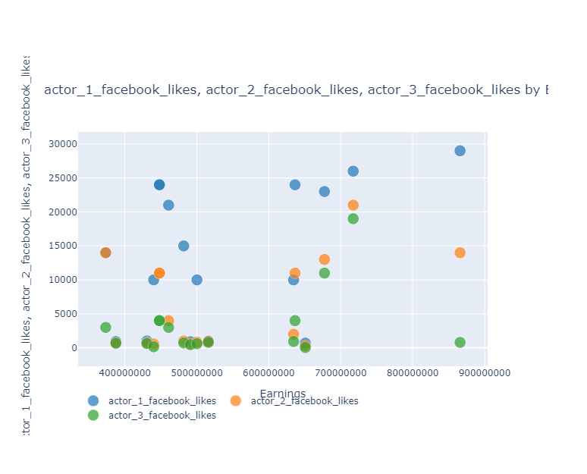
Recommendation
Actor facebook likes is not a good indicator for earnings.

Slide 9
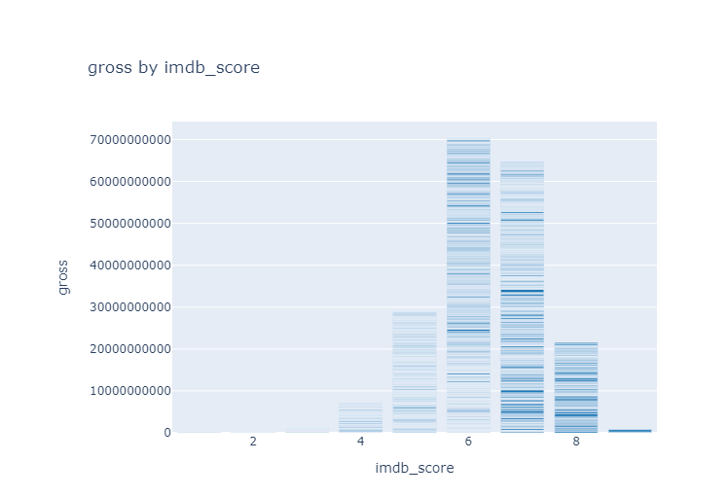
Recommendation
IMDB score gives some indication but is still not a good feature on its own to help in predicting higher earnings. (data set contains movies from many countries and many years)

Slide 10
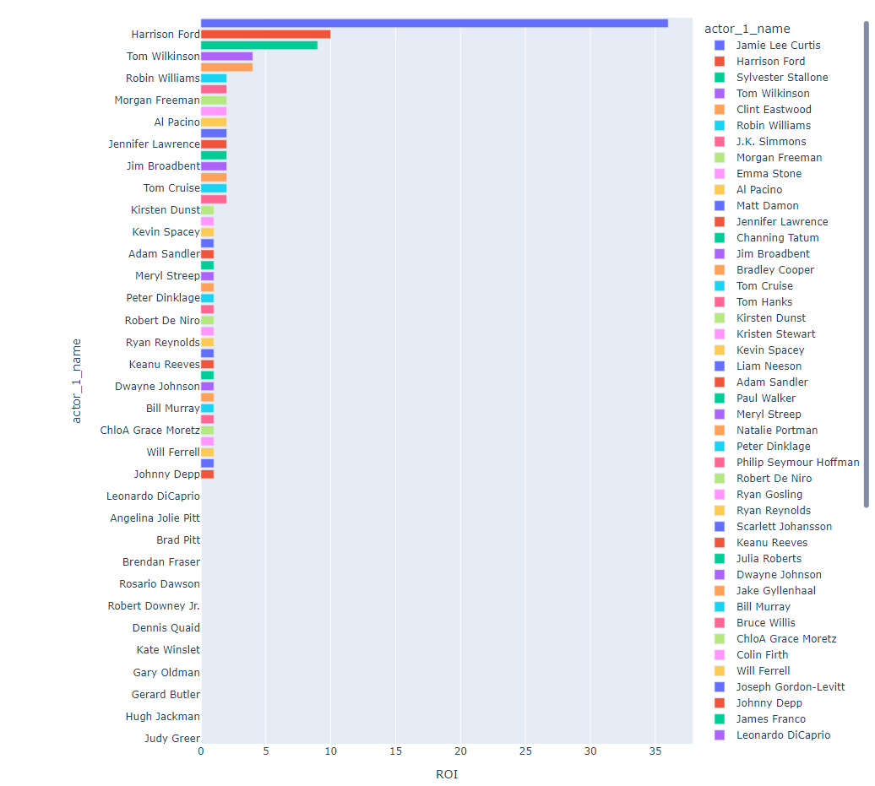
Recommendation
Actor/Actress do provide some lead into the earnings.
Critical finding is that women actors can lead to higher earnings.

Slide 11
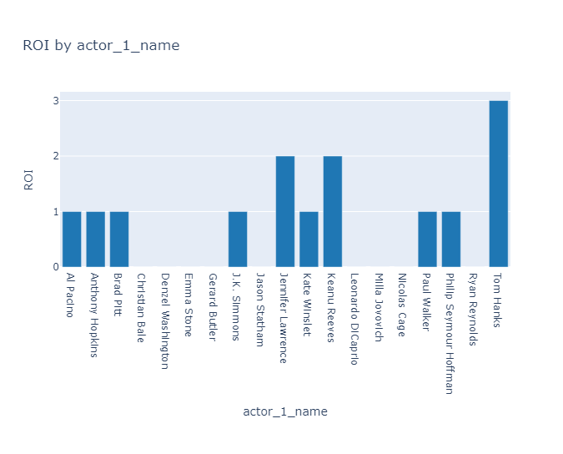
Recommendation
Actor who is part of most of the movies in high earning movies but may not be lead actor. Tom hanks seems to be most dependable actor followed by Jennifer, confirming women power.

Slide 12

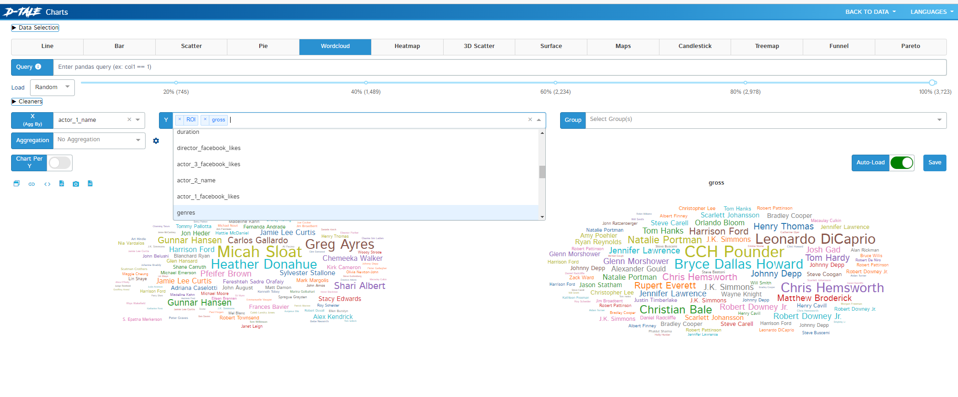
Dashboard
Powered by D-Tale. Use imdb_data_copy for overall drill down and profilic_actors to dive into highly active actors.

Slide 13
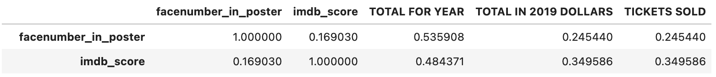
Poster and imdb score vs grossing revenue relationship and tickets sold for Top Grossing Movies in US
Recall: The Highest Grossers data lists the top grossing movie for each year based on the tickets sold for each movie during the course of that respective year and also its corresponding year 2019 valuation(adjusted for inflation), Only in North America
'Number of Faces' contain the amount of actor’s faces on the theatrical poster. This doesn't count CGI characters, or characters with a mask covering their face, like Batman. Shrek and Toy Story are outliers for this data (everything else I checked to make sure it was accurate).
For the highest grossing films per year (US) you can see there is a positive correlation between every variable.
Specifically, the number of faces is most correlated with the total earning per year and the amount of tickets sold (total per year is without inflation which is what I'm referring to).

Slide 14
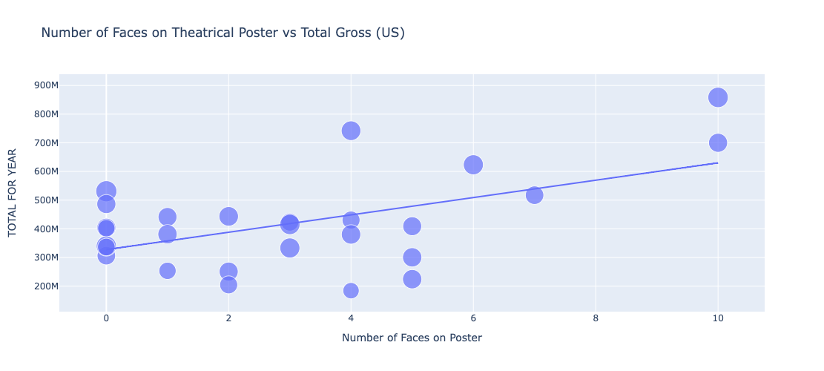
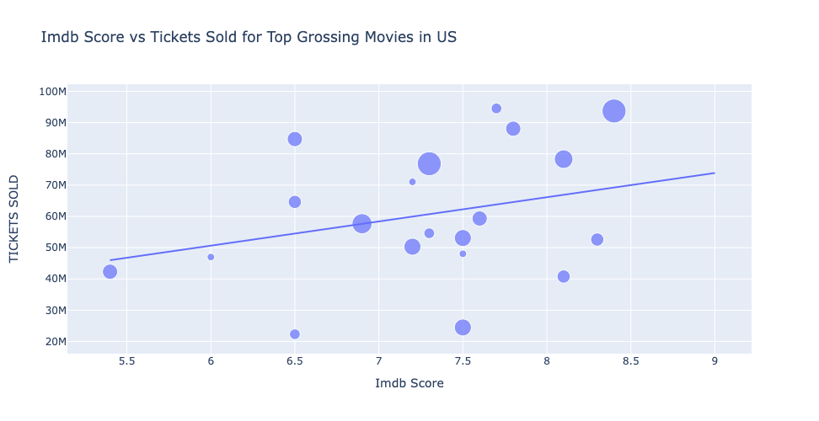
Recommendation
Additionally, it seems the imdb score has more to do with success than the number of faces on the poster.
The imdb score is more correlated with tickets sold than the number of faces on poster are.
My conclusion is, if there are more faces on the poster, and the imdb score is good then it results in more tickets sold and higher box office earnings. (at least in the US)

