Slide 1
CSSE 220
Linked List Implementation
and
Project Preparation
Checkout LinkedListSimple project from SVN
Notes:
Doing everything in LinkedListSimple today
Quiz given in next slide

Slide 2
Quiz
Get into pairs
Look at/run the code in LinkedList.java main
Draw a box-and-pointer diagram of what’s happening in the main code.
To figure it out, you’ll have to look at the LinkedList constructor and addAtBeginning.
If you’ve forgotten how to do box-and-pointer diagrams, checkout the handout on Day 5 of the schedule
Q1
Notes:
This diagram is their quiz for the day

Slide 3
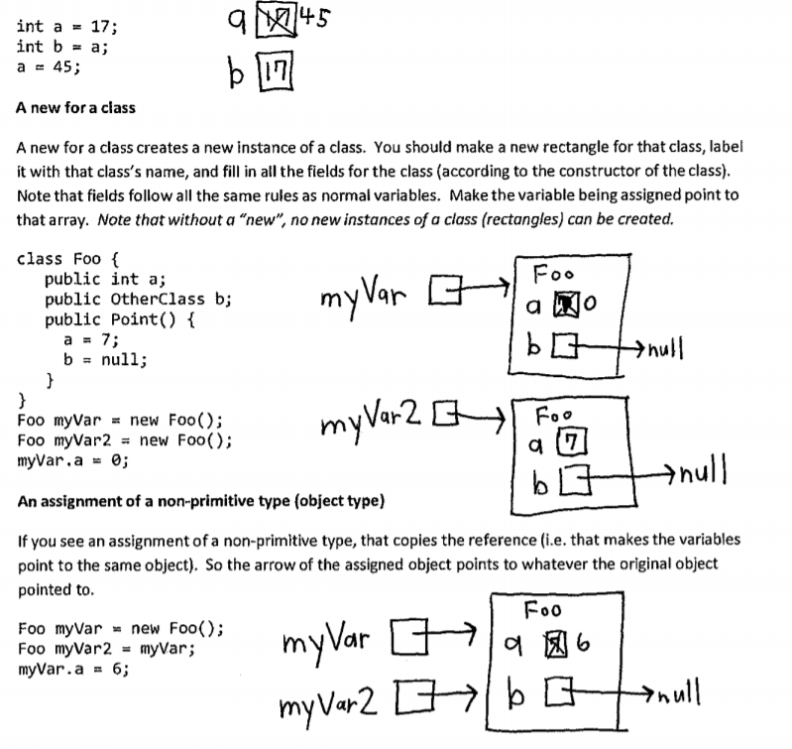

Slide 4
Solve the Other Problems in LinkedListSimple
Look at toString to get an idea of how to do size, then go from there
They are in approximate difficulty order
Get help if you get stuck!
Hold on to your quiz today, we will finish it next class period.

Slide 5
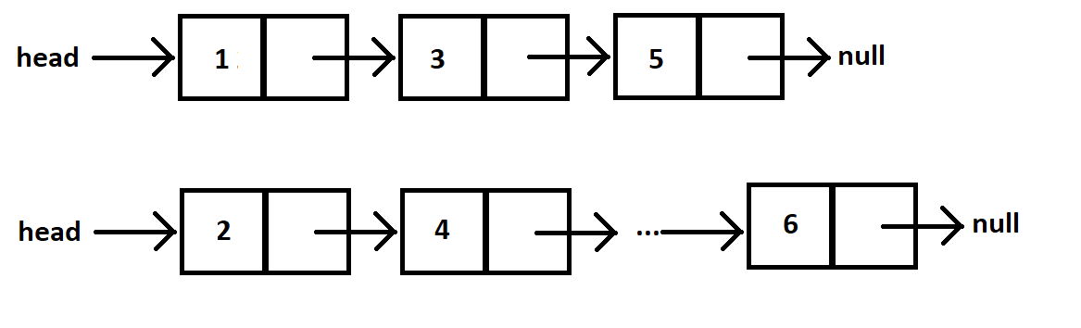
Shorthand Notation
Using pictures will be extremely helpful
Can use System.out.println( this ) to see what the current list looks like (does it match diagram?)

Slide 6
Loops in Arrays vs. LinkedLists
int[] nums = ……
for (int i=0; i< nums.length; ++) {
//do stuff with
//arbitrary element nums[i]
}
Equivalent in while loop
int i=0;
while ( ? ) {
//do stuff with
//arbitrary element nums[i]
?
}
LinkedList list = ……
//Another Day!
Node current = this.head;
while ( ? ) {
//do stuff with
//arbitrary element
?
}

Slide 7
Loops in Arrays vs. LinkedLists
int[] nums = ……
for (int i=0; i< nums.length; ++) {
//do stuff with
//arbitrary element nums[i]
}
Equivalent in while loop
int i=0;
while ( i < nums.length ) {
//do stuff with
//arbitrary element nums[i]
i++;
}
LinkedList list = ……
//Another Day!
Node current = this.head;
while ( ? ) {
//do stuff with
//arbitrary element
?
}

Slide 8
Loops in Arrays vs. LinkedLists
int[] nums = ……
for (int i=0; i< nums.length; ++) {
//do stuff with
//arbitrary element nums[i]
}
Equivalent in while loop
int i=0;
while ( i < nums.length ) {
//do stuff with
//arbitrary element nums[i]
i++;
}
LinkedList list = ……
//Another Day!
Node current = this.head;
while ( ? ) {
//do stuff with
//arbitrary element
current = current.next;
}

Slide 9
Loops in Arrays vs. LinkedLists
int[] nums = ……
for (int i=0; i< nums.length; ++) {
//do stuff with
//arbitrary element nums[i]
}
Equivalent in while loop
int i=0;
while ( i < nums.length ) {
//do stuff with
//arbitrary element nums[i]
i++;
}
LinkedList list = ……
//Another Day!
Node current = this.head;
while ( current != null ) {
//do stuff with
//arbitrary element
current = current.next;
}

Slide 10
Solve the Other Problems in LinkedListSimple
Look at toString to get an idea of how to do size, then go from there
They are in approximate difficulty order
Get help if you get stuck!
size()
add…
remove…

Slide 11
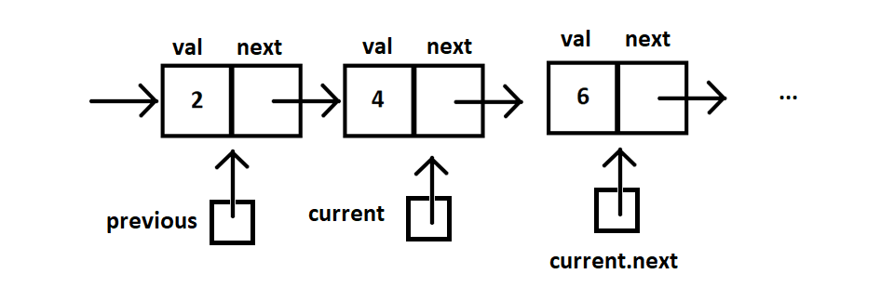
Shorthand Notation

Slide 12
Homework
SinglyLinkedList
Requires you to implement a SinglyLinkedList
Additional algorithm questions which make use of the SinglyLinkedList
Will give time in next class to work on it

Slide 13
Software Engineering Techniques
Pair programming
Project can be coordinated well with this
Version Control
How to avoid merge conflicts in SVN
Notes:
Start here with 10-15 minutes left in class

Slide 14

What Is Pair Programming?
Two programmers work side-by-side at a computer, continuously collaborating on the same design, algorithm, code, and/or test
Enable the pair to produce higher quality code than that produced by the sum of their individual efforts
Notes:
Q: What is pair programming? [a software technique where 2 programmers work side by side at the (one) computer continuously collaborating on the same design, algorithm, code, and or test.]

Slide 15
Pair Programming
Working in pairs on a single computer
The driver, uses the keyboard, talks/thinks out-loud
The navigator, watches, thinks, comments, and takes notes
Person who really understands should start by navigating ☺
For hard (or new) problems, this technique
Reduces number of errors
Saves time in the long run
Notes:
Q: What are the two roles in Pair Programming? [driver and navigator]

Slide 16
Pair programming video
https://www.youtube.com/watch?v=rG_U12uqRhE
Notes:
Optional, can skip this but mention it to the students as something to watch if they are unfamiliar with pair programming

Slide 17
Software Versions

Slide 18
When Two+ People Edit the Same Code
Math.java
Alice edits sqrt method
Bob edits sqrt method
Alice commits changes
Bob attempts to commit changes
ERROR
Source control system cannot
resolve multiple changes on the
same code, Bob should have
updated and resolved conflicts
before committing.
Updated Math.java

Slide 19
Team Version Control
Version control tracks multiple versions
Enables old versions to be recovered
Allows multiple versions to exist simultaneously
Always:
Update before working
Update again before committing
Commit often and with good messages
Communicate with teammates so you don’t edit the same code simultaneously
Pair programming ameliorates this issue ☺
Notes:
Q4: For team version control, what should you “always” do? [update before working, update again before committing, commit often with good messages]
Consider viewing (possibly adding here) the 120 slides on version control (Day 2 in the clifton branch of the repository). I think the visuals of the update edit update commit cycle are good. CWA.

Slide 20
Team Version Control
Check Out
Update and Commit often!
Update
Edit
Commit
Update
Notes:
Update before editing or committing to make sure you don't get out of sync with changes made by others (like your instructor, or later your teammates).

Slide 21
What if I get a conflict on update?
If you did an update and now have File.java, File.java.mine, File.java.rN, and File.java.rM (where N and M are integers):
YOU HAVE A CONFLICT!
Eclipse provides tools for resolving conflicts
Follow the steps in this link to resolve a conflict:
http://www.rose-hulman.edu/class/csse/csse221/current/Resources/ResolvingSubversionConflicts.htm
Notes:
Go over this quickly, mentioning that if they pair program and always start by updating they will never have a problem!

Slide 22
Team Project Work TiMe
Move into your groups if not already
Review comments from Milestone 0 feedback
Be prepared to ask question of the grader
You will have ~5 minutes, so use it well
Notes:
This is the end of Monday’s class, pick up from here on Wednesday to complete quiz

Slide 23
Wednesdays material

Slide 24
Data Structures + BiG-O Notation
CSSE 220
Understanding the engineering trade-offs when storing data
Checkout LinkedListSimple project from SVN
Checkout SinglyLinkedList homework from SVN
Notes:
If students get through things quickly we can move into this material in the first hour, but if not- that is OK, we have the next class period to go through it and give them time to work on the rest of the quiz and the homework problems.

Slide 25
Data Structures
Efficient ways to store data based on how we’ll use it
The main theme for the rest of the course
So far we’ve seen ArrayLists
Fast addition to end of list
Fast access to any existing position
Slow inserts to and deletes from middle of list
Notes:
Q: Have to move all the other elements up or down to make/use room. O(n)

Slide 26
Big-O Notation
Describes the limiting behavior
How slow it can possibly run?
Describes the worst case
Used for Classifying Algorithm Efficiency
“O” for “Order”
O(n) → said as “Order n”
O(n^2) → said as “Order n-squared”

Slide 27
Big-O Notation (continued)
Don’t Care About Constants
O(2n + 7) → O(n)
Don’t Care About Smaller Powers
O(6n^2 + 7n) →O(n^2)
Algorithm grows asymptotically no faster than n^2
If constant value, we say O(1) → “Order 1”
O(48) → O(1)
Q2
Notes:
We care about which part of the expression grows the fastest as n, the input size, grows.

Slide 28
ArrayList Performance (Revisited)
Fast addition to end of list:
Fast access to any existing position – O(1) (like array)
Keep extra capacity for list growth
Fast access includes items in capacity not yet filled – O(1)
Capacity management is best left for CSSE230
Slow inserts to and deletes from middle of list
Can get to insert/delete location quickly
For insert, shift all items right to accommodate -O(n)
For delete, shift all items left to fill gap – O(n)
Q3

Slide 29
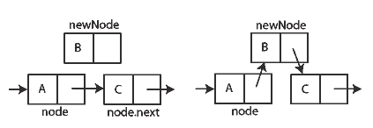
Another List Data Structure
What if we have to add/remove data from a list frequently?
LinkedLists support this:
Fast insertion and removal of elements
Once we know where they go
Slow access to arbitrary elements
data
data
data
data
null
data
Insertion, per Wikipedia
Q4-5
Notes:
- Examples: employee list, music play list
Sketch a linked list on the board for “two more weeks” (quiz #3)
Then show insertion and deletion.

Slide 30
LinkedList<E> Methods
void addFirst(E element)
void addLast(E element)
E getFirst()
E getLast()
E removeFirst()
E removeLast()
Notes:
Big-Oh of each?
All of the operations perform as could be expected for a doubly-linked list.
Thus, these operations all take O(1) time.

Slide 31
Complete Quiz
Turn in quiz today

Slide 32
Homework
SinglyLinkedList
Requires you to implement a SinglyLinkedList
Additional algorithm questions which make use of the SinglyLinkedList
Will give you remaining class time to work on it
If you complete it, work on the project!

