Slide 1
CSSE 220
Merge Sort
Checkout MergeSortSimple project from SVN
Notes:
No quiz today.
Bring printouts from the MergeSortSimpleSolution.

Slide 2
Today’s Plan
Big-oh practice
Merge sort

Slide 3
Merge Sort
Basic recursive idea:
If list is length 0 or 1, then it’s already sorted
Otherwise:
Divide list into two halves
Recursively sort the two halves
Merge the sorted halves back together
Notes:
Don’t burn too much time on it. They understand recursion…
Demo with cards or big letters
[I reviewed selection and insertion sort stressing the differences before going over merge sort. That helps emphasize the differences.]

Slide 4
Analyzing Merge Sort
If list is length 0 or 1, then it’s already sorted
Otherwise:
Divide list into two halves
Recursively sort the two halves
Merge the sorted halves back together
Merge n items
n items merged
Merge n/2 items
Merge n/2 items
n items merged
Merge n/4 items
Merge n/4 items
Merge n/4 items
Merge n/4 items
n items merged
etc
etc
n items merged
Merge 2 items
Merge 2 items
Merge 2 items
Merge 2 items
etc
Notes:
Just summarize it here. Don’t dawdle; this will make more sense when they implement it.
Have students implement mergesort.StringMergeSort. Walk around the room and help students as needed. Have your TAs do the same. Keep students engaged.

Slide 5
Next Week: Your Presentations
8 minutes long
~3 minutes showing off your extra features
~5 minutes explaining JUST ONE technical decision in detail
Could be a design decision, feature implementation, or tricky bug
Be careful about code examples (good – but in moderation)
Should include prepared slides usually including diagrams
Notes:
5

Slide 6
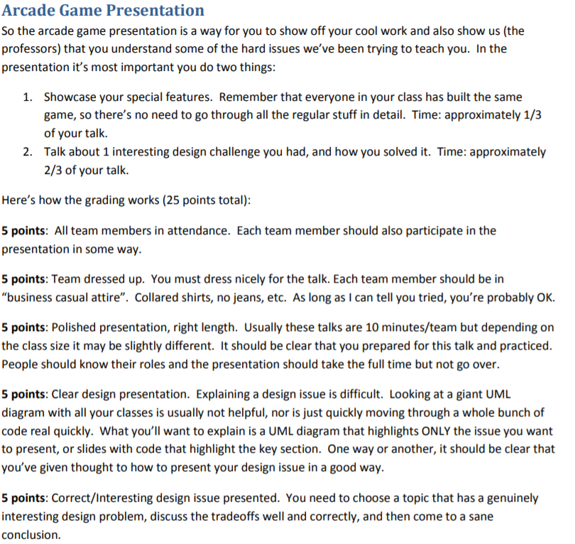
Notes:
Dress 1 step up form your normal dress level

