Slide 1
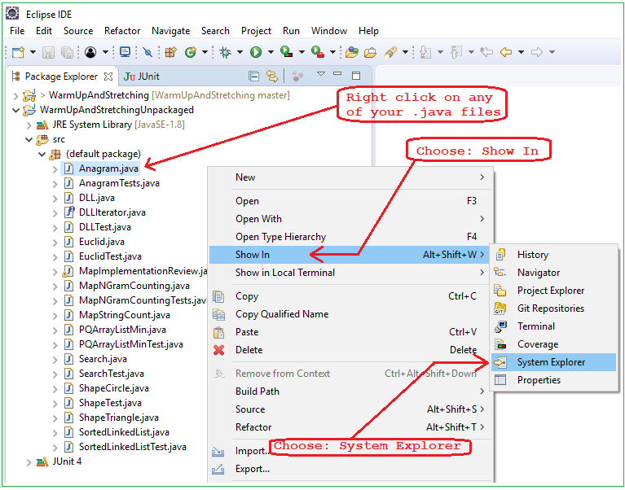
How to Find Your Source Code in Eclipse

