Slide 1
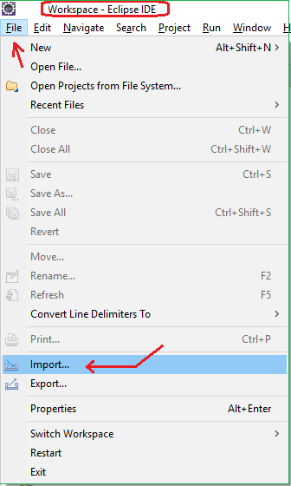
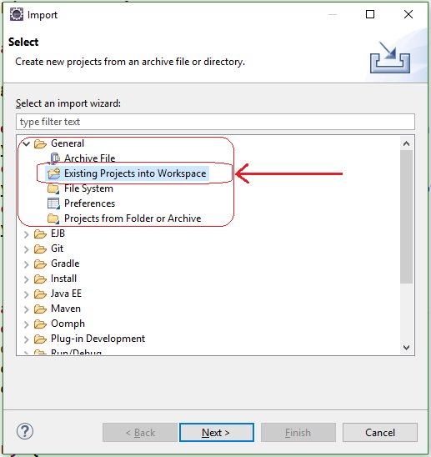
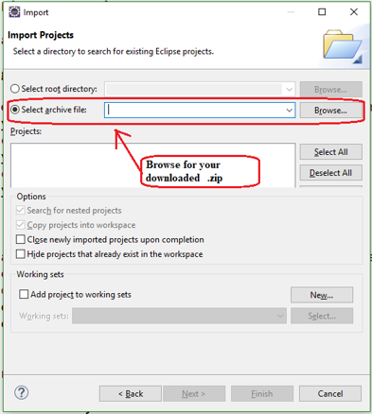
Importing .Zip into Eclipse
File | Import – Step 1
Import Dialog - Step 2
Import Dialog - Step 3

