Slide 1
Step lengths - All
n = 1498, range = 4 to 4975m
Fit to exponential distribution q-q plot

Slide 2
Step lengths - Close (first sighting < = 2000m)
n = 813, range = 4 to 3063m
Fit to exponential distribution q-q plot

Slide 3
Step lengths - Far (first sighting > 2000m)
n = 190, range = 6 to 4975m
Fit to exponential distribution q-q plot

Slide 4
Turn angles - All
n = 933, range = -3.13 to 3.14 radians

Slide 5
Turn angles - Close (first sighting <= 2000m)
n = 484, range = -3.13 to 3.13 radians

Slide 6
Turn angles - Far (first sighting > 2000m)
n = 105, range = -3.11 to 3.00 radians

Slide 7
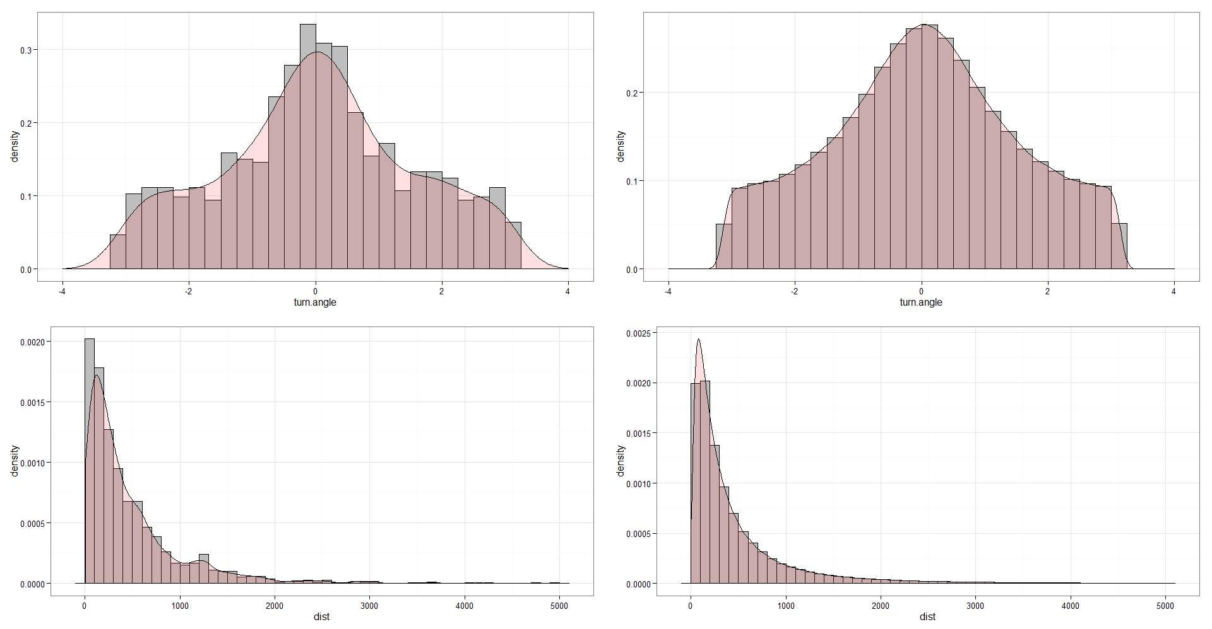
Density plots of step length and turning angle; all observed data and simulation (n = 1000000) using observed data parameters.
Observed
Simulated

Slide 8
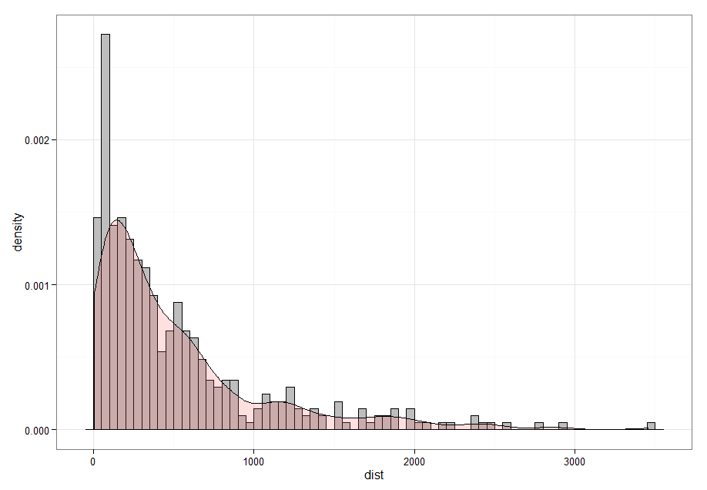
Step lengths – Blowing observational behavior state
n = 411, range = 6 to 34555m

Slide 9
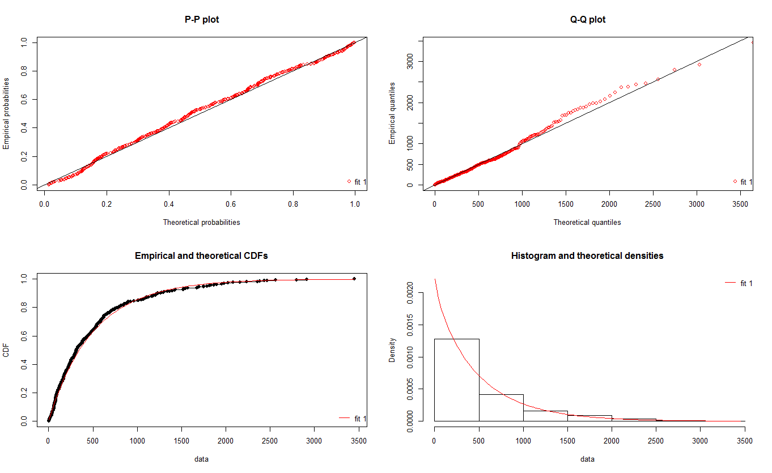

Slide 10
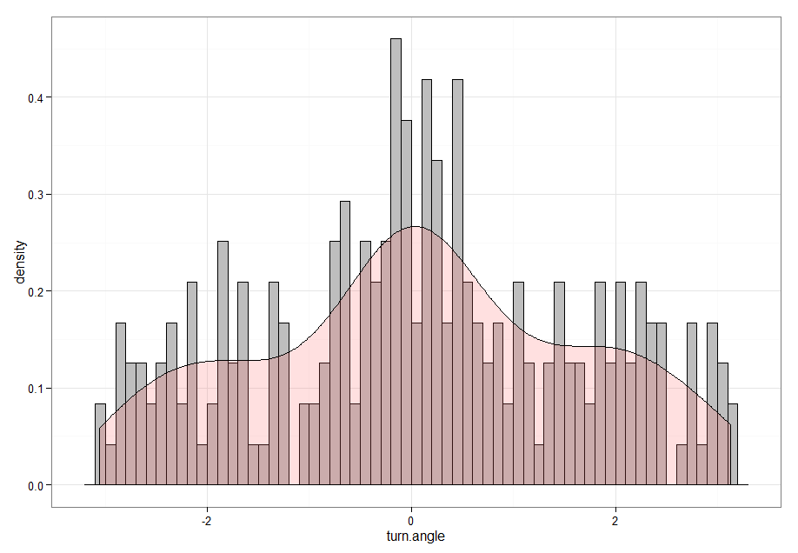
Turn angles - Blowing observational behavior state
n = 239, range = -3.06 to 3.13

Slide 11
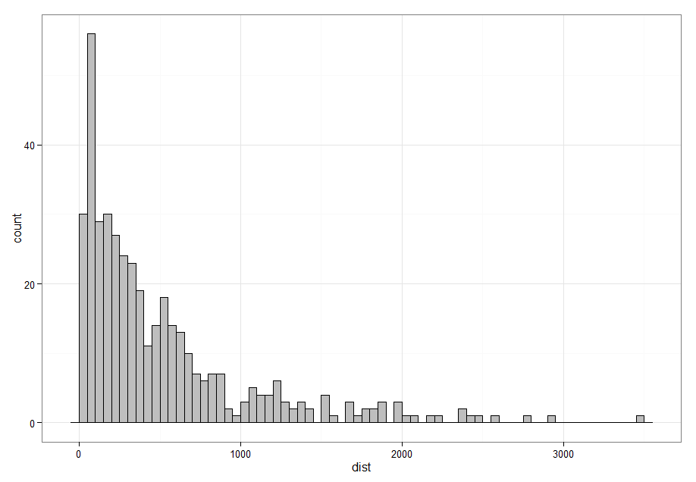
Step lengths – Blowing observational behavior state
n = 411, range = 6 to 34555m

Slide 12
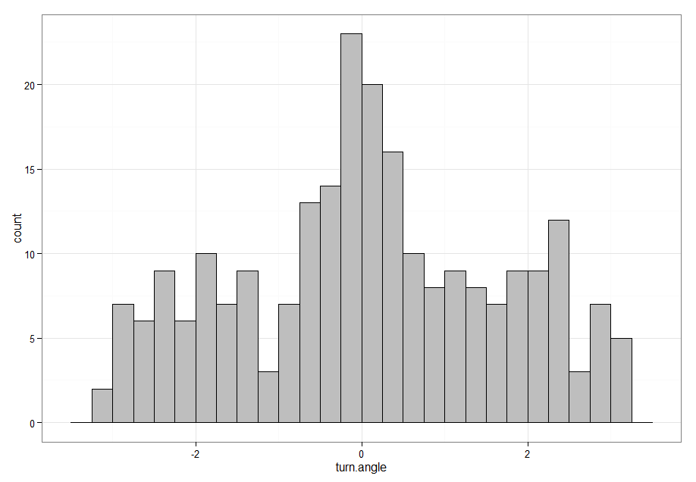
Turn angles - Blowing observational behavior state
n = 239, range = -3.06 to 3.13

Slide 13
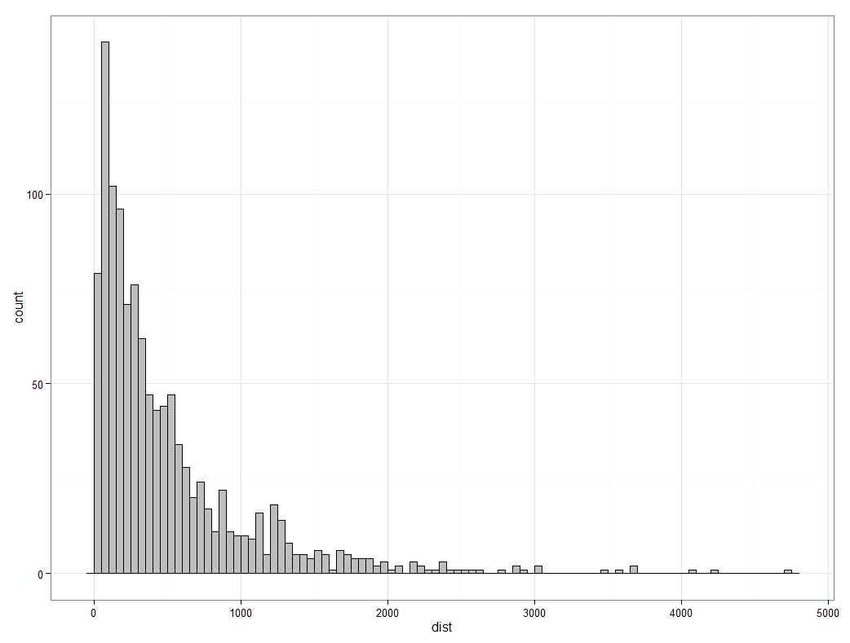
Step lengths – Transit observational behavior state
n = 1149, range = 6 to 4705m

Slide 14
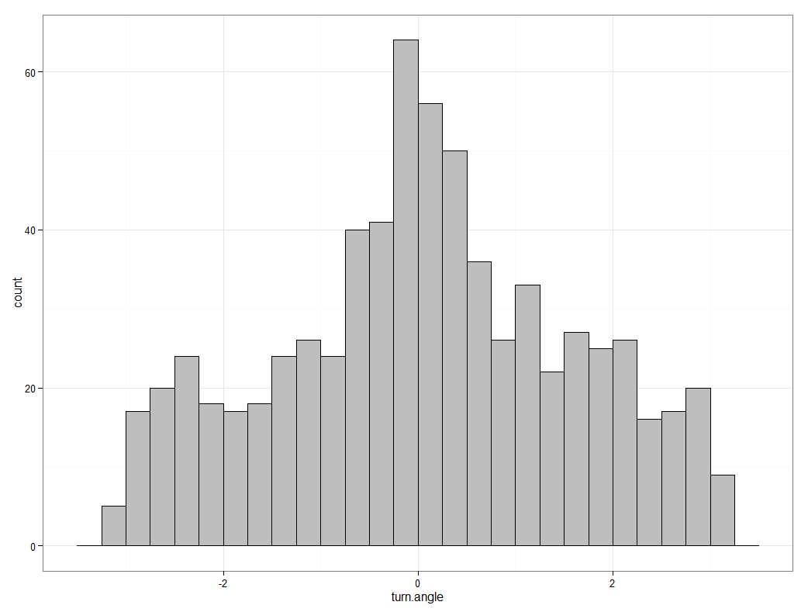
Turn angles - Transit observational behavior state
n = 701, range = -3.13 to 3.13

Slide 15
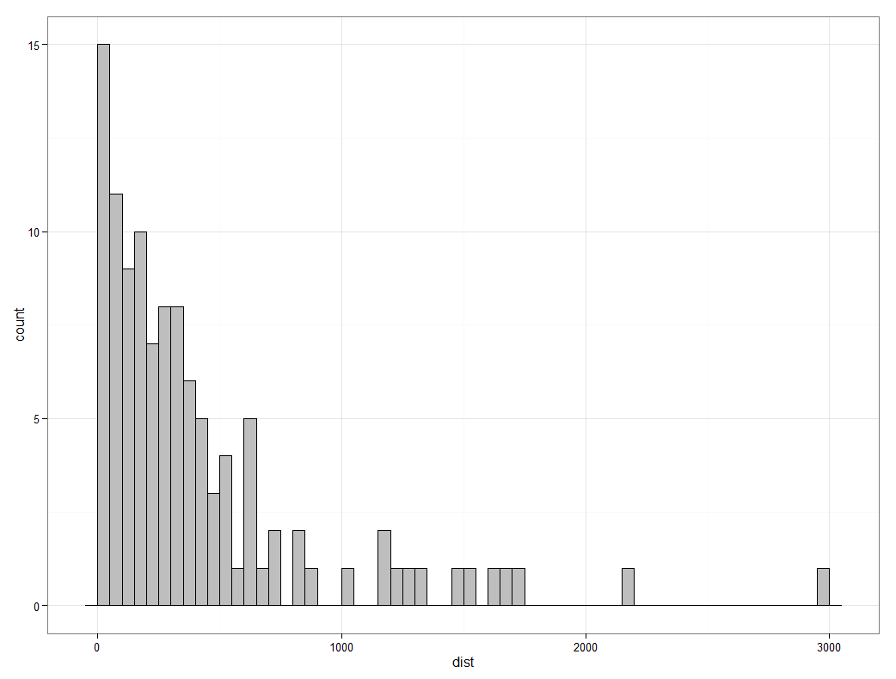
Step lengths – Stationary observational behavior state
n = 111, range = 4 to 2957m

Slide 16
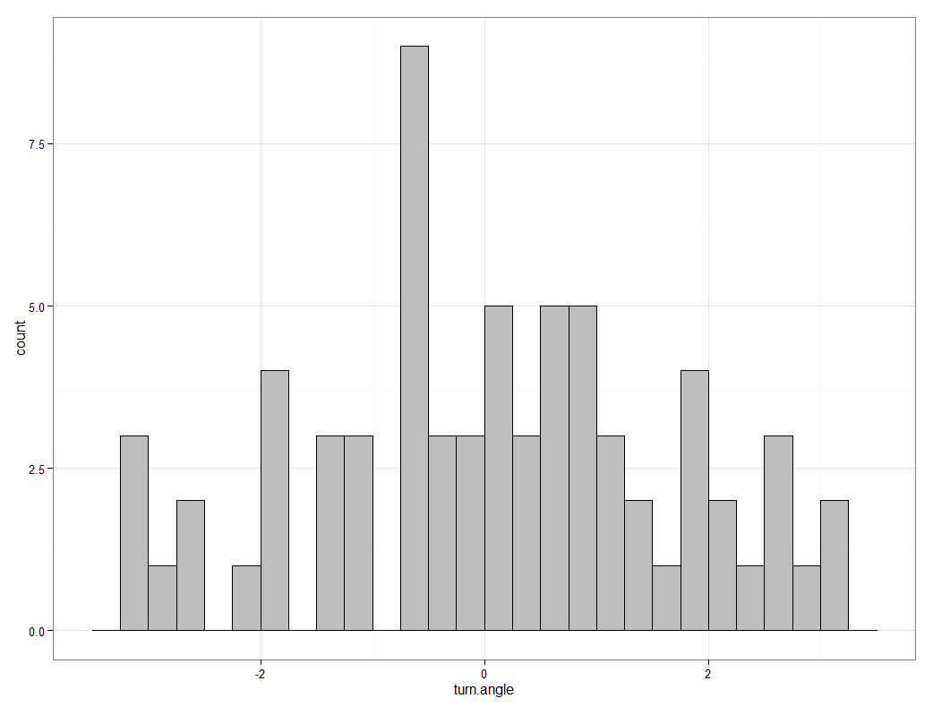
Turn angles - Stationary observational behavior state
n = 69, range = -3.03 to 3.08

Slide 17
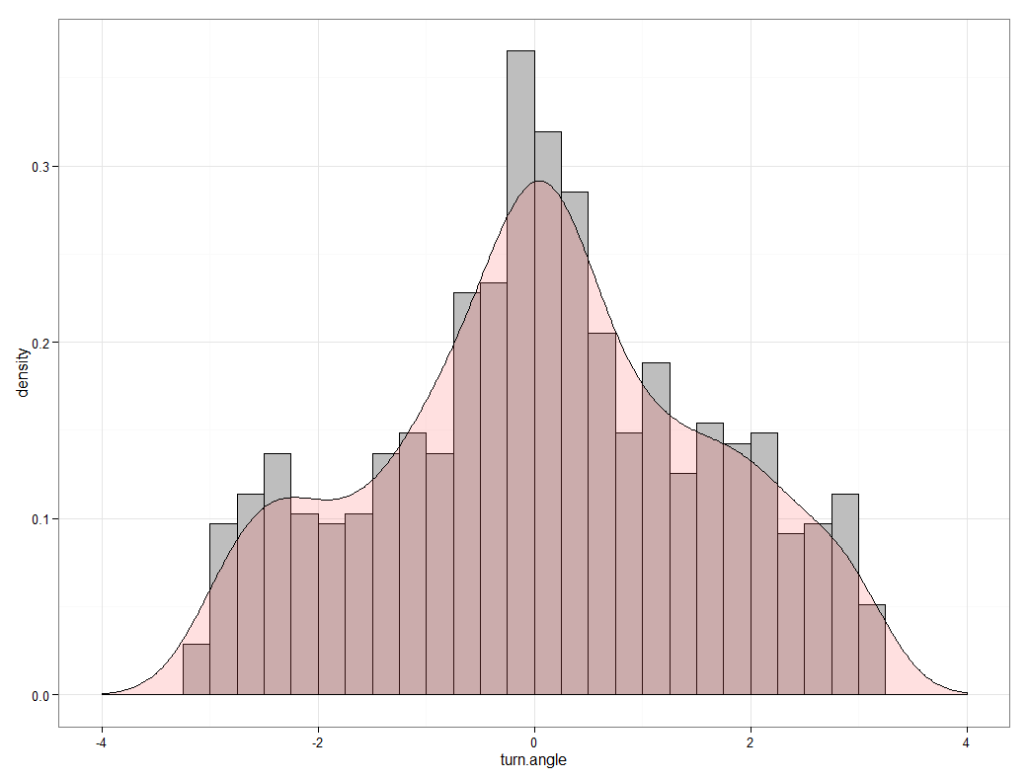
Turn angles - Transit observational behavior state
(simulated)

Slide 18
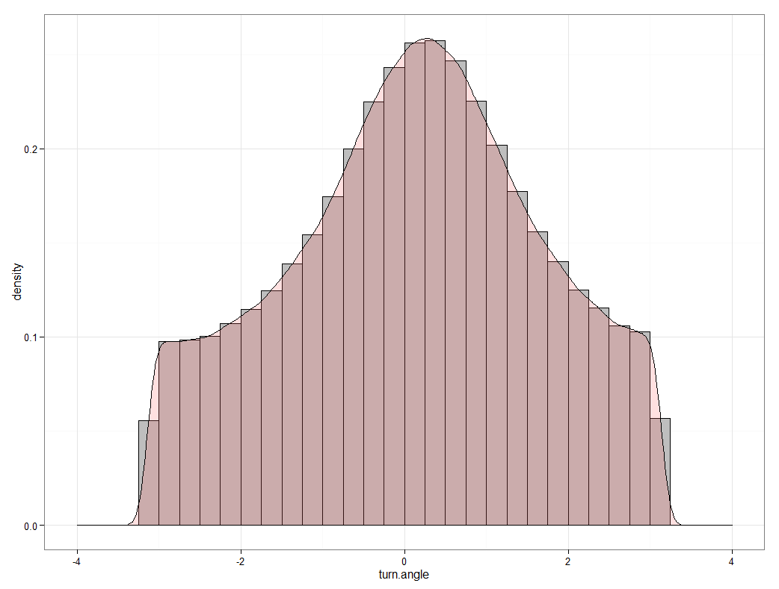
Turn angles - Stationary observational behavior state
(simulated)

Slide 19
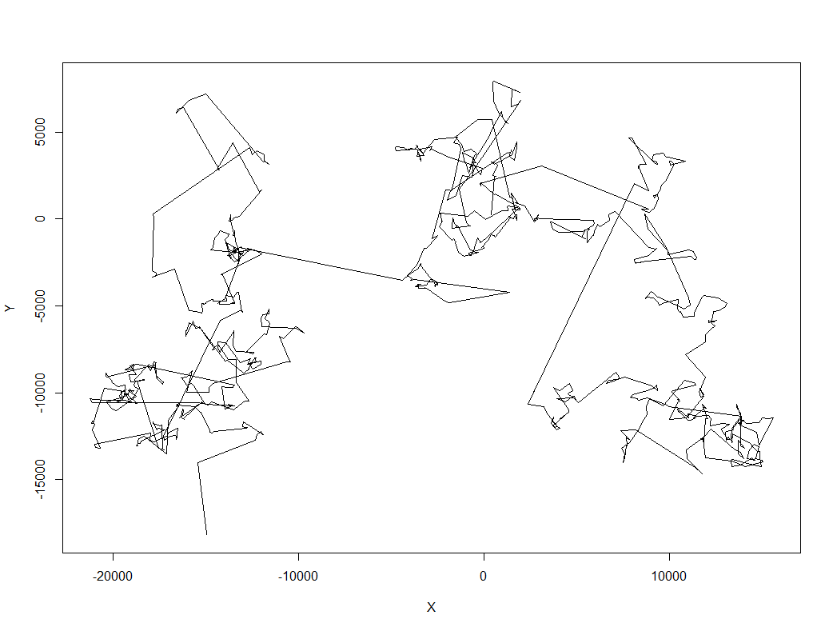
Turn angles - Transit observational behavior state
simulated – CRW 1000 points

Slide 20
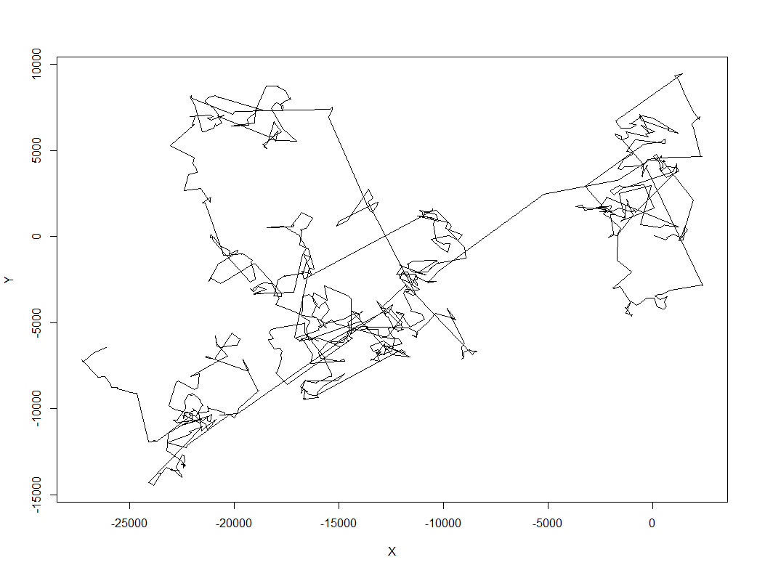
Turn angles - Stationary observational behavior state
simulated - CRW 1000 points

Slide 21
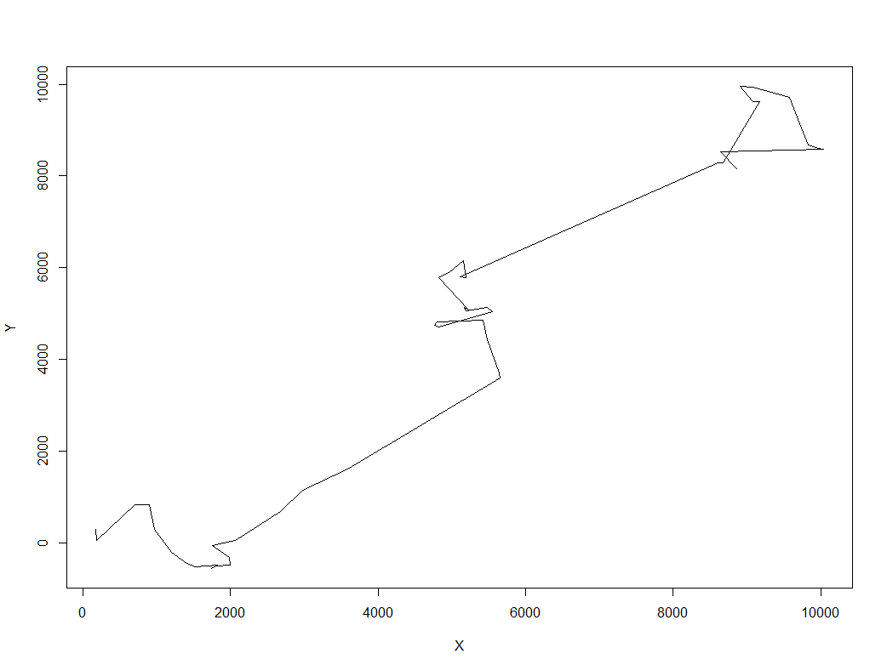
Turn angles - Transit observational behavior state
simulated – CRW 50 points

Slide 22
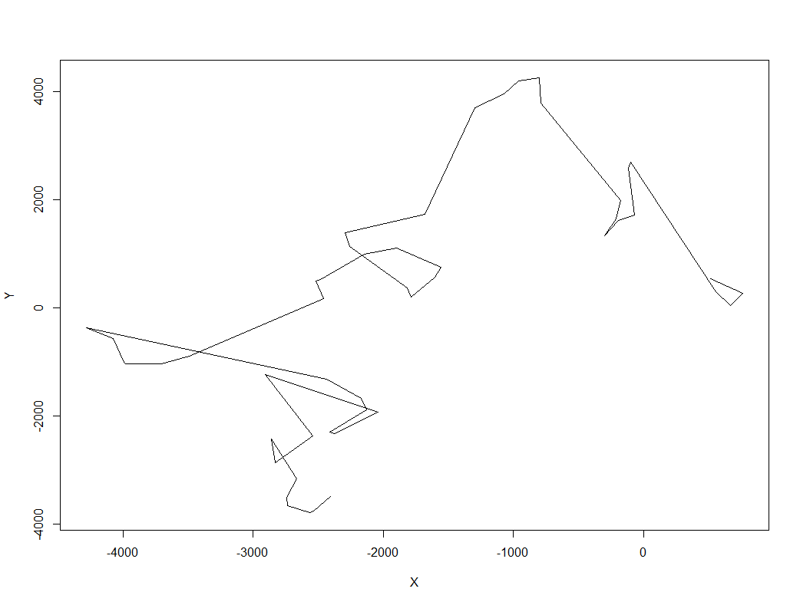
Turn angles - Stationary observational behavior state
simulated - CRW 50 points

Slide 23
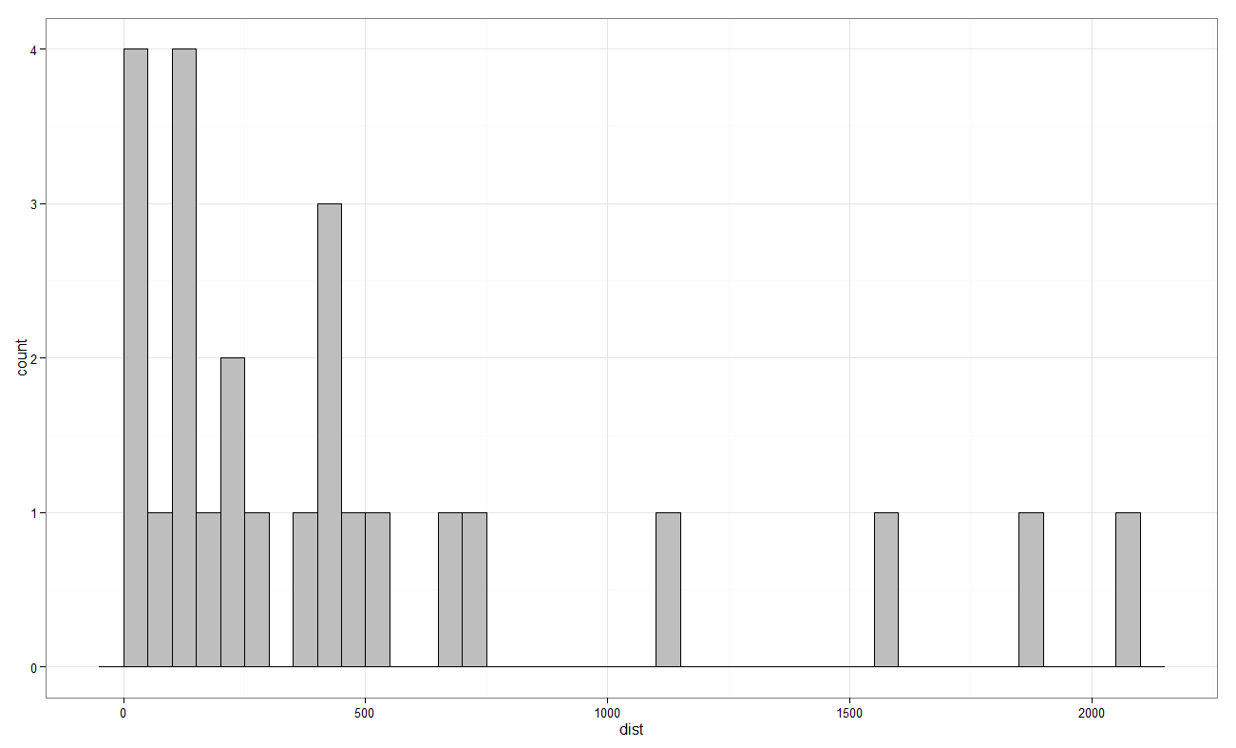
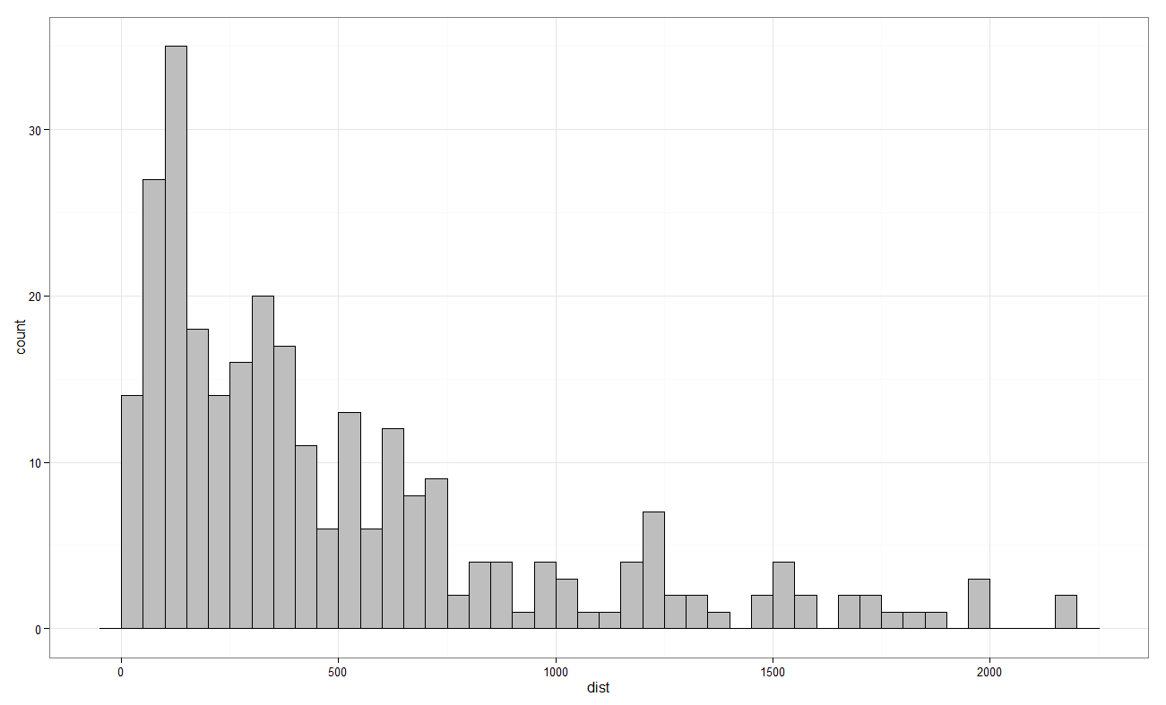
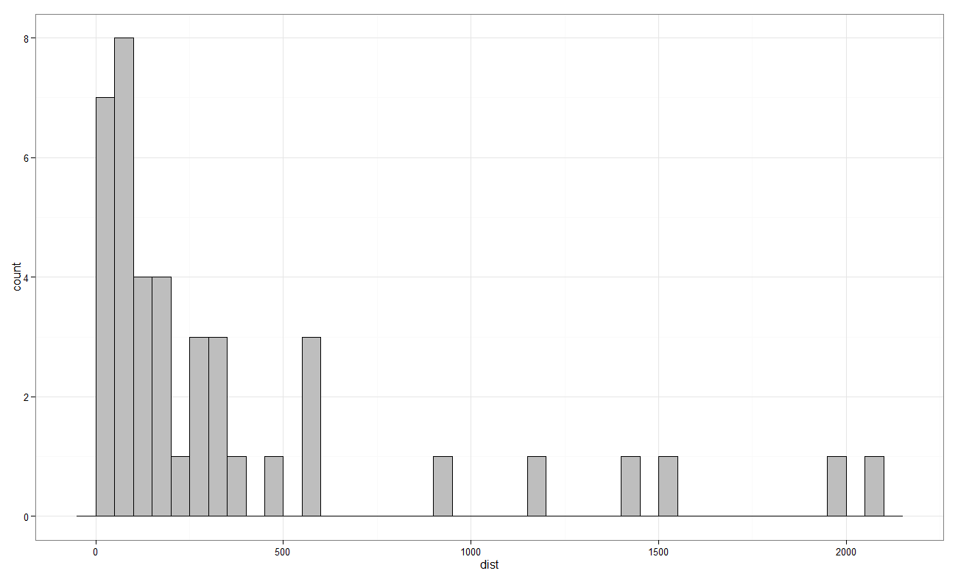
Step lengths – before, at, after CPA
Before
After
CPA

Slide 24
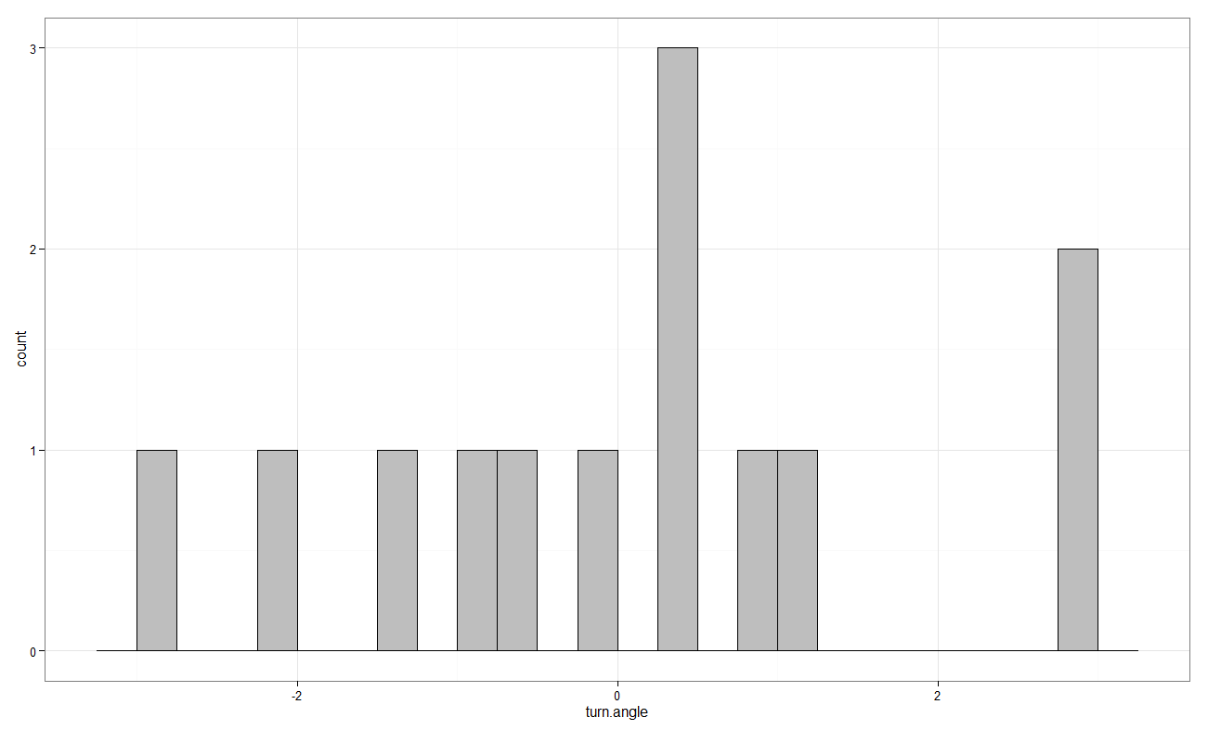
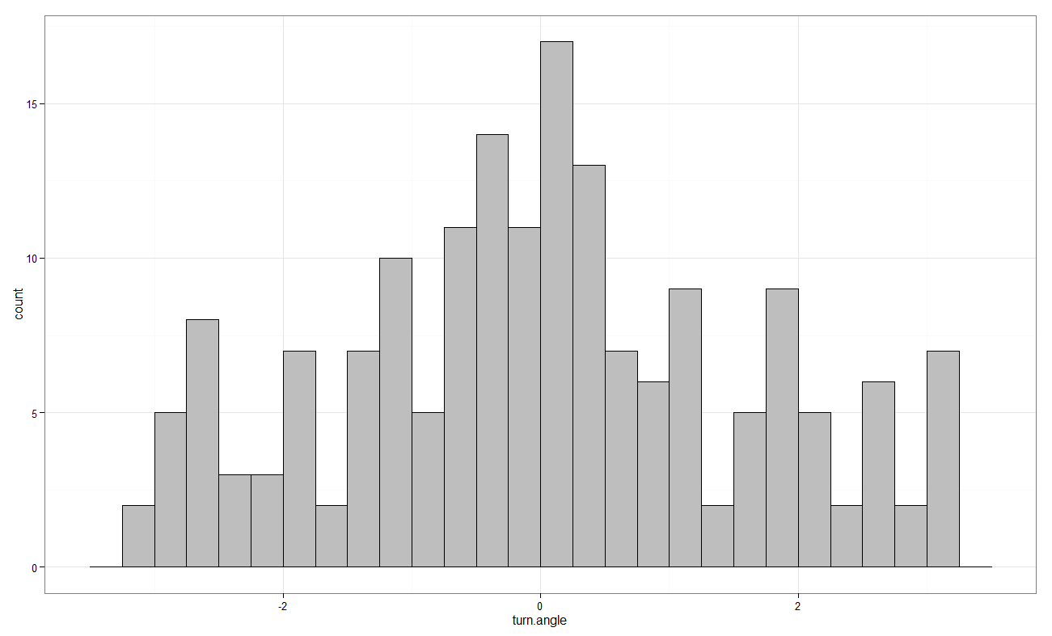
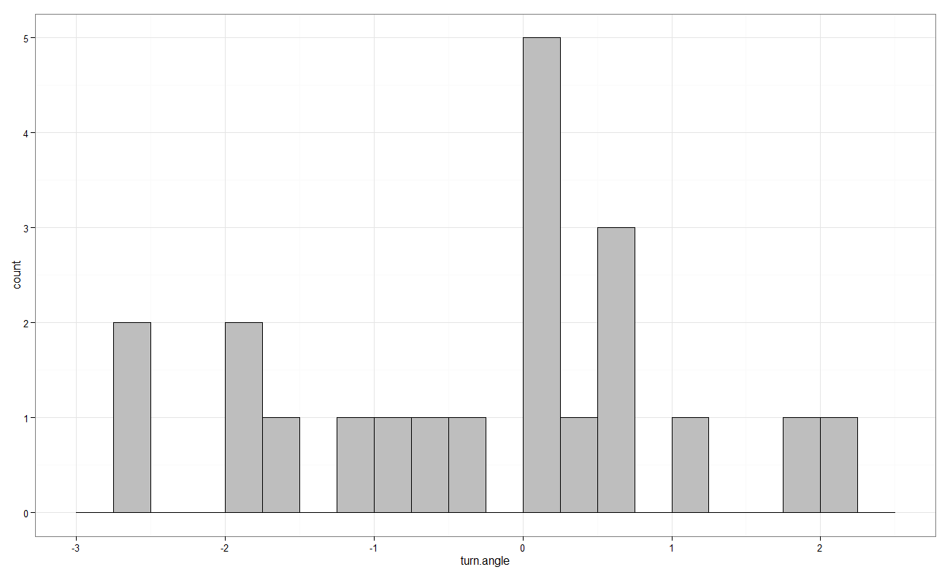
Turning angles – before, at, after CPA
Before
After
CPA

