Slide 1
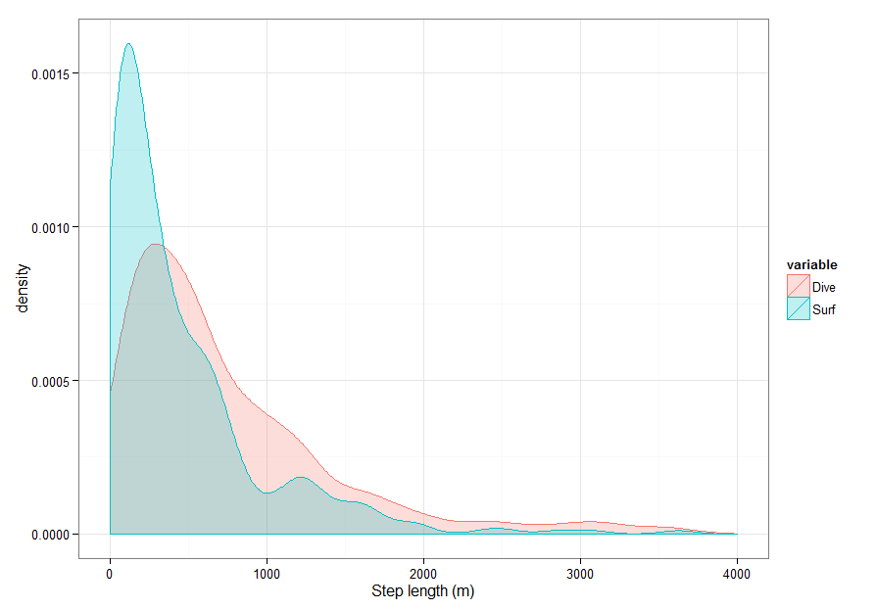
Observed distributions
ADE package
Observations separated
by visual assessment of
behavioral category
Dive = only dive with fluke
Surf = all surface activity
observations (surface
active, lunge feed, resting)
These two groupings
Resulted in the biggest
difference of movement
Parameters.
Area under curve
Overlap coefficient: 0.77

Slide 2
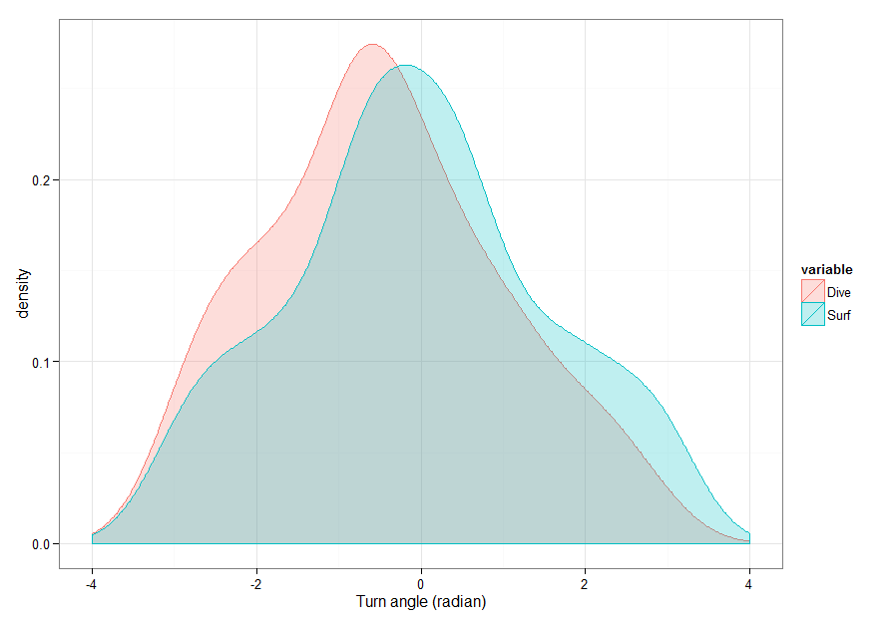
Observed distributions
ADE package
Observations separated
by visual assessment of
behavioral category
Area under curve
Overlap coefficient: 0.89

Slide 3
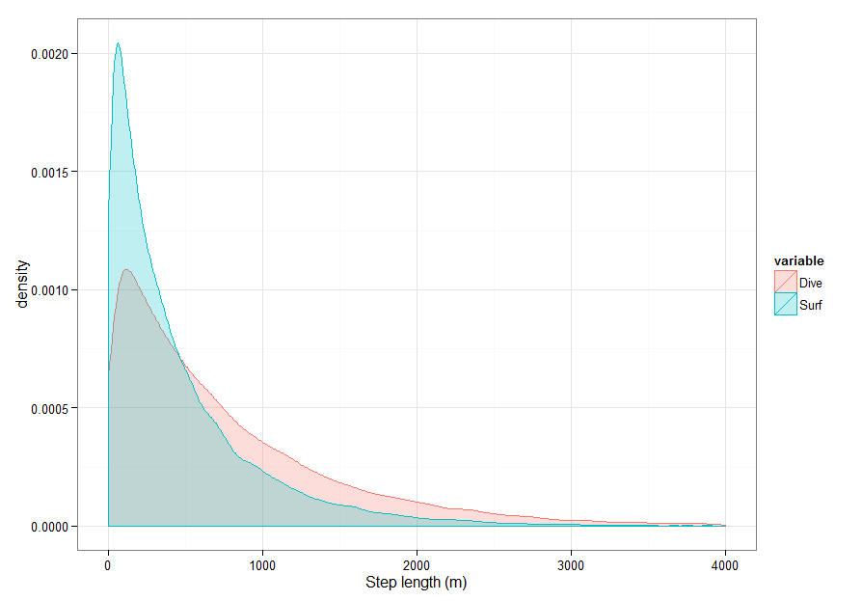
Simulated distributions
ADE package
Observations separated
by visual assessment of
behavioral category
Area under curve
Overlap coefficient: 0.80

Slide 4
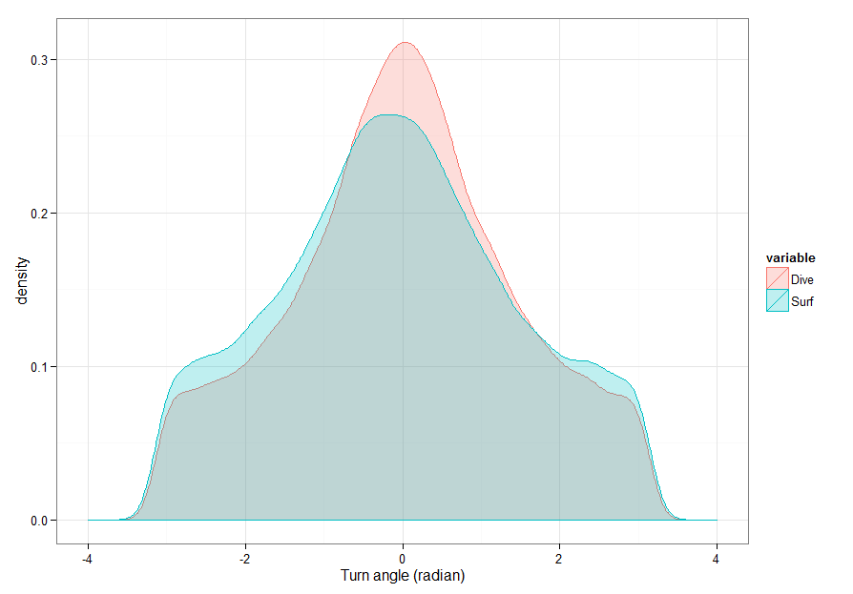
Simulated distributions
ADE package
Observations separated
by visual assessment of
behavioral category
Area under curve
Overlap coefficient: 0.94

Slide 5
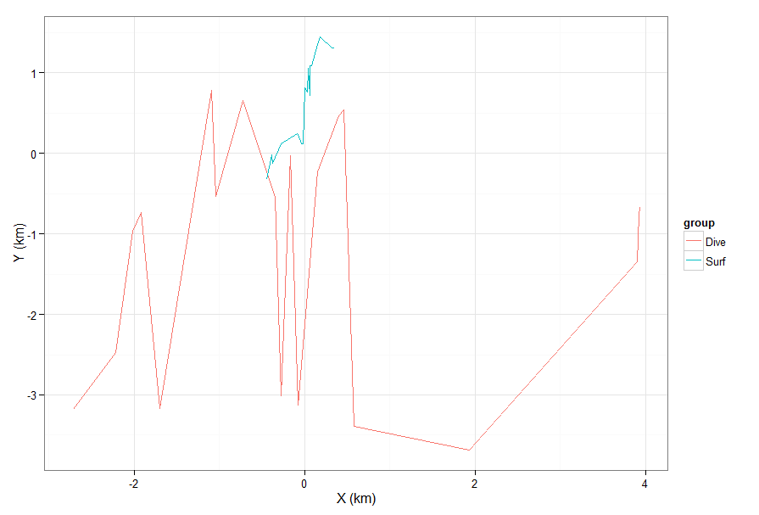
Simulated CRW
# of sightings = 20

Slide 6
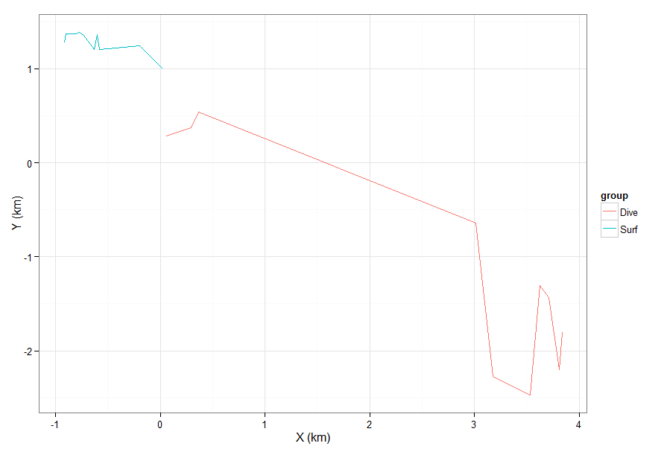
Simulated CRW
# of sightings = 10
Some sims result
in paths that are
quite different…

Slide 7
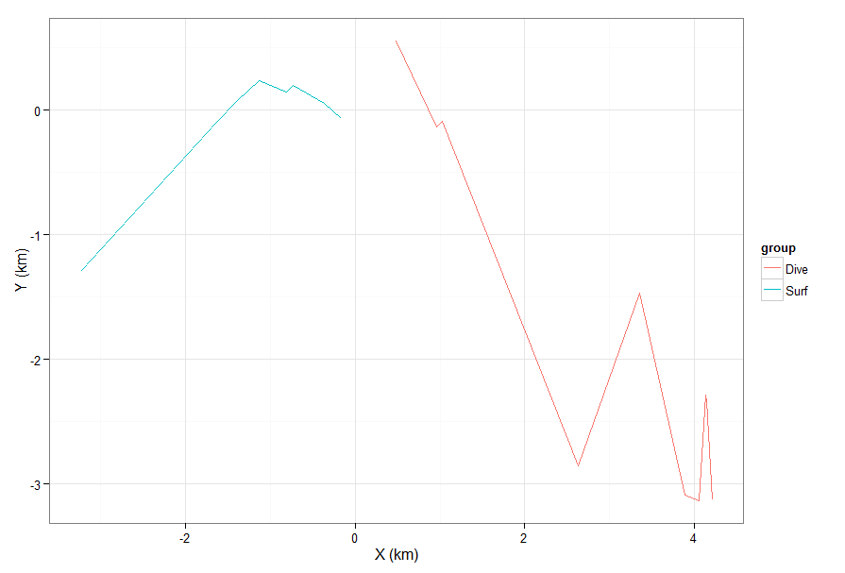
Simulated CRW
# of sightings = 10
Still different…

Slide 8
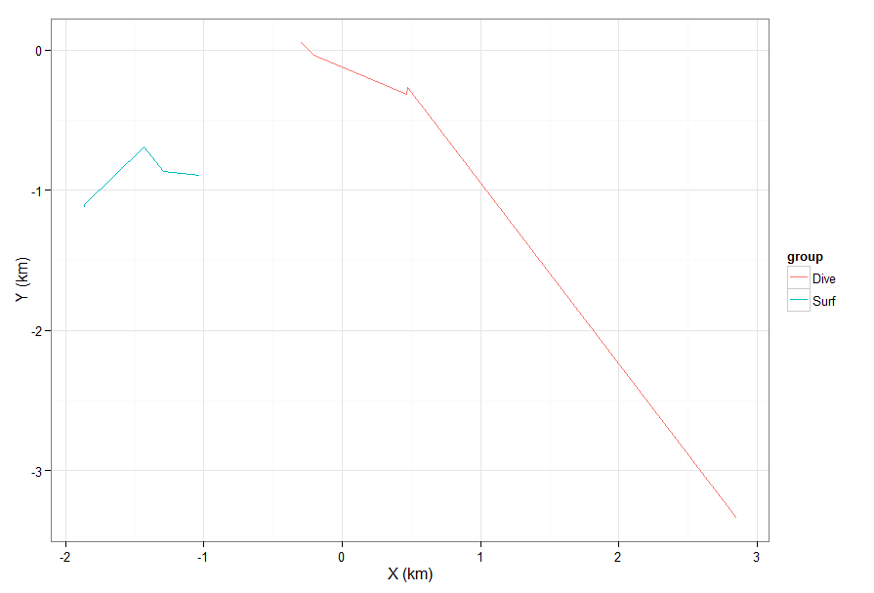
Simulated CRW
# of sightings = 5

Slide 9
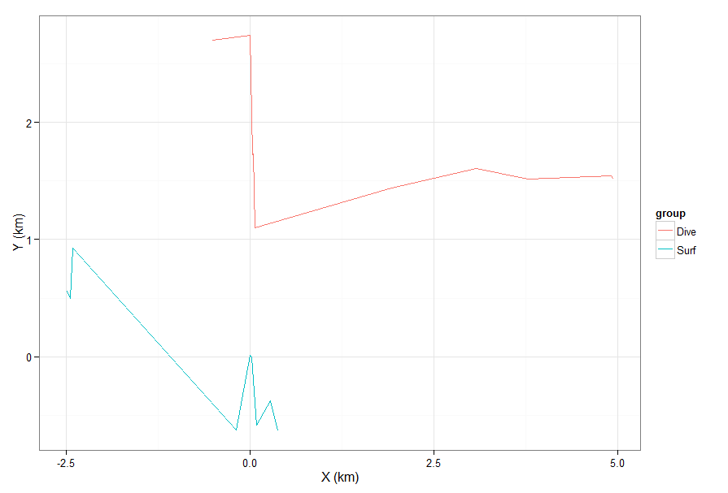
Simulated CRW
(manual code)
# of sightings = 10
…but some look
more similar or
opposite of the
expectation.

Slide 10
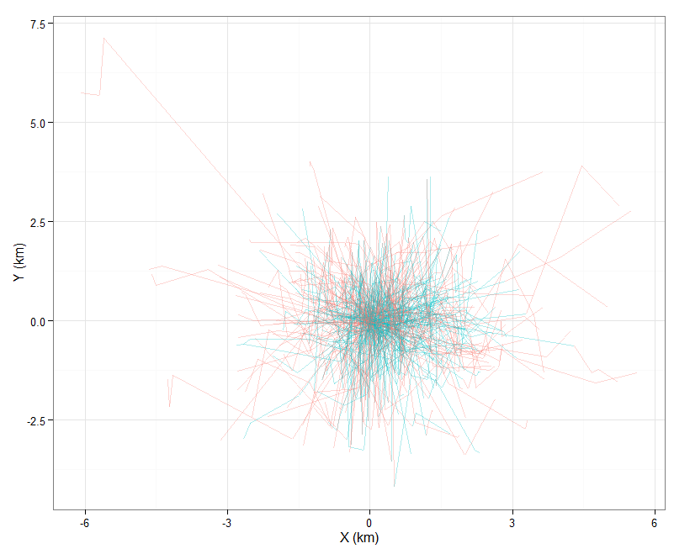
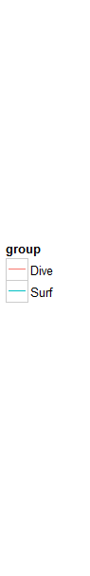
Simulated CRW
# of sightings in a
single walk = 4
# of sims = 250

Slide 11
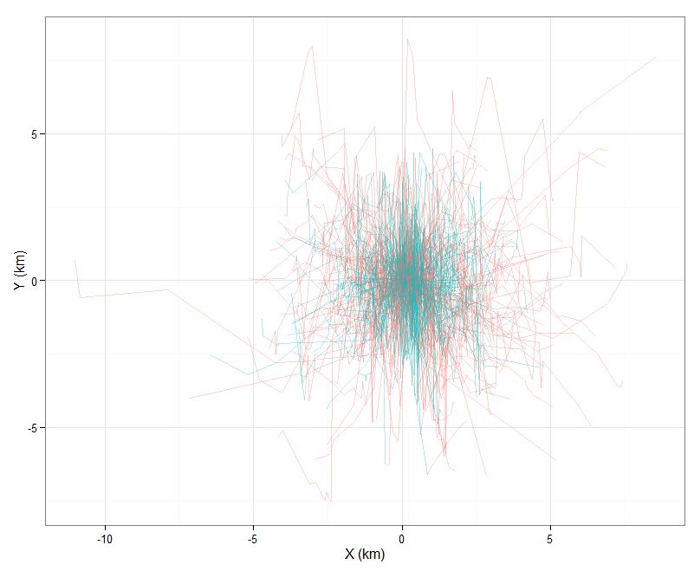
Simulated CRW
# of sightings in a
single walk = 8
# of sims = 250

Slide 12
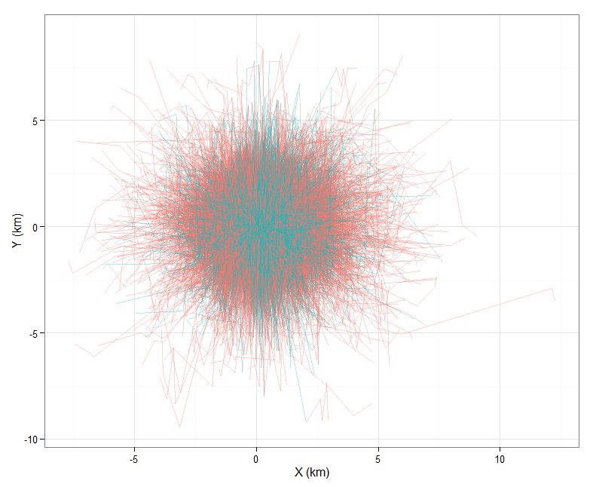
Simulated CRW
# of sightings in a
single walk = 5
# of sims = 10,000

Slide 13
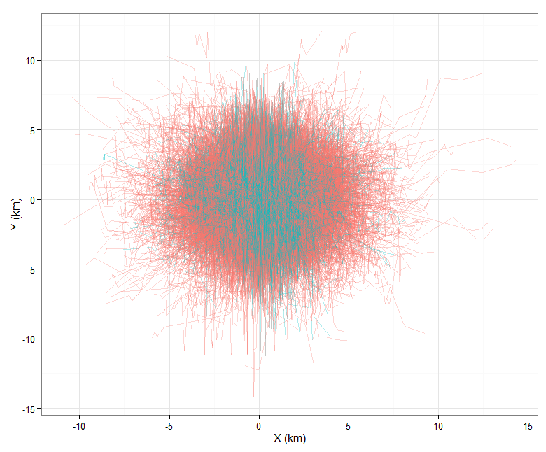
Simulated CRW
# of sightings in a
single walk = 10
# of sims = 10,000

Slide 14
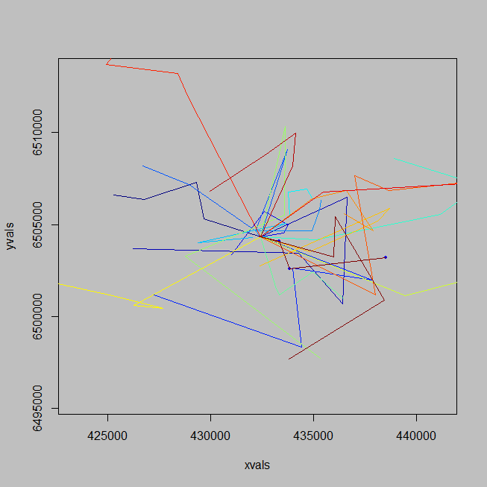
Simulated CRW
From CRAWL package
Simulated walks from estimated movement
parameters of a single whale’s movement
Using ALL data (not separated by observed
behavior)

