Slide 1
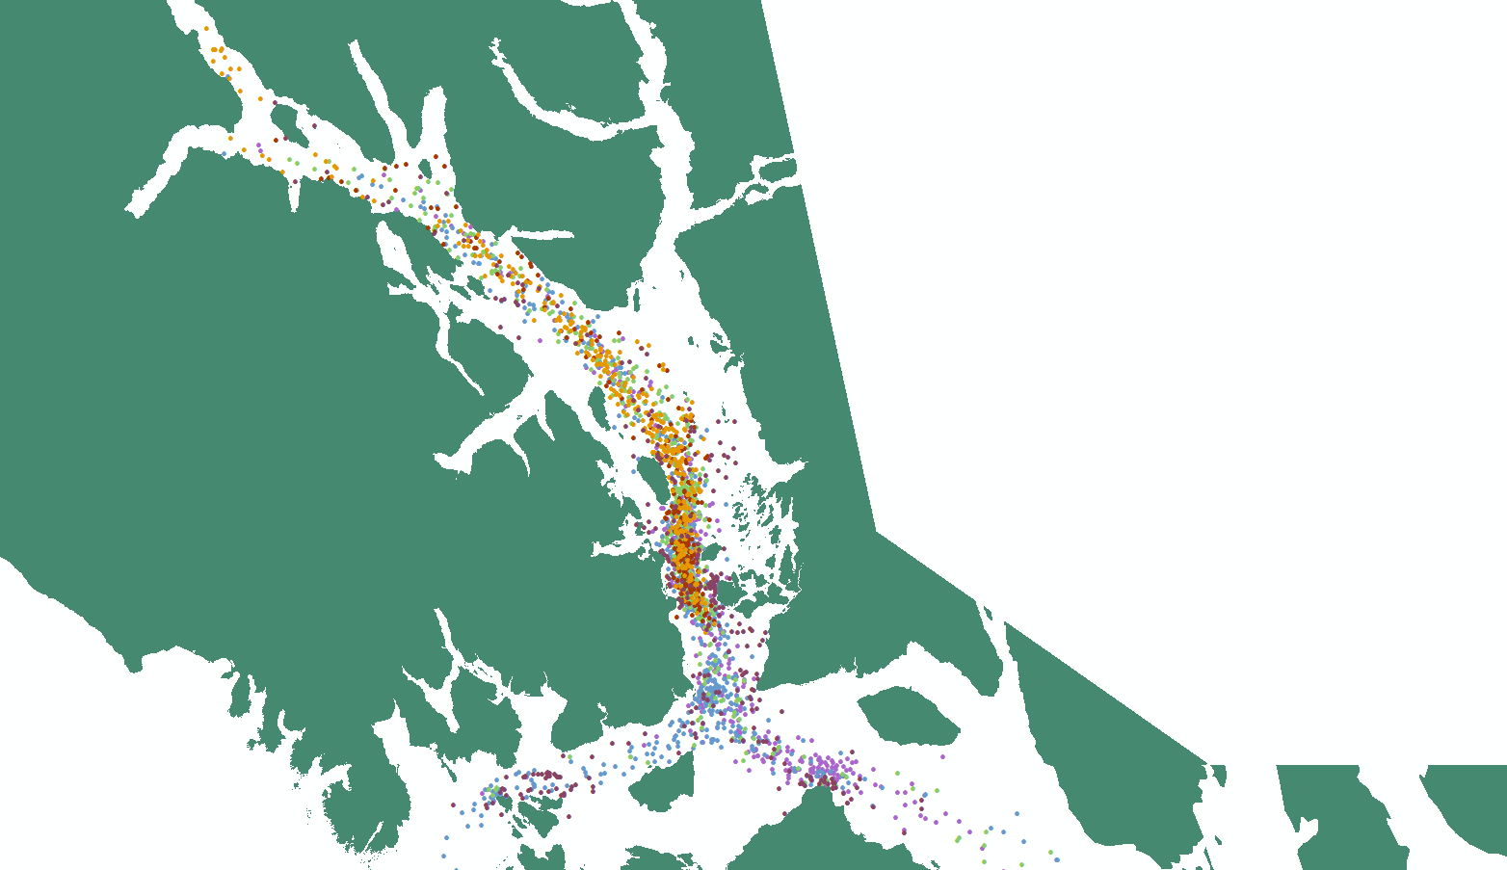
First sightings by year

Slide 2
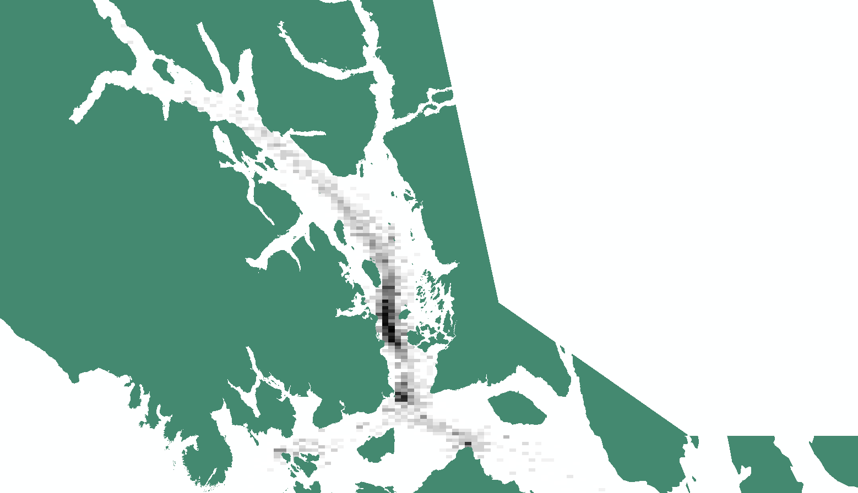
Density of first sightings in each grid cell over all years

Slide 3
Density of first sightings in each grid cell over all years adjusted by detection probability

