Slide 1
Painting the Data for Fun and Profit
William Ballenthin
Consultant
Mandiant

Slide 2
Agenda
Introduction
Exploring the Attacker Lifecycle
Visually Reviewing Binary Files
Making Sense of Malware Variants
Q&A

Slide 3

Introduction
Willi Ballenthin
Mandiant Consultant
Primarily Tasked with
Incident response
Forensics
Mobile application pen-testing
@williballenthin
Notes:
→Willi
I’m an consultant out of Mandiant’s New York City office.
On a day to day basis, I typically respond to/investigate computer intrusions and hacking, perform forensics on Unix and Windows systems, and pen-test mobile applications.
I often see evidence of attackers performing exploits against vulnerable systems, and its my task to figure out exactly what happened.
Its important to me to ensure that I’ve discovered the true extent of a compromise.
I’m really excited to have you on the phone today,
because recently I’ve seen attackers get much better at cleaning up after a job,
and the techniques we’ll demonstrate today can help you see right past the obfuscation.
By the end of today’s session, I think you’ll be ready to tackle INDX buffers in the field, and you’ll be better equipped to battle emerging cyber threats.

Slide 4
Exploring the Attacker Lifecycle

Slide 5
Exploring the Attacker Lifecycle
Problem Domain
During an IR, we collection many events, items
They're all related on a macro scale
And, if you're lucky, you're only dealing with one adversary...
How can we digest the "big picture" of a compromise while still retaining access to the details?
Timelines are an accepted approach, but are they scalable?

Slide 6
Motivating Example
We're in the middle of an IR with ~5,000 hosts
There are a few adversaries in the environment
Fortunately, we have a number of tools available

Slide 7
Potential Solutions
Bodyfile/CSV/Excel
Handles a few hundred thousand entries
View is usually a simple grid
Data formatting?
SIEM
Collects all the data, so its ready to go
Interface may be a bit... cumbersome

Slide 8
Potential Solutions
Simile Widget
Interactive HTML + JavaScript widget
MIT libraries, http://www.simile-widgets.org/timeline/
Tons of fun to play with!
Does not scale to 10s of thousands of items
HTML page generation is required
Notes:
overview bars can give an overview, but scaling out smoothly doesnt work
its nice you can link to external content

Slide 9
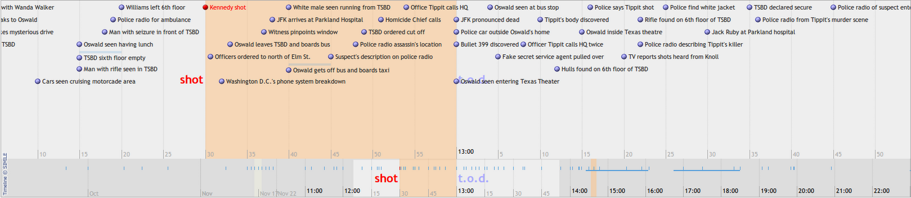
Potential Solutions - Simile Widget
Notes:
file - doesnt give much more than filetype
diff - won't really work with anything besides text
hex editor - perhaps too much detail. macro view?
distance function - comparison only. doesnt approach file structure
DSTs (domain specific tools) - requires an analyst with domain-specific knowledge

Slide 10
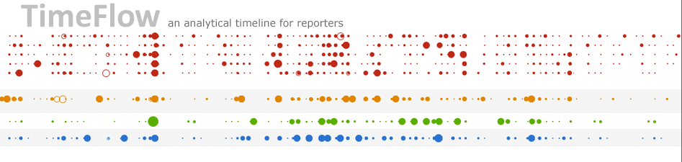
Enter: TimeFlow

Slide 11
Enter: TimeFlow
TimeFlow
http://flowingmedia.com/timeflow.html
Developed for journalists to reconstruct events
Extremely interactive
Slice-n-dice on fields
Supports long running events
A bunch of views
Timeline
Calendar
Bar chart
Table, List
Implemented in Java, provided as a single JAR

Slide 12
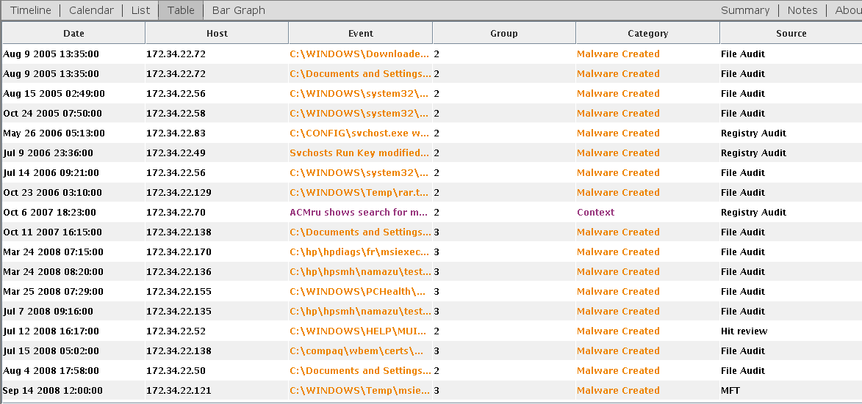
TimeFlow - As easy as a CSV
Example data: 4,265 events from ~2008 - 2010

Slide 13
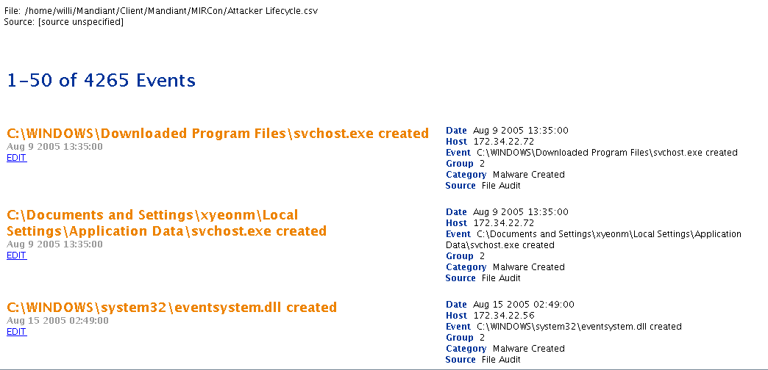
TimeFlow - Review, Edit Data

Slide 14
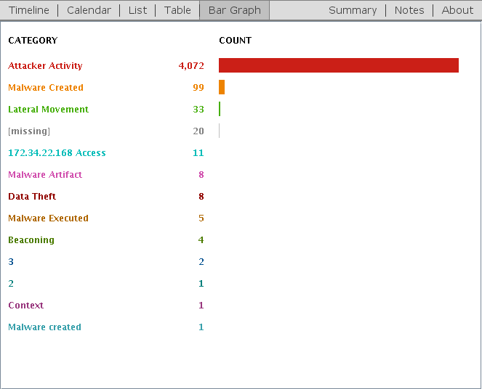
TimeFlow - Summarize and Stack

Slide 15
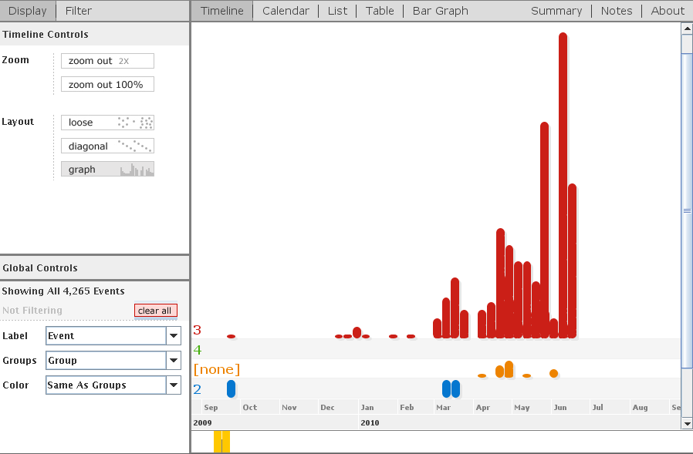
TimeFlow - Summarize and Timeline

Slide 16
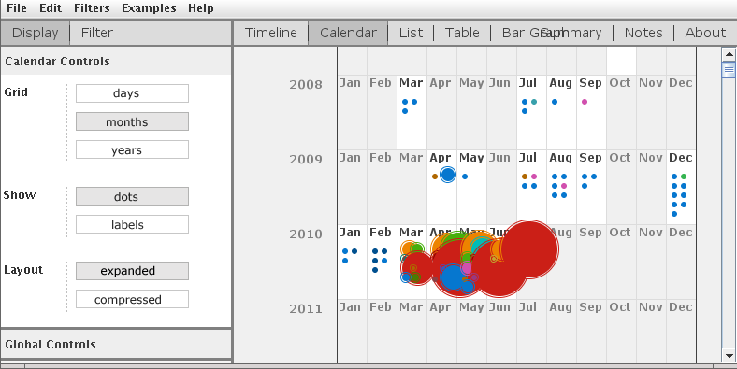
TimeFlow - Events over Time

Slide 17
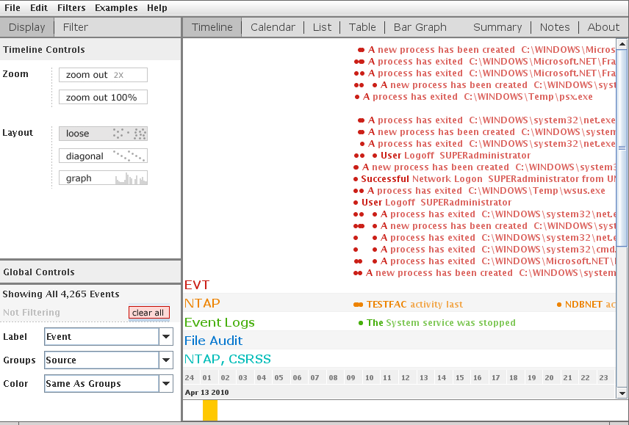
TimeFlow - Interact with the Timeline

Slide 18
Visually Reviewing Binary Files

Slide 19
Visually Reviewing Binary Files
Problem Domain
We treat files as (file names + arbitrary data)
But, what do files look like?
A step above hex encodings
Hashes, even SSDeep, have little meaning
Once we start looking at files, can we compare them?

Slide 20
Motivating Example
We have two completely unknown files recovered during disk forensics
Do they have a similar structure?
Sure, we can use traditional techniques, like `file`, but this doesn't capture embedded structures
Notes:
Why forensics -- using Scalpel to automatically recover files. This may fail or give us unusual data. We need to double check
Or, think steganography/CTF. We are interested in NOT ONLY the magic header, but any embedded structures.

Slide 21
Potential Solutions
`file` - guess the file type based on headers and file structure
`diff` - compare text and show differences
Hex editor "compare files..."
Distance function from part 3
Domain-specific tools
e.g. `objdump` for executable files
Notes:
file - doesnt give much more than filetype
diff - won't really work with anything besides text
hex editor - perhaps too much detail. macro view?
distance function - comparison only. doesnt approach file structure
DSTs (domain specific tools) - requires an analyst with domain-specific knowledge

Slide 22
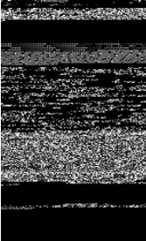
Let's try to draw the files
Malware images: Visualization and automatic classiﬁcation. L. Nataraj, S. Karthikeyan, G. Jacob, and B. Manjunath, 2011
Convert file to a vector of 8-bit values
Use this data as a bitmap
Ultimate goal: use image recognition techniques to identify malware
Turns out, this works

Slide 23
"Malware Images" Technique
This works well
Very intuitive
Fast
However,
Color scale
File sizes / image dimensions
Feature locality

Slide 24
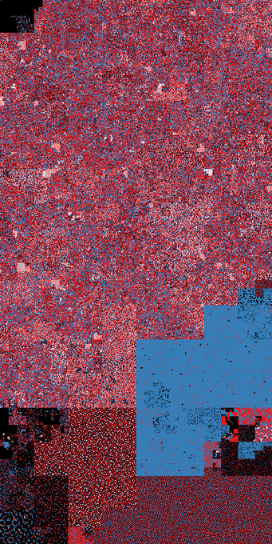
Aldo Cortesi - binvis
Aldo of Nullcube suggests an improvement `binvis`
Meaningful colors
Better spatial clustering
Free, open-source, Python
http://corte.si/posts/visualisation/binvis/index.html

Slide 25
"Malware Images"
"binvis"

Slide 26
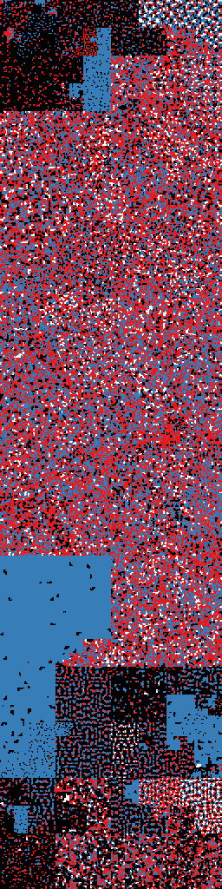
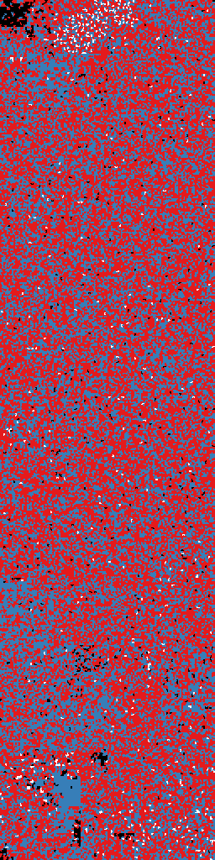
"binvis" Color Schema
Black - 0x00
White - 0xFF
Blue - Printable
Red - Else

Slide 27
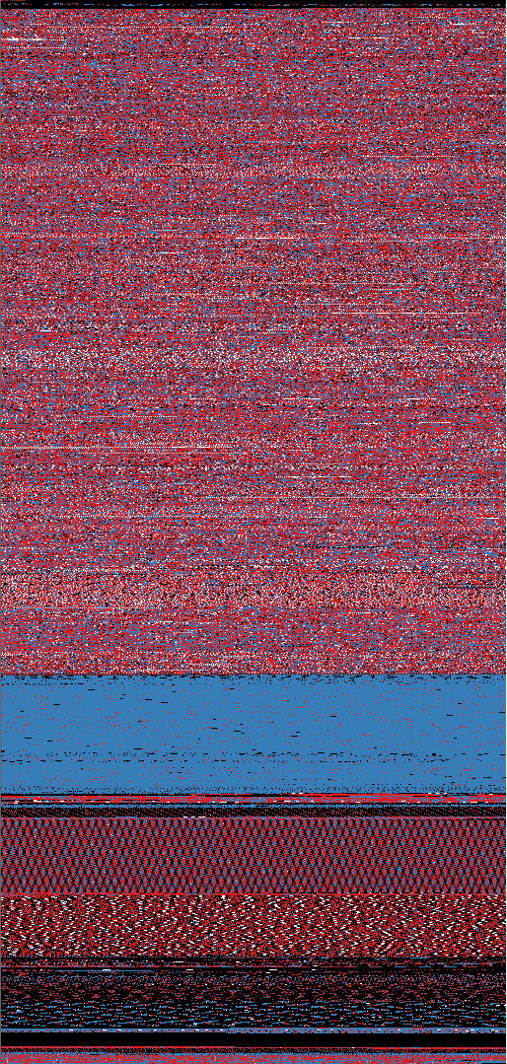
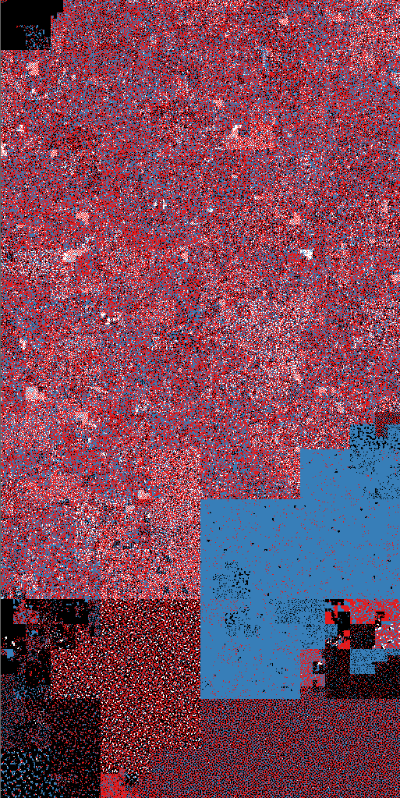
Coloring is a start...

Slide 28
Some mathematics: Hilbert Curves
Space filling curves
Intuitively, draw line along all points in a region without crossing
Why? Georg Cantor: the infinite points on a unit line has the same cardinality as the infinite points in the unit square
Hilbert curve
David Hilbert in 1891
Mapping preserves (some) locality from 1D to 2D
Close association with fractals, so plots are approximations

Slide 29

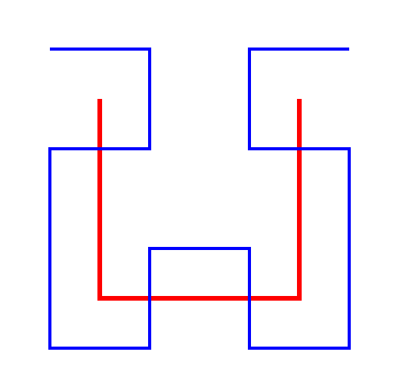
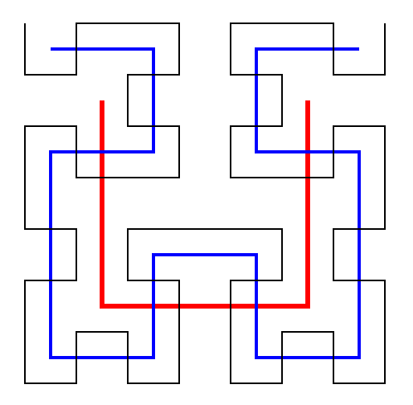
Building Hilbert Curves

Slide 30
"binvis" Technique
This works well
Colors are meaningful
Features are obvious
However,
Slow (Hilbert curve calcs)
Feature shapes inconsistent
Feature locations unintuitive

Slide 31
Making Sense of Malware Variants

Slide 32
Making Sense of Malware Variants
Problem Domain
Malware is not unique
Variants are grouped into families
zbot/Zeus Trojan
Poison Ivy RAT
Gh0st RAT
How do we identify families?
Differences in settings
C2 domains or IPs
Differences in capabilities
Gh0st extended to inject shellcode
Differences in bugs
New versions of Poison Ivy

Slide 33
Motivating Example
A client gives us 500 malwarez and asks for a report on each one
We know many share the same author, intent
Let's just find the families, pick representative samples, and reverse those, instead
Result
Client is happy and richer
We spend less time in front of IDA

Slide 34
Data Sources
Binary file similarities (static)
Entropy
Fuzzy hashing - ssdeep
Malware analysis sandboxes (dynamic)
Cuckoo sandbox, Mandiant Threat Analyzer
PE file similarities (static)
objdump
Disassembly-based graph theory comparisons (static)
bindiff
Anti-virus signatures
Malware analyst brains (expensive)
Notes:
http://www.cuckoosandbox.org/
http://www.zynamics.com/bindiff.html

Slide 35
Clustering
Explorative data mining
From a bunch of samples, produce groups of similar things
Here, require only a distance function to identify nearest neighbors
Distance function: a metric between two samples that describes how similar (or different) they are
Compose a distance function from a set of weighted metrics
D(x,y) = a0 * d0(x,y) + a1 * d1(x,y) + ... aN * dN(x,y)
Notes:
scale the distance function to [0.0, 1.0]
composite distance function weights can be determined by high-powered machine learning. or malware analysts' experience

Slide 36
Distance Function Ideas - Static Analysis
Find the range of the function and normalize
e.g. Entropy, scale to 1.0 by dividing by 8.0
Other numeric functions, you may scale by the standard deviation
Categorical distance metric - use a points-based function
10 points * number of shared imports, max. 10
20 points if both are a DLL
etc.

Slide 37
Distance Function Ideas - Dynamic Analysis
Record API calls and use the Levenshtein edit distance
"the number of single-character edits required to change one word into the other"
s/character/api call/g and s/word/call history/g
Record file system/Registry/etc. activity and define a categorical composite distance metric
10 points if it writes to the same directory
50 points if it changes the same Registry key
Notes:
well this may or may not work with multi-threaded applications, it helps when malware is heavily packed or obfuscated

Slide 38
Let's find some families
We'll use a force-directed layout when graphing nodes
aka. minimize a global energy function
akka. pretend each spring is a bowling ball and there's springs among all the balls
Graphviz
http://www.graphviz.org/
'neato', 'fdp', and 'sfdp' layout algorithms
Gephi
https://gephi.org/
"an interactive visualization and exploration platform for networks and complex systems"

Slide 39
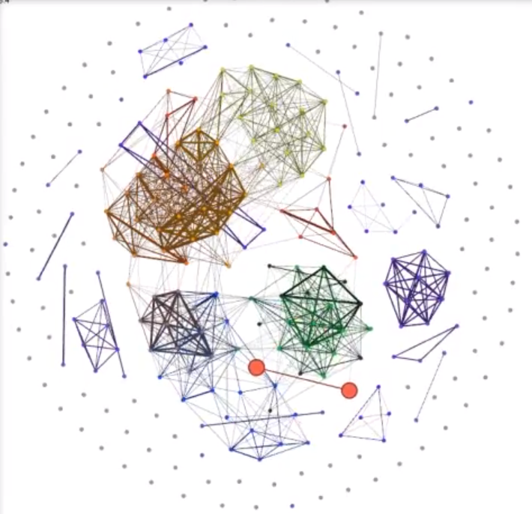
Motivating Example: Results

Slide 40
Try it at home!
ssdeep -r -p . |
grep "matches" |
sed
-e "s/.*\/\([^\/]*\) matches/\1,matches/g"
-e "s/matches.*\/\([^\/]*\)/\1,/g"
-e "s/ (\\([0-9]*\\))/,0.\1/g" |
awk '
BEGIN{print "Source,Target,Weight,Type"}
{print $0",Undirected"}'
> /tmp/clusters.csv
Notes:
ssdeep -r -p . | grep "matches" | sed -e "s/.*\/\([^\/]*\) matches/\1,matches/g" -e "s/matches.*\/\([^\/]*\)/\1,/g" -e "s/ (\\([0-9]*\\))/,0.\1/g" | awk 'BEGIN{print "Source,Target,Weight,Type"}{print $0"Undirected"}' > /tmp/clusters.csv

Slide 41
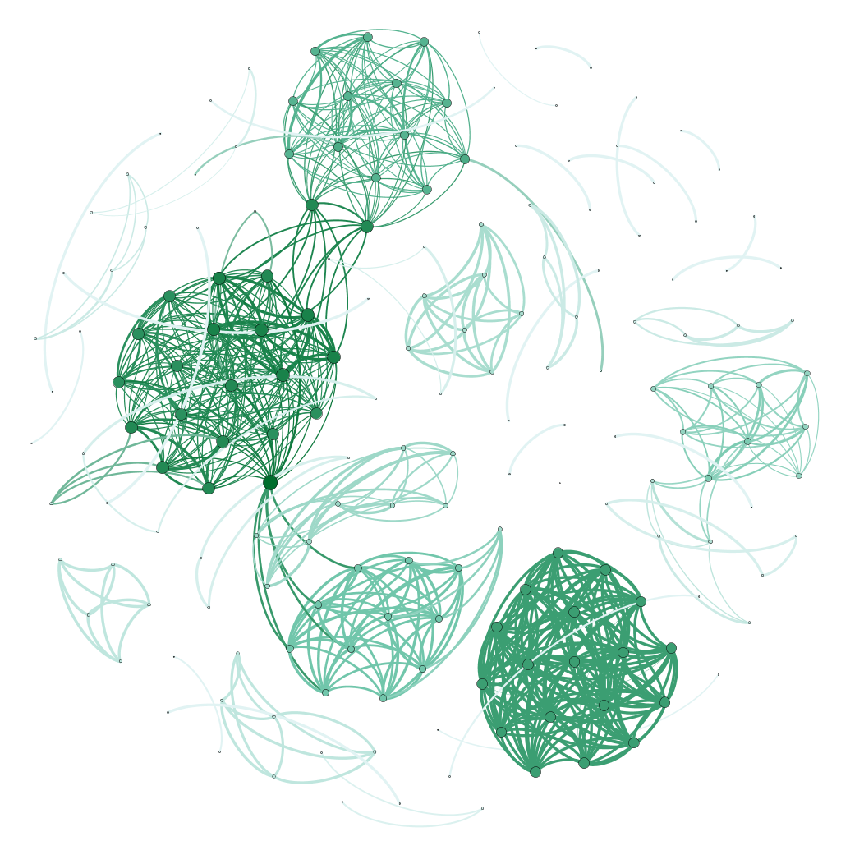
Try it at home!
Notes:
one thing that is nice about this is that the algorithm is transparent.
want to know why two things are the in the same cluster, well its easy to look up.
the quality of the clustering is dependent on the distance function

Slide 42
Try it at home!
With Gephi
New Project...
Data Labratory
Import Spreadsheet
As Table... Edges table
Finish
Overview
Choose a layout... "Fruchterman Rheingold"
Run
???
Profit

Slide 43
Q&A

Slide 44
Citations
Malware Images: Visualization and Automatic Classification
A Comparative Assessment of Malware Classiﬁcation using Binary Texture Analysis and Dynamic Analysis
Wikipedia
http://corte.si/posts/visualisation/hilbert-snake/index.html and others
http://flowingmedia.com/timeflow.html
http://www.simile-widgets.org/
https://gephi.org/

