Slide 1

COS731 FA2 Topic E. Configuration Management with Ansible, Puppet, or Chef.
EN

Slide 2


What is Ansible?
Open source automation tool
Task automation through playbooks.
Follows a declarative automation framework.
Uses YAML syntax for readable code.
Mainly uses ssh to access remote machines.
Remote machines are defined as inventory.
EN

Slide 3




Agentless vs Agent based Automation
Agentless
Agent based
Low maintenance overhead, avoiding the installation of additional agent software.
Higher maintenance overhead, due to the requirement to install additional agent software on managed hosts.
EN
Notes:
Agentless: Ansible and Puppet’s Bolt
Agent: Chef and Puppet

Slide 4
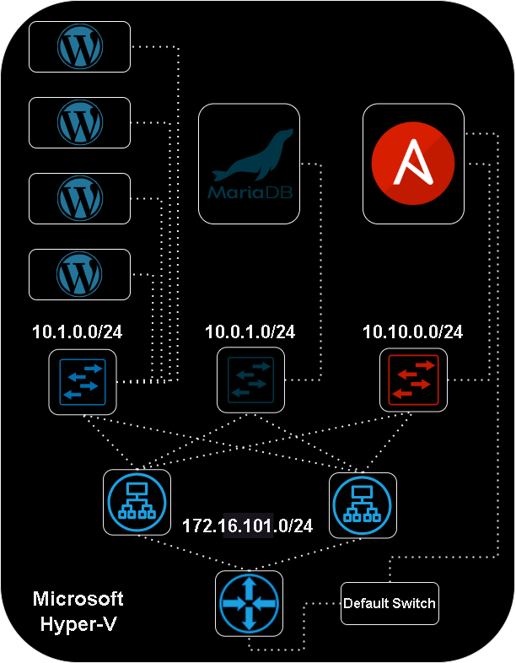

EN
Notes:
Our demonstration for configuration management with ansible includes various virtual machines that we built using Debian 12 (bookworm) on Microsoft Hyper-v.
The solution includes 4 wordpress frontend virtual machines, one backend mariadb virtual machine, and ansible management virtual machine.
We have three hyper-v virtual switch interfaces, and then we have two load balancers running keepalived. Then at the bottom we have a Debian vm with kernel based forwarding enabled, turning it into an open source router for the project.
The router and the ansible vm connects to the Microsoft Hyper-v default switch to allow the project to have an internet connection.

Slide 5
Agenda:
Defining our inventory.
Working with our vault file.
Project Structure.
Creating our playbooks.
Creating our roles.
Looking at our roles
Running our playbooks.
If time permits, a live playbook demonstration
EN

Slide 6
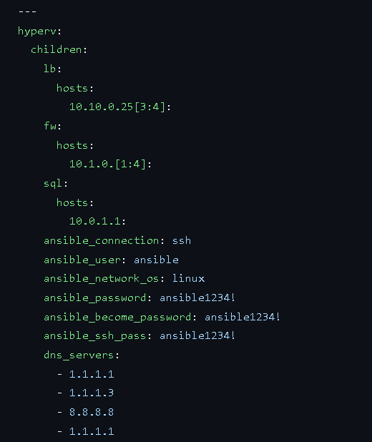
1. Declaring our Inventory in hosts.yml
WS
Notes:
Ansible automates tasks on managed hosts using a list , or group of lists known as inventory.
Our inventory file defines the managed nodes that we are configuring and the variables associated with those hosts.
We specified groups, which allow for referencing multiple hosts on which we will the perform a task in bulk.

Slide 7




2. Working with Vault Files
Create the vault file
$ ansible-vault init vault.yml
Edit the vault file
$ ansible-vault edit vault.yml
Encrypt the vault file
$ ansible-vault encrypt vault.yml
Decrypt the vault file
$ ansible-vault decrypt vault.yml
WS
Notes:
A vault file allows us to encrypt and safely store variables, passwords and keys.

Slide 8
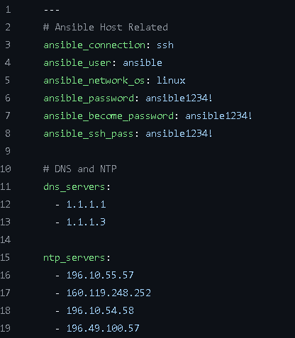
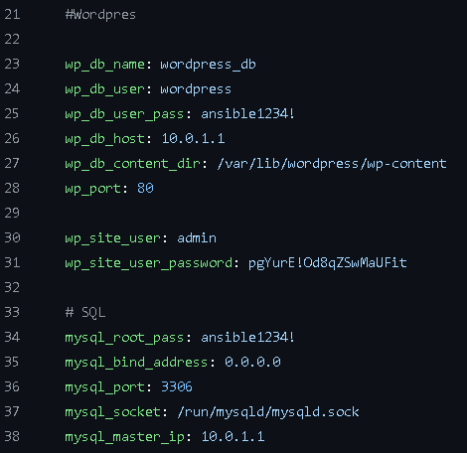
Decrypted Vault File
WS

Slide 9
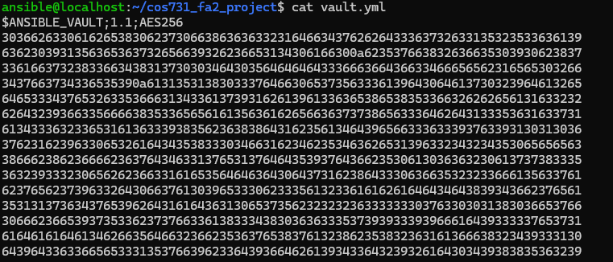
Encrypted Vault File
WS

Slide 10
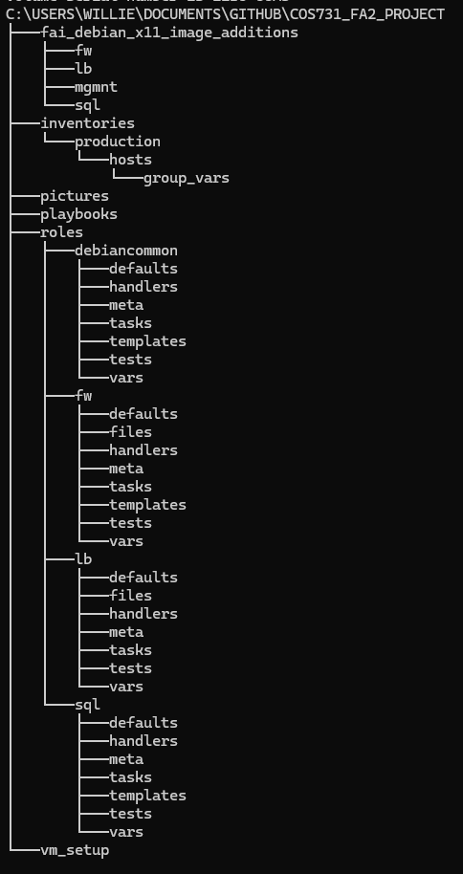
3. Project Structure
3.1 Based on ansible best practice guidelines
3.2 Dedicated directory for playbooks.
3.3 Dedicated directory for roles
3.4 Dedicated directory for inventory
3.5 Directory space for staging and production.
WS

Slide 11
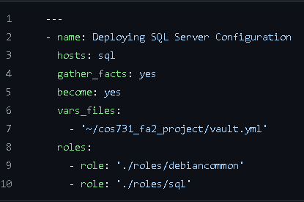
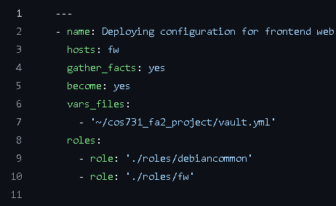
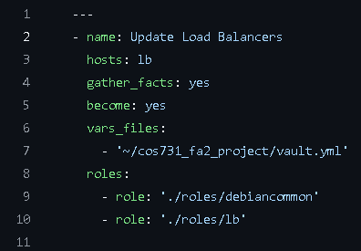



4. Creating our Playbooks
deploy_lb.yml
deploy_fw.yml
deploy_sql.yml
WS
Notes:
Ansible playbooks allow us to play out our configuration. In our playbooks we declare the roles that should be assigned to the hosts, and the order in which the roles should be executed.
We have three playbooks, one for deploying the sql backend configuration, one for deploying the wordpress frontend configuration, and one for deploying the configuration of our load balancers.
It should be noted that we specify roles, instead of individual tasks that should be performed on the host machines but we will get into that in a second. We are also specifying the vault file from previously, and loading the variables from the vault file into our playbook.

Slide 12
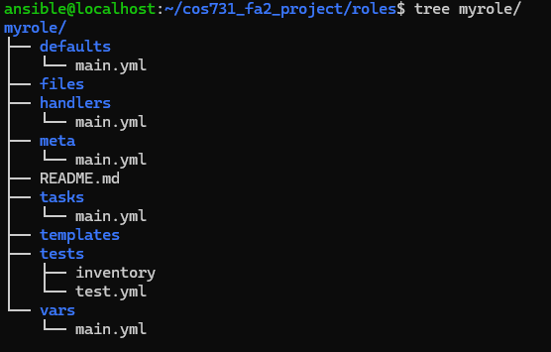
5. Creating our Ansible Roles
$ cd cos731_fa2_project/roles/
$ ansible-galaxy init myrolename
VJ
Notes:
Why roles? They allow us to automatically load related variables, files, tasks and other ansible artifacts based on a known file structure.

Slide 13
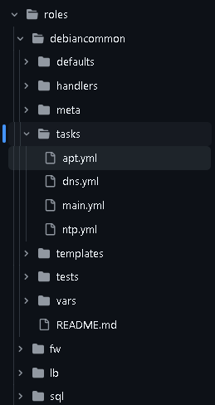
6. Looking at our roles: debiancommon
Used for our common linux config tasks.
apt.yml
Updating the apt repository
Installing commonly used packages
dns.yml
Updating the recursive dns resolvers that our linux servers are using.
ntp.yml
Updating our the ntp servers that our linux servers are using for accurate time keeping.
main.yml
It is used as ansible’s reference point when defining role use in ansible, within it our tasks are imported.
VJ

Slide 14
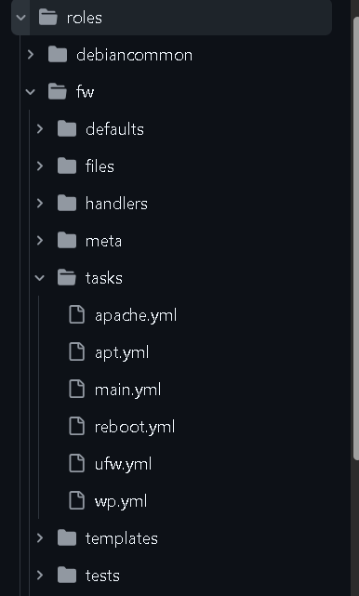
6. Looking at our roles: fw (frontend web)
apache.yml
Used for configuring the apache2 web server.
apt.yml
Installing frontend specific packages such as wordpress, and apache2
reboot.yml
Leveraged when we need to reboot the system.
ufw.yml
Utilized for uncomplicated firewall configuration.
On the web server we want port 80 for web and port 22 for ssh access.
VJ

Slide 15
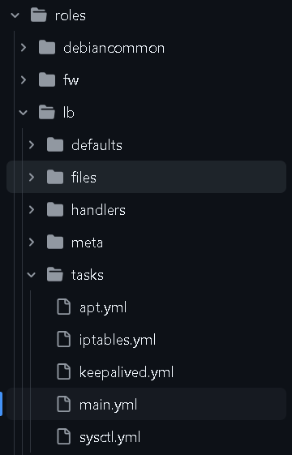
6. Looking at our roles: lb (load balancer)
apt.yml
Installing load balancer specific packages such as keepalived. (used for high availability)
iptables.yml
Used for flusing, configuring, and saving our firewall rules related to the load balancers.
Why not ufw?
It’s a more complex set of rules with source and destination nat with a vrrp shared virtual ip address.
keepalived.yml
For config tasks related to keepalived vrrp.
sysctl.yml
Used to enable ipv4 kernel based forwarding.
VJ

Slide 16
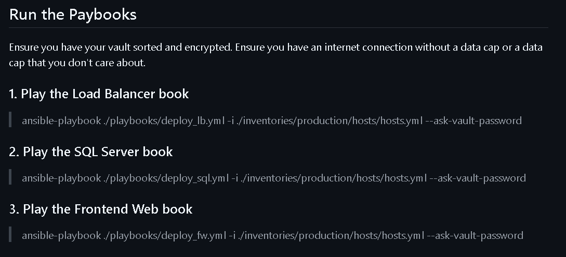
7. Running Playbooks
WDK

Slide 17
Conclusion
Automation tools such as ansible, puppet and chef allow us to implement consistent configuration at scale.
This will reduce deployment time.
It will also reduce the amount of human errors made during a deployment.
Deployments can also be tested and placed in a ci/cd pipeline with the addition of GitHub runner and GitHub workflows.
It is of vital business interest to implement source control, automation, and automated testing in a production environment.
What we have covered:
Overview of configuration management tools.
Managing system configurations effectively using automation tools.
WDK

Slide 18

Group Members
Ettienne Nel
Werner Strydom
Vuyisile Jonas
Willie de Klerk
Thank you for watching our presentation!
WDK
https://github.com/willie-de-klerk/cos731_fa2_project/tree/main

Slide 19
Reference Documentation
Ansible. (n.d.). Ansible best practices. Retrieved from docs.ansible.com: https://docs.ansible.com/ansible/2.8/user_guide/playbooks_best_practices.html#best-practices
Ansible. (n.d.). Ansible Inventory Guide. Retrieved from docs.ansible.com: https://docs.ansible.com/ansible/latest/inventory_guide/intro_inventory.html
Ansible. (n.d.). Ansible playbook guide. Retrieved from docs.ansible.com: https://docs.ansible.com/ansible/latest/playbook_guide/playbooks_reuse_roles.html
Ansible. (n.d.). Ansible roles guide. Retrieved from docs.ansible.com: https://docs.ansible.com/ansible/latest/playbook_guide/playbooks_reuse_roles.html
keepalived. (n.d.). keepalived. Retrieved from https://www.keepalived.org/
Our Topic Example's documentation and source. (https://github.com/willie-de-klerk/cos731_fa2_project/tree/main, 2025 04). Retrieved from COS731 FA2 Project: 22
scalingo.com. (n.d.). scalingo.com. Retrieved from Turning IPTables into a TCP load balancer for profit and for fun: https://scalingo.com/blog/iptables
svgrepo.com. (n.d.). Where we got the cool icons from, if you're interested. . Retrieved from svgrepo.com: https://www.svgrepo.com/
WDK

