Slide 1
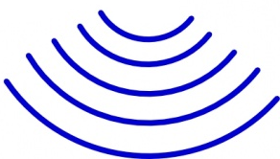
ESP32 device with
distance sensor
Sends out a sound
pulse to measure the
distance in cm
Salt
Block
Salt Block

