Slide 1


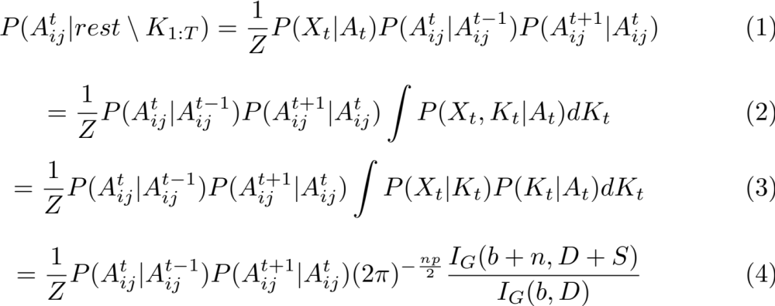
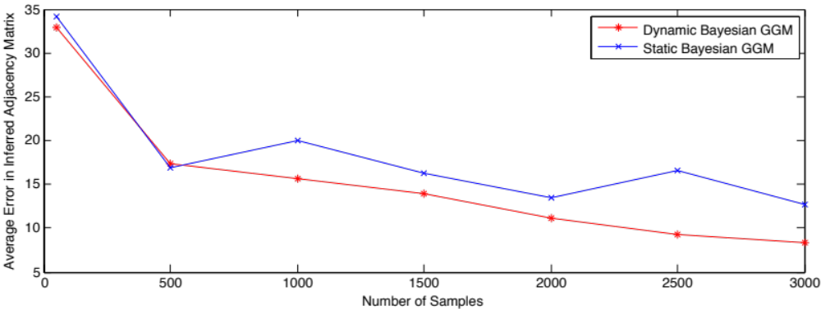
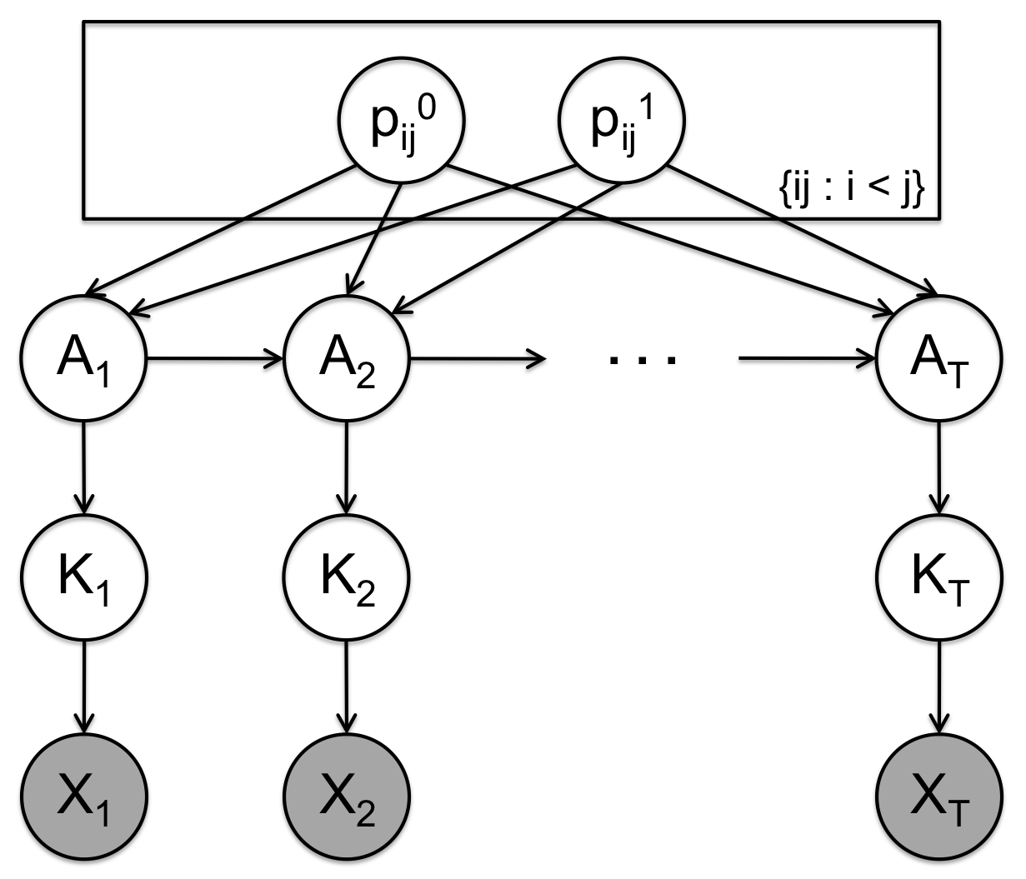
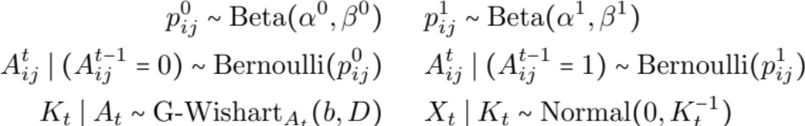
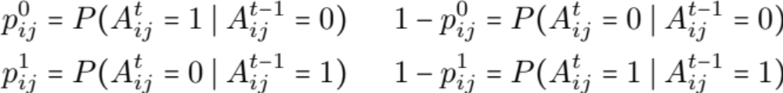
Dynamic Bayesian Gaussian Graphical Models for Inferring Evolving Network Structure
Slav Kirov¹, Micol Marchetti-Bowick², Willie Neiswanger²
¹Department of Mathematical Sciences and ²Machine Learning Department, Carnegie Mellon University
ABSTRACT
We propose a method for learning the structure of evolving Gaussian graphical models via Bayesian inference. Gaussian graphical models (GGMs) are often used to model the structure of a network, where they have found applications in computer vision (object pose), finance (relationships among stocks), biology (gene networks), and a number of related ﬁelds.
INFERENCE
We experiment with two different inference methods for estimating the posterior distribution of our dynamic model.
Collapsed Gibbs Sampling
First, we implemented a Gibbs sampler in which we integrate out the precision matrix variables K_{{1:T}} and resample each edge at each time point, A^{t}_{ij}, using the Gibbs proposal distribution.
RESULTS
We carry out several experiments on both synthetic and real data to evaluate the success of our method.
Synthetic Data Experiment
We performed SMC inference on a synthetic time-varying network with 12 nodes over 10 time-steps, in order to judge performance. We compared its algorithm error with that of running BD-MCMC independently at each time step. The figure below shows that the dynamic model was better able to recover the correct network structure.
INTRODUCTION
Learning the structure of a network is a problem of interest in a variety of fields. For a biologist, uncovering the structure of a gene network that characterizes functional associations between genes can provide insight into how genes interact during the regulation of a biological process. Similarly, a financial analyst may be interested in understanding how the prices of different stocks relate to one another. In both of these settings, learning a dynamic network that evolves over time can provide even more valuable information about how these relationships change in time.
In (4), I_{G}(b, D) is the normalization constant of the prior G-Wishart distribution P(K_{t}) and I_{G}(b+n, D+S) is the normalization constant of the posterior G-Wishart distribution P(K_{t} | X_{t}). These constants are computed using Monte Carlo simulation.
Sequential Monte Carlo
Second, we implemented a version of Sequential Monte Carlo (SMC) that builds on the Birth-Death MCMC inference method proposed by Mohammadi & Wit (2012). We chose SMC because it performs inference in an online fashion and is thus well-suited to time-varying models. At a high level, SMC proceeds with the following steps:
SMC Algorithm:
  At the first time step, run BD-MCMC using X₁ as input and get N
  samples from the partial posterior P(A₁, K₁ | X₁) as output
  2. At time t-1, we have N particles (samples of A_{1:t-1,} K_{1:t-1}) that are
  approximately distributed according to P(A_{1:t-1}, K_{1:t-1} | X_{1:t-1})
  At time t, run a modified version of BD-MCMC to sample A_{t} and
  K_{t} from proposal distribution Q, where:
  Q(A_{t}, K_{t} | A_{1:t-1}, X_{1:t}) = P(A_{t}, K_{t} | A_{t-1}, X_{t})
  4. Extend the particles with these new values
  5. Compute the importance weight of each particle
  Resample the N particles according to a categorical distribution ma-
  de up of the normalized importance weights
  7. Output N samples from the full posterior P(A_{1:T}, K_{1:T} | X_{1:T})
In step (3), we sample from the proposal distribution P(A_{t}, K_{t} | A_{t-1}, X_{t}) by modifying BD-MCMC to incorporate the prior over the graph structure P(A_{t} | A_{t-1}). BD-MCMC traverses the space of hidden variables by executing birth moves (adding an edge) and death moves (removing an edge), and re-sampling the precision matrix after each move.
Finance and Genetic Data Experiments
MODEL
Our generative model is a dynamic Bayesian network (DBN) that incorporates a Gaussian graphical model (GGM) at each time step, where
A_{t} = {A^{t}_{ij} : i<j}: adjacency matrix for the graph at time t.
K_{t}: precision matrix for multivariate Normal distribution.
X_{t}: observations / emissions from model.
CONCLUSIONS
We have derived a time-varying, Bayesian model for inferring the structure of a sequence of Gaussian graphical models. By running this model on synthetic data (for which there exists ground-truth) we have shown that our model outperforms a static equivalent. We have also demonstrated our model on multiple real-life datasets in order to show its ability to infer network structure in the fields of both finance and genetics. We hope that pursuing Gaussian graphical model learning in a Bayesian setting will allow for flexible specification of dependencies, especially of the dynamics of time-varying graphs
Where:

