Slide 1
Big – O Condensed
Willie Wu Section 1D
5/22/2020

Slide 2
What’s the idea?
You want to be able to understand how a program will perform with a variety of inputs, but almost always LARGE numbers.
Performance can be measured by both speed, and space.
Notes:
Why isn’t wall time a good measure of performance? What about instructions?
Big O isn’t everything if you don’t need to make something super fast, make it simple
For performance applications BigO will matter and when handling large datasets but keep what your use cases are.

Slide 3
How to evaluate speed/time
Calculate the amount of operations in rough amounts, discarding lower order terms.
n^n > n^3 > n^2 > nlogn > n > logn > 1
You also discard all numbers, unless the number is in the exponent, it shouldn’t show up in the final answer.
What counts of an operation?
Accessing an item
Doing math
If you do any sort of work it will count!

Slide 4
Basic Procedure
Find all the loops and their control conditions.
for (int i = 0; i < n; i+=2) { … }
while ( i < k) { ... }
Find all the independent variables that represent the input
For all loops find how many times they run, if the loops changes how many times it runs set it to the MAX amount it could run at

Slide 5
Space complexity how to
Find all memory usages of big things: arrays, vectors linked lists etc.
Ignore simple local variables.
Find out how much memory you would need to store all of it together
Apply the simplification rules of dropping smaller terms
Make sure to include all independent values
FOR RECURSION: find how many method calls you will do, each method call is kind of like an entry in an array

Slide 6
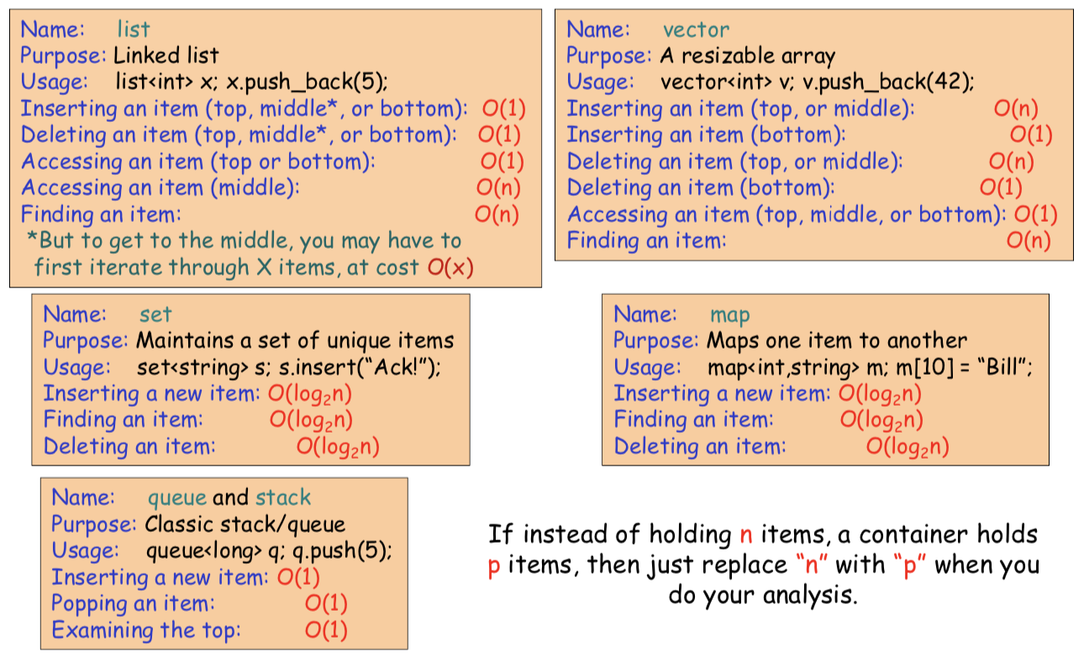
STL and Big O

Slide 7
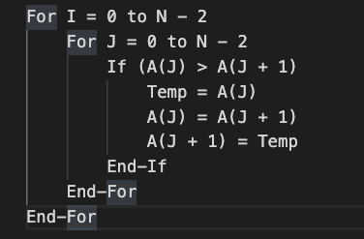
Bubble Sort Pseudocode

Slide 8
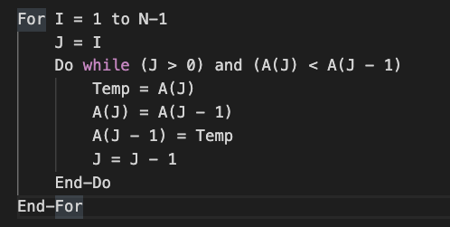
Insertion Sort Pseudocode

Slide 9
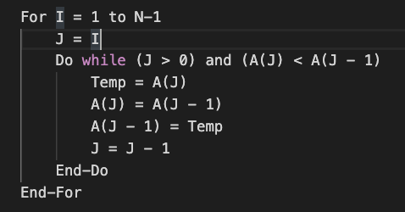
Selection Sort Pseudocode

