Slide 1
Practice Problems
3/2/2020

Slide 2
Return true if the binary trees values are all the same, return false if it is not. An empty tree is Univalued.
struct TreeNode {
int val;
TreeNode *left;
TreeNode *right;
TreeNode(int x) : val(x), left(NULL), right(NULL) {}
};
bool isUnivalTree(TreeNode* root) {
}
20
15
12
10
3
2
1
13
4
5

Slide 3
Return true if the binary trees values are all the same, return false if it is not. An empty tree is Univalued.
bool isUnivalTree(TreeNode* root) {
if (root == nullptr)
return true;
int v = root->val;
bool leftUni = true, rightUni = true;
if (root->left != nullptr)
leftUni = (v == root->left->val &&
isUnivalTree(root->left));
if (root->right != nullptr)
rightUni = (v == root->right->val &&
isUnivalTree(root->right));
return leftUni && rightUni;
}
struct TreeNode {
int val;
TreeNode *left;
TreeNode *right;
TreeNode(int x) : val(x), left(NULL), right(NULL) {}
};
20
15
12
10
3
2
1
13
4
5
What’s the Big-O?
Notes:
O(N)
What kind of traversal is this?
Preorder dot on left
In order dot on bottom
Post order dot on right

Slide 4
An N-tree is a tree of integers with nodes as shown, each node can have dynamically allocated number of children. The tree has no duplicate values and no negative numbers. Given a value k, find the sum of the values for all nodes whose parent nodes value is k. If a node with a value of k is not found, return -1. Use recursion in a useful way.
class node
{
public:
int getNchildren() { return numChild; }
int getValue() { return value; }
node* getChild(int place) { return children+place; }
//...other functions not implemented
private:
int value;
node* children;
int numChild;
int size;
};
20
15
12
10
3
2
30
1
14
13

Slide 5
An N-tree is a tree of integers with nodes as shown, each node can have dynamically allocated number of children. The tree has no duplicate values and no negative numbers. Given a value k, find the sum of the values for all nodes whose parent nodes value is k. If a node with a value of k is not found, return -1. Use recursion in a useful way.
int find(node* root, int k) {
if (root == nullptr)
return -1;
if (root->getValue() == k) {
int sum = 0;
for (int i = 0; i < root->getNchildren(); i++) {
sum+=root->getChild(i)->getValue();
}
return sum;
} else {
int res = -1;
for (int i = 0; i < root->getNchildren(); i++) {
int temp = find(root->getChild(i), k);
if (temp > res)
res = temp;
}
return res;
}
}
class node
{
public:
…
private:
int value;
node* children;
int numChild;
};
20
15
12
10
3
2
30
1
14
13

Slide 6
Given the Binary search tree provided, what would be the result after inserting 45, deleting 80, deleting 50 and then inserting 57 in that order? Favor left subtree to get replacement for deletion.
50
40
20
null
80
60
15
35
55
75
null

Slide 7
Given the Binary search tree provided, what would be the result after inserting 45, deleting 80, deleting 50 and then inserting 57 in that order? Favor left subtree to get replacement for deletion.
45
40
20
null
60
55
15
35
null
57
75

Slide 8
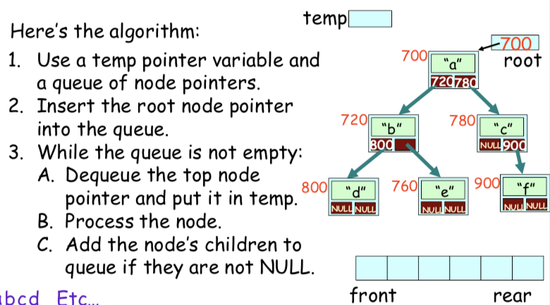
We have seen level order traversal in trees as implemented with a queue, what would happen if we implemented this as a stack?

Slide 9
We have seen level order traversal in trees as implemented with a queue, what would happen if we implemented this as a stack?
Stack History:
 | C | F |  | E
A | B | B | B | D | D
Output: a c f b e d
What does this look like?

Slide 10
How many elements would be in a closed hash table with linear probing have if it has 1,000,000 buckets and it takes 2.5 tries on average to find an item?

Slide 11
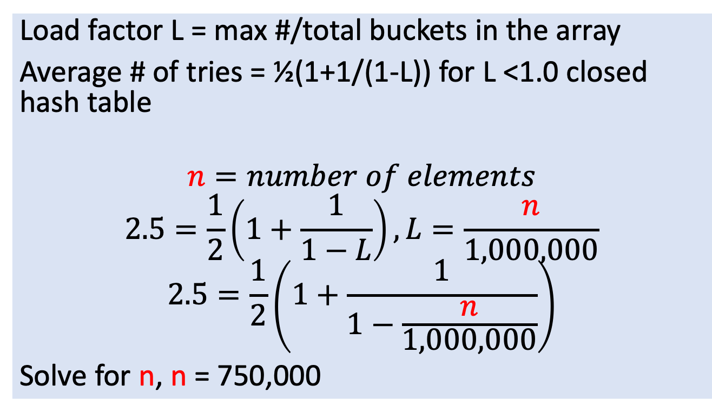
How many elements would be in a closed hash table with linear probing have if it has 1,000,000 buckets and it takes 2.5 tries on average to find an item?
Load factor L = max #/total buckets in the array
Average # of tries = ½(1+1/(1-L)) for L <1.0 closed hash table
$$n=number of elements$$
$$2.5=\frac{1}{2}\left(1+\frac{1}{1−L}\right), L=\frac{n}{1,000,000}$$
$$2.5=\frac{1}{2}\left(1+\frac{1}{1−\frac{n}{1,000,000}}\right)$$
Solve for n, n = 750,000

Slide 12
What is the number of buckets in an open hash table if it takes 1.2 searches on average to find an item and there are 50,000 items in the array.

Slide 13
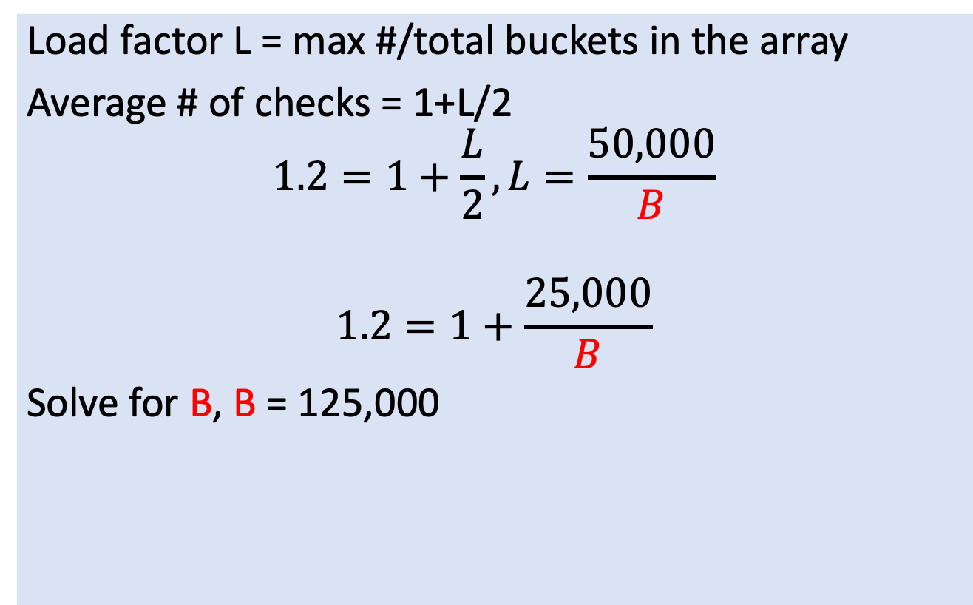
What is the number of buckets in an open hash table if it takes 1.2 searches on average to find an item and there are 50,000 items in the array.
Load factor L = max #/total buckets in the array
Average # of checks = 1+L/2
$$1.2=1+\frac{L}{2}, L=\frac{50,000}{B}$$
$$1.2=1+\frac{25,000}{B}$$
Solve for B, B = 125,000

Slide 14
Hash Tables vs. Binary Search Trees (from Carey)
Hash Tables
Binary Search Trees
Speed
O(1) regardless of # of items
O(log₂N)
Simplicity
Easy to implement
More complex to implement
Closed: Limited by array size
Open: Not limited, but high load impacts performance
Max Size
Unlimited size
Wastes a lot of space if you have a large hash table holding few items
Only uses as much memory as needed (one node per item inserted)
Space Efficiency
Ordering
No ordering (random)
Alphabetical ordering

