Slide 1
Tableau_Sketches
File created on: 11/28/22 1:21:39 PM EST

Slide 2
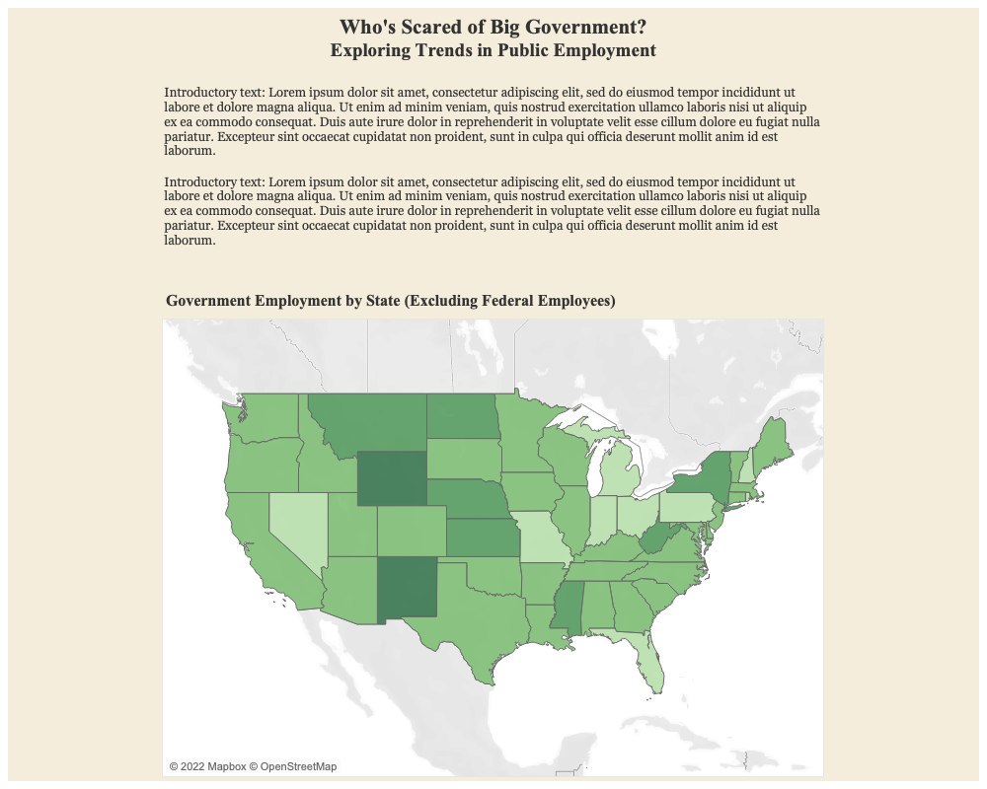

Slide 3
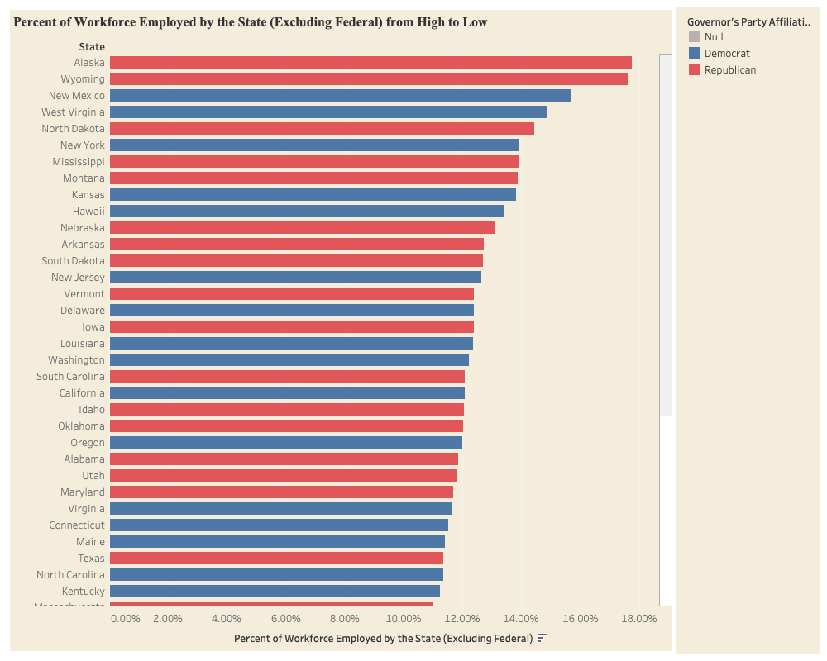

Slide 4
