Slide 1

Welcome to the February Meetup
February 3, 2014
Thank you to our gracious host: Brightscope

Slide 2
Agenda
Hello and Introductions
Thank you to our host
Developers at Brightscope
Q&A
Learning
Intro to Pelican
Hacking and socializing

Slide 3

Hello and Welcome

Slide 4

San Diego <3 Brightscope
http://www.brightscope.com

Slide 5
Faces of Brightscope
Awesome Python Developers

Slide 6
Questions?
Thoughts?
Observations?
Want to know more?

Slide 7
Learning
Beginning Python
IRC, Version Control (git)
Resources for the Resourceful
Building skills and knowledge
Work together
Ask and assist
Web Development
Static Site Generators
Pelican
Bottle
Micro-framework
Flask
Framework (aka Big Mama)
Django
Science and Data
NumPy
Pandas
SciPy

Slide 8
Hacking
Getting comfortable
Learn something new
New PyLadies San Diego logo
PyLadies San Diego Website
Pelican?
Brainstorm
Interate

Slide 9
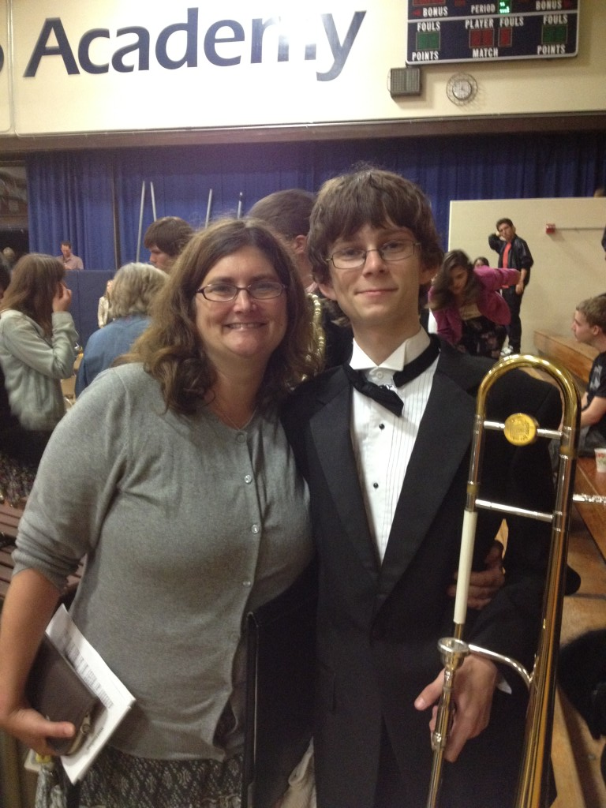
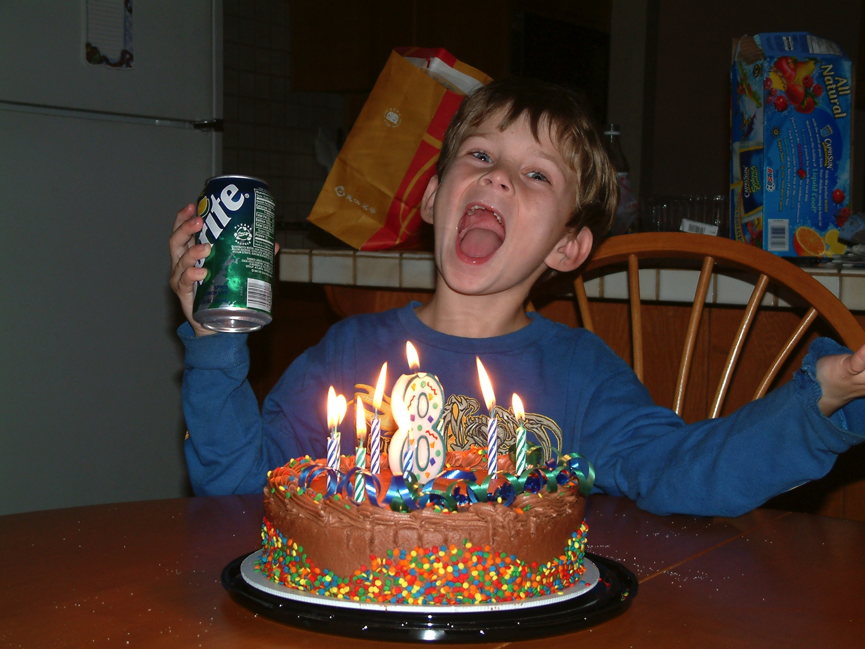
Life Happens
Improvise
Use your resources

Slide 10
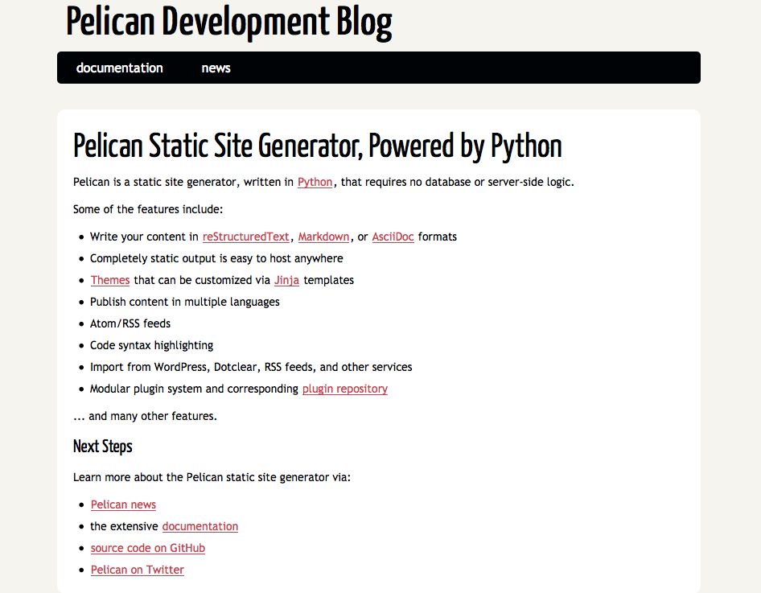
Intro to Pelican
Static Site Generator http://blog.getpelican.com/

Slide 11
Why?
Fast learning curve and ease of use
Good starting point to move to Flask and Django
Themes
Blog
Static pages – about, contact,…
Quickstart

Slide 12
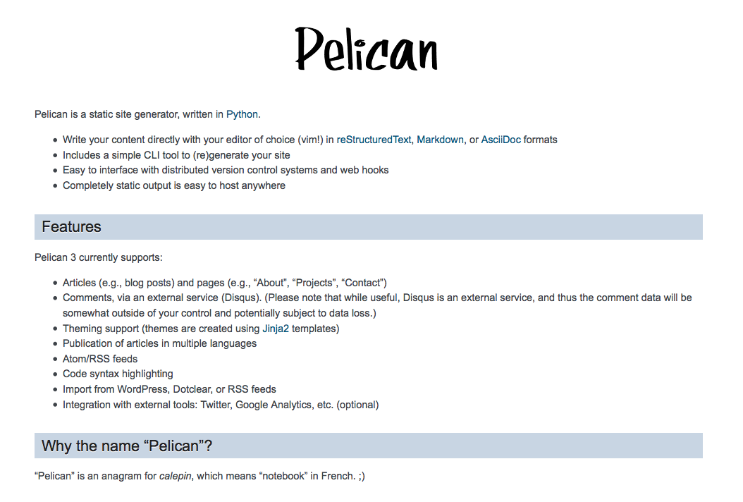
Pelican Docs

Slide 13
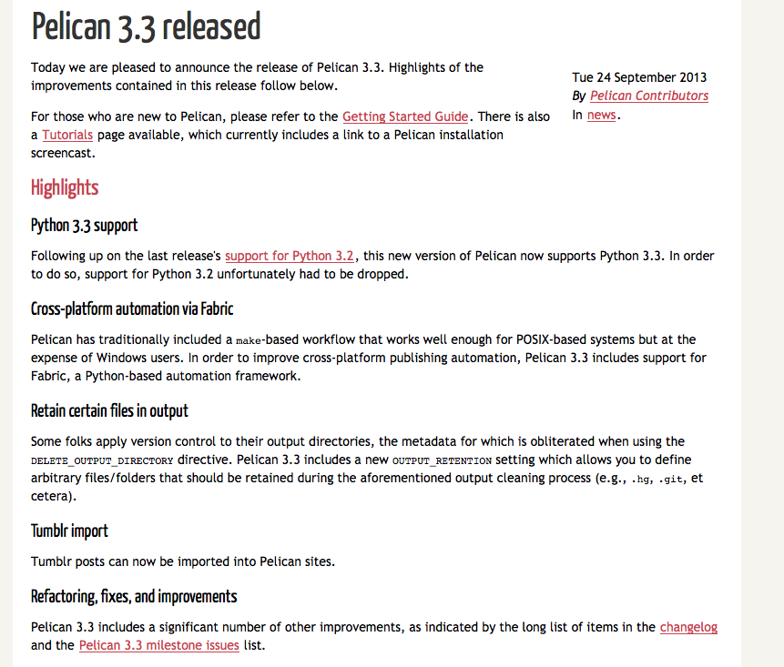
Active Development

Slide 14
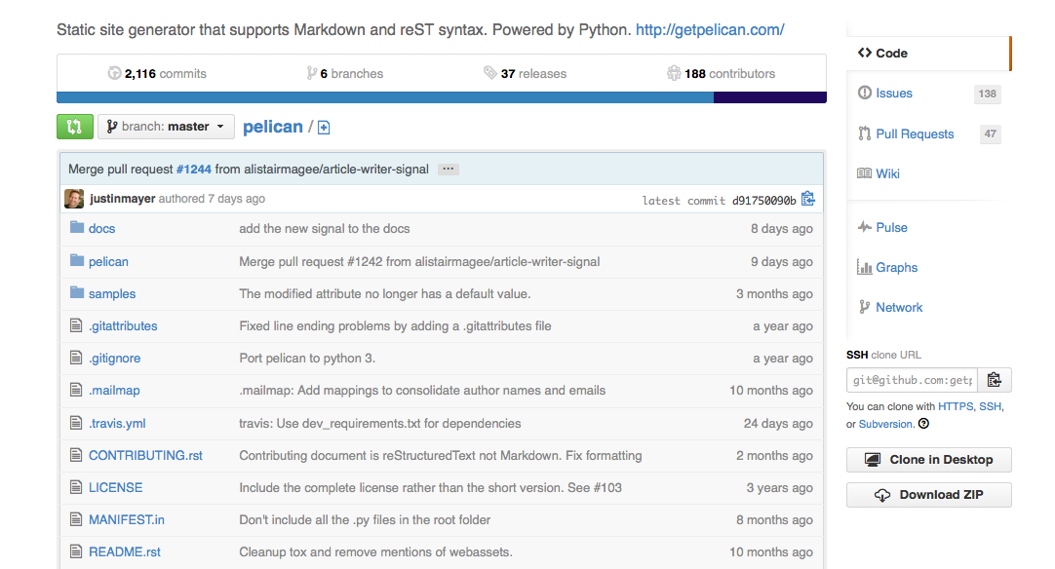
Find Pelican on GitHub

Slide 15
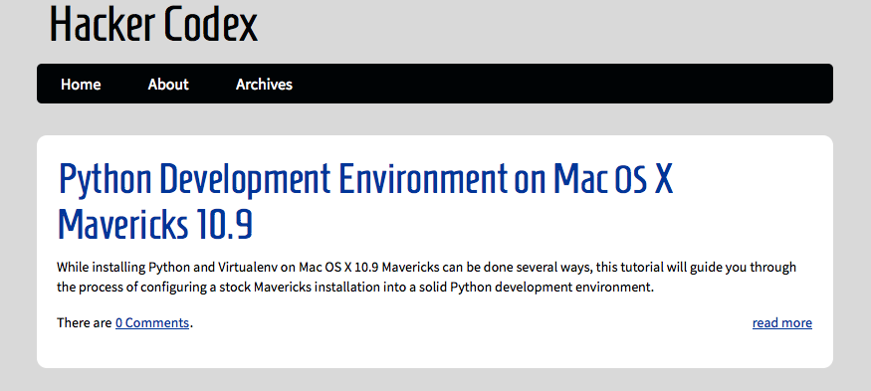
Friendly Devs
Justin Mayer http://hackercodex.com

Slide 16
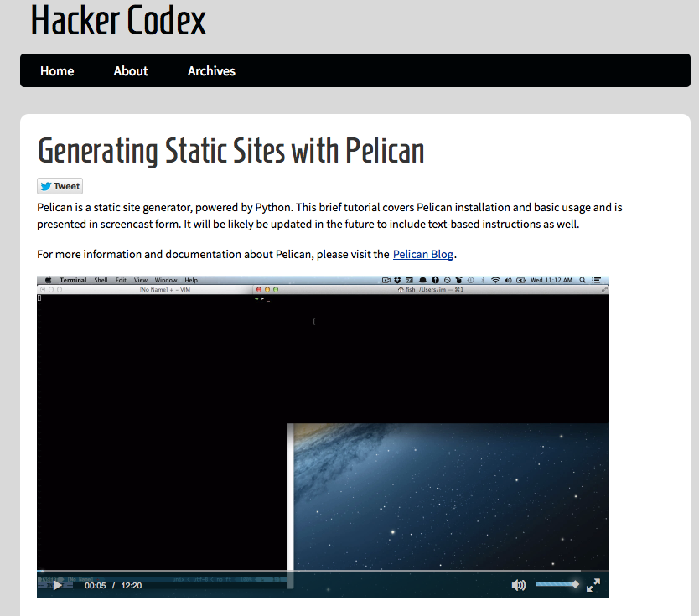
12 min 12 sec to Pelican site
http://hackercodex.com/guide/pelican-static-site-generator-install/

Slide 17
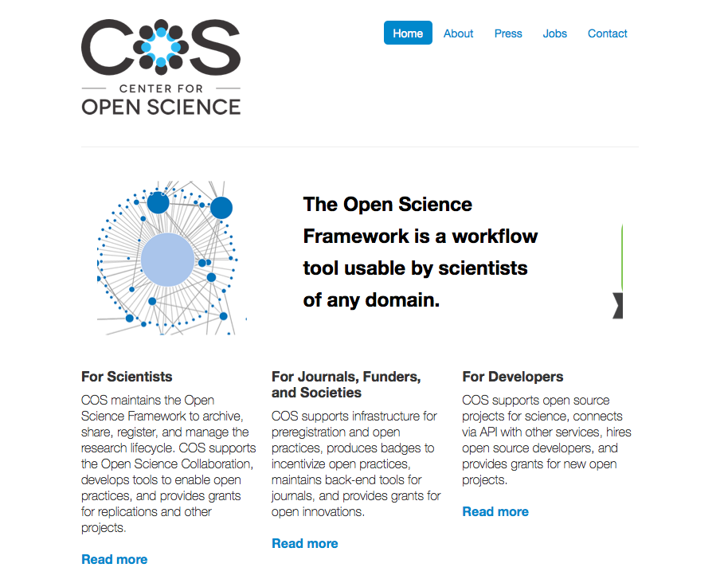
Some Examples
http://centerforopenscience.org/

Slide 18
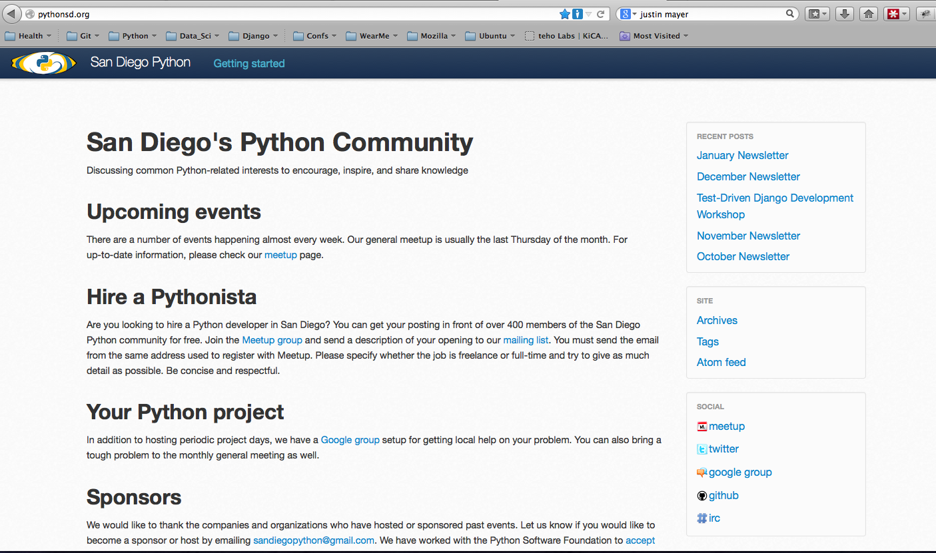
Local Example
http://pythonsd.org/ with a “mellow” IRC channel #sdpython
http://pythonsd.org/november-2013-django-tdd-workshop.html

Slide 19

Hacking and Socializing
PyLadies San Diego Website
Logo
?????

Slide 20

See you soon!
Thanks for coming to the hack night.
Join us on the SD Python IRC.
Thanks to Brightscope and their awesome folks for hosting.

