Slide 1
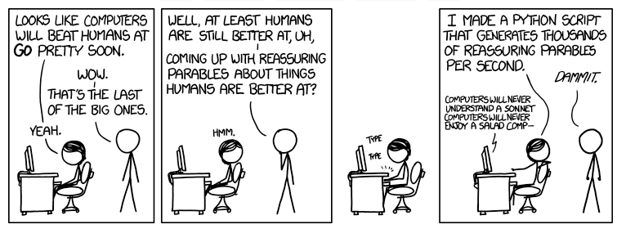

Slide 2
PyCon 2014
Learning, Networking, and Developing
In Montreal or San Diego
San Diego Python User Group
January 23, 2014

Slide 3
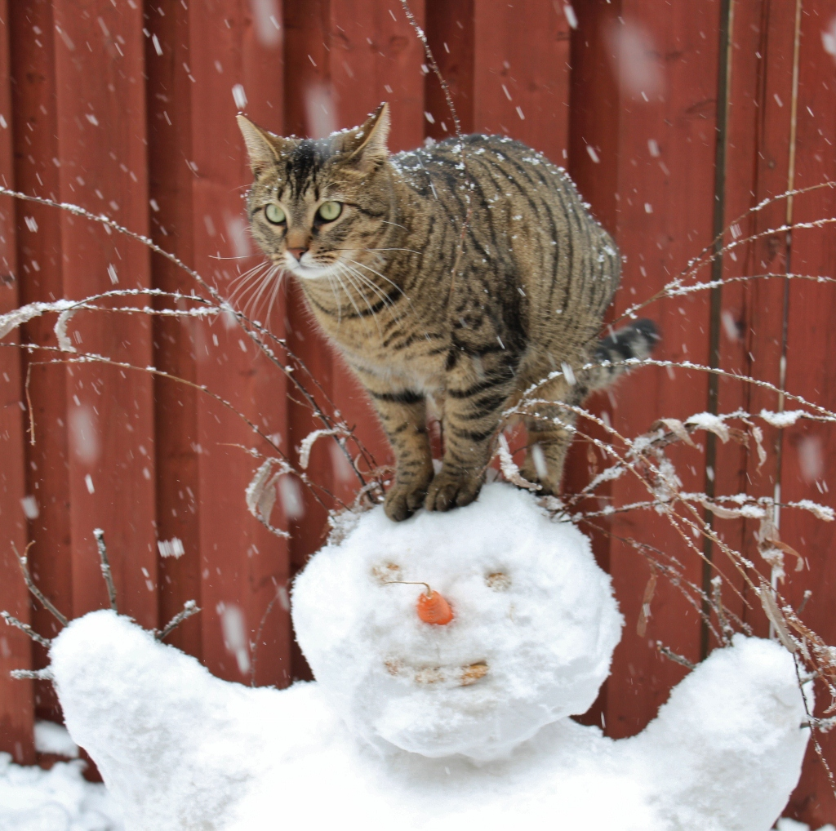
Can haz PyCon?

Slide 4
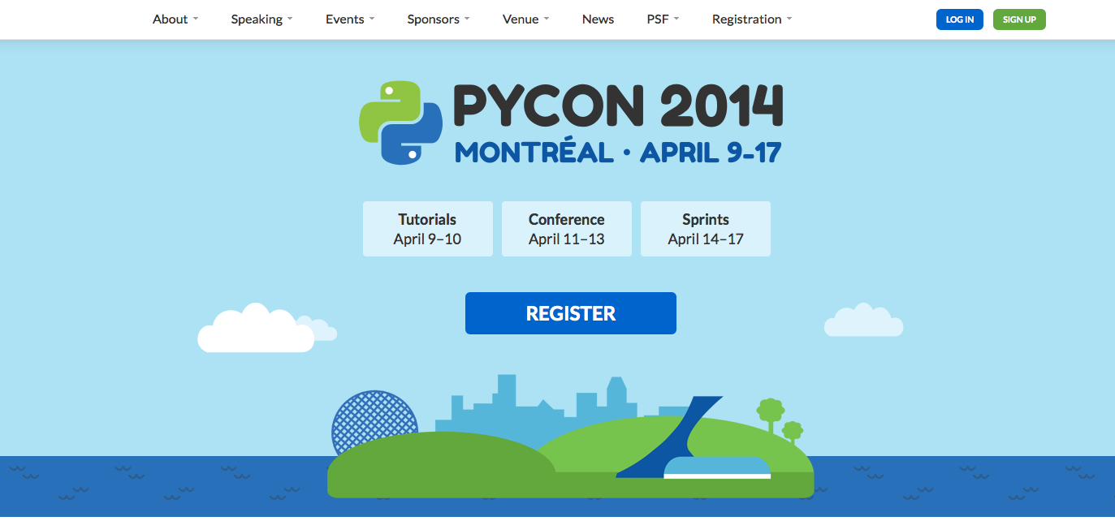
Python's premier conference...

Slide 5

Tutorials
Two days of tutorials
$150 per tutorial
Schedule posted at pycon.org
Childcare available for first time at PyCon

Slide 6
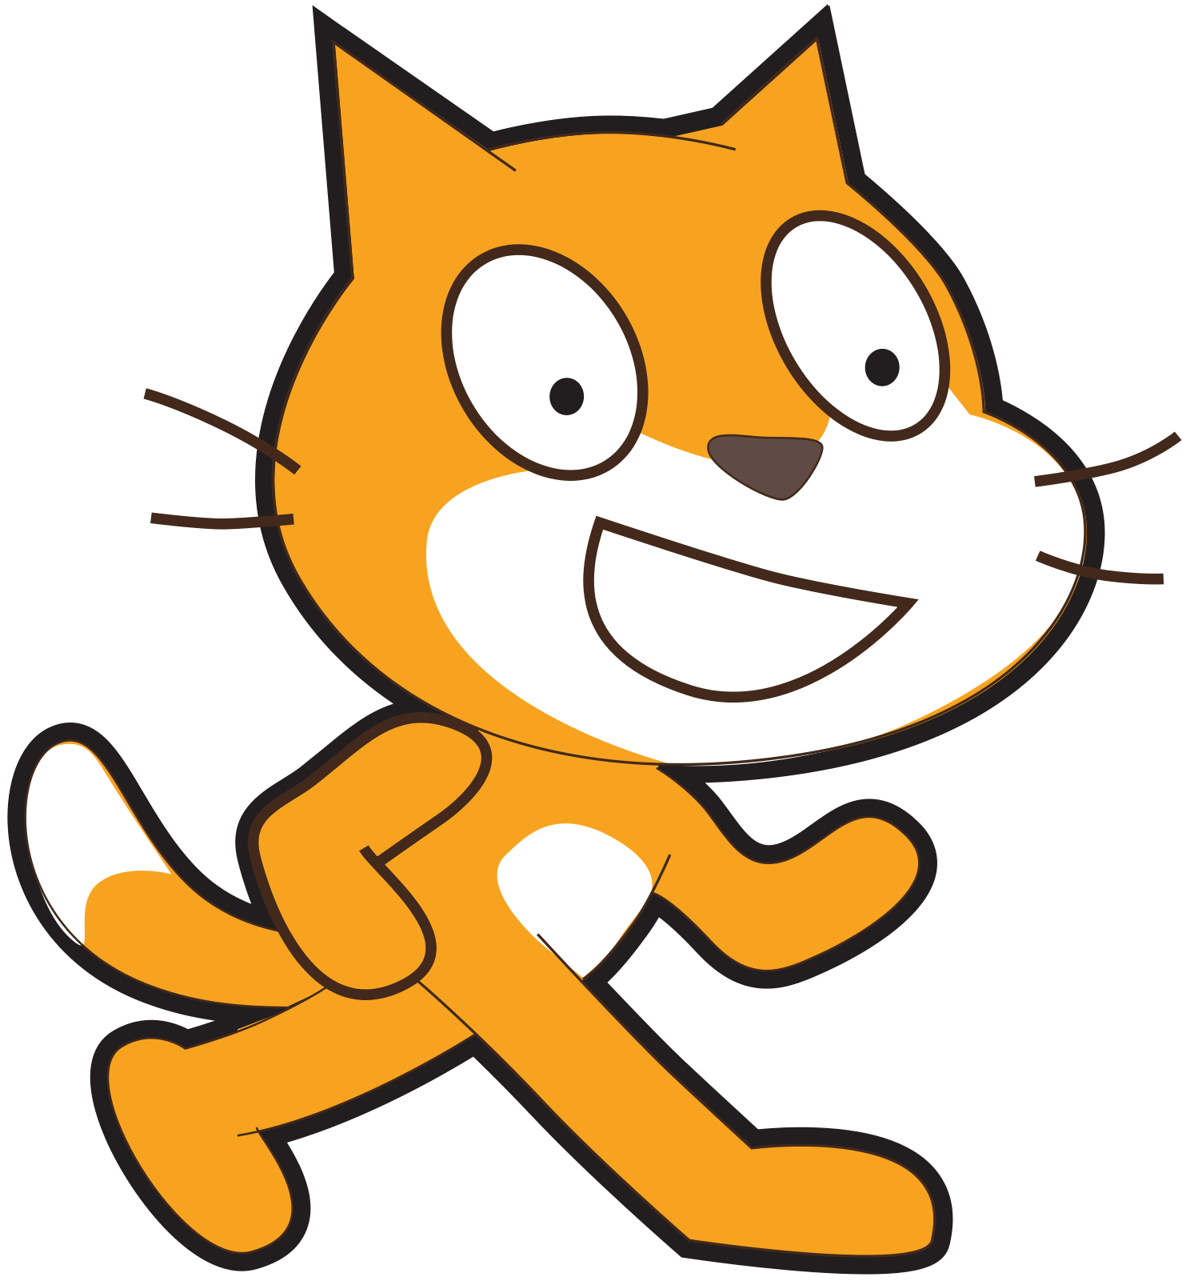
Talks
Over 595 submissions (increase of 100 over 2013)
95 talk slots
Program committee spent 3 months reviewing proposals
Broad range of subjects for 3 days of talks

Slide 7
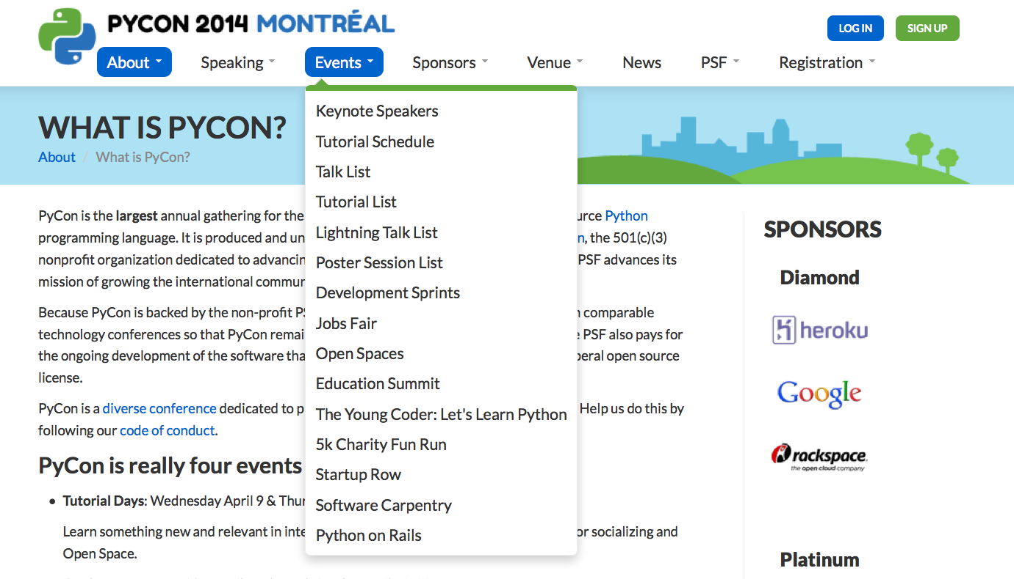
… and much more

Slide 8
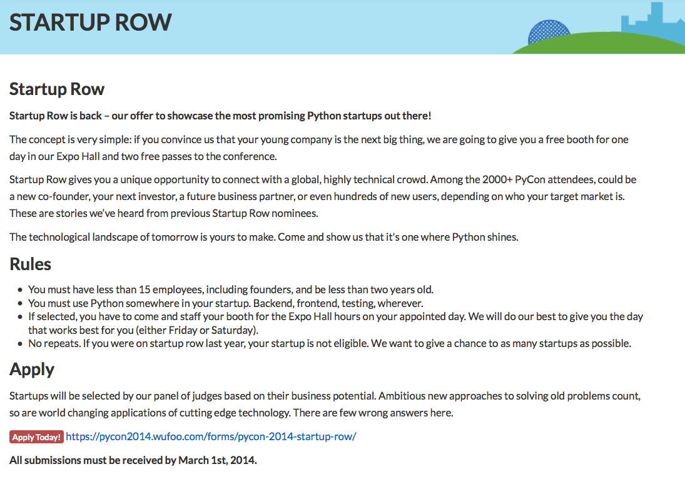
Startups: Gain exposure (3/1/2014)

Slide 9
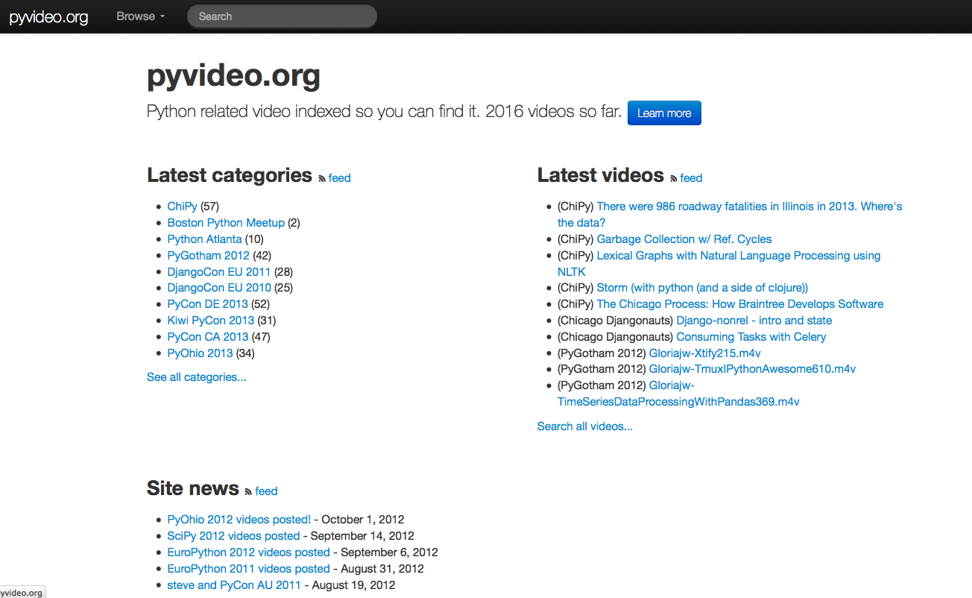
Schedule conflicts? Use pyvideo.org

Slide 10
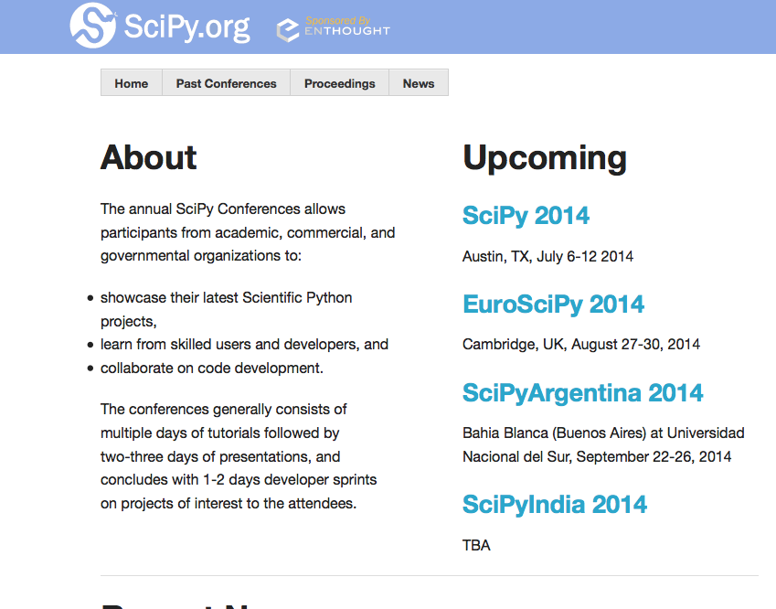
SciPy (July 2014 in Austin, TX)

Slide 11
Closer to San Diego...
SCALE12x (Los Angeles, Feb 2014)
Geek Girl Tech Conference (San Diego, June 2014)
OSBridge (Portland, June 2014)
SciPy (Austin, TX, July 2014)
OSCON (Portland, July 2014)
Grace Hopper Celebration (Phoenix, October 2014)

Slide 12
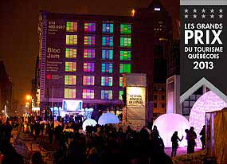
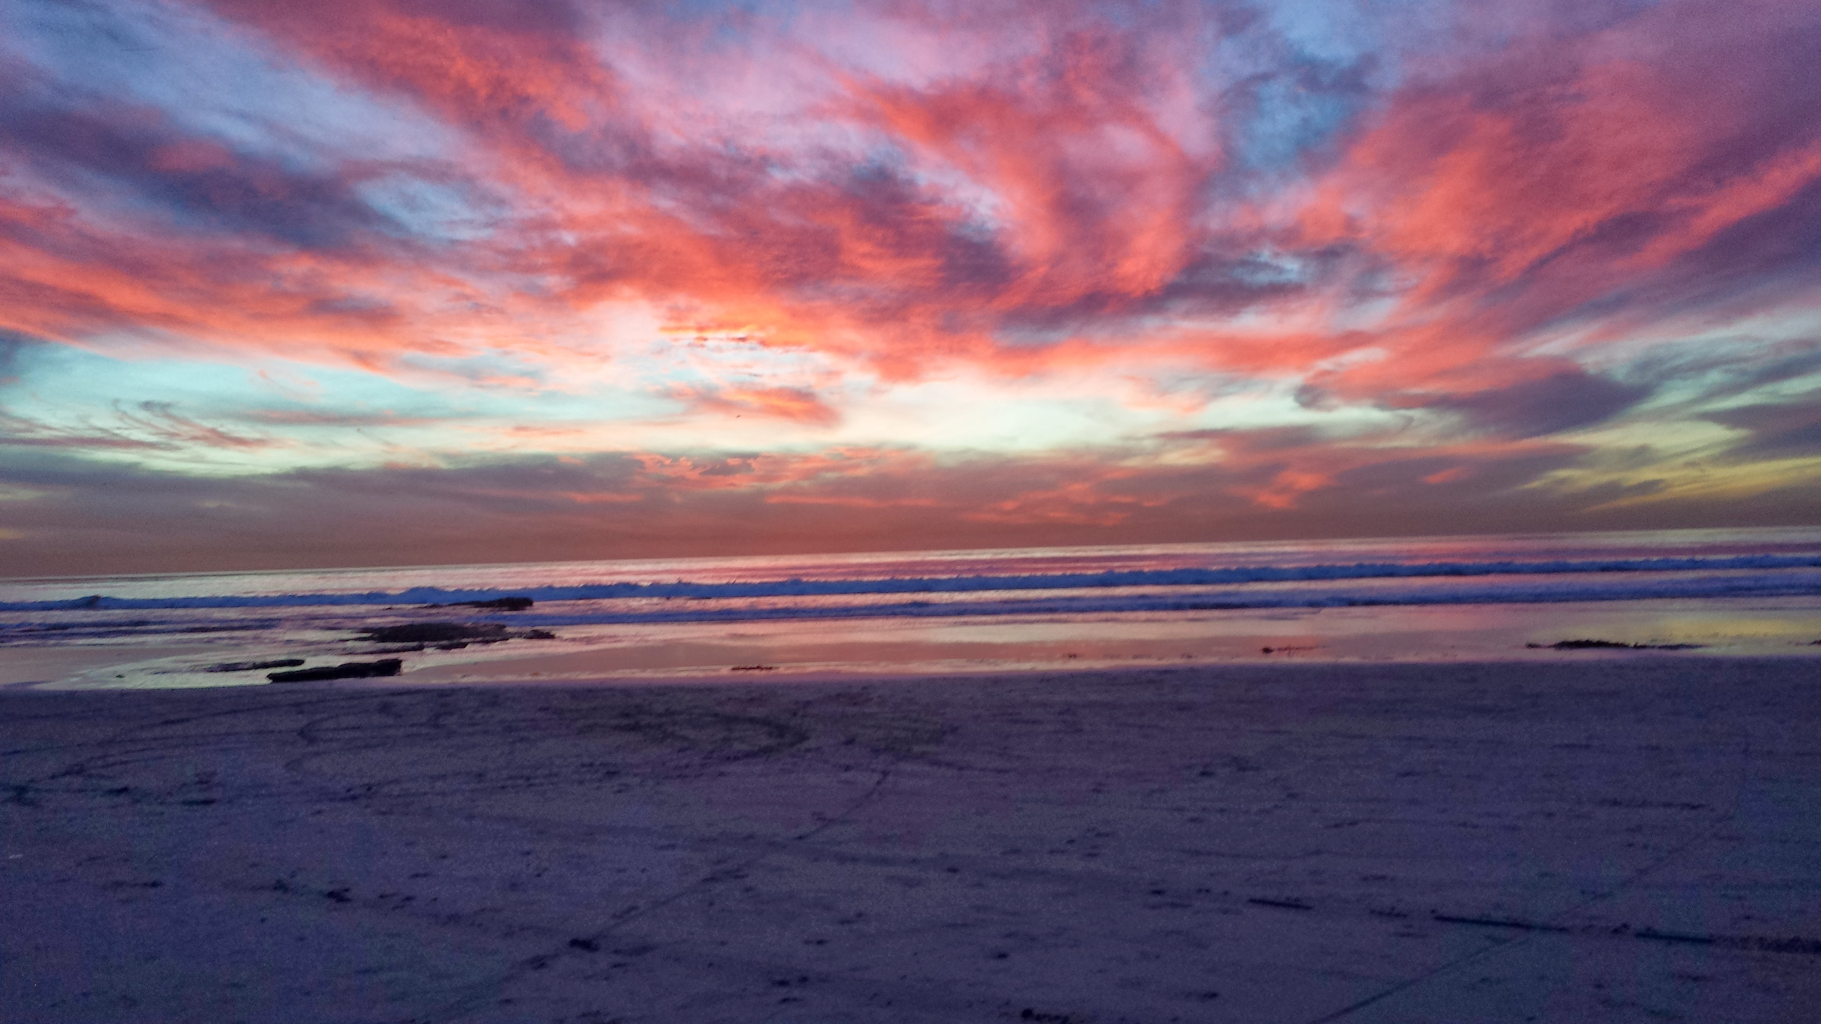
PyCon is cool...
Whether you travel to Montreal or
Enjoy from San Diego

