Slide 1

San Diego Python User Group
Outreach and Education
January 23, 2014

Slide 2
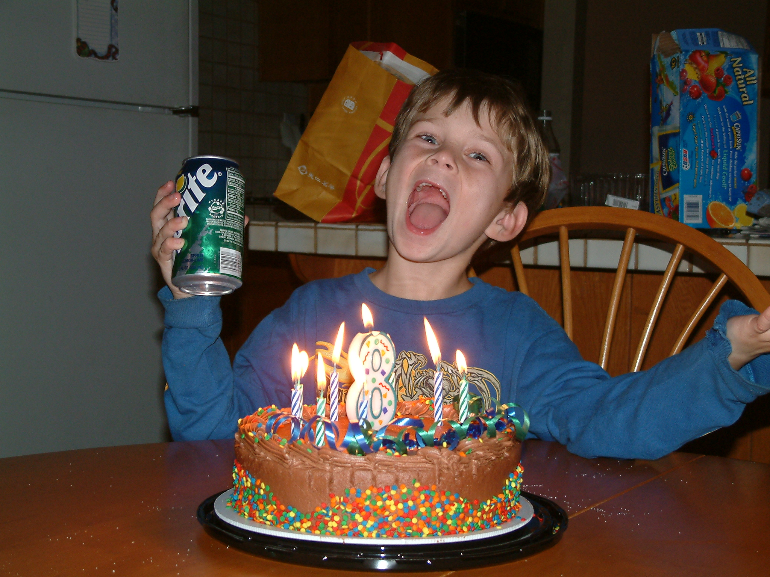
Happy Birthday! Um...Jake...

Slide 3
Outreach
Hack evenings with San Diego Python User Group
Google Hangouts – Large Geographic Area
74 members
Meetup Group
Website – coming soon

Slide 4
Education – Member Community
Intro to Python Group
Basics of Pelican and Static Website Generators
Intro to IRC and Command Line Tools
Intro to Git and GitHub
Gentle Introduction to NumPy, SciPy, Pandas, MatPlotLib

Slide 5
Education – K-12
Conference support and participation
San Diego Science Week
GeekGirl TechCon
Intro to Python for High School and Middle School
Collaboration with San Diego FabLab, CSTA, and others

Slide 6
Fun Stuff coming soon
New PyLadies San Diego logo
PyLadies San Diego website
More hacknights
February meeting at Brightscope

Slide 7

Thank You

