Slide 1
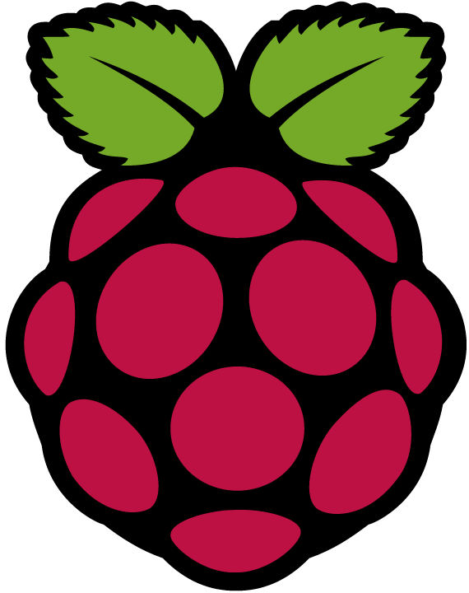

FabLab San Diego Wearable Electronics
Gentle Introduction (No coding)

Slide 2
Overview
Class 0 | Gentle Introduction (No coding or programming)
Class 1 | Wearable Electronics – Lights and Programming
Class 2 | Wearable Electronics – Sensors, Sound, and Design

Slide 3
Gentle Intro to Wearable Electronics
Let there be light!
Learn basics of wearable electronics (light)
How a battery, conductive thread, and an LED work (series circuit)
How to use more than one LED (parallel circuit)
Using and creating an on-off switch
Working with a pre-programmed microcontroller to blink, fade, or flicker LEDs
Modifying a design to personalize your creation
Next class: Moving on to programming

Slide 4
Gentle Intro to Wearable Electronics
Leah Buechley & Kanjun Qiu's Sew Electric Projects (curriculum tested and CC license)
Bookmark book light
Sparkle Bracelet
Bookmark book light (coin cell battery, conductive thread, LEDs)
Sparkle Bracelet (LilyTiny, coin cell battery, conductive thread, LEDs)
Next class: Moving on to programming (LilyPad and Lights or Flora and Lights)

Slide 5
Wearables – Programming and Lights
Intro to LilyPad (or Flora, Arduino based wearables)
Programming LEDs to Light, Blink, and Fade
Project: TBD but to include colored leds

Slide 6
Wearables – Sensors, sound, and design
Sensors – Light, Sound, Color, Temperature...
Sound – Microphone and speaker
Project Idea: Interactive Stuffed Monster
Design your own creation
Advanced (Beyond this course): GPS, MP3, Wireless communication

