Slide 1
去雨&reid
郭鑫 BA20010027

Slide 2
实验设计
合成RAIN200L_REID和RAIN200H_REID两个数据集，在RAIN200的gt基础上
使用prenet进行训练
在market1501上分别加上light和heavy两种雨
对比去雨前后reid性能变化
Reid网络使用Bag of Tricks and A Strong ReID Baseline

Slide 3
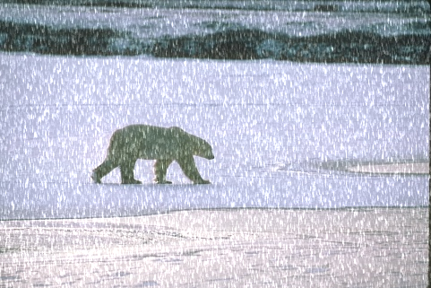
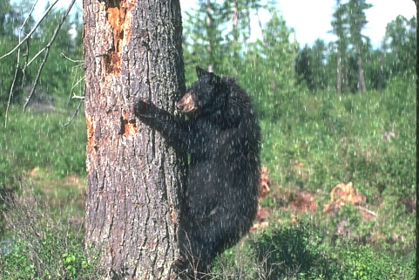
RAIN200L_REID 展示

Slide 4
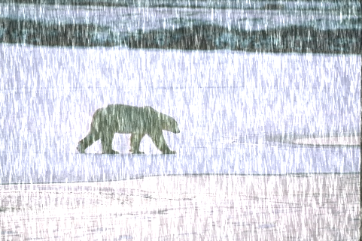
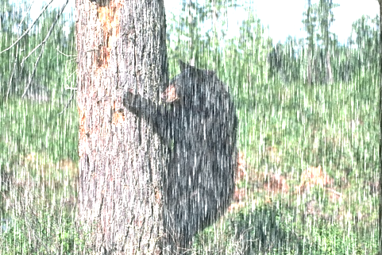
RAIN200H_REID 展示

Slide 5








Market1501-light
去雨前
去雨后

Slide 6








Market1501-heavy
去雨前
去雨后

Slide 7
 | Rank1 % | mAP %
original dataset | 95.4 | 94.2
reid_rain_light | 90.5 | 87.8
reid_rain_light(derain) | 95.5（5.0） | 93.9
reid_rain_heavy | 68.3 | 55.2
reid_rain_heavy(derain) | 94.1（25.8） | 92.3
Reid网络前后性能变化
 | PSNR | SSIM
RAIN200L_REID | 34.360 | 0.9421
RAIN200H_REID | 29.423 | 0.8717
在RAIN200L_REID和RAIN200H_REID上去雨结果
market1501 | PSNR | SSIM | PSNR_original | SSIM_original
query_light | 29.027 | 0.8971 | 18.673 | 0.5960
bounding_box_test_light | 29.524 | 0.9018 | 18.699 | 0.5740
query_heavy | 35.020 | 0.9607 | 27.332 | 0.8168
bounding_box_test_heavy | 35.510 | 0.9611 | 27.324 | 0.8002
在market1501上去雨前后保真度对比

Slide 8
实验总结
通过prenet进行去雨后，reid网络性能在light情况下基本不变，在heavy情况下下降了一个点，去雨对于性能保持有效。

Slide 9
附录
 | Rank1 % | mAP %
Original dataset | 95.4 | 94.2
rainy_query_density-4,-3_intensity0.8,0.9_streaklen20,30-40_rainsize1.5,1 | 48.6 | 33.1
rainy_query_density-7,-6_intensity0.4,0.5_streaklen2,0,5_rainsize1.01,0.3 | 95.4 | 94.0
rainy_query_density-6,-5_intensity0.6,0.7_streaklen2,0,5_rainsize1.01,0.3 | 95.0 | 93.3
rainy_query_density-4,-3_intensity0.6,0.7_streaklen2,0,5_rainsize1.01,0.3 | 91.4 | 88.3
rainy_query_density-4,-3_intensity0.6,0.7_streaklen5,0,5_rainsize1.01,0.3 | 90.5 | 87.8
rainy_query_density-4,-3_intensity0.9,1.0_streaklen5,0,5_rainsize1.01,0.3 | 84.2 | 78.1
rainy_query_density-5,-4_intensity0.9,1.0_streaklen5,5,10_rainsize1.01,0.3 | 87.4 | 83.3
rainy_query_density-5,-4_intensity1.0,1.1_streaklen5,5,10_rainsize1.01,0.5 | 84.9 | 79.2
rainy_query_density-6,-5.5_intensity1.2,1.3_streaklen5,5,10_rainsize1.01,0.5 | 88.4 | 84.3

Slide 10
 | Rank1 % | mAP %
Original dataset | 95.4 | 94.2
rainy_query_density-5,-4_intensity1.2,1.3_streaklen5,5,10_rainsize1.01,0.5 | 79.6 | 71.5
rainy_query_density-7,-6_intensity1.2,1.3_streaklen10,10,20_rainsize1.01,0.5 | 87.1 | 82.0
rainy_query_density-5,-4_intensity1.2,1.3_streaklen10,10,20_rainsize1.01,0.5 | 68.3 | 55.2

