Slide 1


Lending club case study
Exploratory Data Analysis Assignment
Group members:
Shraddha Jaiswal
Sanat Srivastava

Slide 2
Business Objective
A leading consumer finance company, which facilitates disbursal of personal loans, business loans, and loans for other purposes, via an online marketplace wants to identify “risky” loan applicants so that it can reduce disbursal of bad loans. At the same time legit applications shall not be rejected. Thus the key objectives are to:
Study the data available for past loans
Apply Exploratory Data Analysis techniques and identify patterns which indicate if a person is likely to default.
Use EDA to understand how consumer attributes and loan attributes influence the tendency of default, which may be used for taking actions such as denying the loan, reducing the amount of loan, lending (to risky applicants) at a higher interest rate, etc

Slide 3
Approach
The entire study was broken down into simple steps, which were further divided into smaller sub steps.
The broader steps are shown below (in the order of their occurrence)…
Data Assessment
Data Cleaning
Data Analysis
(univariate & bivariate analysis)
Conclusion
Data Preparation

Slide 4
Data assessment
Load data file and examine rows/columns using read_csv method.
Understand columns using the Data Dictionary
Obtain info on dataframe using info method such as the number of columns, column labels, column data types, memory usage, range index, and the number of cells in each column (non-null values)
Using the describe() method calculated some statistical data like percentile, mean and standard deviation of the numerical value.

Slide 5
Data Cleaning
Drop columns with high null values
Drop unique columns
Drop columns not relevant for analysis
Drop rows where loan status is “Current”

Slide 6
Data preparation
Converting text values to numeric values, e.g. int_rate, loan_status, term , etc.
Setting correct data type on numeric columns, e.g. emp_length, loan_amnt, annual_inc, etc.
Outlier treatment
Creating data groups on continuous data columsn, e.g. annual_inc, loan_amnt, dti

Slide 7
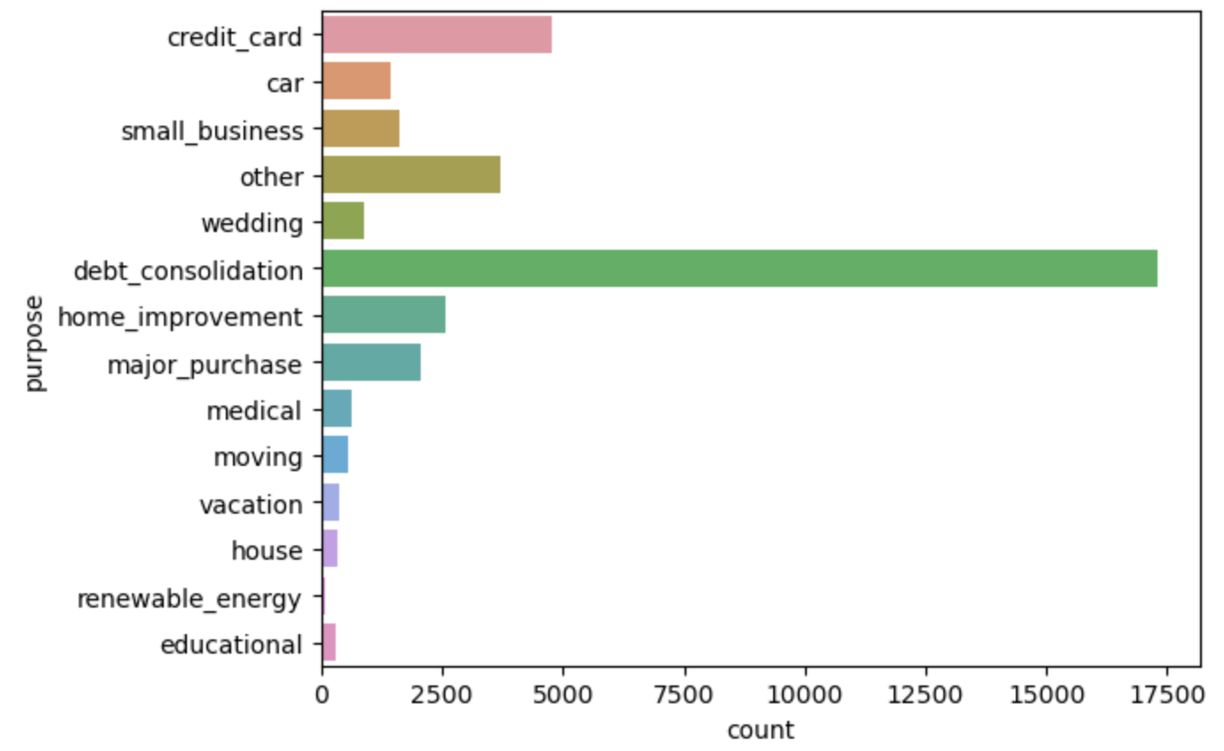
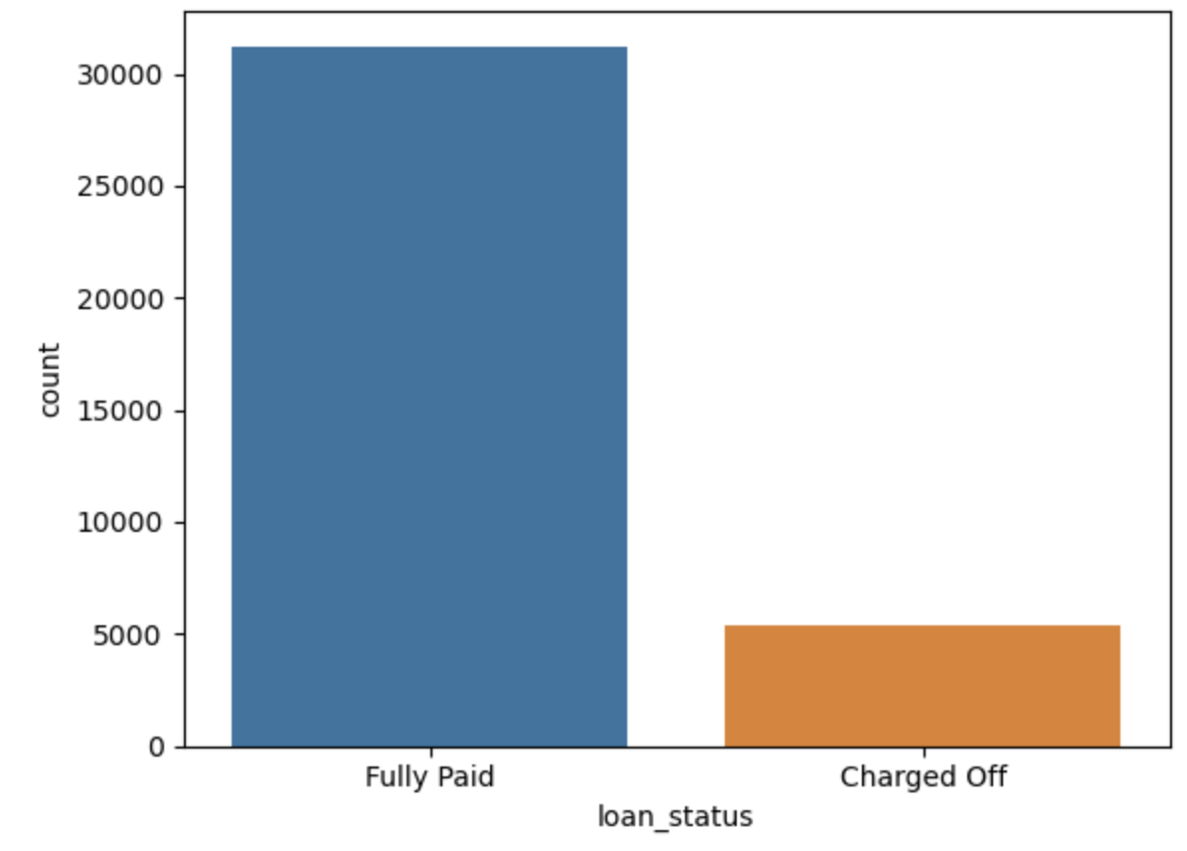
Data analysis
Loan Purpose
Charged off Loan vs Fully Paid Loans
Observation:-
Nearly 50% of the loans were taken for debt consolidation. The next big head was that of credit card.
Observation:-
Nearly 14% of loans turn out to be bad loans.

Slide 8
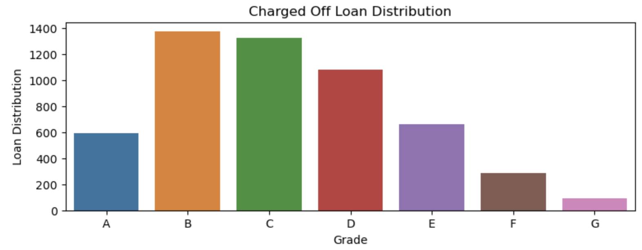
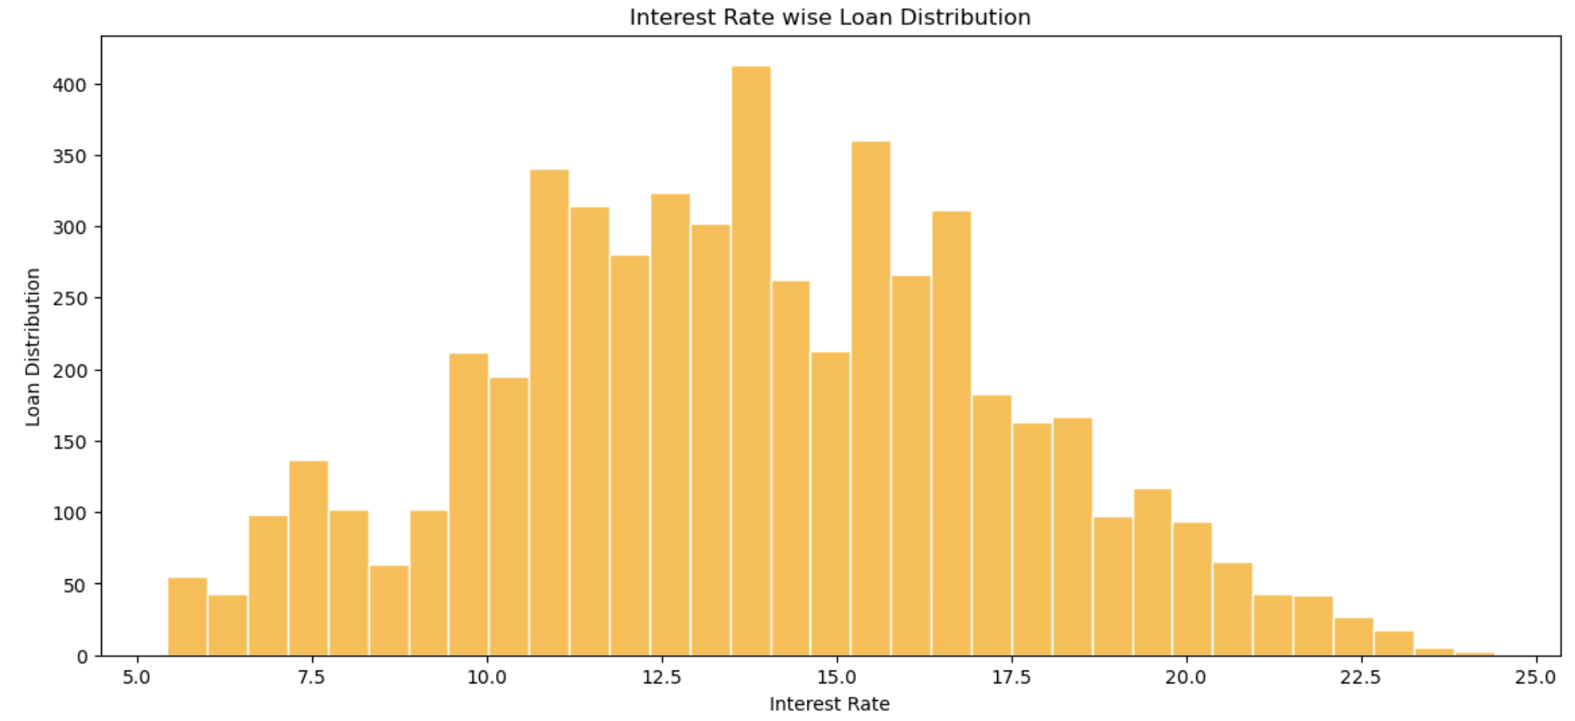
Data analysis
Charged off loan distribution / Grade
Interest rate wise loan distribution
Observation:-
Loan default rate is high for Grades B, C & D.
Observation:-
The graph indicates that loans taken at higher interest rates are more likely to default.

Slide 9
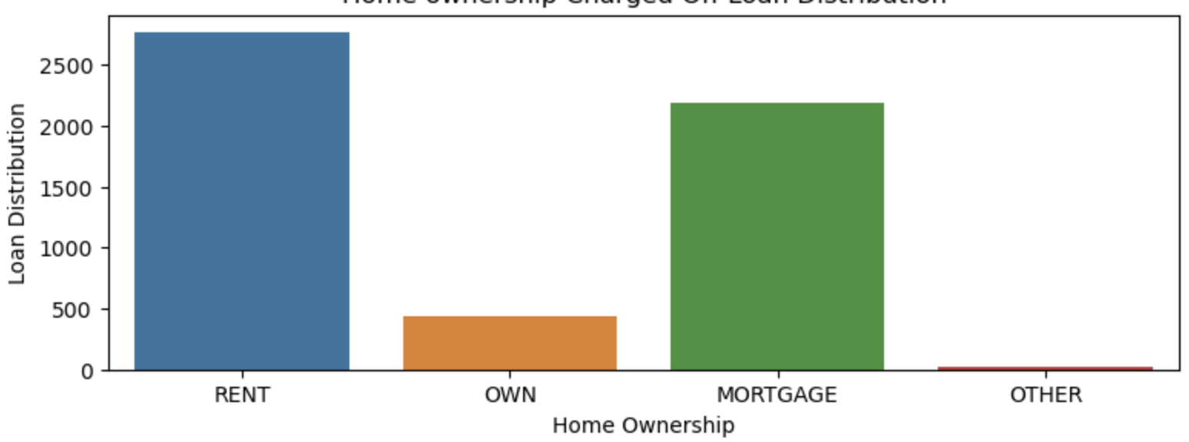
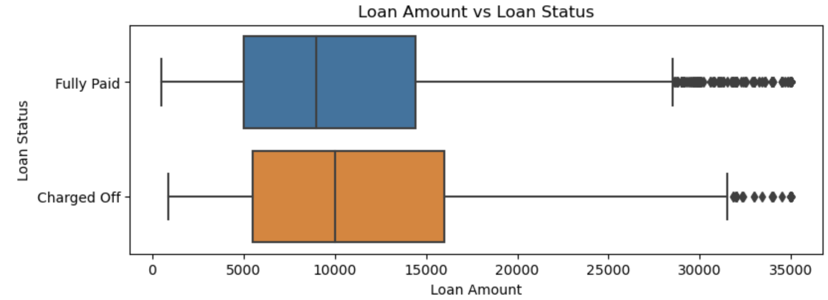
Data Analysis
Charged off loan distribution / Home Ownership
Loan Status / Loan Amount
Observation:-
People who live in Rented accommodation or have their homes mortgaged are more likely to default.
Observation:-
It can be inferred from the above graph that if the loan amount is higher, chances of default are more.

Slide 10
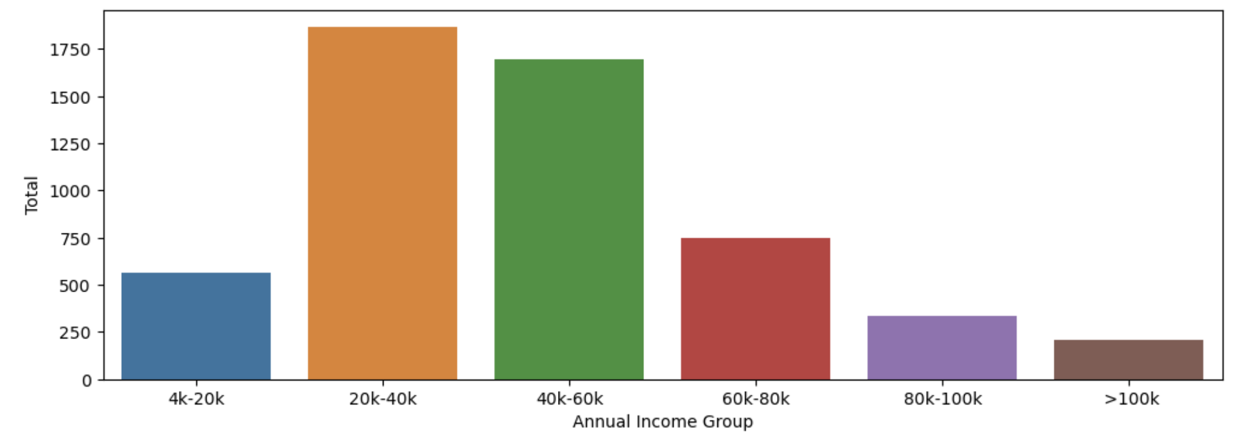
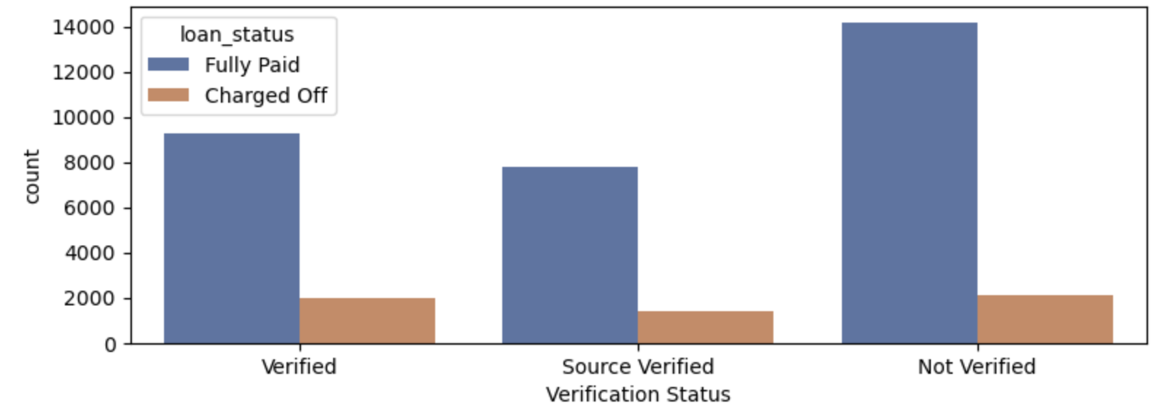
Data Analysis
Monthly income group vs Charged off loans
Verification status and its impact on Charged off loans
Observation:-
Maximum loan charge off happened in the annual income group ranging from 20k to 60k. Higher the annual income, lesser the default.
Observation:-
Not verified loans default the max. However, there are large number of verified loans also which have defaulted. Verification process is not robust.

Slide 11
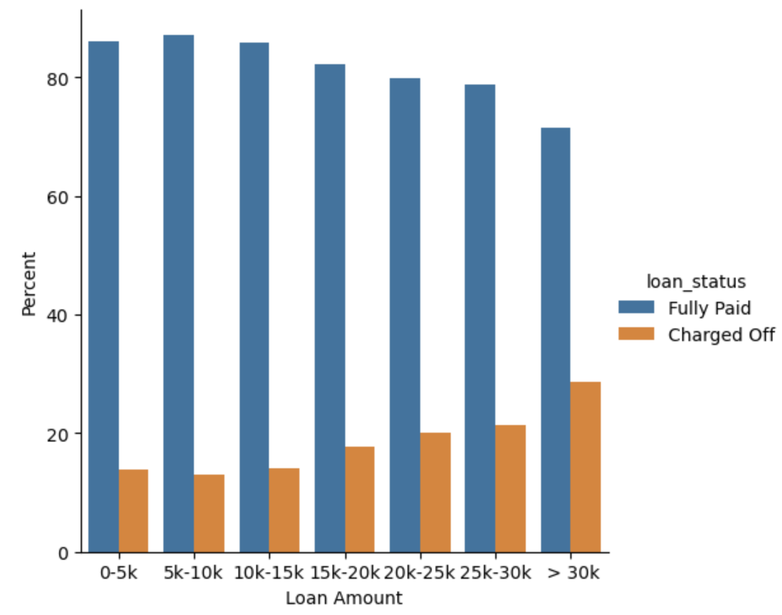
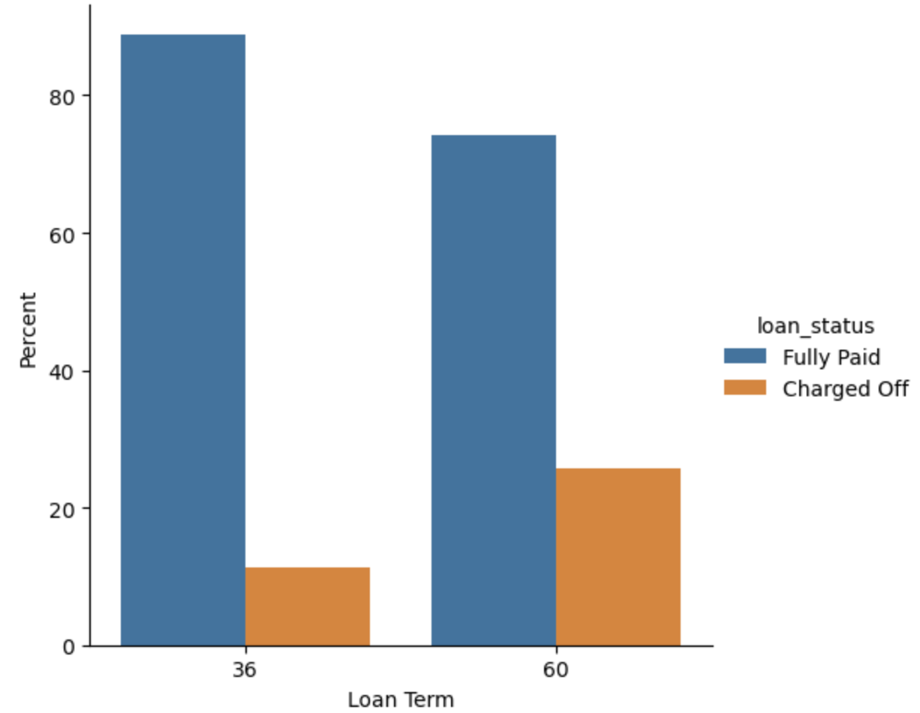
Data analysis
Loan Term and its effect on Loan Status
Loan Amount and its effect on Loan Status
Observation:-
Loans given for longer terms are more likely to get charged off.
Observation:-
Likelihood of loan default increases with loan amount.

Slide 12
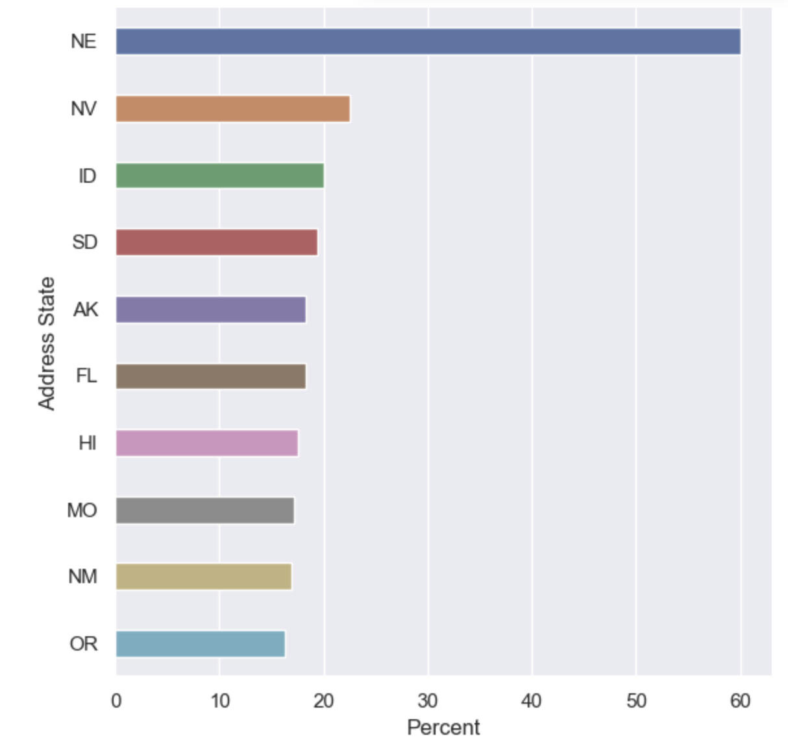
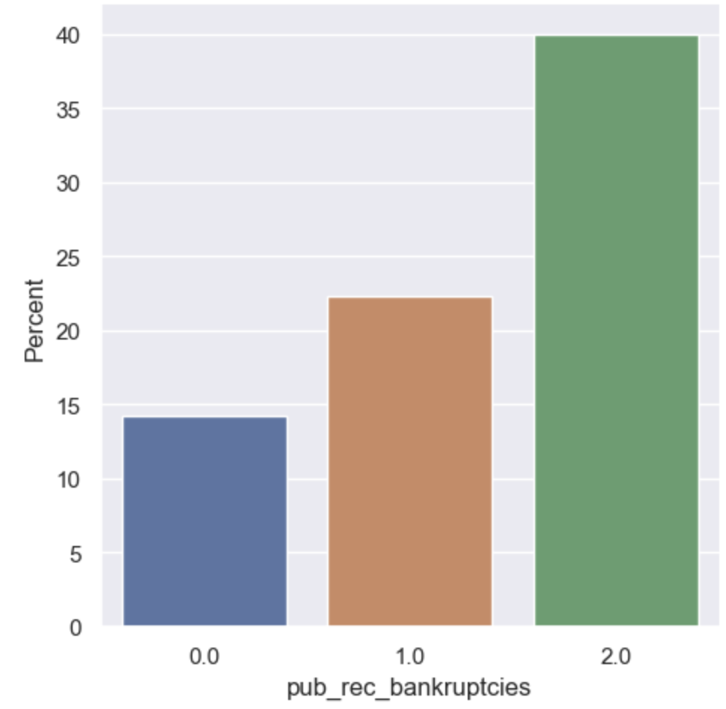
Data Analysis
State wise data for max loan defaults
pub_rec_bankruptices vs charged off loans
Observation:-
Maximum loan default comes from states : NE, NV, ID, SD, AK, FL.
Observation:-
Higher the public records for bankruptcies, greater is the risk of loan default.

Slide 13
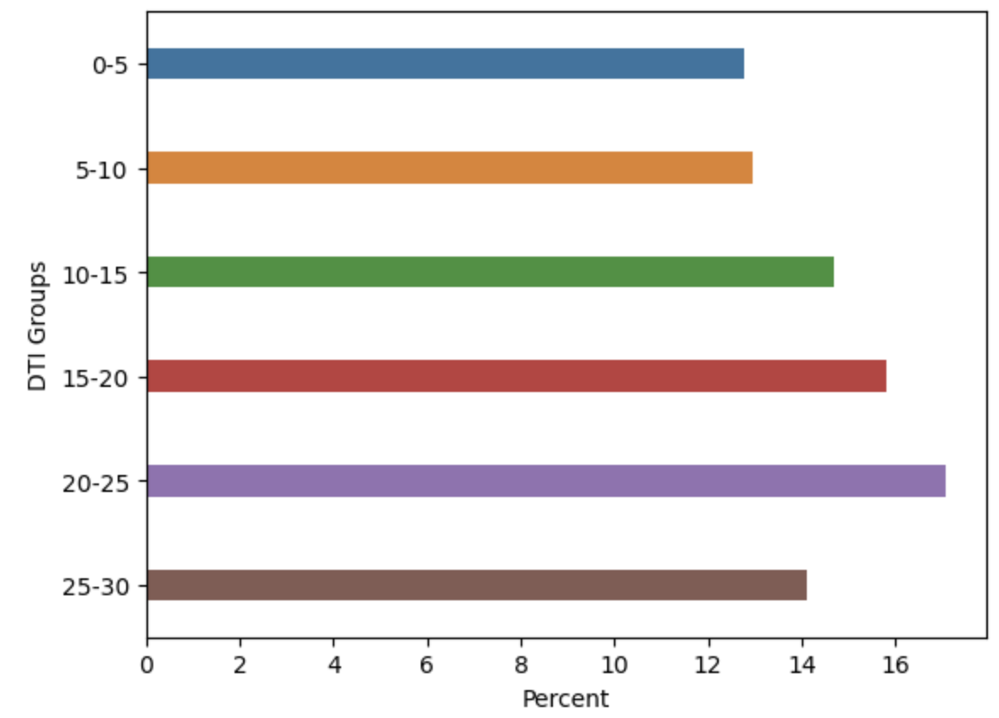
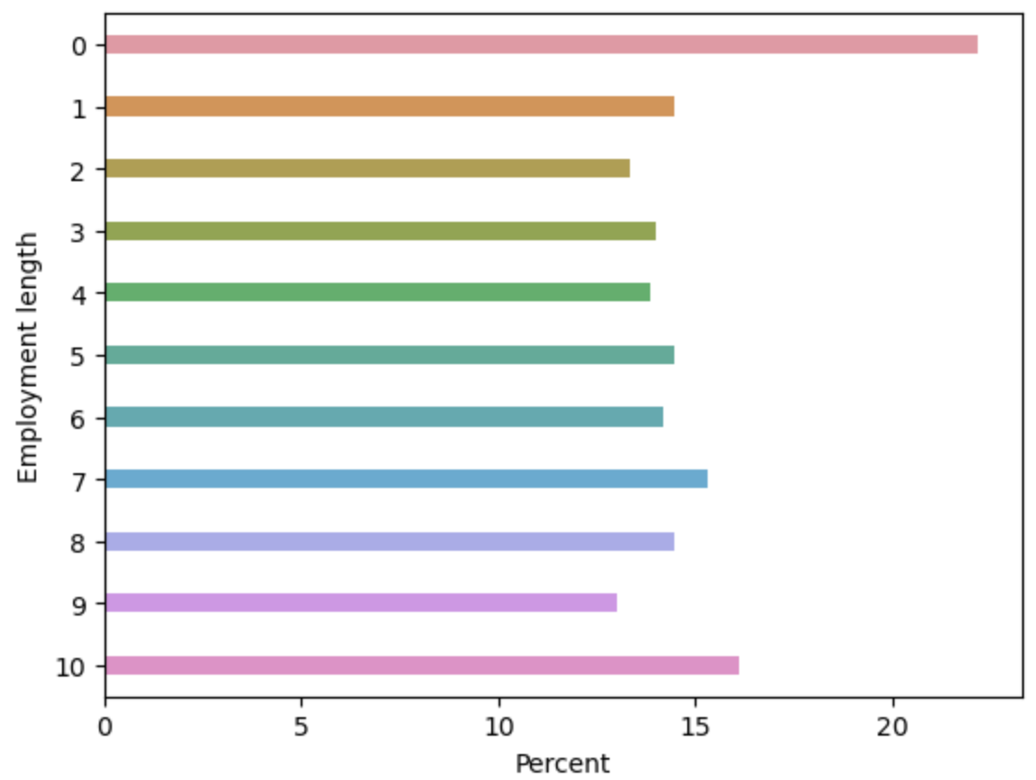
Data analysis
DTI Groups vs Charged off Loans
Employment length vs Charged off Loans
Observation:-
Increase in Debt to Income ratio may lead to higher default rate.
Observation:-
Unknown Employment Duration has max charged off loans.

Slide 14
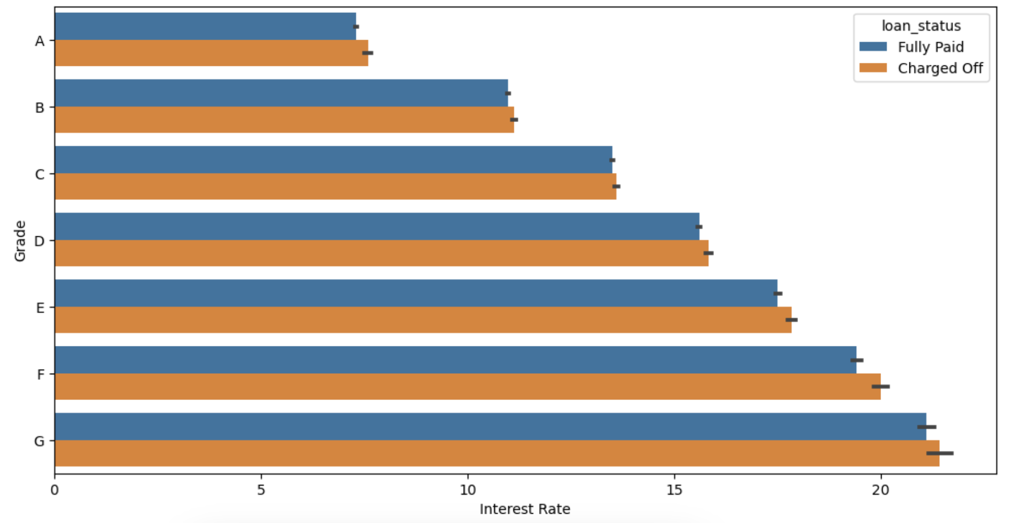
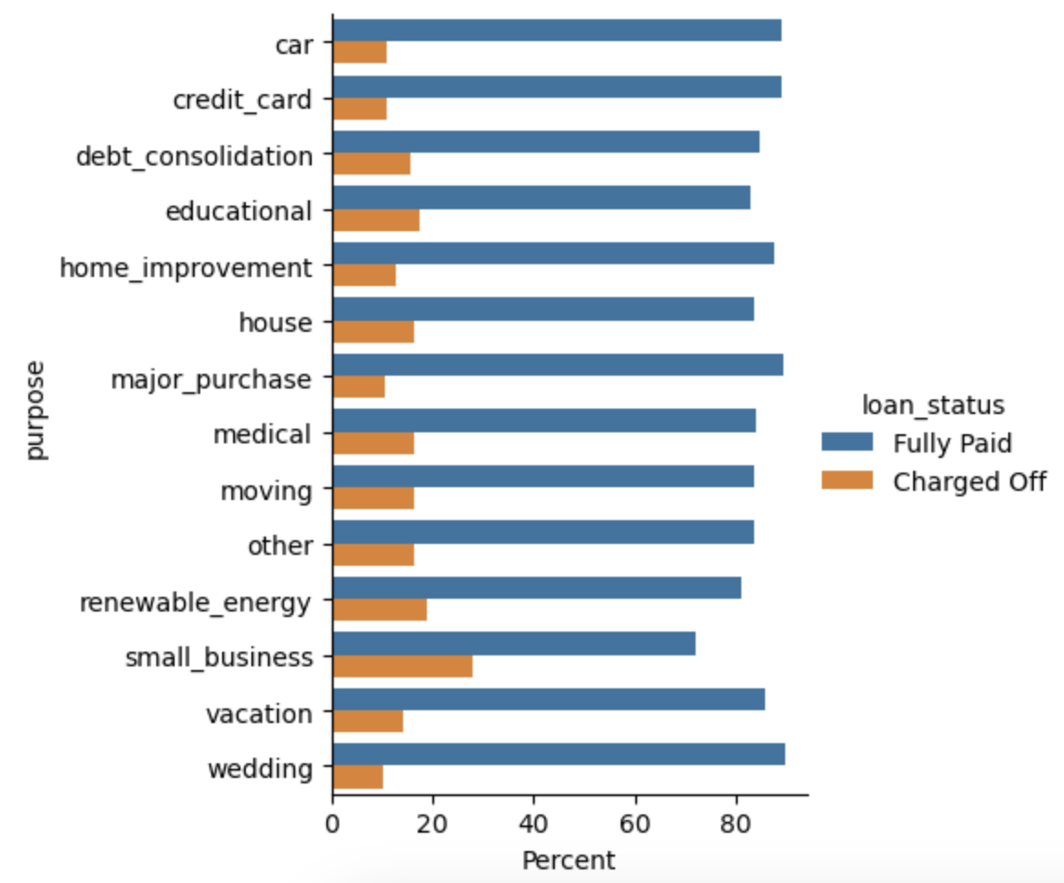
Data Analysis
Grade & Interest Rate effect on loan status
Loan purpose vs Loan status
Observation:-
Higher the Grade & Interest Rate, higher the Charged Off loans rate.
Observation:-
Small Business loans are more likely to get charged off.

Slide 15
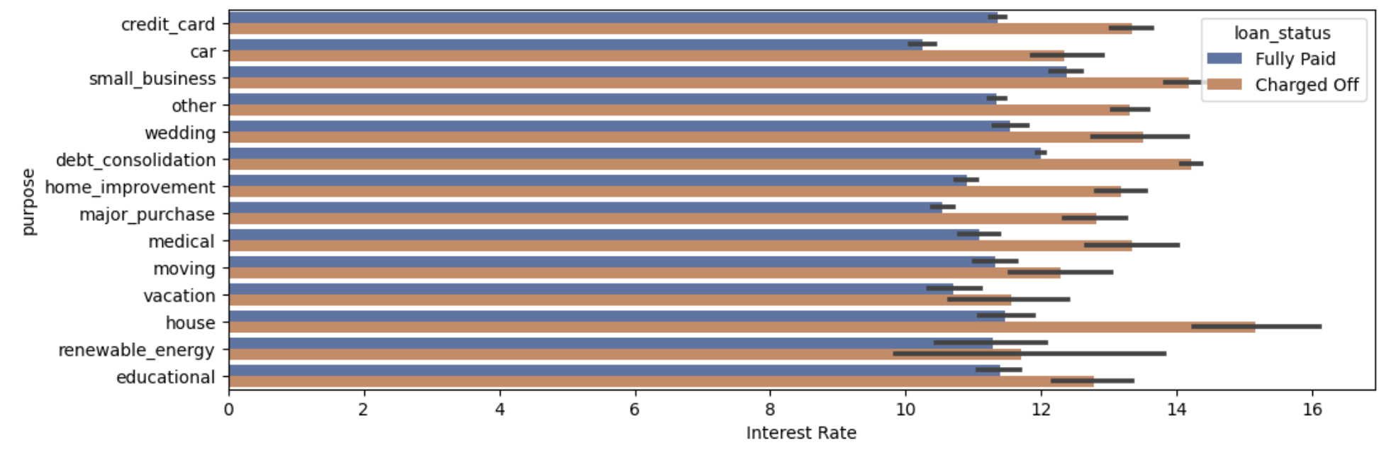
Data Analysis
Loan purpose & Interest Rate’s impact on Loan Status
Observation:-
Small business and House purpose loans were given at very high interest rates, which led to high percentage of default. Interest rate has huge impact on loan default.

Slide 16
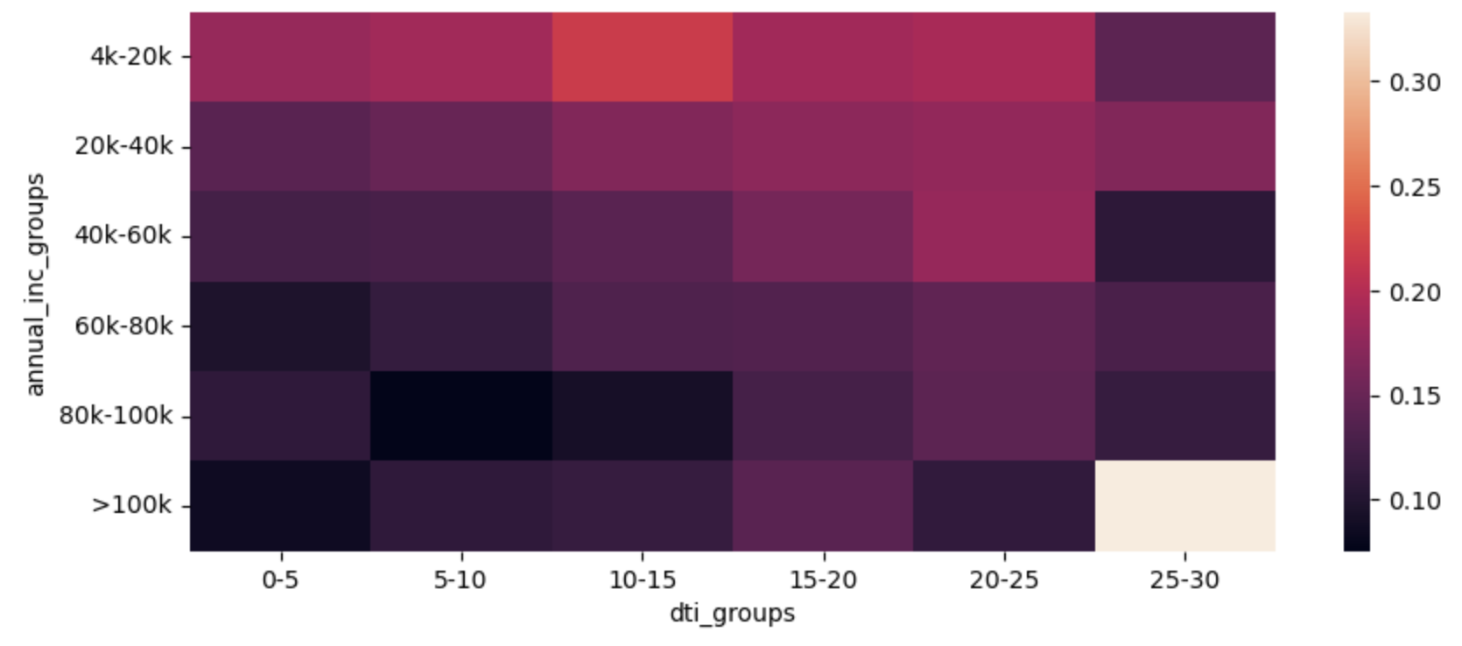
Data analysis
Annual Income Groups – DTI Groups heatmap

Slide 17
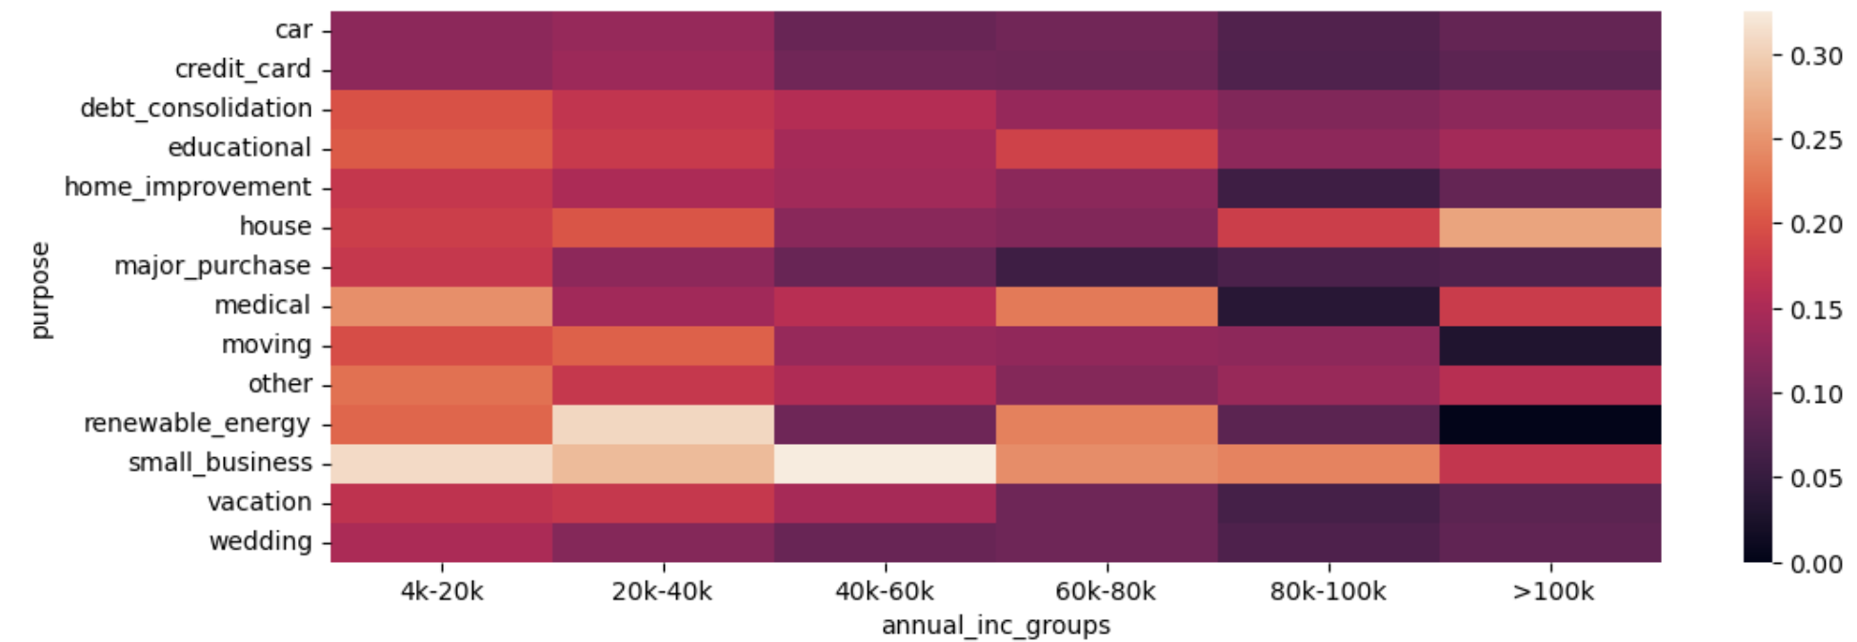
Data Analysis
Annual Income Groups – Loan purpose heatmap

Slide 18
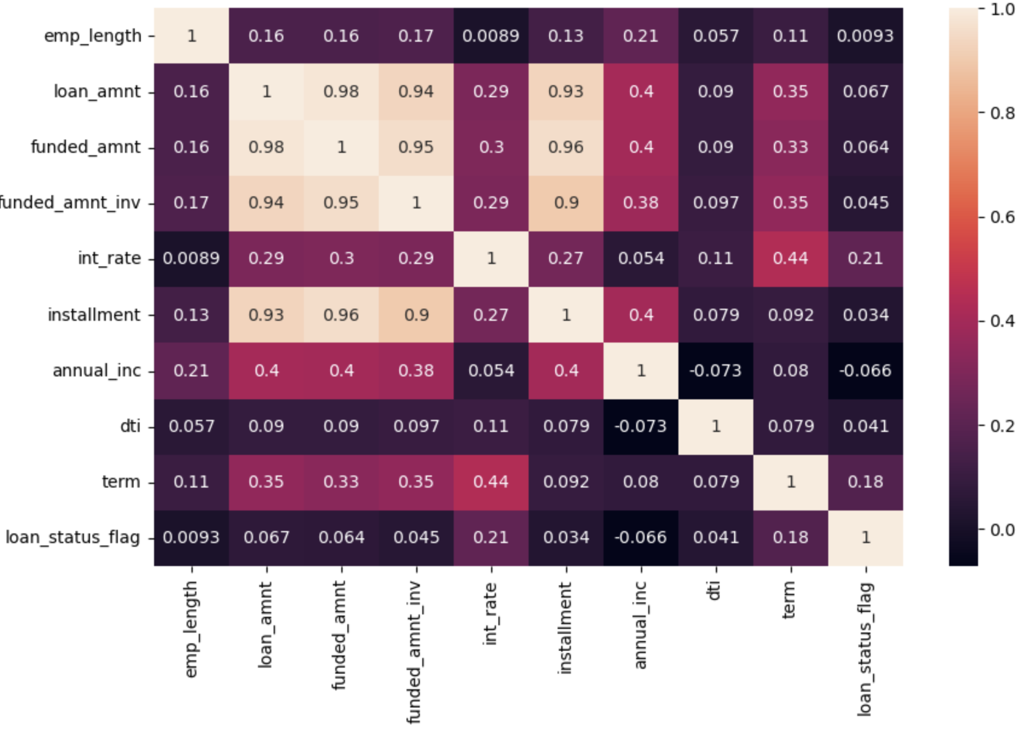
Data Analysis
Heatmap of correlation among numeric variables

Slide 19
Conclusion / Recommendation
Loan default rate is high for Grades B, C & D.
Higher the Grade & Interest Rate, higher the Charged Off loan rate.
People who live in Rented accommodation or have their homes mortgaged are more likely to default.
Caution has to be exercised while giving loans in the lower annual income group specially at higher interest rate.
Not verified loans default the max. However, there are large number of verified loans also which have defaulted. Verification process needs to be improved to reduce loan default.
Loans given for longer terms are more likely to get charged off.
Likelihood of loan default increases with loan amount.
Maximum loan default comes from states : NE, NV, ID, SD, AK, FL.
Higher the public records for bankruptcies, greater is the risk of loan default.
Increase in Debt to Income ratio leads to higher default rate.
Unknown Employment Duration has max charged off loans.
Small business and House purpose loans were given at very high interest rates, which led to high percentage of default. Interest rate has huge impact on loan default.

