Slide 1
Nested / Inner Classes

Slide 2
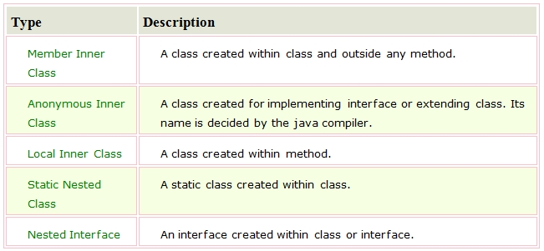
Inner Classes
Inner classes are class within Class. The purpose of a nested class is to signal that the two classes are to be used together. Nested classes are considered members of their enclosing class. Thus an inner class has access to all the members of it enclosing class (outer class).
Types of Nested classes

Slide 3
Member Inner Class
Member inner class is a class that is declared inside a class but outside any of its method.
public class MemberInnerClass {
int serialNumber = 100;
class InnerClass{
public void printLocation(){
System.out.println("Called from InnerClass method printLocation. Value of serial number is : " + serialNumber);
}
}
}

Slide 4
Anonymous Class
A class without a name is called anonymous class. An anonymous class Is usually used for inline definition of an abstract class or an interface.
public class AnonymousClas {
SimpleAbstractClass abstractClass = new SimpleAbstractClass() {
@Override
public void printSomeValue() {
System.out.println("Printing value from anonymous implementation of abstract class.");
}
};
}
In the above code we are doing an inline implementation of an abstract class as anonymous class.

Slide 5
Local Inner Class
A class that is created inside a method is known as local inner class. If you want to invoke the methods of local inner class, you must instantiate this class inside the method. A Local Inner Class can’t access non-final variables of the method.
public class LocalInnerClass {
int instValue = 100;
public void withLocalInnerClass(){
final int value = 40;
class ClassWithinMethod{
void displaySomeText(){
System.out.println(value);
System.out.println(instValue);
System.out.println("Displaying data from displaySomeText method of a local inner class.");
}
}
ClassWithinMethod cwm = new ClassWithinMethod();
cwm.displaySomeText();
}
}

Slide 6
Static Nested Class
A static class that is created inside a class is known as static nested class. It cannot access the non-static members.
It can access static data members of outer class including private.
static nested class cannot access non-static (instance) data member or method.
public class StaticInnerClass {
static int data=30;
static class Inner{
void displayMsg(){
System.out.format("Data is %d", data);
}
}
}

Slide 7
Class within Interface
An interface in Java can also have a class within. If we define a class inside the interface, java compiler creates a static nested class. Let's see how can we define a class within the interface:
public interface InterfaceWithClass {
public class ClassInsideInterface{
public void printSomething(){
System.out.println("Hey ! I am printing from within a class defined inside an interface.");
}
}
}

