Slide 1

Data Mining Homework2
P76091048
仰凱駿

Slide 2
目錄
Dataset Create
Target Create Rule
Accuracy
Compare
Result Analysis
Conclusion
Dataset

Slide 3
Dataset Create
This Dataset is about clothes with 11 features. The following are mean of the these feature：
TID：ID for clothes, default { i for i in range(1000) } .
Price：Price of clothes, range：{ i*100 for i in range(1,21) }.
Sex：Sex of consumer, range：{'male','female’ }.
Categroy：Categroy of clothes, range：{'shoes','pants','jack','shirt','suit','vest','coat’,'sweater','garter','louse','uniforms','dress’}
Color:Color of clothes, range：{'black','white','yellow','red','orange','green','blue','purple','pink','Brown’ }
Size：Size of clothes, range：{ 'XSS','XS','S','M','L','XL','XXL','XXXL’ }
Brand：Brand of clothes, range：{ 'Unique','NET','H&M','Zara','GAP','GU','Adidas','NIKE’ }
Material：Material of clothes, range：{'cotton','polyester','nylon','acrylic','linen','silk','rayon','acetate','spandex','lycra’}
Origin：Origin of clothes, range：{'America','Taiwan','China','Canada','Japan','Europe','Korea’ }
Sales channel：Sale channel of clothes, range：{'Internet','shopee','amazon','Adidas','Storefront’ }
Season：Season of clothes, range：{ 'spring','summer','winter','fall’ }
s/n：if the clothes sold or not, range：{ ‘sell’, ‘fail’ }
Each data is random of these list. Ex：TID：1,Price：500, Sex：male, Categroy：shirt ,⋯⋯

Slide 4
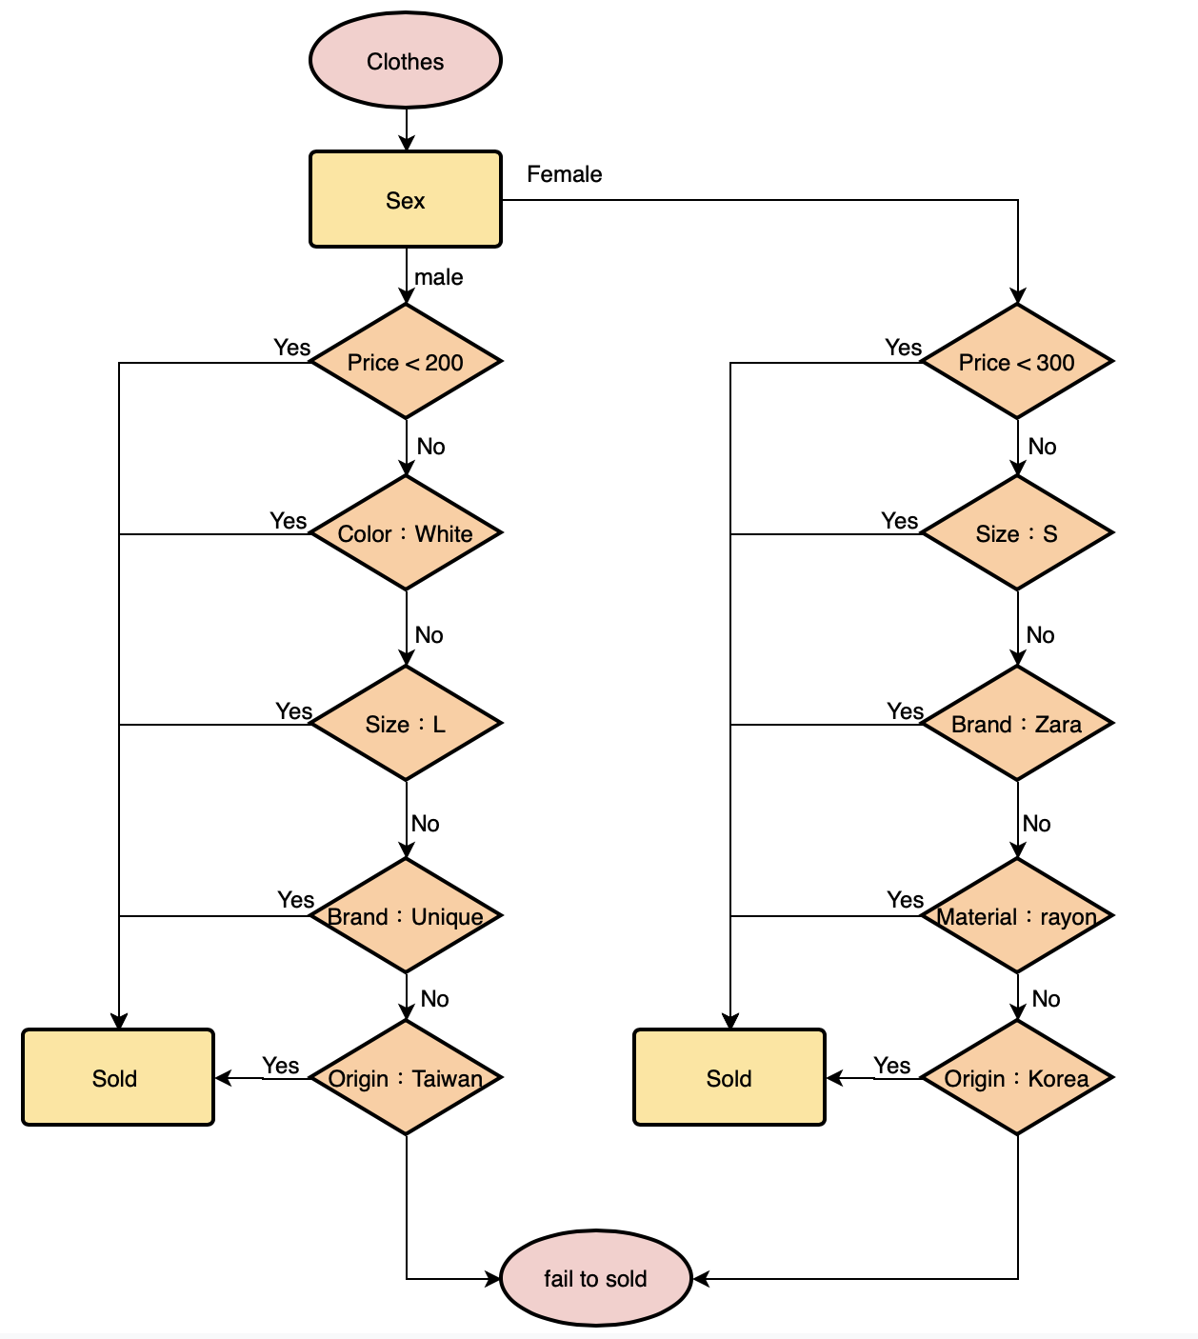
Targer Create Rule

Slide 5
Accuracy
Because of the rule is determinate by myself，and not generated Randomly.As a result,the train of the model is overfitting when the number of data. We can see that the train data accuray is always 1 ,but the accuray is decreasing.So the result of the dataset need to add some random condition into it.
method\num of data | 1,000 | 10,000 | 100,000
ave. train_acc | 1 | 1 | 1
ave.valid_acc | 0.6909 | 0.9376 | 0.9830
accuracy | 0.7310 | 0.7261 | 0.7193

Slide 6
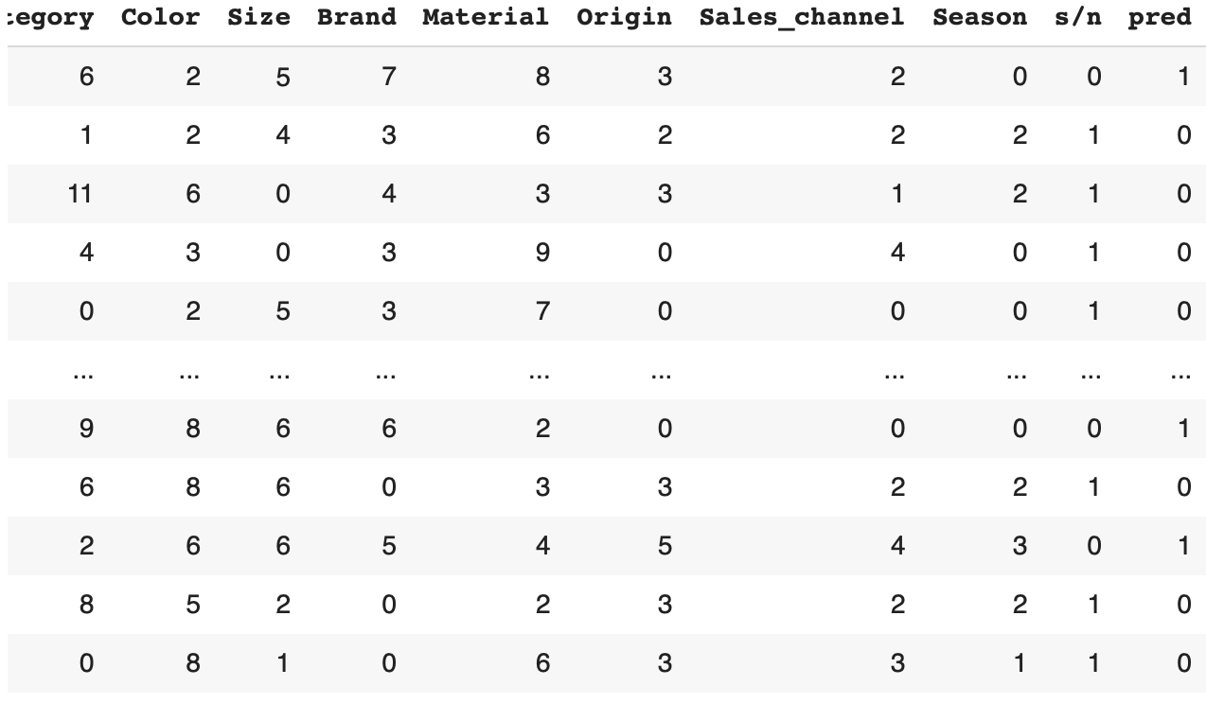
Compare
These data is the predict error case of result. We can see that the pred for 0 is more than 1 ,0 means fail and 1 means sold.The result of it is that the fail case is not in the rule I created ,so that it is not easy to predict fail,but easy to predict sold.

Slide 7
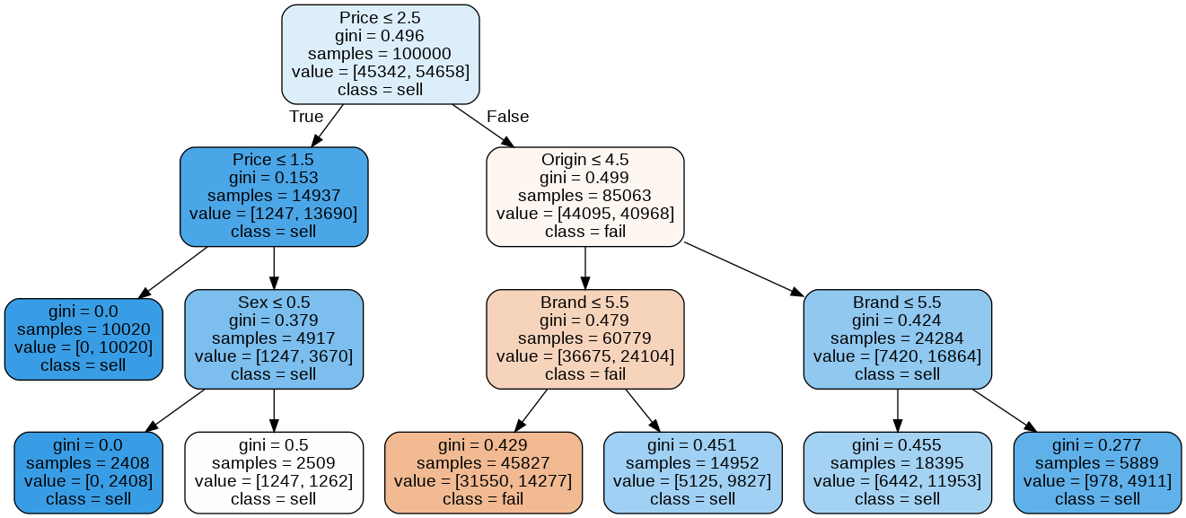
Result Analysis
This graph is for 100000 data . The result of the accuracy is not good is because the rule of the dataset is not real suitation.The dataset is create by myself , so if I can use the data by the real world ,the mode might perform better than now.

Slide 8
Conclusion
After this project , I learn many thing about decision tree and scikit-learn.The dataset is create by myself ,so that the perform is not ideal.Next time I will try to get some dataset from Internet to train the model ,to see that it is better or not . Thanks for professor and every teaching assistants to bring the chance to implememt this project.

Slide 9
Dataset
Dataset
Hw2_colab網址

