Slide 1
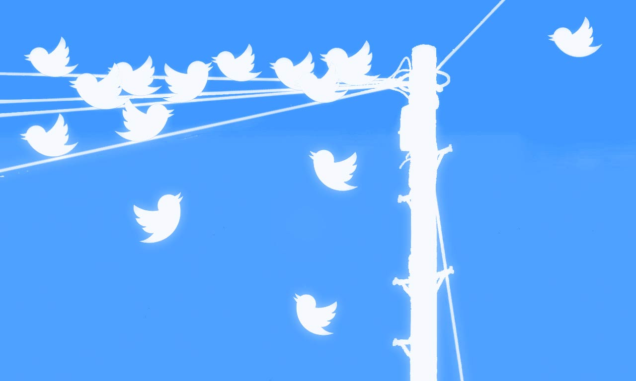
Exploring the Associations Between Sleep Disorders and Stress Using Social Media Analysis
Willis Cheung, Julian Mulia, Justin Woods

Slide 2
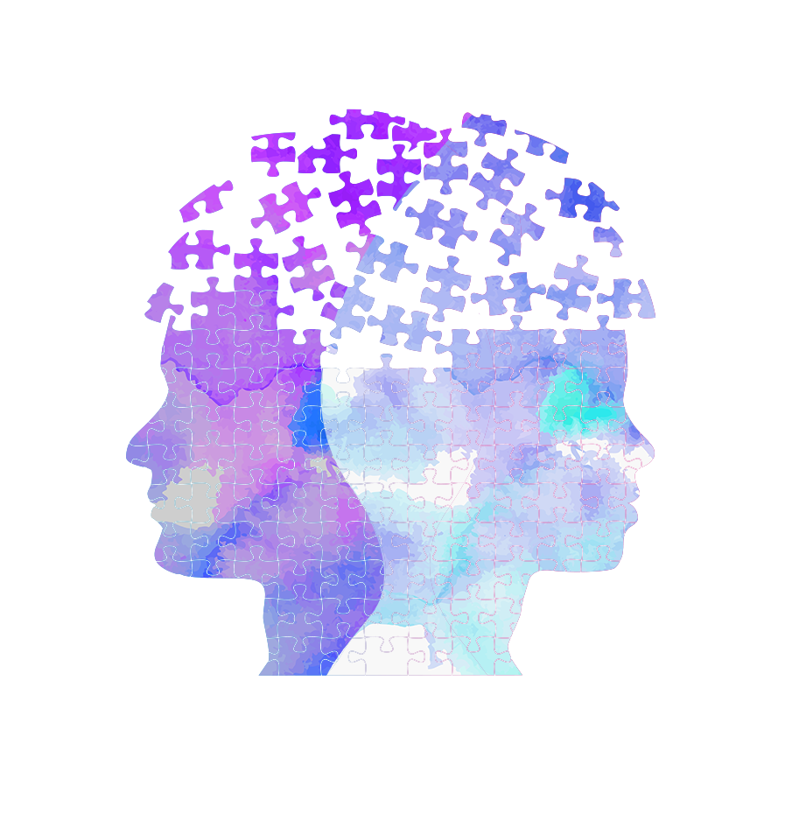
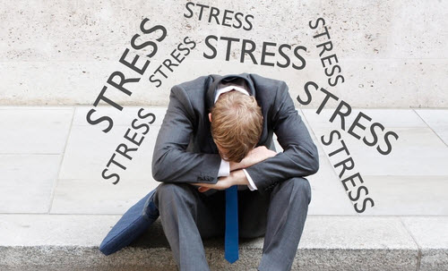
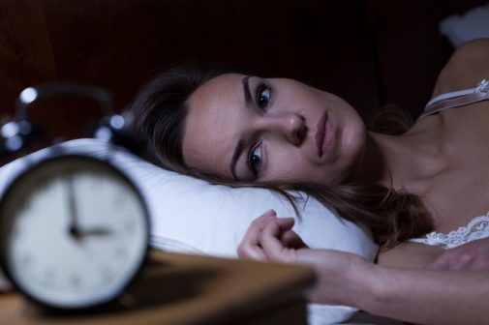
50%
Stress patients
also suffer from
sleep disorders
35%
Sleeping
disorders
25%
Excessive stress

Slide 3
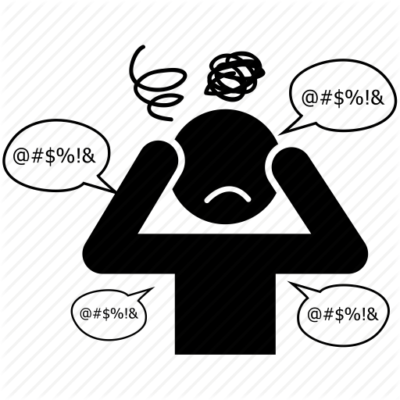
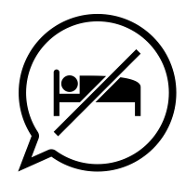
Why?
Solution
Stressed?
Can’t Sleep?
Both?
Currently, stress and sleep disorders are treated under different pharmacotherapies. However, clinically emerging concepts highlight the need to treat patients with both co-existing symptoms differently than patients with individual symptoms

Slide 4
Research
Questions
Solution
RQ1 - Is it feasible to use Twitter data to explore the association between sleep disorders and stress in Canada?
Aims to show that the association between sleep disorders and stress holds true in larger population samples and has potential to be studied through social media. If conclusions from social media are in line with those from the clinical studies, it will strengthen the position of using treatments that consider when both conditions occur simultaneously.
RQ2 - What are the main trends in our Twitter data related to sleep disorder, stress and their association in Canada?
Aims to identify trends for sleep disorders and stress in Canada. By identifying an estimate on potential patients suffering from these disorders, governing bodies could use social media to quickly identify sleep and stress trends and allocate resources or programs to meet the needs of the Canadian population.

Slide 5
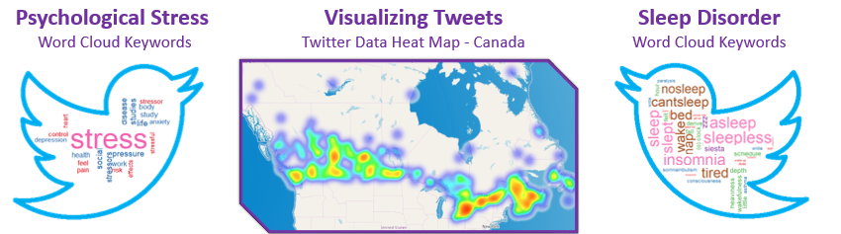


Data Set
Solution
Sleep Heat Map
Data Collection
Twitter Data Heat Map - Canada
Collected using Twitter Streaming API
Total of 50 million tweets
400 GB
Collected over a 3-month period (Nov 24, 2018 to Jan 24, 2019)

Slide 6

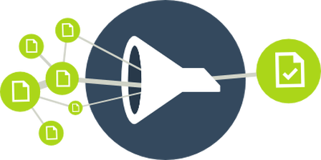
Spark
Data Cleaning
Extraction/Filtering
Solution
1
5
Loaded raw JSON files into Spark SQL context a Data Frame for manipulation
New fields created/calculated: Extracted the province, cleaned and saved the raw cleaned Tweet text and the cleaned tweet text, corrected the tweet’s time to the user’s localized time, calculated the user’s account life
2
Selected desired columns to keep of the tweet object. For example: Text, Created_at, User.id, User.followers_count, etc..
5
3
Filtered Tweets who had sleep/stress key-words
Applied initial filtering: Selected tweets of Canadian origin, selected English tweets, selected original (non-retweeted tweets)
7
Implemented Spam bi-gram, tri-gram filtering
4
8
Applied Spark transformations with user-defined functions where required to create new data fields
Selected the desired columns to export to CSV for labeling
Spark was used in the data cleaning / extraction / filtering sections of the project. The raw data containing line separated JSON objects was processed, filtered, and transformed into easy to label clean objects using Spark.

Slide 7
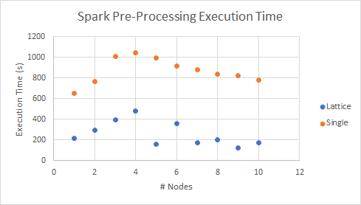
Spark
Solution
Spark vs Local Machine
Using different Spark nodes
Twitter Data Heat Map - Canada
Twitter Data Heat Map - Canada
Spark
Processing 50 million tweets following the steps above using Spark was 1 hour
The process resulted in a Spark data frame with 100,000 extracted tweets
Local Machine
In comparison the same process took 10 hours
in a regular personal computer.
A 10x faster speed was expected using Spark and was obtained in our analysis

Slide 8
Data
Labelling
Solution
Data Labelling
(P) Psychological Stress: “My depression and anxiety do not define me!”
(Z) Sleep Disorder: “Gotta be up for a flight in 6hrs and can't fall asleep"
(B) Both: “I am up at 10pm feeling depressed and waiting for a capsule to kick in”
(U) Unclear: “haha I’m depressed now lol”
(N) Neither: “We're hiring in Victoria BC Canada! Click the link in our bio to apply to this job and more”
2000 tweets were labelled with the possibility 98,000 tweets remaining to be labelled. All members participated in the labelling

Slide 9
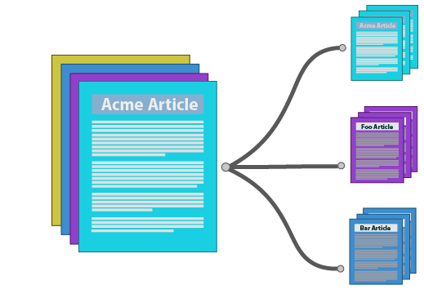
Analysis
Solution
Data Analysis
Supervised
Unsupervised
Logistic Regression (K-fold validated)
Binary Naïve Bayes (Unigram)
LDA (Latent Dirichlet Allocation)
BTM (Bi-term Topic Model)
Both supervised and unsupervised analysis returned related results

Slide 10
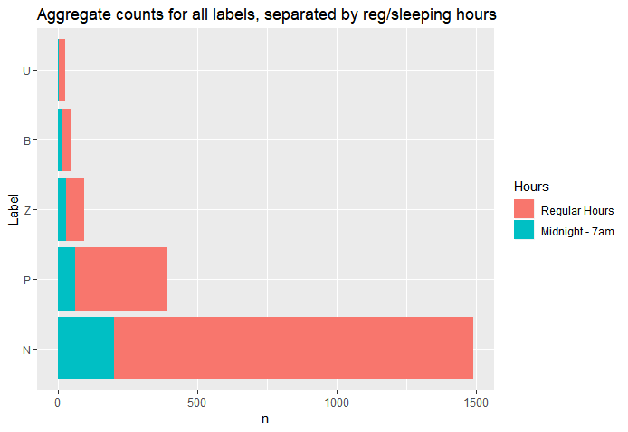
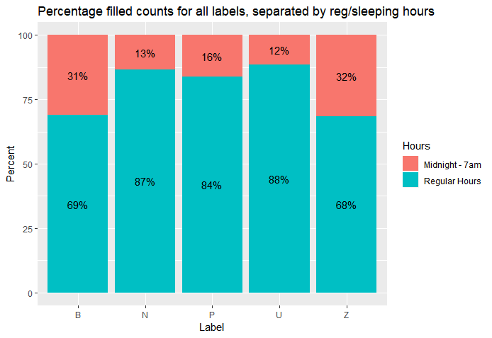
Visualizations
Aggregate counts for all labels, separated by regular sleeping hours
Percentage filled counts for all labels, separated by regular sleeping hours

Slide 11
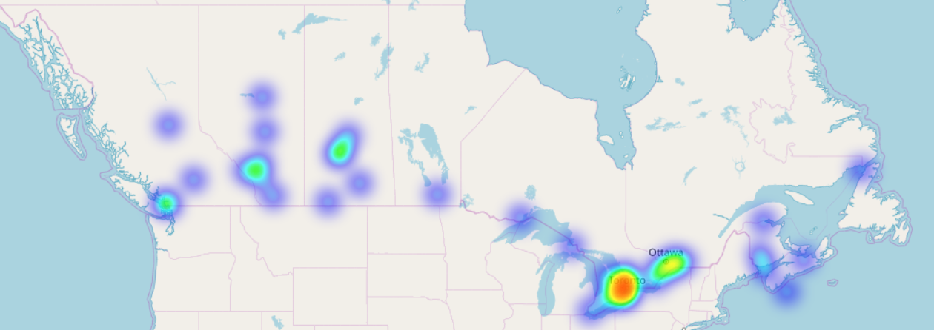
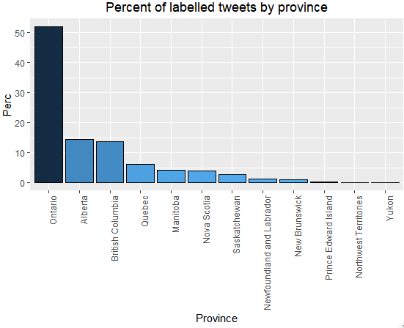
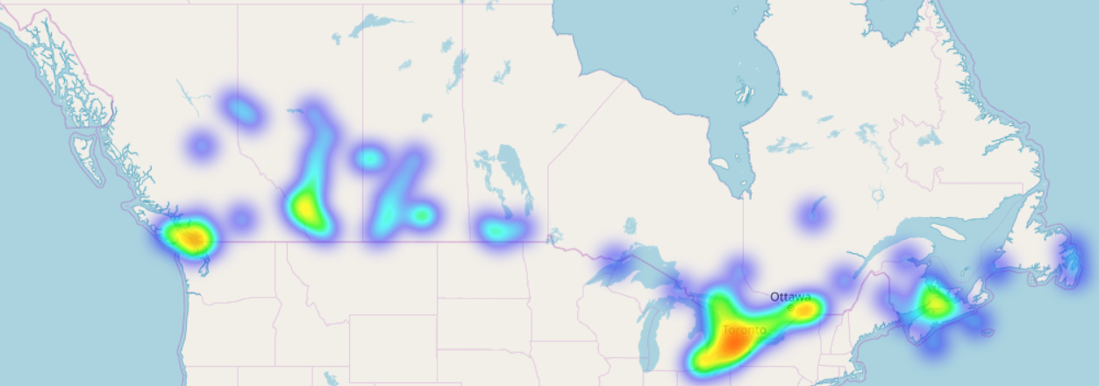
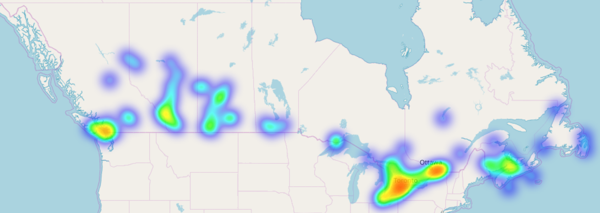
Stress Heat Map
Visualizations
Sleep percentage counts per province
Sleep Heat Map
Both Heat Map

Slide 12
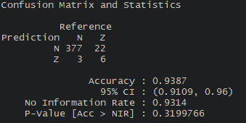
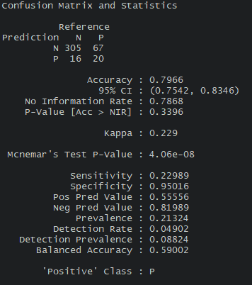
Supervised
Solution
BNB Sleep
BNB Stress
LR Sleep
LR Stress
Statistic | Binary Naïve Bayes |  | Logistic Regression
 | Sleep | Stress | Sleep | Stress
Precision | 0.67 | 0.56 | 0.67 | 0.46
Recall | 0.21 | 0.23 | 0.11 | 0.11
F-Score | 0.32 | 0.33 | 0.18 | 0.18
Neither the LR or BNB were able to predict Both sleep and stress simultaneously.
Binary Naïve Bayes had an overall better performance predicting sleep and Stress independently.

Slide 13
Supervised
Solution
Logistic Regression Correlations
 | Higher Odds | Lower Odds
Stress | Wednesday, Thursdays and Sundays Higher odds of being stressed | A higher sentiment score had lower odds of the tweet indicating stress
 | The Manitoba, New Brunswick, Ontario and Quebec higher odds of being stressed | Posting between [12pm-1pm] had lower odds of indicating stress
Sleep | Manitoba users had higher odds of indicating sleep disorders | *Users with higher friends’ count had lower odds of indicating sleep disorders
 | *Posting between [1-4am], [5-7am] had higher odds of indicating a sleep disorder
* Reflected in existing literature

Slide 14
Un-
Supervised
Solution
LDA Topics
 | Topic 1 | Topic 2 | Topic 3 | Topic 4 | Topic 5
1 | Life | Heart | Cold | Shit | School
2 | Time | Coffee | Day | Fuck | Rest
3 | Job | Mental | Today | Fucking | New
4 | Years | Love | Hours | Hate | High
5 | Ago | Health | Late | People | Year
About → | Work/Life | Positive Sentiment | Weather | Stress Sentiment | School
BTM Topics
 | Topic 1 | Topic 2 | Topic 3 | Topic 4 | Topic 5
1 | Life | Cold | Emoji_red_heart | Emoji_Pizza | Mental
2 | Time | Coffee | School | Wind | Health
3 | School | Emoji_snowflake | Avenue | Pressure | Stigma
4 | Cold | Emoji_heavy_minus | Alarm | Rain | Fighting
5 | Shit | snow | Institution | Forecast | Alcohol Awareness
About → | Complaints on school/life | Complaints on weather/cold | Unknown | Weather forecast | Support Talks
Notes:
Both the LDA topics and BTM topics found a topic classification similar to what we were looking for in the supervised portion of the study. LDA topics 3 and 4 and BTM topics 1 and 2 in correlate with keywords associated to sleep/stress disorders. LDA and BTM topics also identified keywords of spam topics that repeatedly appeared in our supervised analysis. For example, tweets supporting mental health (but the tweet had no stress/sleep disorder) correlate to BTM topic 5 and job postings correlate to LDA topic 1. Both LDA and BTM topics had similar topics and related to our supervised keyword analysis in stress and sleep disorders.

Slide 15
Conclusions
Solution
The models developed were not able to effectively show an association between sleep and stress disorders in Canada using Twitter data with the current 2000 labelled points. Further work refining filtering and labelling of the remaining 98000 data points is required to further develop and improve the models.
1
2
The sleep models found similar findings in existing literature affecting sleep, such as: numbers of friends, sentiment of tweet and time of day.
3
The stress model showcased the following factors affecting stress, such as: day of week, province, time of day and tweet sentiments. They all had a significant effect identifying tweets with stress.

Slide 16

Questions
?

