Slide 1

Staffing a security program
Group Name: Tuesdays @ 4:20
Members: Seth Denny, Mark Feder, Joshua Gomez, Andrew Tran, Shane McCarthy, Jacob Willis

Slide 2
Organization Size
A "smaller organization" is 100 systems or fewer to manage
Many small organizations struggle to attract cybersecurity professionals because they lack the resources of large companies
Given the lack of cybersecurity professionals, many organizations must transform IT workers into cybersecurity professionals

Slide 3
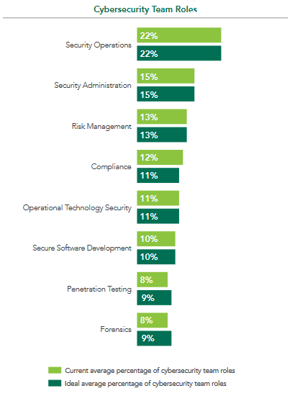
Titles and Roles
Roles at smaller organizations tend to be more general
Larger organizations need specialists to meet specific requirements
Specific roles and titles for a small org might be:
Manager
Security operations – Security Engineer
Security administration – Security Administrator

Slide 4
Groups and Departments
DevSecOps – combination of development, security, and operations; used to prevent system of "handoffs" so that all aspects of the secure development lifecycle are handled by the same team
IT – information technology teams need to be separate from security teams to avoid conflicts of interest, but will still work closely
Day-to-day – security needs to be a part of normal business operations, especially at small organizations
71% of cyber-attacks are perpetrated against small businesses

