Slide 1

CMMCv2.0
Tuesdays @ 4:20
Seth Denny, Mark Feder, Josh Gomez, Shane McCarthy, Andrew Tran, Jacob Willis

Slide 2
Recap
CMMC = Cybersecurity Maturity Model Certification
Created by DoD to solve leakage of CUI
CUI = controlled unclassified information; CTI, CDI
FCI = federal contract information
DFARS = defense federal acquisition regulation supplement
C3PAO = CMMC third-party assessment organization
POAM = plan of action and milestones

Slide 3
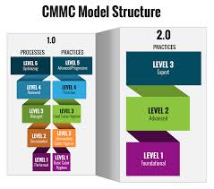
Changes to the CMMC
Changes to the number of levels
Removal of CMMC-specific requirements
Reduction in quantity of third-party assessments
Changes to timeline
POAMs allowed

Slide 4
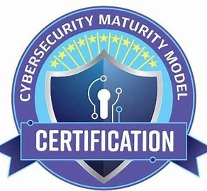
CMMC Level 1
Used for FCI
Basic self-attestation
No baseline other than system security plan (SSP)

Slide 5
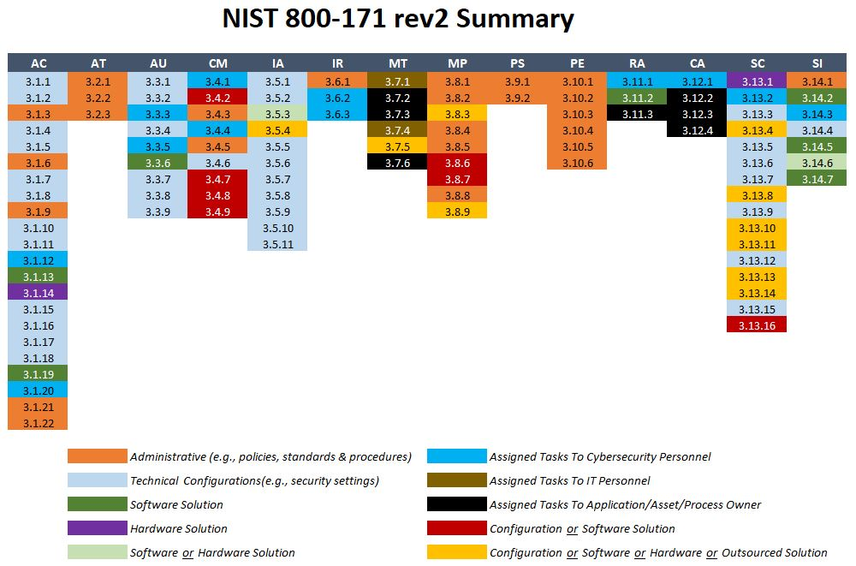
CMMC Level 2
Layered on Level 1
Near perfect score
NIST SP 800-171
Originally level 3
Used for protection of CUI

Slide 6
CMMC Level 3
Layered on Level 2
Perfect 800-171 score
Adds protections from 800-172
Originally Level 4-5
Used for protection of classified materials
Only relates to cyber protections
Organizations handling classified materials have other regulations – FCL, NISPOM

Slide 7
NIST SP 800-171
14 "families"
Access Control, Awareness and Training, Audit and Accountability, Configuration Management, Identification and Authentication, Incident Response, Maintenance, Media Protection, Personnel Security, Physical Protection, Risk Assessment, Security Assessment, System and Communications Protection, System and Information Integrity
110 controls
Based on 800-53 – protecting CUI in federal systems
Assessment version is 171a – created by DoD
Scored –203 to 110

Slide 8
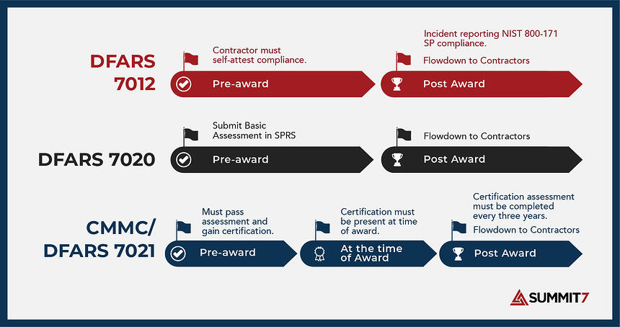
DFARS 70 Series
DFARS 252.204-7012 – original protections
7019 – interim rule for self-attestation
7020 – basically 7019
7021 - CMMC

Slide 9

IT-AAC and GAO
IT-AAC = Information Technology Acquisition Advisory Council
Generated insights on CMMC
GAO = Government Accountability Office
Created report w/recommendations for CMMC final rule
CMMC-COE = center for excellence
Proof that there is more to come from CMMC

