Slide 1
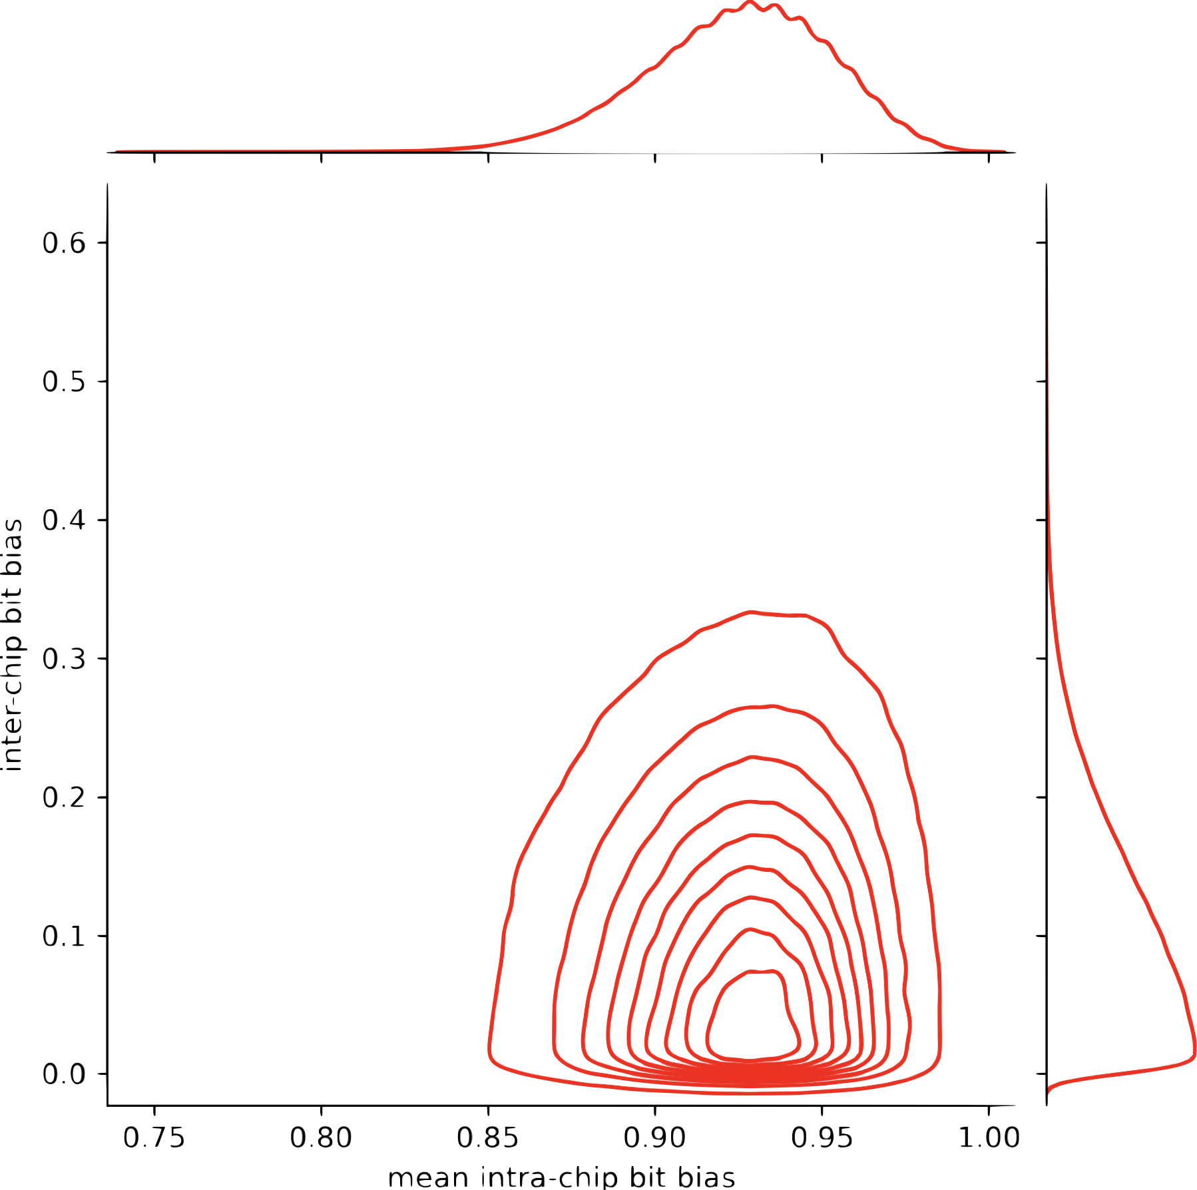
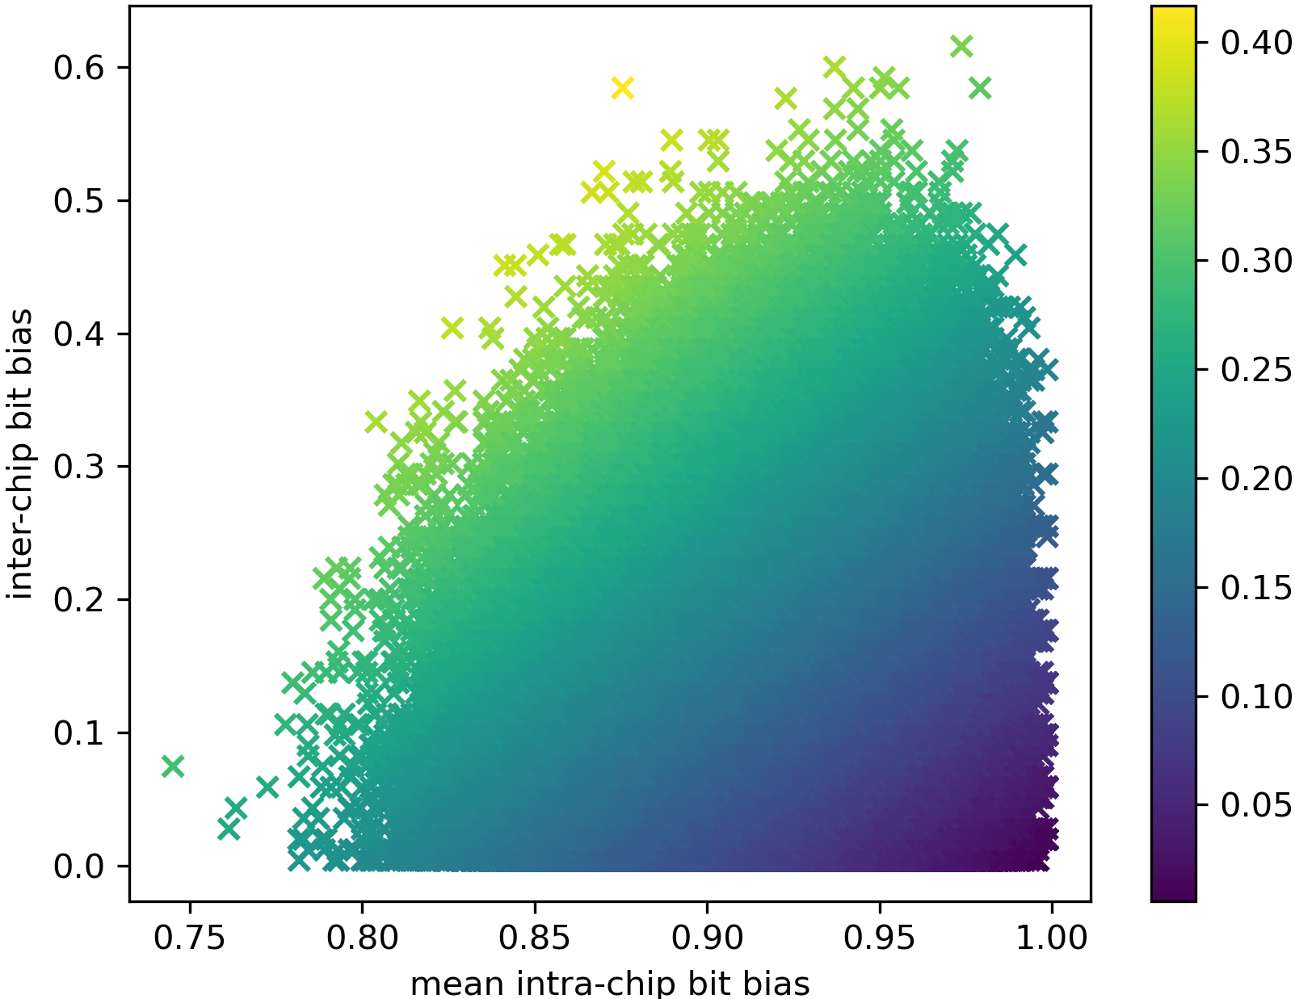


kde
inter-chip bit bias, $Binter(x)$
Chip Usefulness, $U(x)$
mean intra-chip bit bias, $Bintra(x)$

Slide 2
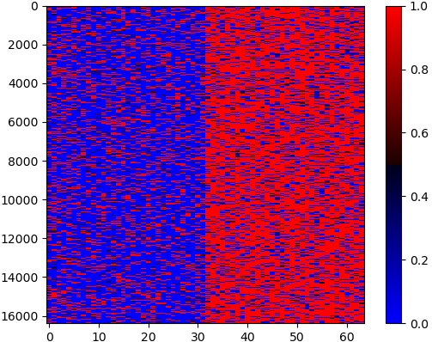

Expected bit value, $E(x)$

