Slide 2
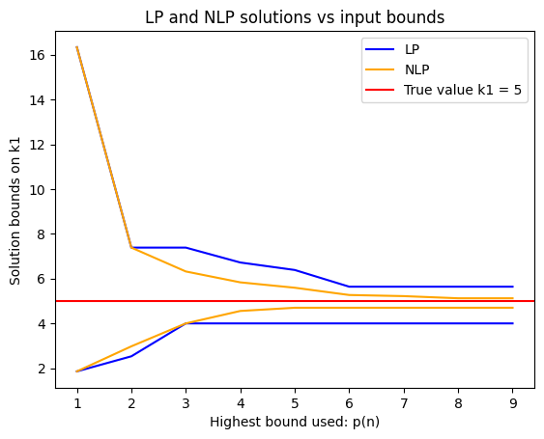

Slide 3
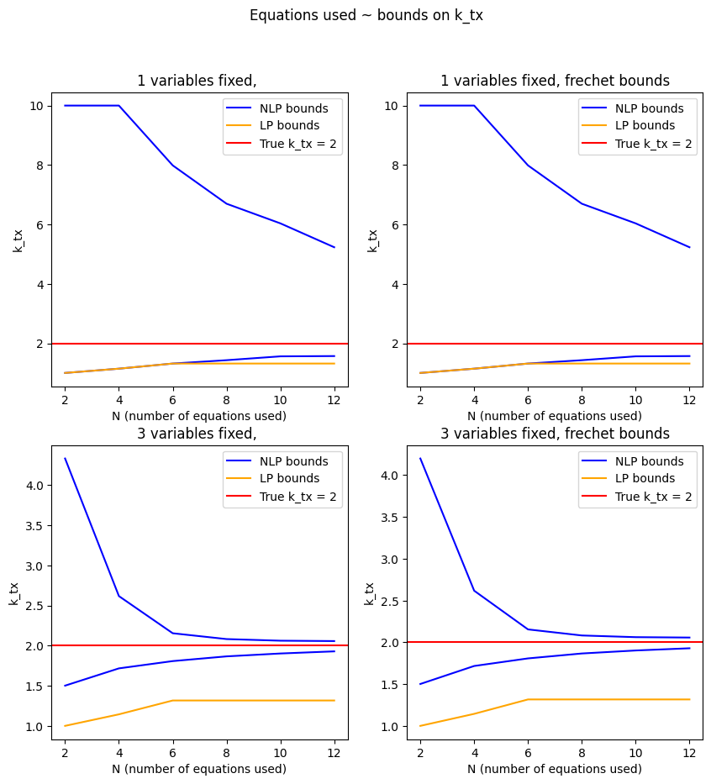
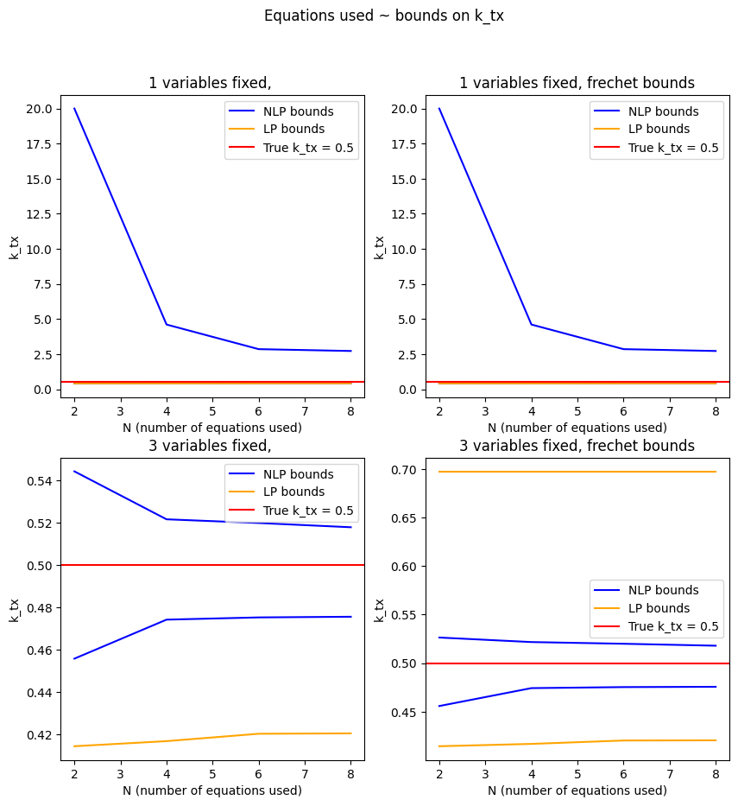

Slide 4
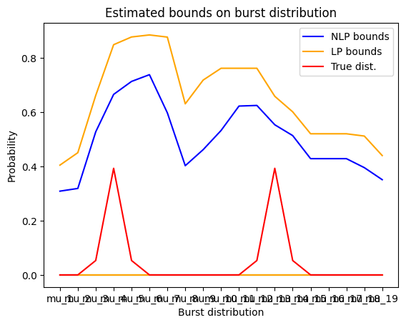
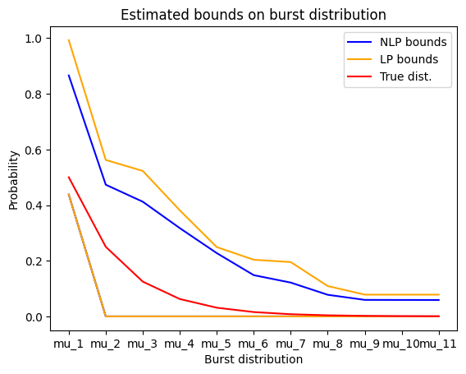
Notes:
Show variation with sample size e.g. plot a larger sample on top

Slide 5
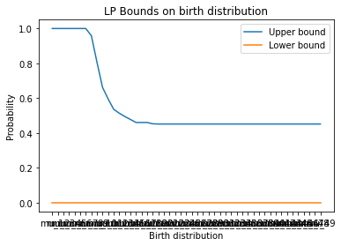
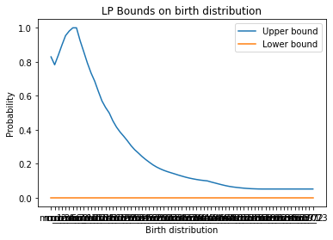

Slide 6
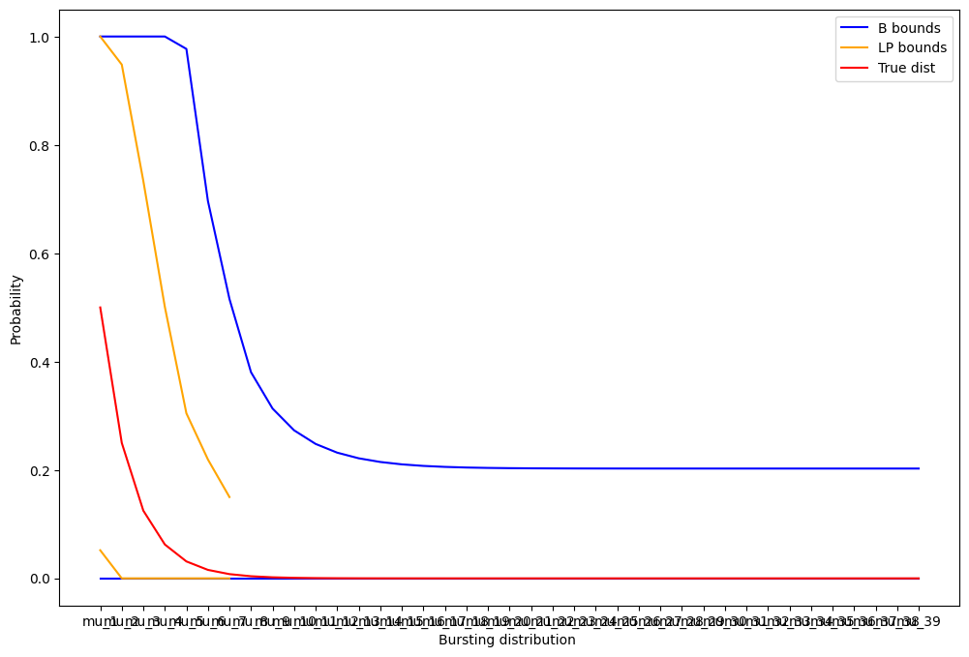
Notes:
Categories: look for a peaked category
compare different methods, statistics of dataset, discuss genes
Sanky “flow-like” plots to show the categories of different genes
Find raw data of genes from website, run all analyses

