Slide 1
Sprint Cycle - 1
Aida Mumin, Muhammad Ali Raza, Samual Meludu, William Jones, Jabari Mitchell

Slide 2
Status Of Tasks In Current Sprint Cycle
Tasks:
Determine what languages we can use for the website (Status: Finished)
William, Aida, Samuel, Muhammed, Jabari
Determine the design of the website - which may includes a logo (Status: In-Progress)
Aida, Samuel
Determine the design of the chatbox (Status: Finished)
Jabari, Muhammad
Design the instructions of the chatbox to be simple and easy to read (Status: In-Progress)
Aida, Muhammad

Slide 3
Missing Tasks?
We don’t have any missing tasks currently.

Slide 4
Task 1: Determine what languages we can use for the website
As a team, we decided to use a combination of Python, HTML, CSS, and Javascript
These languages are languages that everyone is familiar with at some level, and we have to implement a complicated algorithm.

Slide 5
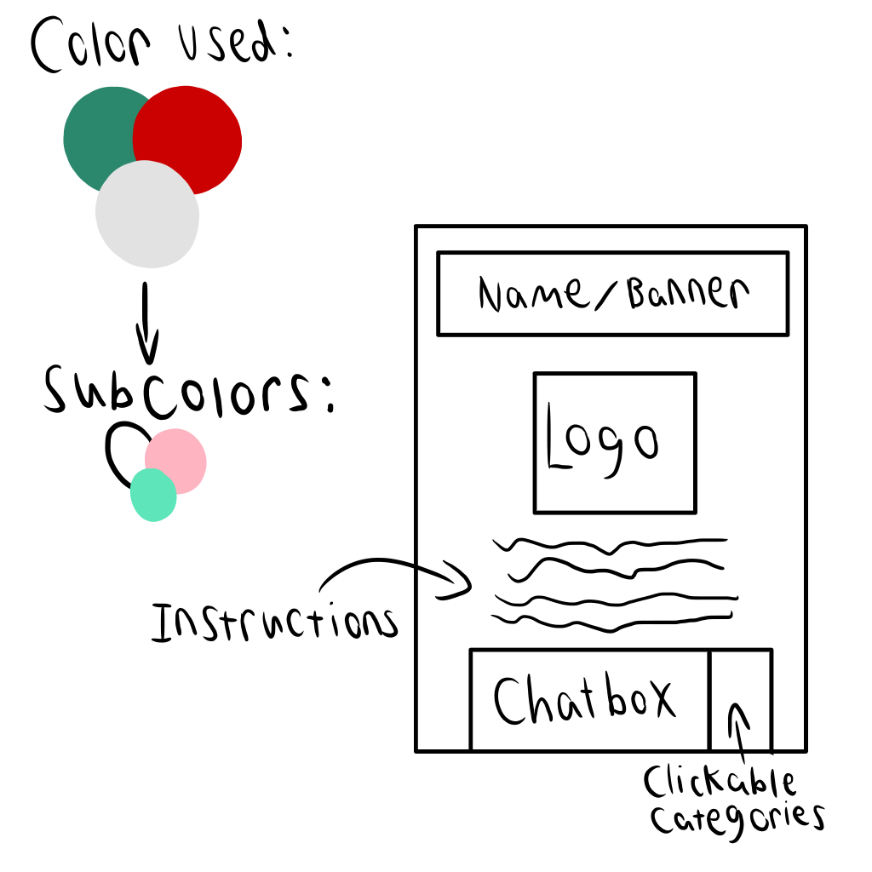
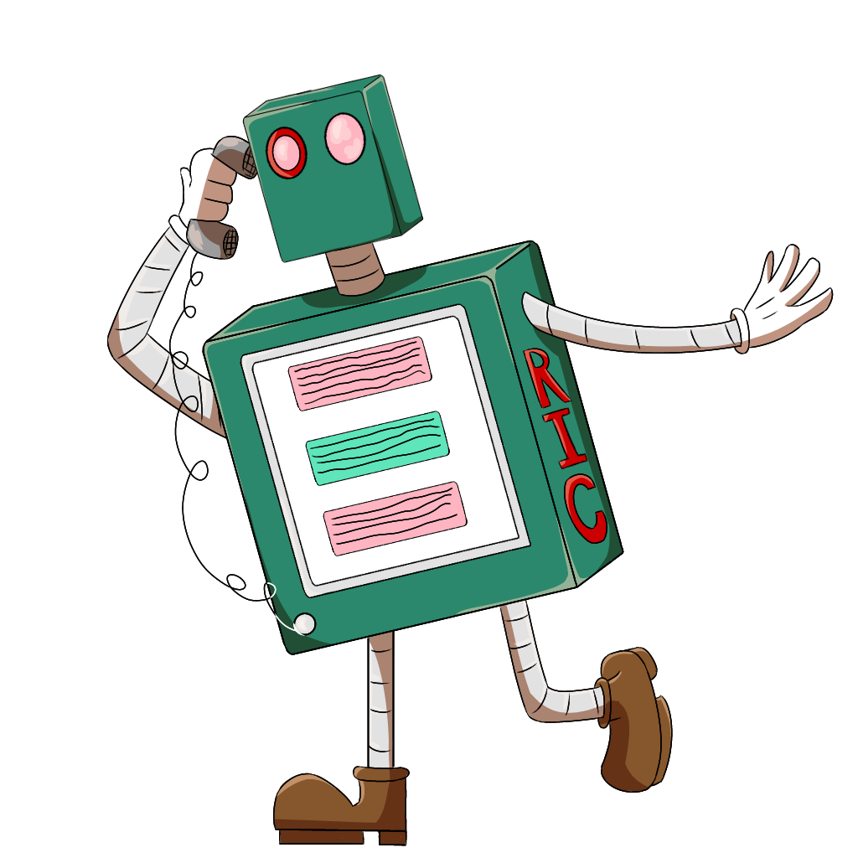
Task 2:Determine the design of the website - which may includes a logo
While it stated that this is in-progress, this task is almost done as Aida and Samual have created a logo and a rough design of the website.
While it is at its finishing stage, it still needs more time for smooth out any rough parts of the designs.

Slide 6
Task 3: Determine the design of the chatbox
Created the layout of the web page using content creation tools.
While creating the layout for the web page, the main purpose was to keep it simple and user friendly with to the point information.
The web page included name header on top, logo and instructions.
At the bottom was the option to select categories.
The user will click on the drop down menu, and select the category.
After the selection is made a new input text button will pop up below the category button, which can take the input from the user and run the algorithm.
At the end the results will be shown according to the algorithm.

Slide 7
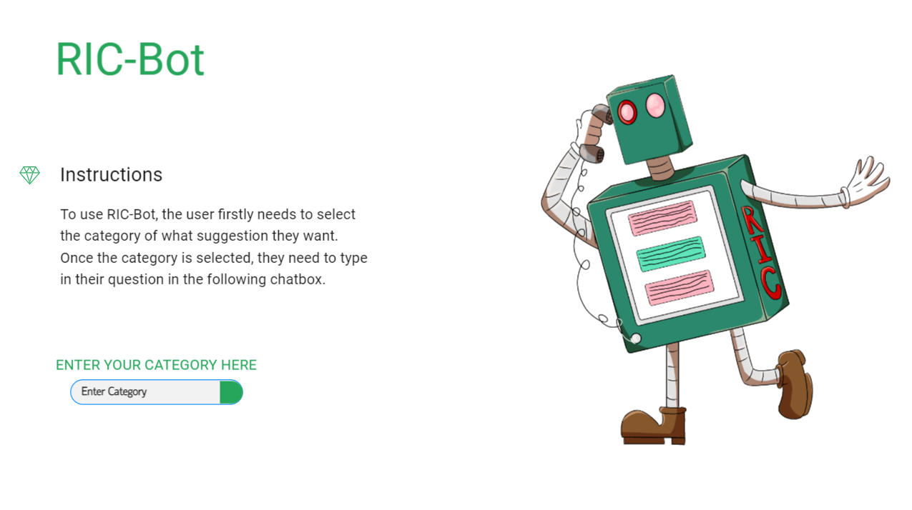
Task 3: Determine the design of the chatbox

Slide 8
Task 4:Design the instructions of the chatbox to be simple and easy to read
Current Version:
“The RIC-Bot is an algorithm where the user can type in the questions and receive a suggestion back
To use RIC-Bot, the user firstly needs to select the category of what suggestion they want. Once the category is selected, they need to type in their question in the following chatbox.
It should be noted that the question must have proper grammar and proper spelling in order for the algorithm to work properly with no usage of slang or profanity. The question must be direct and short to get the best results.”

Slide 9
Issues
One main issue that we had during the sprint cycle is that many of members - including the project manager - didn’t have time to put in the effort required for the cycle.
Many of the members have jobs and personal life that they must attend to first, which lead to the lack of progress for this cycles.
Due to the large work of week 2, we decided to complete the task of determining a web host to alleviate stress.
In the future, hopefully, the team members can push each other in order to work toward the goal.

