Slide 1
Sprint Cycle 3
William Jones, Aida Ali Mumin, Muhammed Ali Raza, Jabari Micah Mitchell, Samuel Meludu

Slide 2
Status Of Tasks In Last Sprint Cycle
Determine where the chatbox is going to be hosted (Status: Finished)
William, Samuel
Design how to categorize the topic for the chatbox (Status: Finished)
Aida, Muhammad
Determine how to extract information from the user with the chatbox (Status: Finished)
Jabari, Samuel
Design the algorithm used to get an user-desirable suggestion (Status: Finished)
William, Jabari

Slide 3
Status Of Tasks In Current Sprint Cycle
Determine how to make the website appealing (Status: In-Progress)
Aida, Samuel
Design an attractive website (Status: In-Progress)
Aida, Samuel, Muhammad

Slide 4
Task 1: Determine how to make the website appealing
Aida and Samuel was in charge of how to make the website appealing to the users, which mean having usability and attractiveness.
Samuel took the role of creating the attractiveness while Aida will be in charge of the usability.
The task is almost complete, but there’s attention that is need in some areas.

Slide 5
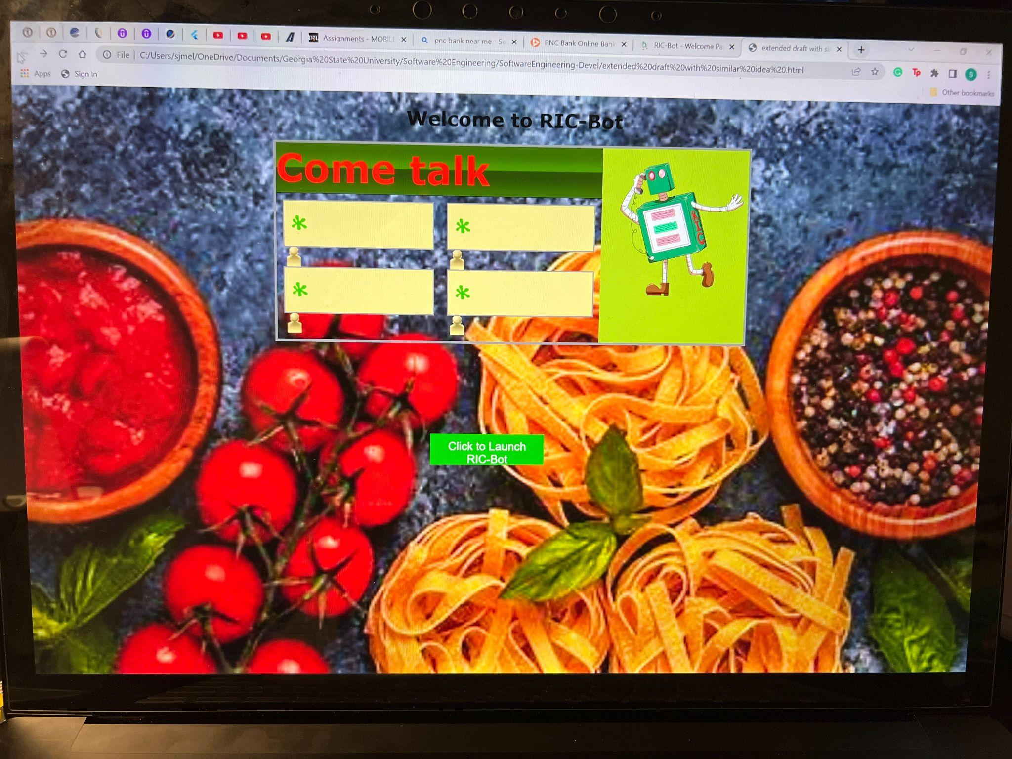
Task 2: Design an attractive website
Aida and Muhammad had made the base of the several HTML pages.
Samuel took the base of the HTML pages and add several elements that makes it appealing.
This task is almost done. It needs some touch-ups.

Slide 6
Issues
We have been disorganized and having being communicating properly as we should.
The team had obligations and personal issues that they must deal with first before this project so we have been behind.
The team is inexperienced with Flask and have problems with integrating python and HTML with the application.

Slide 7
Looking Ahead: Status of Sprint Cycle 4
Determine how to make sure the bot works on start up (Status: In Progress)
William, Muhammad
Design a launch button that initializes the bot to use (Status: In Progress)
William, Samuel
Add a support section that the customer can find (Status: Not Started)
Aida, Muhammad

