Slide 1
Automated Vessel Selection and Combat Load Planning
2024 INFORMS Annual Meeting
Invited Session: OR in Security & Defense I (Operations)
October 20, 2024
MAJ Will Kirschenman
Operations Research Ph.D. Student
Department of Industrial and Systems Engineering, North Carolina State University

Slide 2
Purpose: Discuss doctrinal methods of combat load planning, highlight historical examples that required detailed planning, and present the vision for an ongoing research effort to optimize combat load planning for future conflicts in contested environments.
Agenda:
Problem Motivation and Research Question.
Historical Examples.
Current Doctrine and Methods.
Proposed Problem Framework and Approach.
Current Modeling Efforts and Next Steps.
Potential Results and Conclusion.

Slide 3
Problem Motivation and Research Question
Motivation
Example
Doctrine
Framework and Approach
Modeling
Conclusion
Problem Context:
In large-scale combat operations, the task of maneuvering forces into and throughout a theater is a complex challenge that requires efficient integration of routing, scheduling, sequencing, and the loading of personnel and equipment.
Threat forces complicate things by actively hindering the friendly force flow plan.
Contested ports are the starting point for a landing force’s ground combat operations.
A landing force must be able to efficiently off-load into combat formations to quickly continue to the next military objective.
Important factors need to be addressed when considering off-loading a landing force in a contested environment.
How can we most efficiently combat load sea and air vessels to maximize the combat effectiveness of a large landing force upon off-loading?

Slide 4
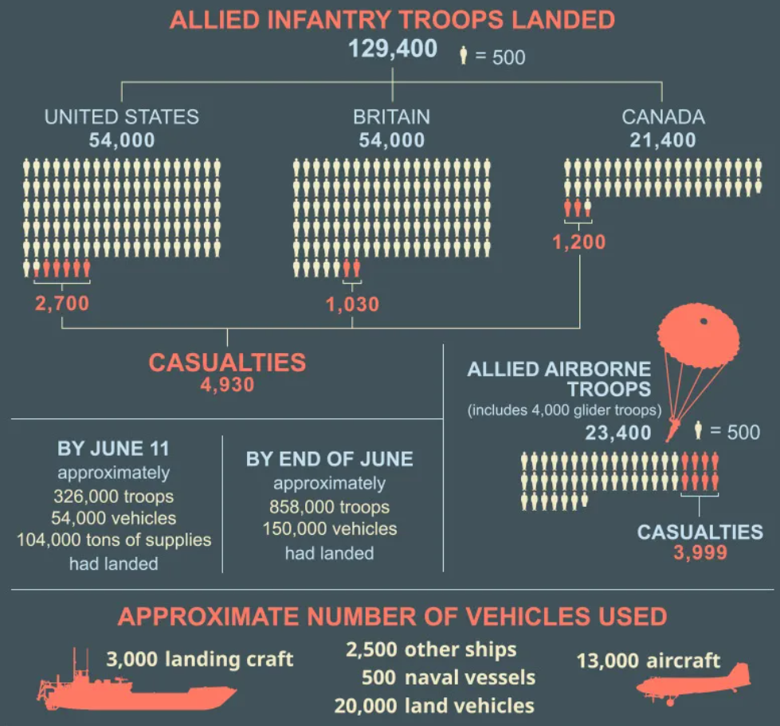
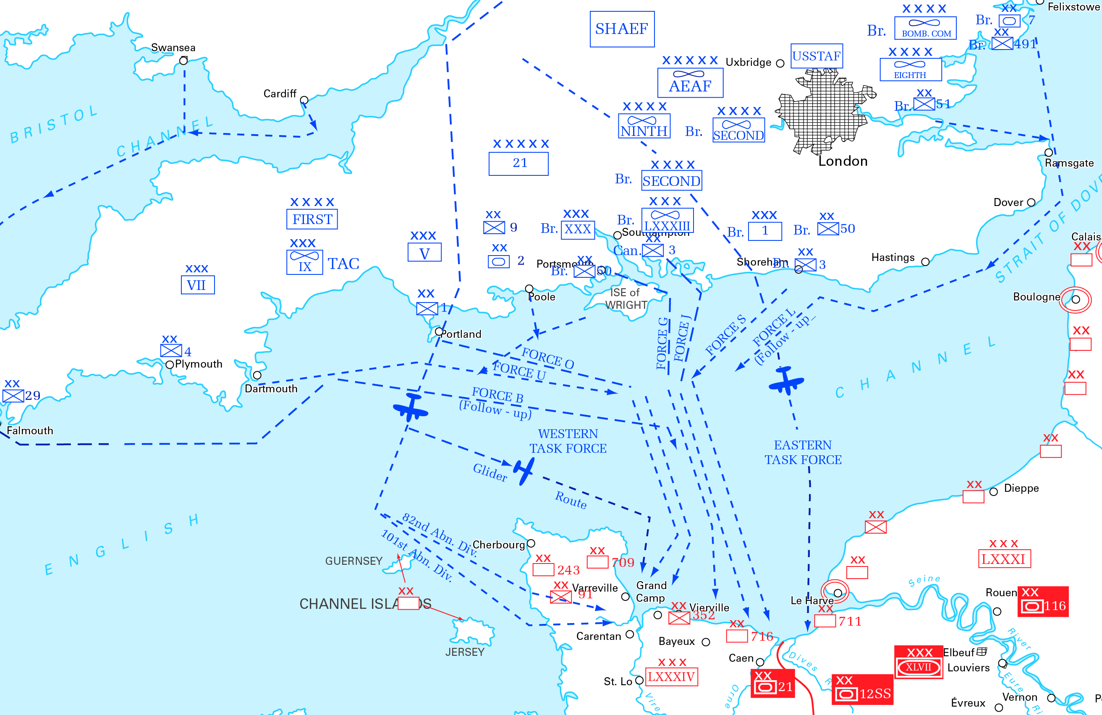
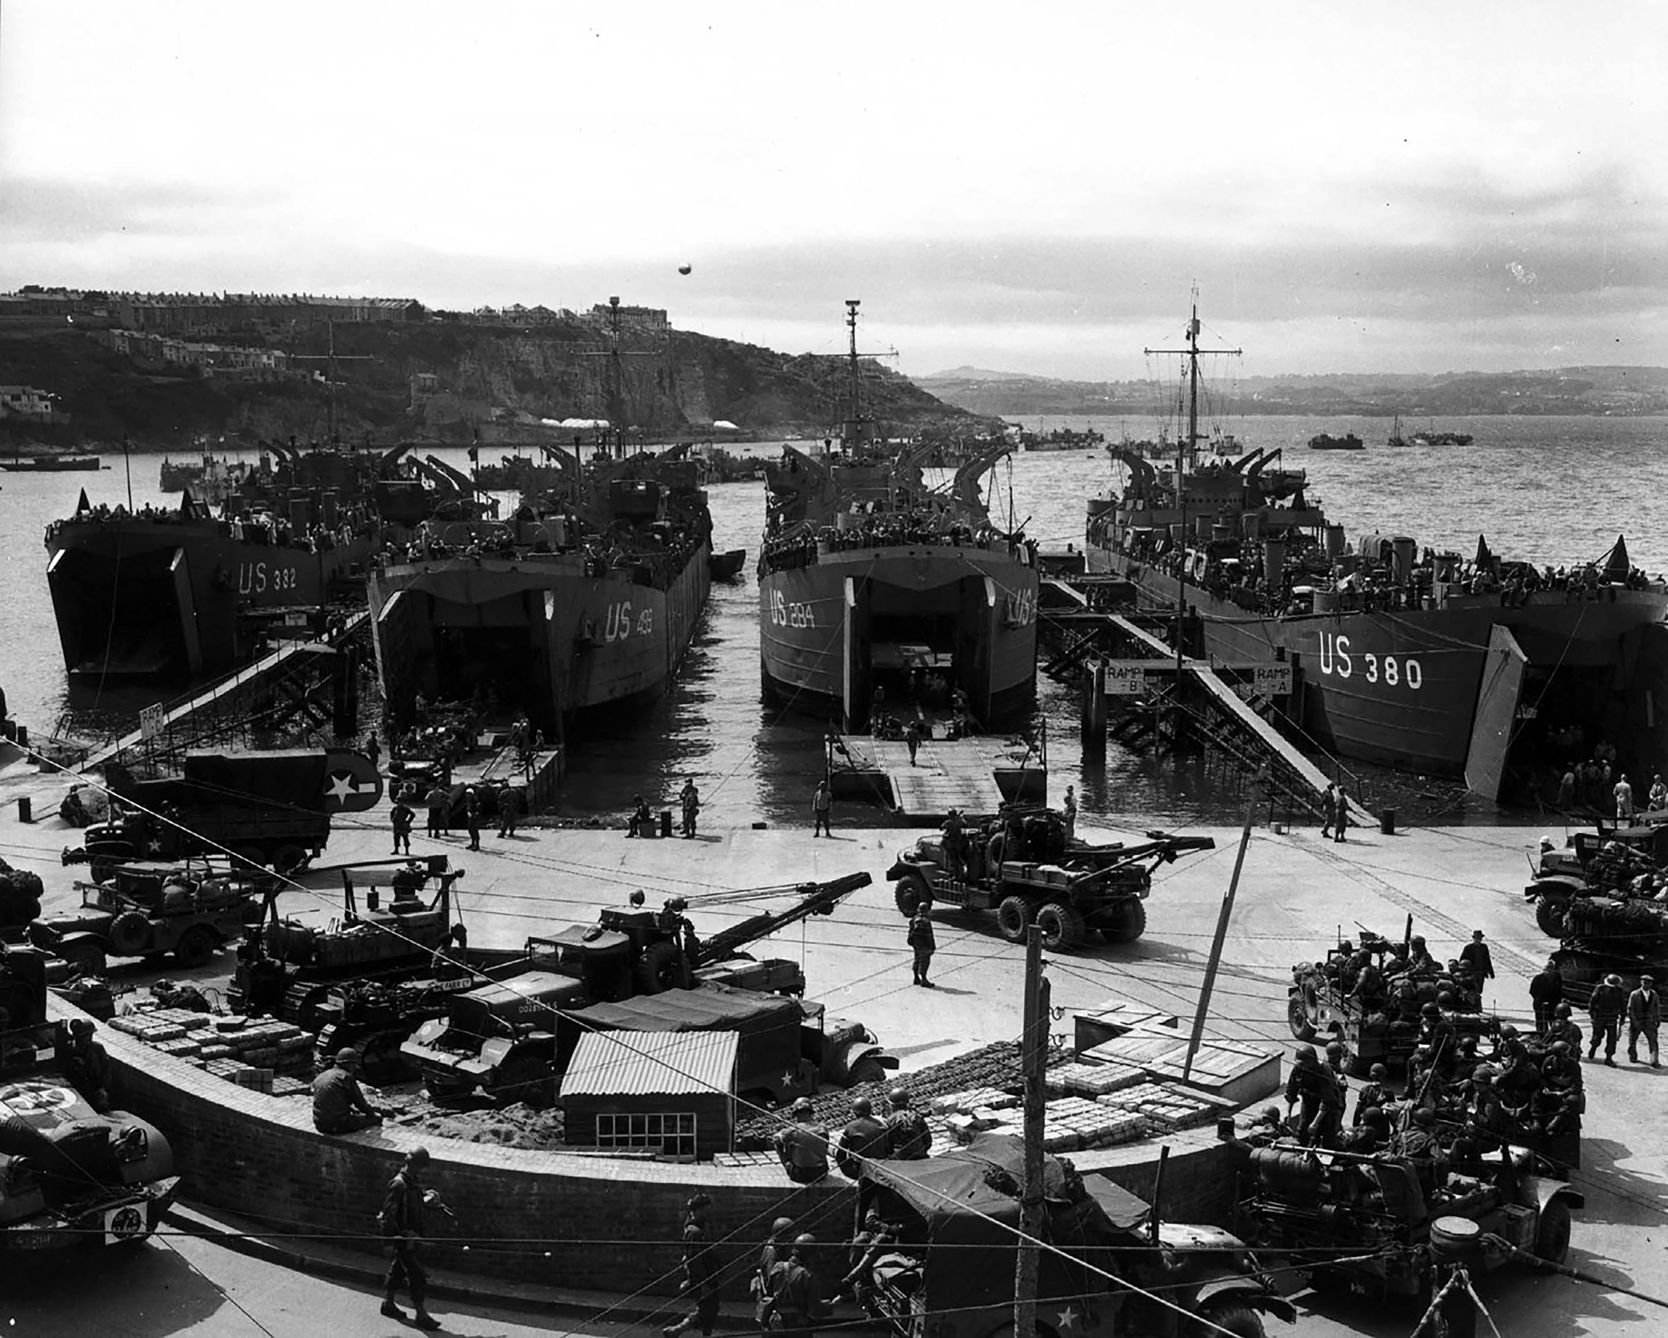
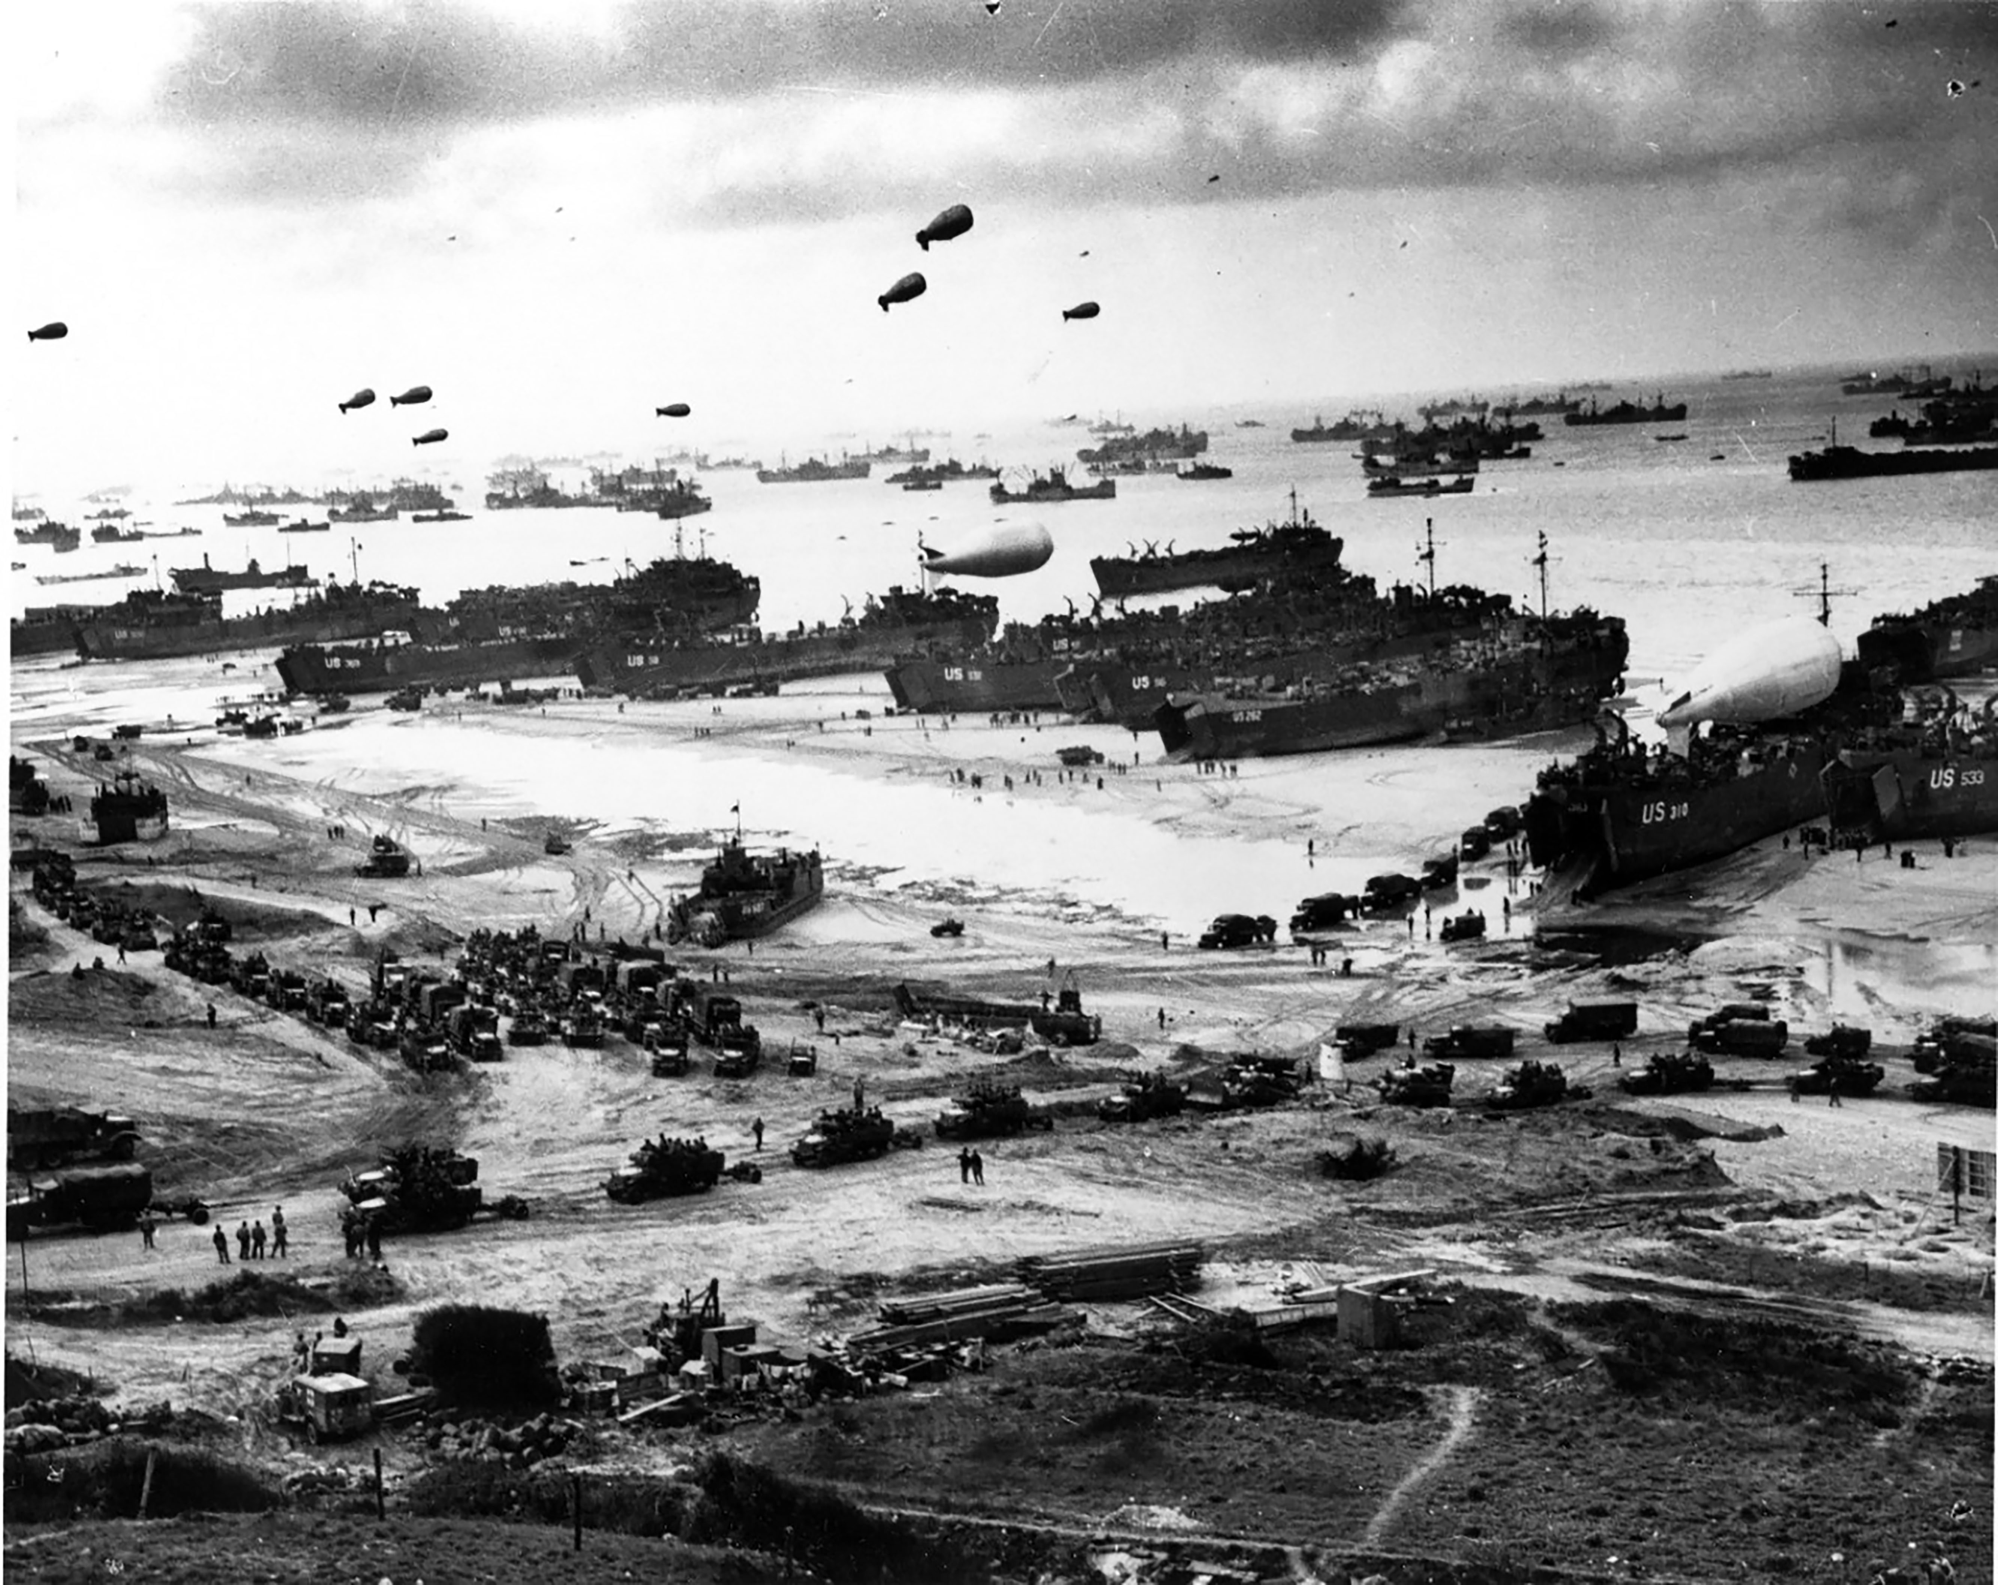
Motivation
Example
Doctrine
Framework and Approach
Modeling
Conclusion
Normandy Invasion: June 6, 1944
Initial detailed planning started in March 1943.
Combat loading commenced in April 1944.
Over 1,200 landing craft were loaded in 14 ports across southern England, each meticulously scheduled to avoid congestion on June 6, 1944.
Allied Invasion Force and German Dispositions, Northern France, 1944.
Other Examples
Incheon Landing.
Operation Cartwheel (Rabaul).
Operation Husky (Invasion of Sicily).
Operation Iceberg (Battle of Okinawa).
What if we need to do this again?
1ID Artillery Equipment Loading on LSTs at Brixham, England, on June 1, 1944.
Off-loading equipment on Omaha Beach in days following June 6, 1944.
Notes:
Graphics from: https://www.britannica.com/story/facts-and-statistics-about-the-normandy-invasion
Map from: https://s3.amazonaws.com/usma-media/inline-images/academics/academic_departments/history/WWII%20Europe%20Med/WWIIEurope54.jpg
Brixham pic: photo by U.S. Army Technician 5th Grade Bill Nehez
Omaha Beach pic: photo by USCG MoMMc3 Arthur DeLorenzo

Slide 5
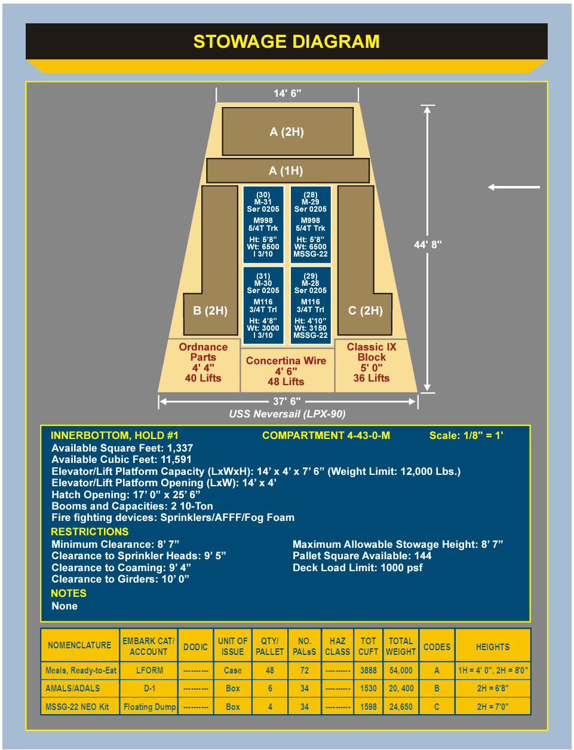
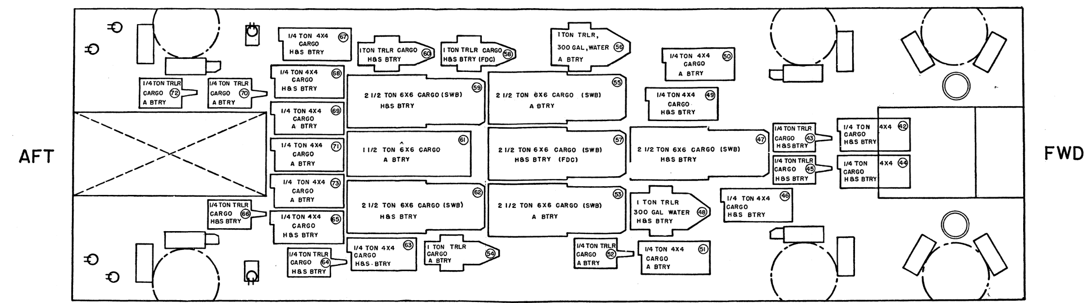
Motivation
Example
Doctrine
Framework and Approach
Modeling
Conclusion
Past and Present Doctrine
Current Doctrine (JP 3-02 Amphibious Operations)
Embarkation planning: involves all the measures necessary to ensure timely and effective loading and off-loading of the amphibious force.
Combat Loading: the arrangement of personnel and the stowage of equipment and supplies in a manner designed to conform to the anticipated tactical operation of the organization embarked.
Loading Plan: a detailed ship loading plan is prepared by the embarkation team for their designated ship. This load plan must be approved by the ship’s commanding officer.
Example Stowage Diagram
– JP 3-02.1 Amphibious Embarkation and Debarkation (2010)
Sample Diagram of Main Deck of 542 Class Tank Landing Ship (LST)
– USMC AM-11 Embarkation and Ship Loading (1949)
Load planning doctrine is mostly unchanged. The main change is that the systems for managing the planning and associated logistics are digital and interconnected now.

Slide 6

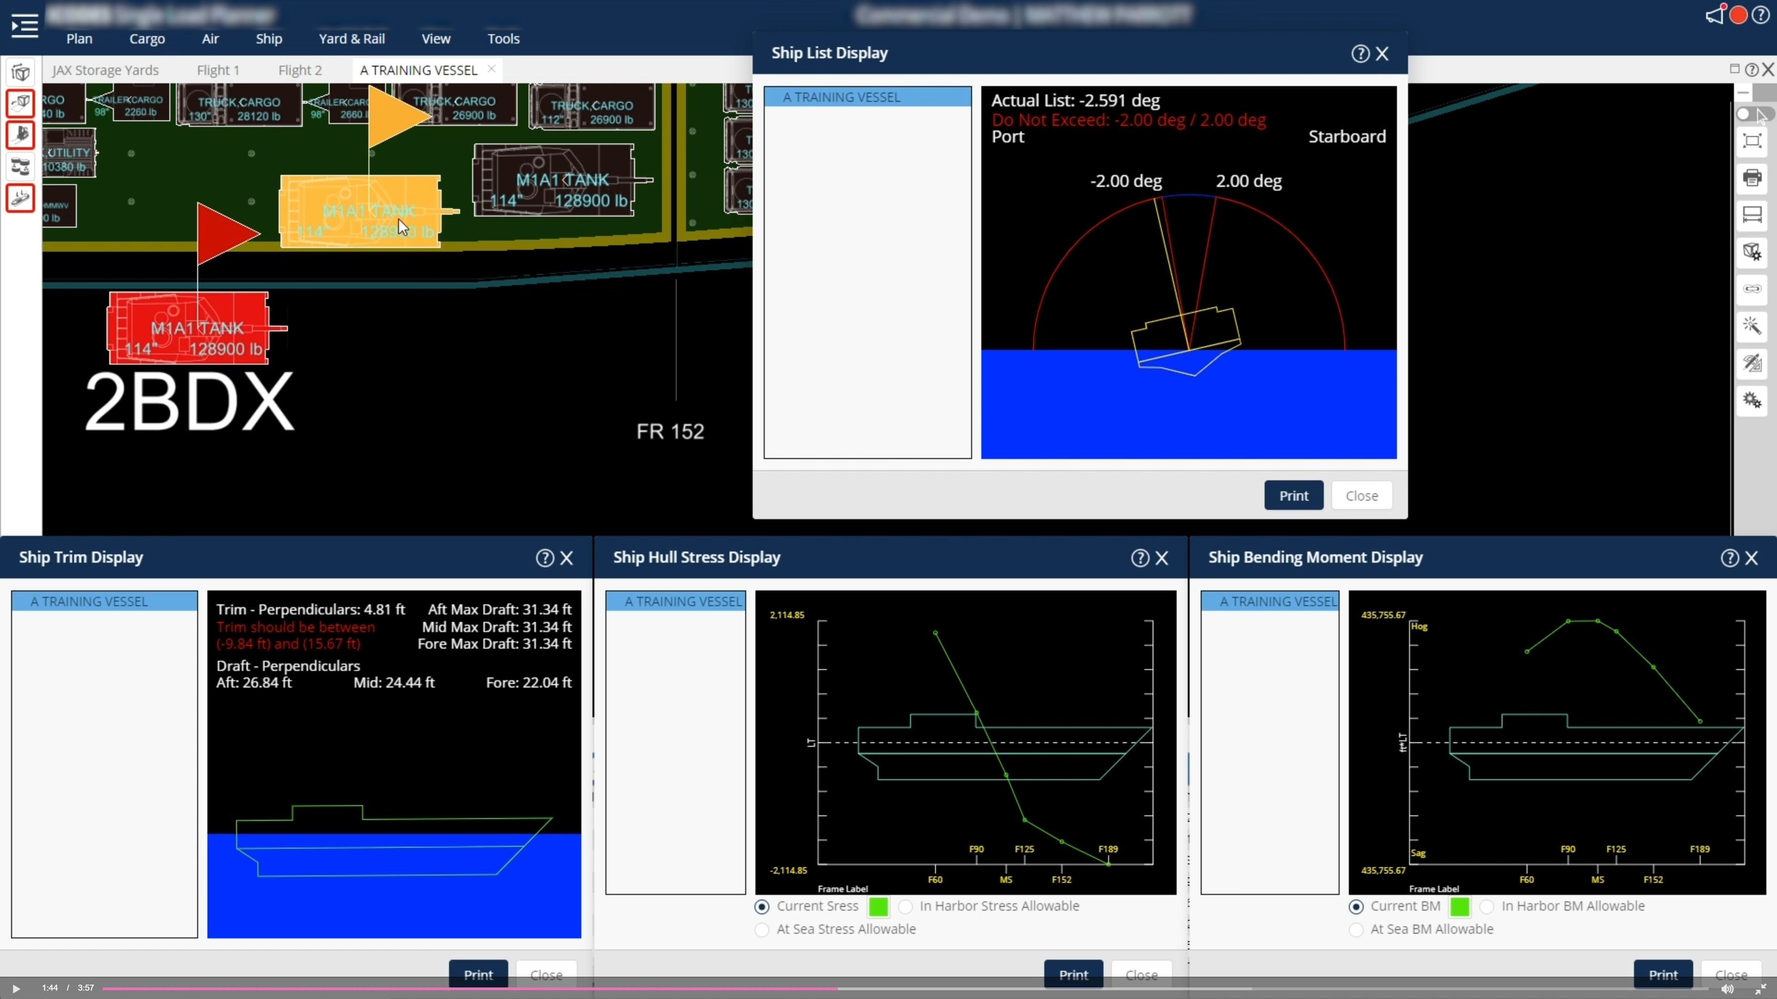
Motivation
Example
Doctrine
Framework and Approach
Modeling
Conclusion
Current Methods
ICODES (Integrated Computerized Deployment System): the single Department of Defense (DoD) system to complete load plans for sealift, airlift and rail.
The combined functionality of ship, air, truck, rail, and yard planning services provides commanders, planners, and operators with a single platform capable of producing and evaluating load plans and alternative actions for various sized units, employing various modes of transportation in support of peacetime or wartime operations.
ICODES Single Load Planner: employs advanced software agent analysis and decision-making assistance to monitor trim, stress and stability.
first digital approach to load planning after Operation Desert Storm.
ICODES Single Load Planner Module

Slide 7
Group Level Priority
Motivation
Example
Doctrine
Framework and Approach
Modeling
Conclusion
Proposed Problem Framework
2-D Bin Selection and Packing:
Items
A set of vehicles/equipment, assigned to a set of groups (military units).
Items must be packed (loaded) based on priority, close to assigned groups, ensuring maximum combat effectiveness of the group upon off-loading.
Bins
A set of available air/sea vessels to pack vehicles/equipment into.
Balancing Levels of Priority
Item Prioritization → Group Unity → Group Prioritization.
Who Cares and Why?
Military leaders want to quickly off-load forces into combat formations in a contested environment.
Groups of equipment fighting cohesively (group unity), off-loaded or quickly reconfigured into a preferred group order of movement (item level prioritization).
Critical groups of equipment are closest to off-loading points on one or multiple vessels (group level prioritization and group unity).
Minimal Example
Groups
Infantry | Armor | Sustainment
Machine Guns | Tanks | Fuel Vehicles
Anti-Tank Missiles | Engineer Vehicles | Spare Parts Vehicles
Mortars | Recovery Vehicles | Mobile Kitchens
Item Level Priority
Items to be Loaded
Group Unity
Group Unity
Group Unity

Slide 8
Motivation
Example
Doctrine
Framework and Approach
Modeling
Conclusion
Related Literature
Prioritization in Bin Packing:
2013 bin packing survey: 3 out of 163 papers since 1980 included prioritization considerations; one of the least studied areas in packing literature (Bortfeldt and Wäscher, 2013).
Recent research into the family unity concept with weakly heterogeneous items and single bins (Erbayrak, Özkır, and Yıldırım, 2021).
Most bin packing prioritization considerations: (1) Online problems and rearranging within a minimal distance from original location; (2) precedence constraints with homogeneous items.
Military Focus:
Amphibious embarkation planning using constraint programming with single bins and no bin selection (Chircop & Surendonk, 2019).
Two-Stage Approach: Bin Selection Problem → Bin Packing Problem:
Most papers look at bin selection and packing as two separate problems.
Recent research combines bin selection and packing using heuristics (Paquay et al., 2018), and decomposition or branch-and-check methods (Fontaine and Minner, 2023).

Slide 9
Proposed Approach
Motivation
Example
Doctrine
Framework and Approach
Modeling
Conclusion
Following the typology of Wäscher et al. (2007):
Residual Bin Packing Problem: The problem of packing a set of strongly heterogeneous items into a set of bins when several types of bins of different sizes are available and the objective is to minimize the total cost of bins used for loading the items.
Key Assumptions:
All vessels have equal priority (no scheduling or time component).
Offline problem (the total set of items to be packed is known), and all item/group level prioritizations and group assignments are known.
Items have priority levels within their assigned groups, but not relative to items in adjacent groups.
Mixed Integer Linear Programming Formulation:
Stage 1: Bin Selection. Select a subset of vessels that (1) minimizes total unused space or (2) approaches a desirable space utilization rate per bin (Longhorn et al., 2022).
Stage 2: Bin Packing. Pack selected bins in a way that minimizes the prioritization-weighted distances of pairs of items in the same group, and each item from the assigned vessel’s off-loading point.
Standard Constraints. Equipment rotation restrictions, obstacle avoidance, space buffering, balanced loading, etc.
Procedure. Decomposition and/or heuristics depending on computational complexity.

Slide 10
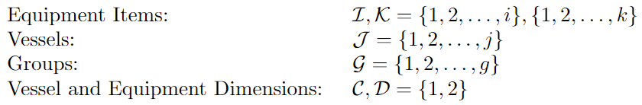
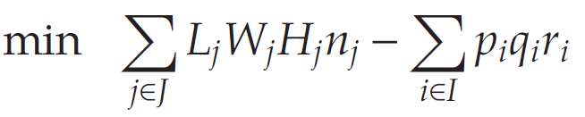
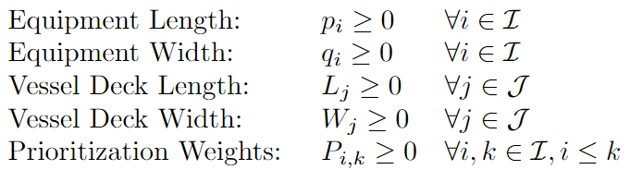
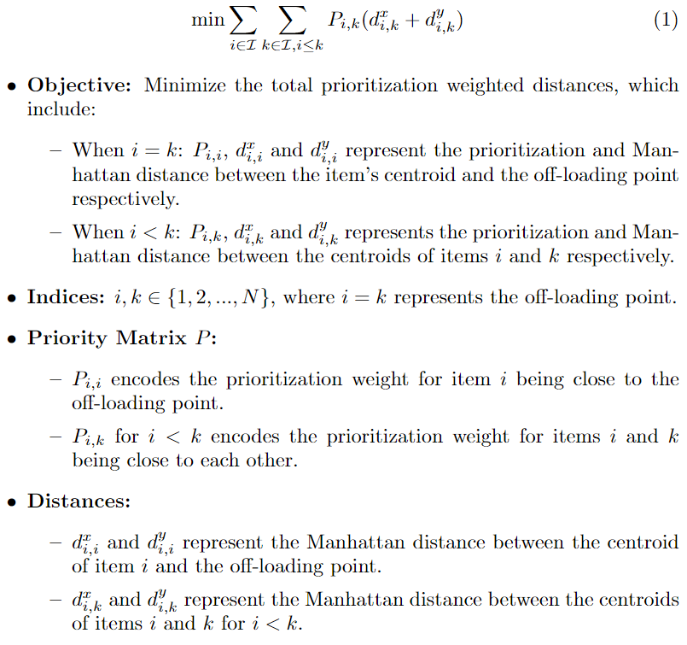
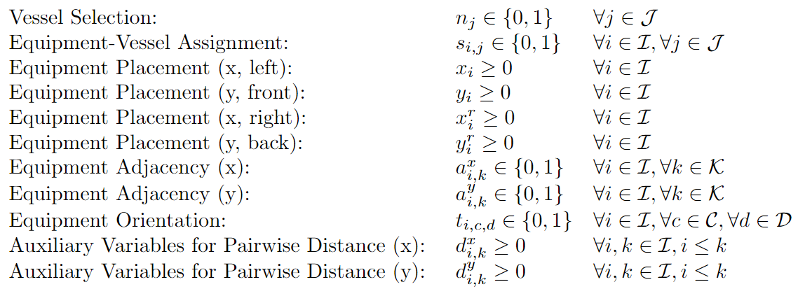
Sets
Motivation
Example
Doctrine
Framework and Approach
Modeling
Conclusion
Bin Packing Problem (BPP) Formulation*
Objective Function
Minimize total unused space:
Parameters
Minimize prioritization-weighted distance between:
Pairs of items in the same group.
Each item and the vessel’s off-loading point.
Decision Variables
*adapted from Paquay et al. (2016), Fontaine and Minner (2023)

Slide 11
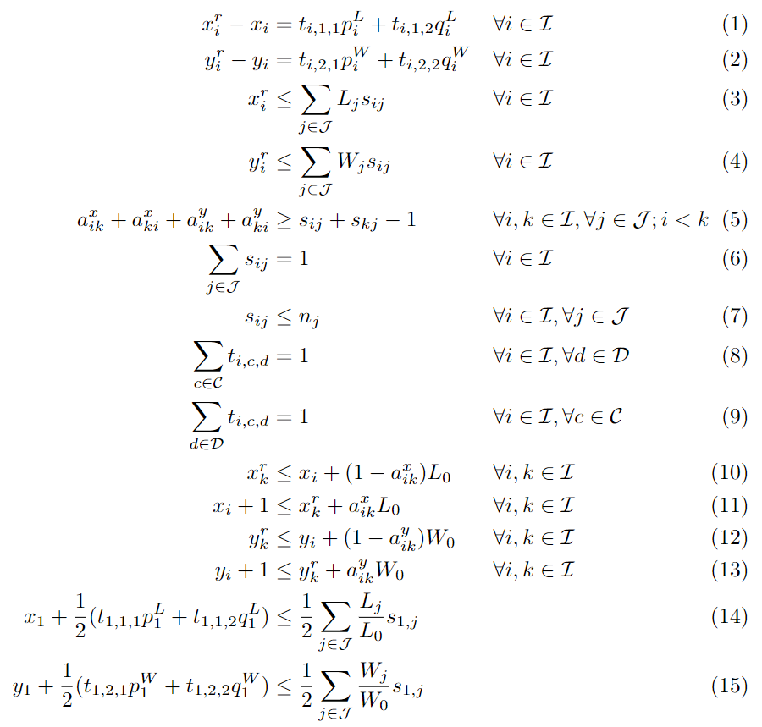

Constraints
Motivation
Example
Doctrine
Framework and Approach
Modeling
Conclusion
BPP Formulation (continued)
(1) and (2): link position variables of corners based on chosen item orientation in each dimension.
(3) and (4): corner point locations do not exceed the size of the bin in each dimension.
(5): no overlapping of items; if two items are packed in the same bin, at least one of them must be to the right (top/behind) of the other.
(6) and (7): each item is only packed into one bin (6) that is selected for use (7).
(8) and (9): guarantee that each side of an item is chosen exactly once and placed exactly once in one direction.
(10) and (11): if an item i is placed to the right of item k, the left-side location of item i must be greater than the right-side location of item k.
(12) and (13): if an item i is placed behind item k, the front-side location of item i must be greater than the back-side location of item k.
(14) and (15): symmetry breaking constraints.
(16) and (17): decision variable domains.

Slide 12
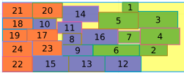
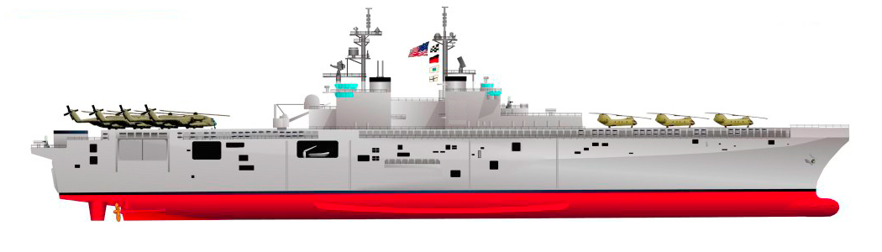

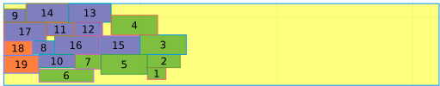
Motivation
Example
Doctrine
Framework and Approach
Modeling
Conclusion
Modeling Efforts and Next Steps
Example BPP Solution Visualizations
Front Half of LHD Deck
Off-Loading Point
Modeling Efforts: Minimal Example of Prioritization in BPP
BPP modeled in Julia (JuMP, Gurobi).
Data: Items. Subsets of companies from a combined arms battalion:
Infantry company (red): priority = 1.
Armor company (blue), priority = 2.
Forward support company (green), priority = 3.
Data: Bins. 1x Wasp-class landing helicopter dock (LHD) amphibious assault ship (266’ x 50’ well deck).
Next Steps
Lower bounds. Using heuristic, iterative group solving (fixed locations and warm starting), and other methods to attain sufficient lower bounds.
Add relevant, problem-specific constraints: mass-load balancing, deck obstacle avoidance, etc.
Experimenting with large test set including different levels of heterogeneity in group-item composition and vessel size.
Develop a branch-and-check type of procedure for the bin selection master problem.
Single Solve, Obj Value = 2.00E5.
Iterative Group Solve (Fixed Locations), Obj Value = 1.96E5.
Stronger Heterogeneity in Group Size (Different Problem)
*numbers inside each item are the prioritization weight for minimizing that item’s distance to the off-loading point.
Notes:
LHD: https://www.surfpac.navy.mil/Ships/By-Class/Amphibious-Assault-Ship-LHD-LHA/

Slide 13
Conclusion
Motivation
Example
Doctrine
Framework and Approach
Modeling
Conclusion
Potential Results and Insights:
Computational complexity: Recent promising two-stage exact approaches are three-dimensional but have minimal number of items per bin comparatively.
Tradeoffs between different subsets of selected vessels and the bin packing objective.
What is a range of good solutions, and how do the loading configurations compare? What is the cost of having a higher weighted prioritization?
What does the weighted prioritization tradeoff look like as the number and variety of available bins increases?
Possible Extensions:
Adding vessel level prioritization and a time component (scheduling) to the vessel selection and packing problem.
Exploring different mission sets and vessel selection and packing implications.
Item prioritization at the overall landing force level vs. item prioritization within specific groups.
Research Timeline:
Now
Preliminary Exam
Dissertation Defense
MAJ Will Kirschenman
Operations Research Ph.D. Student
North Carolina State University
Email: wkkirsch@ncsu.edu
MORSS
DEC24
MAR25
JUN25
SEP25
DEC25
MAR26
Chapter 1
Chapter 3
MAY26
Graduate
Chapter 2

Slide 14
Backup Slides

Slide 15

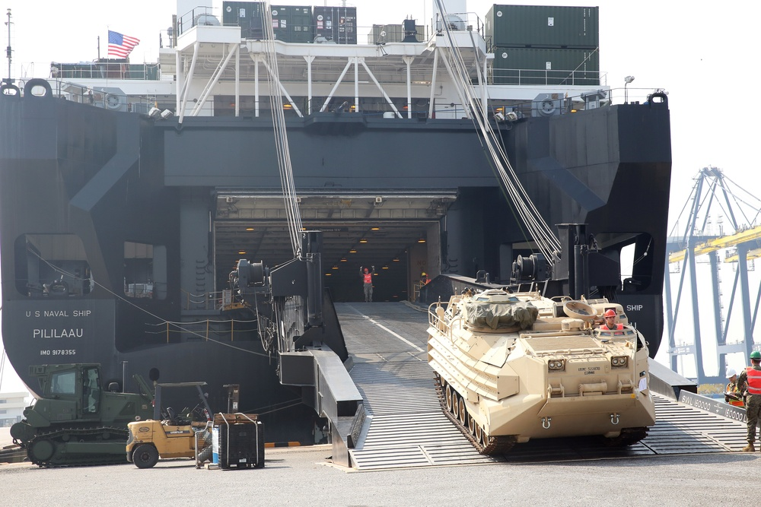
Different Off-Loading Points
Bottom Left Off-loading Point
Center Left Off-loading Point
USNS Brunswick: Expeditionary Fast Transport
USNS Pililaau: Large, Medium-Speed, Roll-On/Roll-Off (RO/RO) Ship
Notes:
LHD: https://www.surfpac.navy.mil/Ships/By-Class/Amphibious-Assault-Ship-LHD-LHA/

Slide 16
Generalized Objective Function

Slide 17
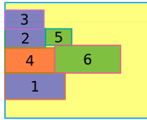
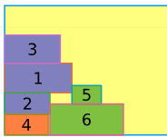
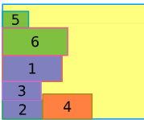
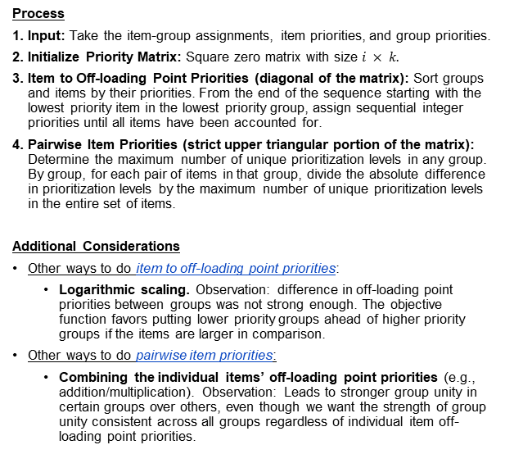
Computing the Prioritization Matrix
Example
Item-group assignments
Group-level priority
Process
Input: Take the item-group assignments, item priorities, and group priorities.
Initialize Priority Matrix: Square zero matrix with size $i × k.$
Item to Off-loading Point Priorities (diagonal of the matrix): Sort groups and items by their priorities. From the end of the sequence starting with the lowest priority item in the lowest priority group, assign sequential integer priorities until all items have been accounted for.
Pairwise Item Priorities (strict upper triangular portion of the matrix): Determine the maximum number of unique prioritization levels in any group. By group, for each pair of items in that group, divide the absolute difference in prioritization levels by the maximum number of unique prioritization levels in the entire set of items.
Additional Considerations
Other ways to do item to off-loading point priorities:
Logarithmic scaling. Observation: difference in off-loading point priorities between groups was not strong enough. The objective function favors putting lower priority groups ahead of higher priority groups if the items are larger in comparison.
Other ways to do pairwise item priorities:
Combining the individual items’ off-loading point priorities (e.g., addition/multiplication). Observation: Leads to stronger group unity in certain groups over others, even though we want the strength of group unity consistent across all groups regardless of individual item off-loading point priorities.
Item-level priority
Inputs
Priority Matrix
Off-loading point
Obj Value: 5898.5
Obj Value: 7483.0
Obj Value: 8082.67
Swap dimensions of items 3 and 4
Highest priority item, but not loaded adjacent to off-loading point
*The numbers on the plot represent item numbers.

Slide 18
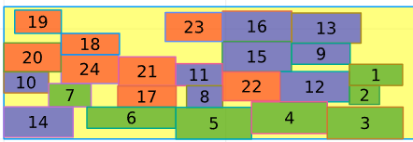
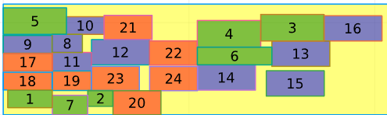
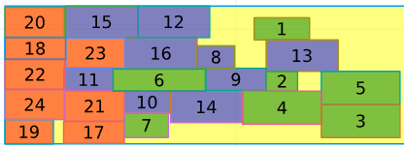
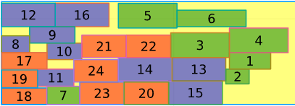
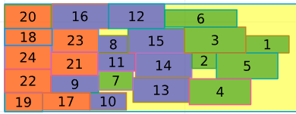
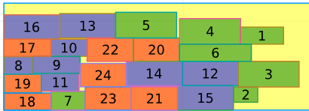
Off-loading point
Generalized Objective Function
Original Test Problem
Center Left Off-loading Point
Bottom Left Off-loading Point
Observations
Different off-loading points. The center left off-loading point gives better objective values and visually tighter group unity.
Dense packing. Longer run times give successively denser packings focused on the off-loading point.
Sacrifices with group unity to maintain denser packing. Item 7 (prioritization level) is a good example where it is consistently loaded away from its group but closer to the off-loading point.
The generalized objective seems to work well and directly addresses item-level prioritization, group-level prioritization, and group unity.
Balancing priorities. Scaling pairwise prioritization weights between 0 and 1, while assigning item-level prioritization weights as integers seems to work relatively well. This balance could be explored in more detail.
This problem may still benefit from warm starting through an iterative group solve or heuristic solution.
Obj Value: 2.74E5, 5 second run time
Obj Value: 3.58E, 5 second run time
run time Increases
Obj Value: 2.17E5, 30 second run time
Obj Value: 2.80E5, 30 second run time
Obj Value: 2.03E5, 300 second run time
Obj Value: 2.74E5, 300 second run time
*The numbers on the plots represent item-to-offloading-point prioritization weights
(e.g., higher numbers should be loaded closer to the off-loading point).

Slide 19
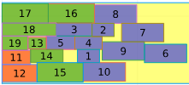
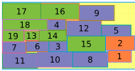
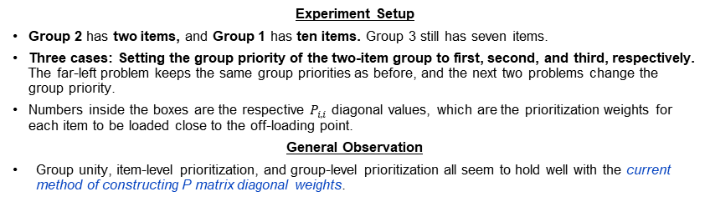
Off-loading point
Priority Matrix Diagonal Weights
Testing with Small vs. Large Groups
Experiment Setup
Group 2 has two items, and Group 1 has ten items. Group 3 still has seven items.
Three cases: Setting the group priority of the two-item group to first, second, and third, respectively. The far-left problem keeps the same group priorities as before, and the next two problems change the group priority.
Numbers inside the boxes are the respective $P_{i,i}$ diagonal values, which are the prioritization weights for each item to be loaded close to the off-loading point.
General Observation
Group unity, item-level prioritization, and group-level prioritization all seem to hold well with the current method of constructing P matrix diagonal weights.
Group Priority Order:
Group Priority Order:
Group Priority Order:
2
1
3
3
2
1
3
1
2
Obj Value: 1.24E5, 300 second run time
Obj Value: 1.20E5, 300 second run time
Obj Value: 1.24E5, 300 second run time
This problem has the original test problem’s group priorities, and it performs as expected when the highest priority group has two items and the second highest priority group has ten items.
It may be possible to load smaller item groups closer to the off-loading point without sacrificing the group unity of other groups.
When the two-item group is last in priority, as we would hope/expect, it does not supersede the priority of other groups being closer to the off-loading point.
For two larger groups with adjacent priority levels, it may be beneficial to load items in flatter columns as each group will be relatively close to the off-loading point while maintaining group unity.

Slide 20
Off-loading point
Iterative Group Solve Comparison
Solution Quality vs. Single Solve with Same Run Time
Iterative group solve (fixing values by priority group).
300 second time limit for group 2 with 8 items.
300 second time limit for group 1 with 9 items.
16 seconds (solved to optimality) with 7 items.
Observations
The iterative group solve has a slightly better objective value than the single solve approach at the same run time.
The iterative group solve solution’s group unity looks “nicer” visually. However, fixing previous groups’ positions could lead to problems when there is heterogeneity in group size.
Insights
It seems worthwhile to further explore the iterative group solve approach (fixing previous groups’ item locations), while also comparing with an iterative warm start approach (feeding previous groups’ iterative solutions into next group as a starting solution).
It may be worthwhile checking how the iterative group solve approaches work when there is more heterogeneity in group size.
Obj Value: 1.96E5, 616 second total run time
Original Problem with same run time as iterative group solve.
Obj Value: 2.00E5, 616 second run time

Slide 21
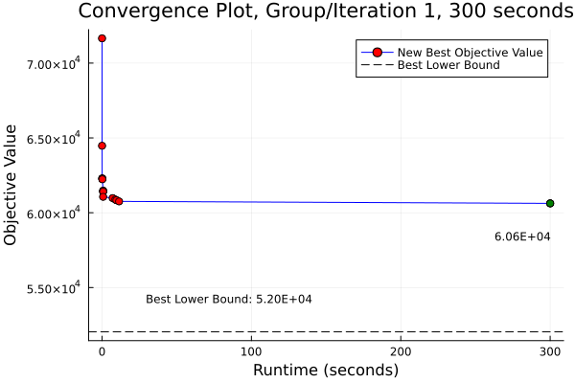
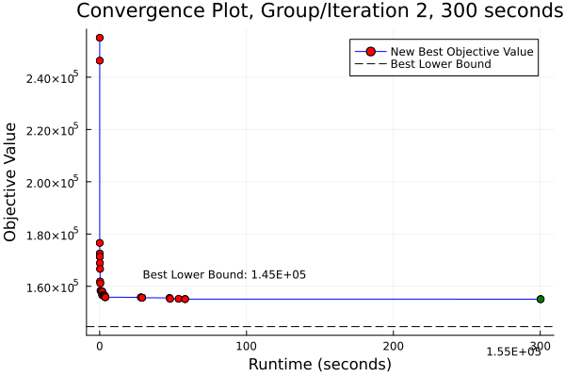
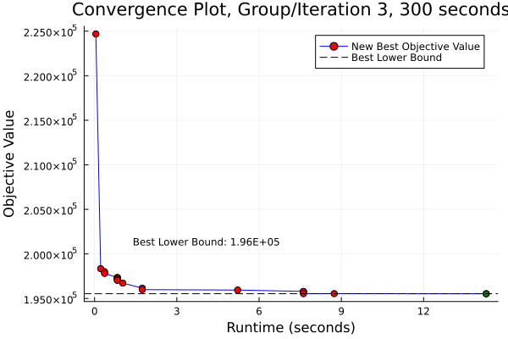
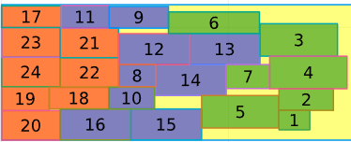
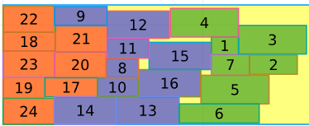
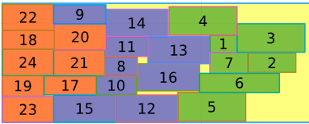
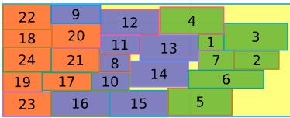
Group Solving (Fixed Locations)
Solving to Optimality
Group 1 Observations
8 items.
Best solution and best bound converge at 3271 seconds.
Optimal solution achieved at 5 seconds, and the rest of the time was spent searching the solution space to improve the lower bound.
Group 2 Observations
9 items (Group 2), with 8 items fixed (Group 1).
Best solution and best bound converge at 9600 seconds.
Optimal solution achieved at 49 seconds, and the rest of the time was spent searching the solution space to improve the lower bound.
Group 3 Observations
7 items (Group 3), with 17 items fixed (Groups 1 and 2).
Optimal solution achieved at 12 seconds.
1 Second per Group Solve
5 Seconds per Group Solve
30 Seconds per Group Solve
300 Seconds per Group Solve
Obj Value: 1.978983333333e+05
Obj Value: 1.967646111111e+05
Obj Value: 1.960233888889e+05
Optimal Obj Value: 1.955317222222e+05

Slide 22
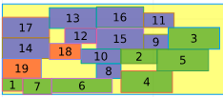

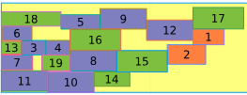
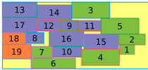
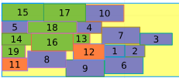

Off-loading point
Priority Matrix Diagonal Weights
Testing with Small vs. Large Groups
Group Priority Order:
Group Priority Order:
Group Priority Order:
2
1
3
3
2
1
3
1
2
Obj Value: 1.51E5, 5 second run time
Obj Value: 1.45E5, 5 second run time
Obj Value: 1.66E5, 5 second run time
Run time Increases
Obj Value: 1.28E5, 30 second run time
Obj Value: 1.34E5, 30 second run time
Obj Value: 1.40E5, 30 second run time
Obj Value: 1.24E5, 300 second run time
Obj Value: 1.20E5, 300 second run time
Obj Value: 1.24E5, 300 second run time

