Slide 1
Coder Dojo
2012-02-11
HTML5 - Javascript
Sprite Animation

Slide 2
Lost and found
We have a number of items in lost and found
Pens/Pencils/Paper not collected for a month will be used for the idea jar.
Technology not collected for a month will be used in projects.
Worryingly, there is a pair of uncollected glasses for almost a month now...

Slide 3

Interesting stuff this week
Paul Bakaus of Zynga Germany is converting their existing games to HTML5.
"I believe that the tech is ready to build those games. I think that the tech is not yet ready to build great 3D games since it's just about browser share penetration. But for 2D games and isometric games, it's the right time."
source - http://blog.games.com/2012/02/02/zynga-germany-html5-paul-bakaus/
Paul Bakaus

Slide 4
And above all...
be cool

Slide 5
Thank you to ..
Val Head
@VLH from whom I stole so many ideas
http://creativejs.com/2012/01/day-11-sprite-sheets/
and
Erica Gorman (wave please)
for putting together the artwork

Slide 6
To begin... get the sprite sheet
http://GitHub.com/WillKnott
Its in the repository
CoderDojo-HTML5-CanvasSpriteAnimationtake the cdsprite.png file

Slide 7
Fire up your editors...
Apple - Text Wrangler
Windows - Notepad ++
Linux - Komodo Edit
There is a reason... file handling

Slide 8
Lets start with a standard template
<!doctype html>
<html>
<head>
<meta charset="utf-8">
</head>
<body>
<script src=sani.js>
</script>
</body>
</html>

Slide 9
And...
move the downloaded image to the same place as the html file

Slide 10
sami.js init part 1
// screen size variables
var SCREEN_WIDTH = window.innerWidth,
SCREEN_HEIGHT = window.innerHeight;
var canvas = document.createElement('canvas');
var c = canvas.getContext('2d');
canvas.width = SCREEN_WIDTH;
canvas.height = SCREEN_HEIGHT;
// Add our drawing canvas
document.body.appendChild(canvas);

Slide 11
part 2
//load the image
image = new Image();
image.src = "cdsprite.png";
c.drawImage(image,0,0,250,250,0,0,250,250);

Slide 12
To explain...
var SCREEN_WIDTH = window.innerWidth,
SCREEN_HEIGHT = window.innerHeight;
Figure out the size of the screen

Slide 13
To explain
var canvas = document.createElement('canvas');
var c = canvas.getContext('2d');
Set up the canvas on which we will draw our images

Slide 14
To explain
canvas.width = SCREEN_WIDTH;
canvas.height = SCREEN_HEIGHT;
Set the canvas to be the size of the screen

Slide 15
To explain
// Add our drawing canvas
document.body.appendChild(canvas);
And put the canvas on the screen

Slide 16
To explain
//load the image
image = new Image();
image.src = "cdsprite.png";
Create an image object
Explain Objects Will...
And define the src (source) part of the image object to be our sprite sheet

Slide 17
And the nasty one
c.drawImage(image,0,0,250,250,0,0,250,250);
Three parts.
1) The Sprite Sheet image
2) The part of the sheet we are copying from
3) The location on the screen we are pasting to
Of course, these numbers will have to change...

Slide 18
And if its working
You should be just displaying an image...

Slide 19
So lets change a few things...
// screen size variables
var SCREEN_WIDTH = window.innerWidth,
SCREEN_HEIGHT = window.innerHeight;
var canvas = document.createElement('canvas');
var c = canvas.getContext('2d');
canvas.width = SCREEN_WIDTH;
canvas.height = SCREEN_HEIGHT;
var initX = 0;
var initY = 0;
var xpos = initX;
var ypos = initY;
var index=0;
var numFrames = 30;
var frameSizeX= 253;
var frameSizeY= 280;

Slide 20
no more numbers (except 0)
// Add our drawing canvas
document.body.appendChild(canvas);
//load the image
image = new Image();
image.src = "cdsprite.png";
c.drawImage(image,
xpos,ypos,frameSizeX,frameSizeY,
0,0,frameSizeX, frameSizeY);

Slide 21
So now..
We are displaying the same image, but we are using variables to do it.
Variables change....

Slide 22
make things move 1
// Add our drawing canvas
document.body.appendChild(canvas);
//load the image
image = new Image();
image.src = "cdsprite.png";
image.onload = function() {
//The animation loop. Call loop so as
//to complete the animation once a second
setInterval(loop, 1000 / numFrames);
}
/This is the same timer that we used for the slideshow last time

Slide 23
And make a loop
function loop() {
//clear the canvas!
c.clearRect(0,0, SCREEN_HEIGHT,SCREEN_WIDTH);
c.drawImage(image,xpos,ypos,frameSizeX,frameSizeY,0,0,frameSizeX, frameSizeY);
xpos += frameSizeX;
//increase the index so you know which frame of the animation comes next
index += 1;
}

Slide 24
Why clear the canvas?
Because sometimes...
you can't overwrite cleanly
So clean the sheet first.

Slide 25
And now...
The animation will run once...

Slide 26
So when you reach the end
Start again...
function loop() {
c.clearRect(0,0, SCREEN_HEIGHT,SCREEN_WIDTH);
c.drawImage(image,xpos,ypos,frameSizeX,frameSizeY,0,0,frameSizeX, frameSizeY);
xpos += frameSizeX;
index += 1;
if (index >= numFrames) {
xpos = initX;
ypos = initY;
index=0;
}

Slide 28
So now...
You have an animation loop

Slide 29
Why is this important?
http://www.widgetworx.com/
Free to use sprite sheets for use in games

Slide 30
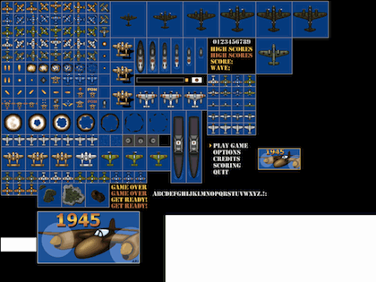
Now you know..
How to animate more

Slide 31
To do
Make your own sheets
Take the WidgetWorx ones
Make your own animations...

Slide 32
You don't have to ask for permission
http://www.gamesbrief.com/2012/02/time-to-stop-asking-for-permission/
You don't need to ask for permission to make a game.
You don't need to ask for a publisher anymore
You don't need to make a huge €60 game

Slide 33
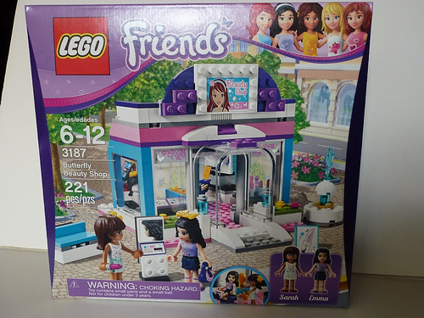
Here you've learned
How to make a single building block
You can put those block together according to someone else's instructions

Slide 34
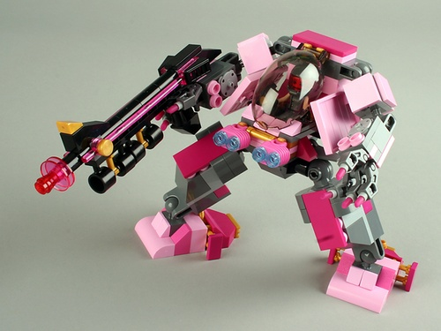
Or you can take those blocks
And do something else

Slide 35
Above all
Go be cool

