Slide 1
Coder Dojo 2012-02-18
HTML5 Shuffle Puzzle

Slide 2
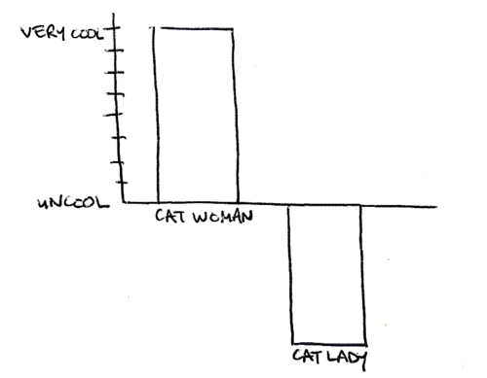
Uncool
Clean up your rubbish!

Slide 3
Creating a simple game
Today we're going to make a simple game using Javascript and HTML5. This game slices up an image, shuffles the pieces about and then the player has to rearrange them.
First off, let's get the image for our game, then we'll have to set up our template page.
To github.com folks....

Slide 4
Go simple...
If you're scared, you already have enough to create a "click Your Own Adventure" game...

Slide 5
Videos...
Just a note (Dublin were on to me...)

Slide 6
The image...
http://github.com/willknott
Look for "CoderDojo-HTML5-CanvasSwapPuzzle"
And find the "CDG.png" image
Image courtesy of Erica
And yes the "CoderDojo" github account will get the files soon.

Slide 7
WARNING
This is a complicated bit of code today.
Pay attention.
We may not complete it today
And we are introducing a LOT of new stuff...
There is no thing as a stupid GENUINE question.
(I said genuine Messers at the back)
If you have any questions... SHOUT THEM OUT

Slide 8
The Template :-)
<!DOCTYPE html>
<html>
<head>
<meta charset="utf-8">
<title>HTML5 Puzzle</title>
<script src = 'puzzle.js'>
</script>
</head>
<body onload="init();">
<canvas id="canvas"></canvas>
</body>
</html>

Slide 9
What's happening?
This html page is complete now. The important things are;
  <script src = 'puzzle.js'>
This tells us the name of our javascript file. This file is seperate from the HTML.
  <body onload="init();">
This onload event tells the computer to load the function "init" when the page opens. This (eventually) puts a picture on our screen.
The question is .........

Slide 10
Thanks to..
http://active.tutsplus.com/tutorials/games/create-an-html5-canvas-tile-swapping-puzzle/
where I stole most of this from
and
Brad Manderscheid from Actionmouse how put the first version together.

Slide 11
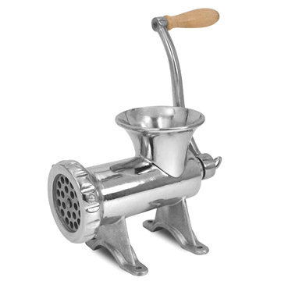
What is a function?
Functions are like a machine. They take in something and give back something else.
What other type of machines do we know about?
This meat grinder works like a function.

Slide 12
Examples
  Calculators - turn several numbers into an answer
  Toasters - turns bread into toast!
  A smoothie maker - turns fruit into a drink!
  Diet Coke + Mentos = A Rocket!

Slide 13
Making the game work
Create a new file and save it as puzzle.js, we need to put in all our variables.
const PUZZLE_DIFFICULTY = 4;
var stage;
var canvas;
var img;

Slide 14
Reminder...
Words have power.
In this case the names of the functions.
If you call Cluck() but meant to call Click() what happens...?

Slide 15
const PUZZLE_DIFFICULTY = 4;
const?
Variables are... variable. They can change
const or constants, don't change.
PUZZLE_DIFFICULTY is just a label.
Why use a label instead of using the value?

Slide 16
Declare more variables
var puzzleWidth;
var puzzleHeight;
var pieces;
var pieceWidth;
var pieceHeight;

Slide 17
And variables we'll use later
const PUZZLE_HOVER_TINT = '#FF0000';
var currentPiece;
var currentDropPiece;
var mouse;

Slide 18
The first Function
function init(){
img = new Image();
img.addEventListener('load',onImage,false);
img.src = "CDG.png";
}
This loads our image into the HTML page.

Slide 19
addEventListener
addEventListener ties a function with a particular action...
img.addEventListener('load',onImage,false);
'load' is the triggering action
onImage is the function called to action if the action has been triggered
and false?
http://www.javascriptkit.com/domref/windowmethods.shtml

Slide 20
Boolean
There is a special variable type called Boolean.
It consists of "true" and "false". No other value.
(In practice, not exactly, but the machine reads "True" or "False")
The third place in an event listened is to do with binding the action, and keep a connection to the following action.
Its false here as we don't need it...

Slide 21
After we load our image, we want to calculate it up into equal sized pieces. You can figure out different sizes later
function onImage(e){
pieceWidth = Math.floor(img.width / PUZZLE_DIFFICULTY);
pieceHeight = Math.floor(img.height / PUZZLE_DIFFICULTY);
puzzleWidth = pieceWidth * PUZZLE_DIFFICULTY;
puzzleHeight = pieceHeight * PUZZLE_DIFFICULTY;
setCanvas();
initPuzzle();
}

Slide 22
Time for some Math.floor
Math.round = standard round
Math.ceiling = always go up
Math.floor = always go down
Math is the American for Maths

Slide 23
And this does...
We are calculating how to cut the image in to (in our case) 16 equal pieces.
That is 4X4 (more maths, sorry)
Then we set the drawing board called the canvas

Slide 24
Next we want to set up our canvas. We will set up a border so that we can see the edges of the image.
// Get element by id,
// on the HTML page, you named the canvas "canvas"
function setCanvas(){
canvas = document.getElementById('canvas');
stage = canvas.getContext('2d');
canvas.width = puzzleWidth;
canvas.height = puzzleHeight;
canvas.style.border = "1px solid black";
}

Slide 25
Next, create a function to start the Puzzle
function initPuzzle(){
stage.drawImage(img,
0, 0, puzzleWidth, puzzleHeight,
0, 0, puzzleWidth, puzzleHeight);
}
//Yes we are just drawing the image
//Remember img is the source
// The first set of co-ordinates is the size of the image to use
// and the second set is the size of the canvas to use

Slide 26
And when you save and run this..
It "just" displays the image.
Why all the extra bits?
Well we need it later...

Slide 27
And due to running out of time we'll leave it here
Expect more next week

