Slide 1
Coder Dojo 2012-02-25
HTML5 Shuffle Puzzle
CONTINUED

Slide 2

UDACity.com - Build a search engine
UDACITY Webcrawler

Slide 3
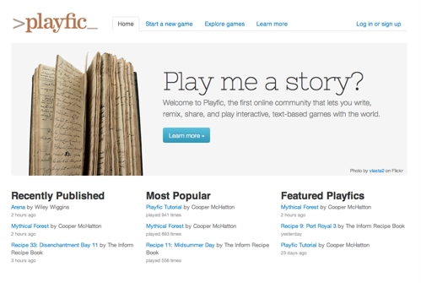
playfic.com, make your own text adventure
Notes:
More for the smallies

Slide 4
MineCraft Servers and networking

Slide 5
LAST week...
Just display

Slide 6
github.com/willknott github.com/coderdojo
Last week's slides, code (puzzle1) and images are available

Slide 7
Next, create a function to start the Puzzle
function initPuzzle(){
pieces = [];
mouse = {x:0,y:0};
currentPiece = null;
currentDropPiece = null;
stage.drawImage(img,
0, 0, puzzleWidth, puzzleHeight,
0, 0, puzzleWidth, puzzleHeight);
buildPieces();
}
//Initializing bits for later

Slide 8
Huh? You created these variables...
currentPiece = null;
currentDropPiece = null;
Null means "No value".
mouse = {x:0,y:0};
This is a full one value array...and an object.
Think about it, what does a mouse position consist of...
pieces = [];
This is an empty array

Slide 9
What is an array?
http://www.w3schools.com/js/js_obj_array.asp
An array is a variable that can contain more than one value.
You can declare a complete array, or, push values on to an array.

Slide 10
For
We are about to hit a for loop
http://www.w3schools.com/js/js_loop_for.asp
for (variable=startvalue;
variable<=endvalue;
variable=variable+increment)
{
do something
}

Slide 11
Now let's make a function to split our image into pieces
function buildPieces(){
var i;
var piece;
var xPos = 0;
var yPos = 0;
for(i = 0;
i < (PUZZLE_DIFFICULTY * PUZZLE_DIFFICULTY);
i++){
piece = {}; //new object
piece.sx = xPos;
piece.sy = yPos;
pieces.push(piece);
//add this object to the pieces array

Slide 12
Continued from last page
xPos += pieceWidth; //move a piece to the right
if(xPos >= puzzleWidth){
// if we fall off the edge of the image
xPos = 0;
//back to the left edge
yPos += pieceHeight;
// and move down one
} // end of if
} //end of for
document.onmousedown = shufflePuzzle;
}

Slide 13
After dividing up our image, we need to shuffle them around.
Or cheat by just reversing the order
function shuffleArray(o)
{
return o.reverse();
}
http://www.w3schools.com/jsref/jsref_reverse.asp
Yes this does make a crap game.
We'll look at shuffling and other mathematics next time.

Slide 14
And we've run out of time
We'll continue this next week

