Slide 1

Uncertainty in GNN Learning Evaluations: The Importance of a Consistent Benchmark in Community Detection
William Leeney and Ryan McConville
Notes:
Hello I am Will, I’m a PhD student at the University of Bristol.
I’m going to be talking about Uncertainty in GNN Learning Evaluations: The importance of a consistent benchmark in community detection.

Slide 2
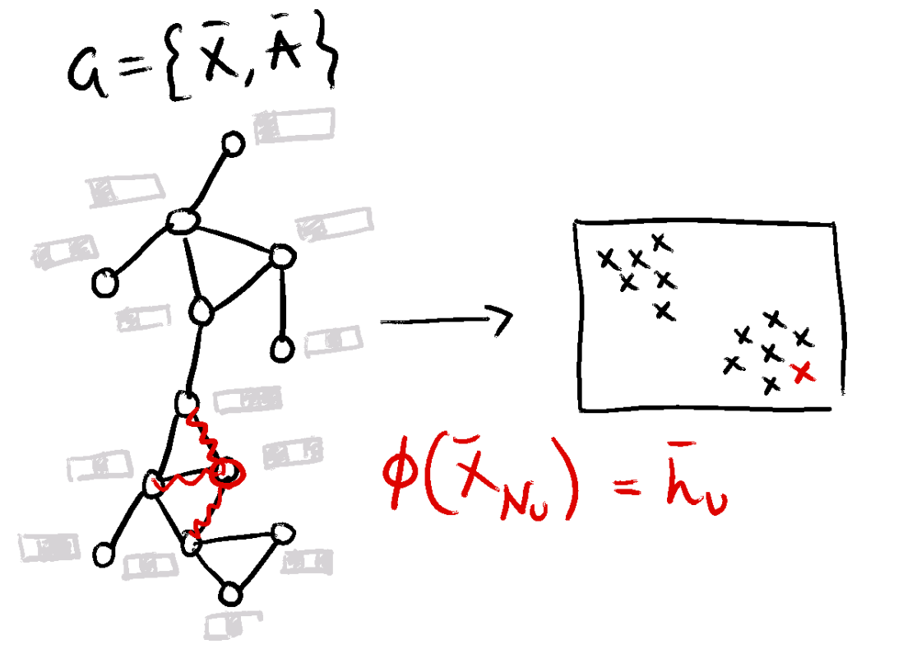
Community Detection with GNNs
Notes:
We are going to be looking at comparisons between different methods and the uncertainty and inconsistency in current benchmarks.
Firstly, community detection is the unsupervised task of clustering nodes, we consider attributed networks in this work and a variety of Graph Neural Network based methods for this.
All GNNs are different but they all use a message passing scheme where each nodes’ representations are update by this rule in some form, where the feature space of each node is passed through a neural network and then are aggregated across the network’s connectivity.
We use some methods that are designed to cluster and some that learn unsupervised representations which we can then cluster with k-means. They all are influenced by hyperparameters which control trade-offs in optimisation.

Slide 3
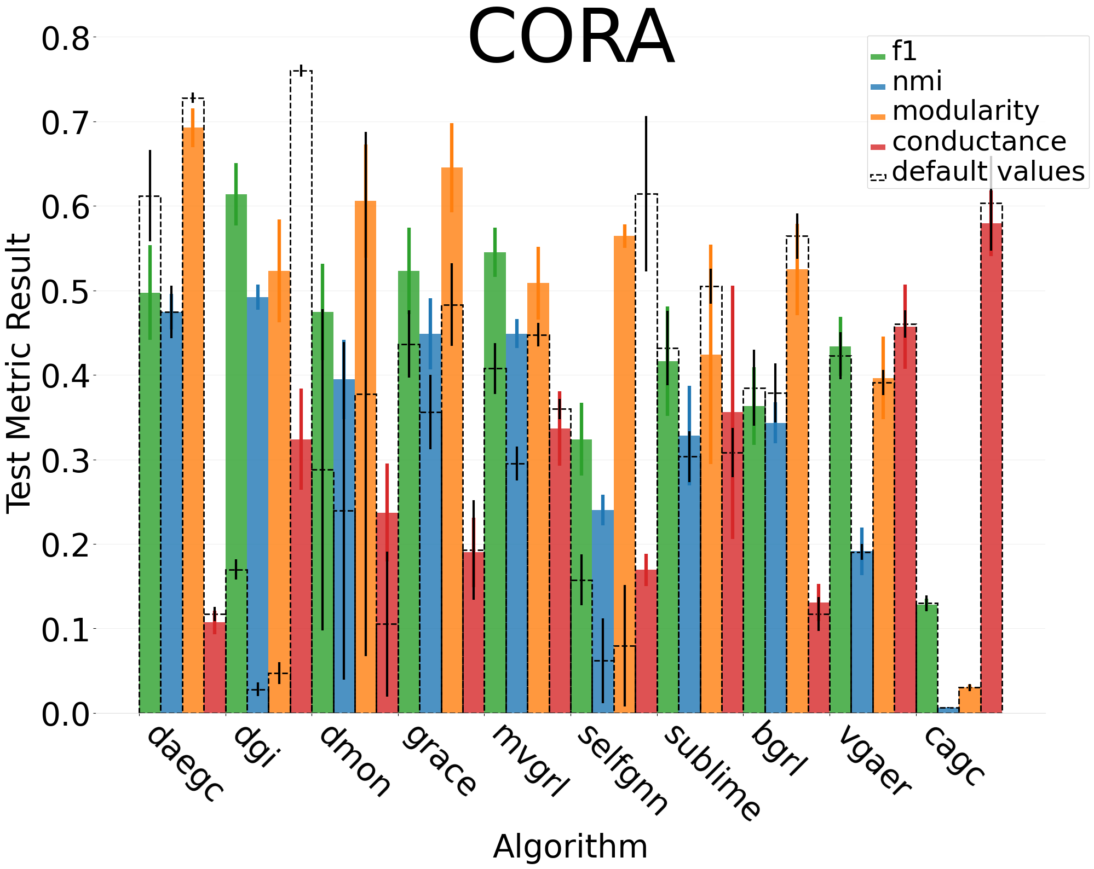
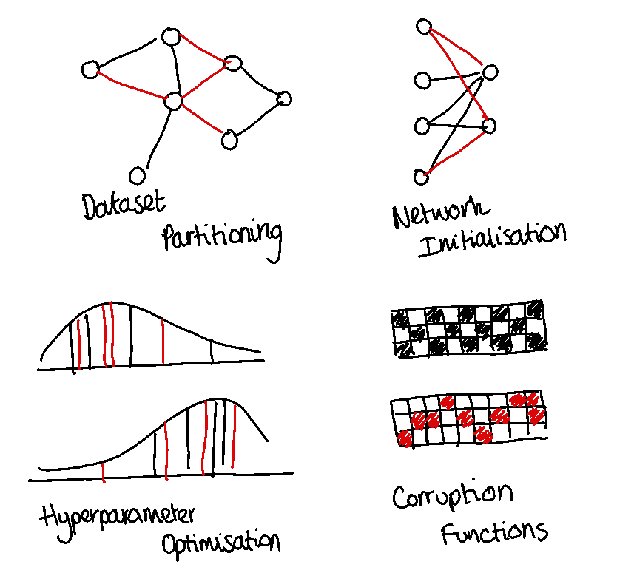
What is the Problem?
Notes:
What is the problem?– Inconsistency of evaluation practices and randomness significantly affects algorithms.
Randomness is always present in evaluations, which affects results: dataset splits, network or k-means initialisations, hyperparameter sampling, contrastive learning functions.
The default hyperparameters given by each paper do not suit all datasets and are not recoverable with a reasonable hyperparameter search.
Not all implementations use a model selection on the validation set or provide code for all algorithms tested which means that results are not trustworthy.
In this chart we show the difference between the default hyperparameters and those found under our investigation. Each algorithm on the x, with the different test metrics and the y gives the corresponding value, the colored bars represent the HPO result and the dashed the default, the error bar represents the variation due to random seed.
As you can see there is a huge inconsistency in the results. For example, due to randomness and inconsistent HP procedures.
The incentive to publish state of the art results means that we are biased towards finding good results that can often be based on unfair model comparisons. In turn this affects the real world, where GNNs are used to detect fake news or influence medical decisions, which are potentially using sub-optimal model comparisons that don’t account for randomness or the relevance of a hyperparameter study

Slide 4
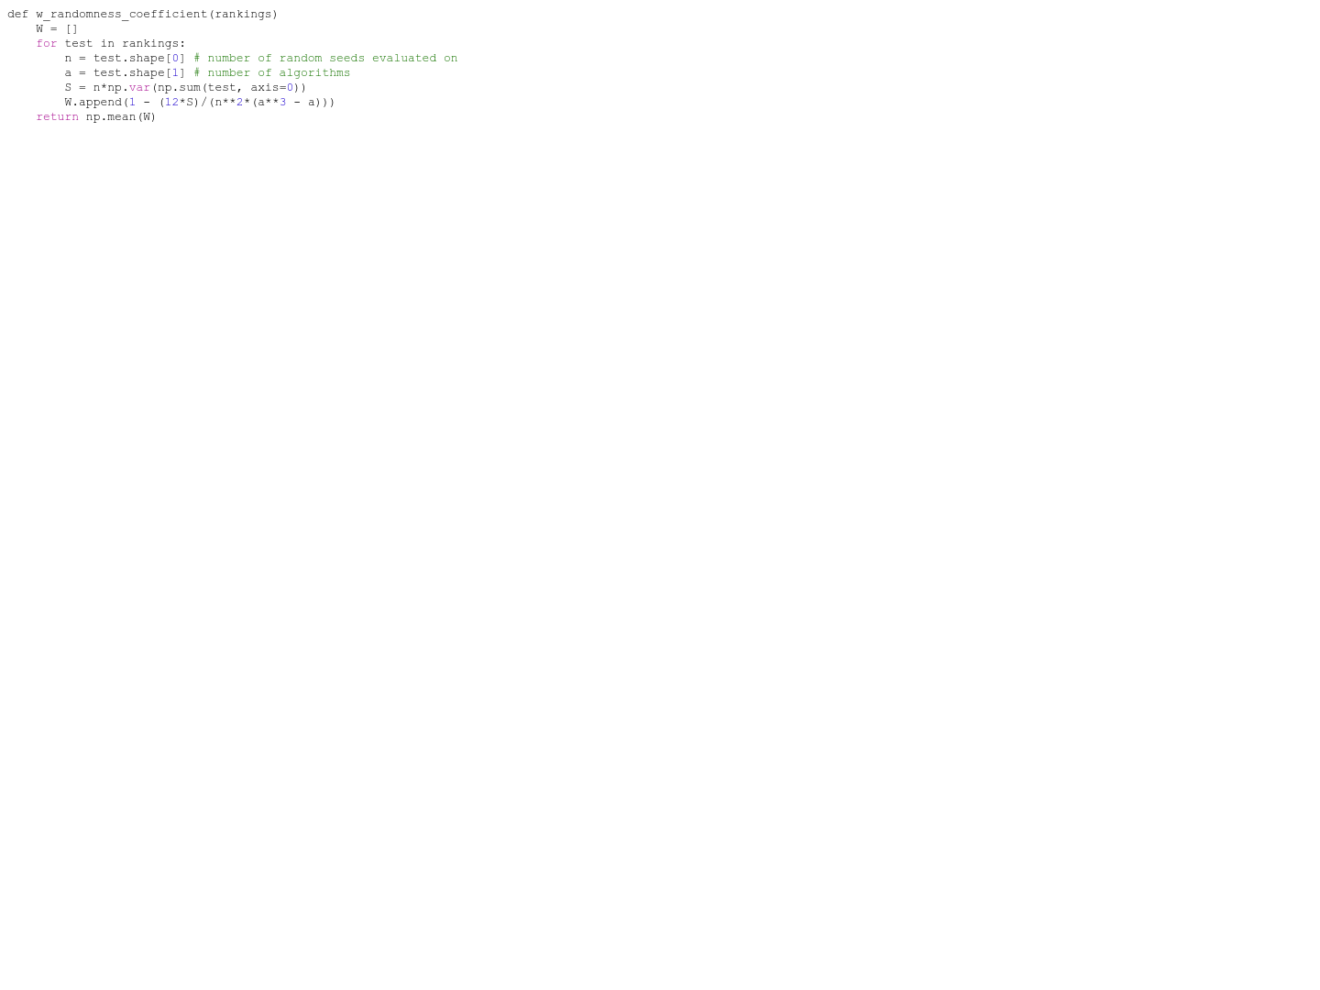
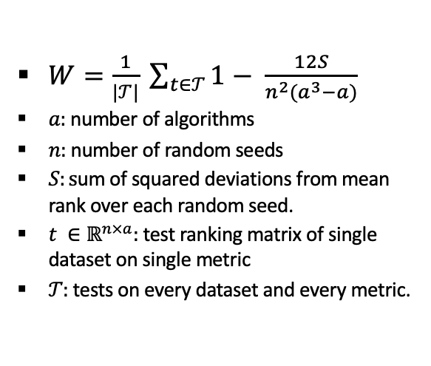
A Solution: W Randomness Coefficient
$W=\frac{1}{|𝒯|} \sum_{t∈𝒯}{1− \frac{12S}{n^{2}(a^{3}−a)}}$
$a:$number of algorithms
$n:$number of random seeds
$S:s$um of squared deviations from mean rank over each random seed.
$t ∈ℝ^{n×a}:$test ranking matrix of single dataset on single metric
$𝒯:$tests on every dataset and every metric.
Notes:
A solution to the randomness issue is to quantify the uncertainty in results as proposed in the paper is to use Kendall’s $W$ coefficient of concordance.
This calculates the consistency of each algorithms’ ranks across random seeds averaged over every test of the investigation.
Here is the code and the maths to demonstrate how easy it is to calculate this number for your investigations.
This helps as we can see how trustworthy results are, a high W randomness coefficient indicates bad results that are heavily influenced by randomness.

Slide 5
Investigation Framework
Methods: DAEGC, DMON, DGI, CAGC, GRACE, MVGRL, BGRL, SUBLIME, VGAER
Metrics: NMI, F1, Modularity, Conductance
Datasets: AMAC, AMAP, BAT, CITESEER, CORA, UAT, EAT, TEXAS, WISC, CORNELL, DBLP
Experiment: Default Hyperparameters Vs Hyperparameter Optimisation
Results: W Randomness Coefficient and Average Framework Comparison Rank
Resource | Allocation
Optimiser | Adam
HPO | MOTPE
Max Epochs | 5000
Max HP Trials | 300
Training/Validation/Testing Split | 0.64/0.16/0.2
Random Seeds | [42, 24, 976, 12345, 98765, 7, 856, 90, 672, 785]
Patience | [25, 100, 500, 1000]
Learning Rate | [0.05, 0.01, 0.005, 0.001, 0.0005, 0.0001]
Decay Rate | [0, 0.05, 0.005, 0.0005]
Notes:
A solution to the inconsistent evaluation practices, is for each new method proposed, follow the exact same procedure to find hyperparameters for all methods.
I reimplemented these methods from their source code, tested them at these metrics on these datasets, on all of these random seeds and open source the code at this url.
Two sets of experiments are carried out, In one the default hyperparameters from the original code are used and the other we carry out a HPO using these resources.
Each method had various hyperparameters which are all detailed in the repo
We are going to rank the results for default values vs the HPO then average over all tests to see which produces better results.

Slide 6
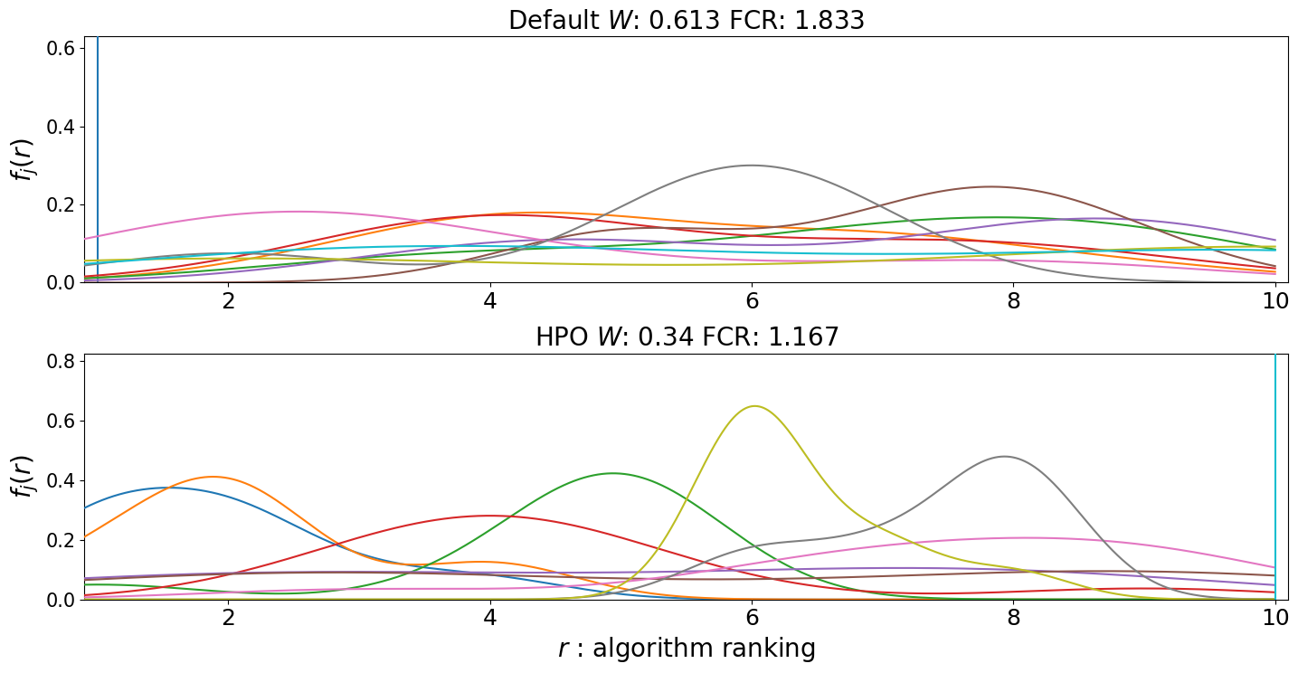
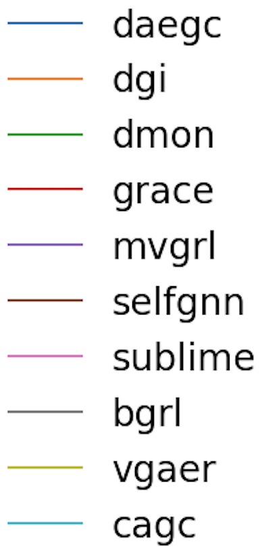
Algorithm F1 Score Rank Distribution Estimation Comparison on Cora
Notes:
Here is the ranking distributions for each algorithm over random seeds for a single metric (f1) and single dataset (cora), comparing the difference in results between default and HPO.
The W randomness coefficient is a proxy for measuring overlap in these probability distribution. In this experiment the HPO had more consistent results and also by the framework comparison rank the results were also better.

Slide 7
Results
 | Default HPs | HPO
W Randomness Coefficient | 0.476 | 0.489
Framework Comparison Rank | 1.829 | 1.171
Notes:
Using these results we calculate the ranking of each algorithm on each seed across all datasets and metrics, which allows us to calculate the W randomness coefficient for evaluating trustworthiness of the results. We get a similar value, likely because of the model validation addition that we make for all default parameter values.
We also compare each result for default hyperparameters and HPO and rank which is higher, then average across all the results, to find that the HPO results are on average better.
The results for both parameter sets are equally trustworthy but the hyperparameter optimisation gives better results

Slide 8
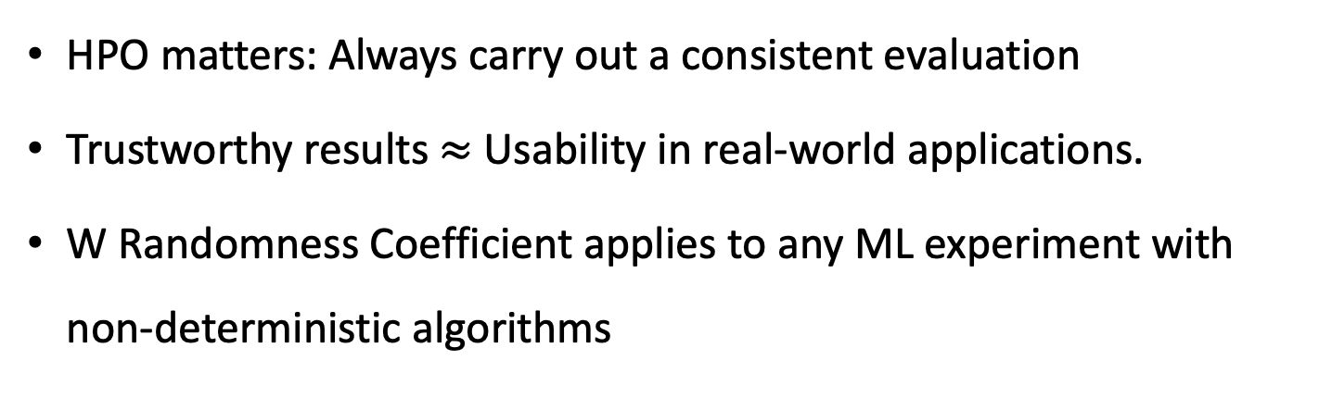
Conclusions
HPO matters: Always carry out a consistent evaluation
Trustworthy results $≈$ Usability in real-world applications.
W Randomness Coefficient applies to any ML experiment with non-deterministic algorithms
Notes:
What does this mean?
HPO matters for unsupervised GNN community detection. This is important as in this field a HPO should always be carried out.
If we quantify the trust we can have in results then it makes model selection more useable for practical real world applications.
This allows us to fairly compare model relative performance, rather than relying on inconsistent evaluations in papers.
Means we don’t waste GPU resources, time, energy and money as we can lift results where the evaluation framework is the same
And this was just one way of quantifying the consistency of a framework, there are potentially other ways of evaluating this, but the main takeaway is that the consistency of results should be detailed in all evaluations.
You can apply this to other ML areas such as Link prediction, Question answering, machine translation, sentiment analysis, object detection, image classification, retrieval, time series forecasting.

Slide 9
Questions?
I’m on the Job Market - Thesis Deadline April 2024
Areas of Expertise: GNNs, Unsupervised Learning, Federated Learning
Twitter: @WillLeeney
Notes:
Now, I’m finishing some work on federated learning and purely unsupervised learning.
My thesis is due in April so I am currently looking for work in industry or as a post doc, and I am interested in GNNs obviously, specifically unsupervised learning or federated learning.
This is my twitter handle but I also have linkedin, pls hit me up to talk about this or find me at the conference.

