Slide 1

PACMAN
Will Migdol

Slide 2
The Presentation
How I setup my project
How I created each object in the game using just Three.JS
How I animated each object
Game Demonstration

Slide 3
Setup

Slide 4
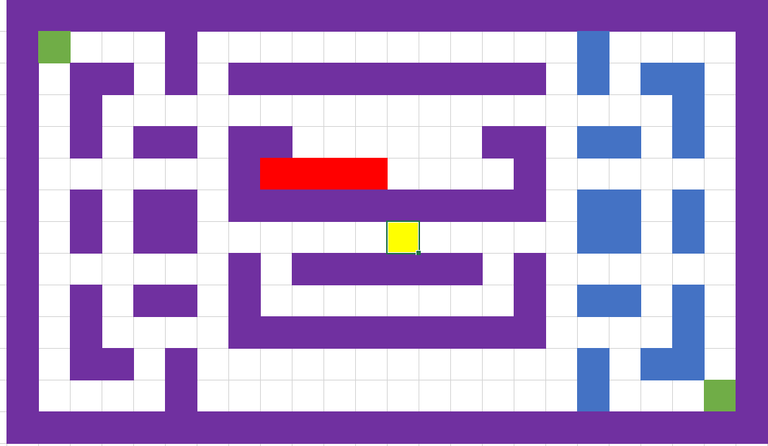
Setup

Slide 5

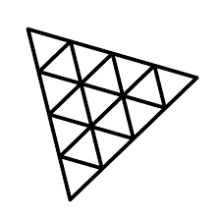

Tech Stack

Slide 6
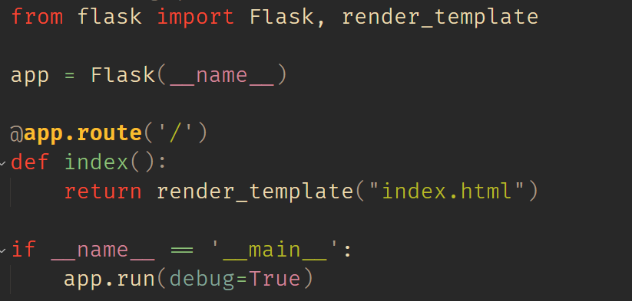
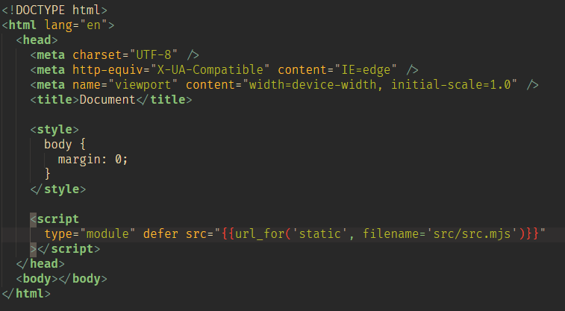

Slide 7
Objects

Slide 8


Pacman

Slide 9
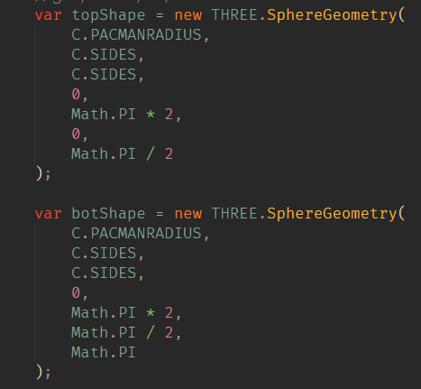
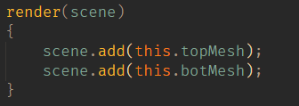
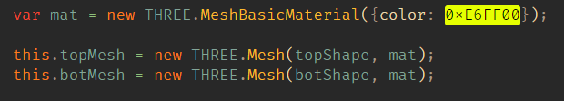

Slide 10
Walls

