Slide 1
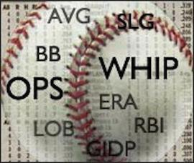
Determinants of a winning pitcher
By, William, Mohammed, and Tyler

Slide 2

Workflow:
-Getting clean/cleaning the data
-Exploring the variables
-Modeling
-Validating the model

Slide 3
Getting clean data
The data was taken from MLB.com: The Official Site of Major League Baseball (www.mlb.com).
The acquired data is in a structured format.
For our study we are going to use the players names & surnames as unique key for the data.
Any row where the salary was missing was discarded and any missing game statistic was set to 0.

Slide 4
Exploring the variables: Explanations
Wins - this is our dependent variable that we will be testing which of the other variables are statistically significant and determining whether a pitcher wins or not.
pSal - each independent pitchers salary of 2016 season which we are testing whether a higher salary correlates to more wins.
IP - Innings Pitched is the total number of innings (3 outs) a pitcher throws in a regular season; whether the more innings they pitch the more likely they are to win.
ERA - Earned Run Average is a measurement of the average number of Runs a pitcher allows in 9 innings of play over the entire season. Testing whether the lower this is the more likely a pitcher iis to win.
WHIP - Measurement of the number of baserunners a pitcher has allowed per inning pitched. Testing where the lower the number the more likely a pitcher is to win.
Ks - The number of strikeouts the pitcher had throughout the whole regular season. Testing whether the number of strikeouts a pitcher has in the regular season is a determinant of the number of wins they have.
BB’s - The number of walks the pitcher had throughout the whole regular season. Testing whether having a lower number of walks over a regular season is a determinant of the number of wins they have

Slide 5
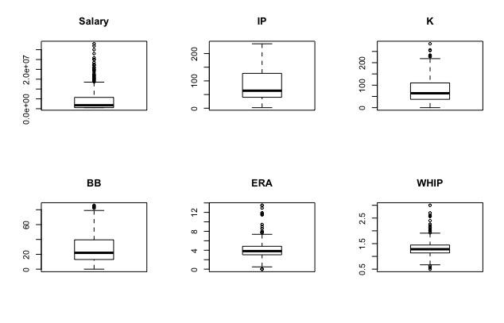
Statistics of Variables: boxplots
These boxplots show:
Salary has a very low average but has many outliers in the 3rd quantile
IP (Innings pitched) has most observations around the average and no outliers.
K (strikeouts) has a similar average to IP and has few outliers.
par(mfrow=c(2, 3))
boxplot(data_pitchers$sal, main="Salary")
boxplot(data_pitchers$IP, main="IP")
boxplot(data_pitchers$K, main="K")
boxplot(data_pitchers$BB, main="BB")
boxplot(data_pitchers$ERA, main="ERA")
boxplot(data_pitchers$WHIP, main="WHIP")

Slide 6
Box Plot’s Cont.
BB (walks) average is low and most of the observations are around it with very few outliers.
ERA(Earned Run Average) has most of its observations inbetween .5 and 8 with a few outliers.
WHIP(majority of the observations are really close to the mean with very few outliers.
par(mfrow=c(2, 3))
boxplot(data_pitchers$sal, main="Salary")
boxplot(data_pitchers$IP, main="IP")
boxplot(data_pitchers$K, main="K")
boxplot(data_pitchers$BB, main="BB")
boxplot(data_pitchers$ERA, main="ERA")
boxplot(data_pitchers$WHIP, main="WHIP")

Slide 7
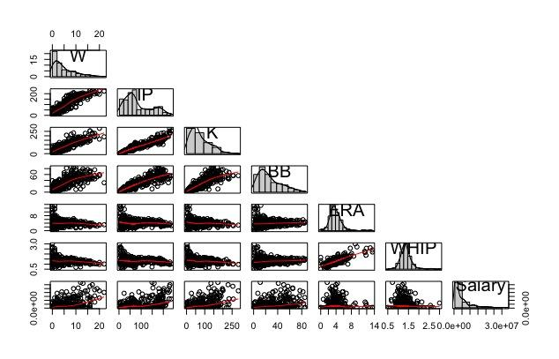
Correlation amongst independent and dependent variables: W~
IP = Strong positive(+) correlation
K = Strong positive(+) correlation
BB = Strong positive(+) correlation
ERA = Weak to no correlation
WHIP = Weak to no correlation
panel.hist <- function(x, ...) {
# Set user coordinates of plotting region
usr <- par("usr"); on.exit(par(usr))
par(usr = c(usr[1:2], 0, 1.5))
par(new=TRUE) # Do not start new plot
hist(x, prob=TRUE, axes=FALSE, xlab="", ylab="",
main="", col="lightgray")
lines(density(x, na.rm=TRUE)) # Add density curve
}
pairs(~ W + IP + K + BB + ERA + WHIP + Salary, data=data_pitchers,
lower.panel = panel.smooth, upper.panel = NULL,
diag.panel = panel.hist)
* Also note that IP is strongly correlated to K’s BB, and Salary.
Notes:
*Amongst independent variables
The more innings a pitcher is likely to throw, the higher his salary is expected to be, as well as the more chances he has to strike out and walk batters.
Also talk about the correlation amongst variable besides K’s, BB, and Salary

Slide 8
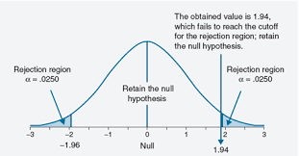
Does the entire set of independent variables contribute significantly to the prediction of Y(Win the game)?
We are aiming to build a predictive model of a team’s wins based on it pitcher statistics.
Ho = WINS is independent of variables
Ha = at least one variable is dependent
For this non-directional question we are going to use a significance 𝜶 = 0.05

Slide 9
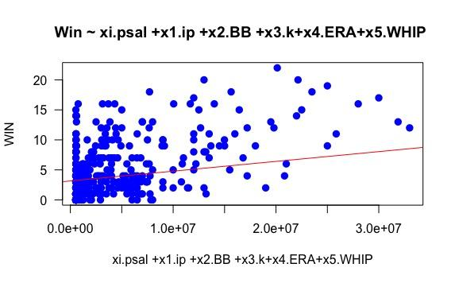
Hypothesis: Wins = pSal + IP + ERA + WHIP + Ks + BB
Ho = WINS is independent of IP + ERA + WHIP + Ks + BB + pSal
Ha = at least one variable is dependent
Residuals:
Min 1Q Median 3Q Max
-5.845 -1.153 -0.056 1.045 7.417
Coefficients:
Estimate Std. Error t value Pr(>|t|)
(Intercept) -5.054e-01 5.716e-01 -0.884 0.37710
pSal_d 5.057e-08 1.985e-08 2.548 0.01122 *
IP_d 6.043e-02 5.804e-03 10.413 < 2e-16 ***
ks_d 1.504e-02 5.750e-03 2.616 0.00922 **
bb_d -2.742e-02 1.087e-02 -2.522 0.01205 *
ERA_d -1.009e-01 8.977e-02 -1.124 0.26154
whip_d 1.370e-01 5.801e-01 0.236 0.81346
---
Signif. codes: 0 ‘***’ 0.001 ‘**’ 0.01 ‘*’ 0.05 ‘.’ 0.1 ‘ ’ 1
Residual standard error: 1.939 on 400 degrees of freedom
Multiple R-squared: 0.8241, Adjusted R-squared: 0.8215
F-statistic: 312.4 on 6 and 400 DF, p-value: < 2.2e-16
plot(lm())

Slide 10
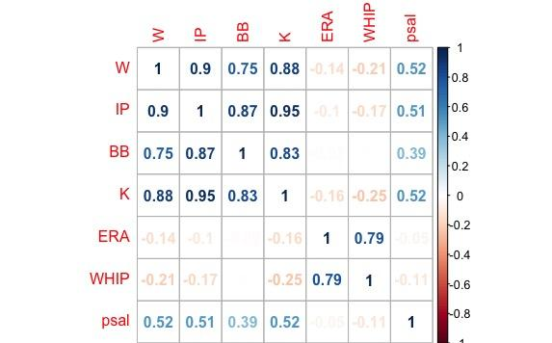
Correlation matrix between Variables explained
ERA & WHIP are negatively correlated with WINS
corrplot()

Slide 11
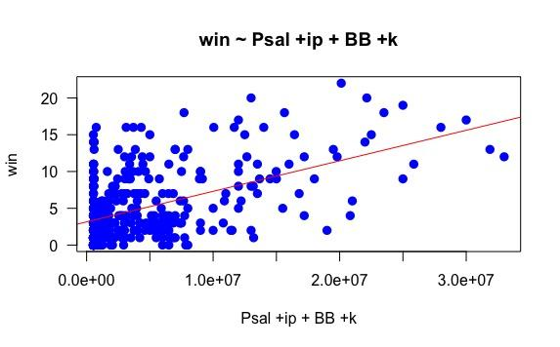
Excluding: ERA and WHIP (w ~ psal+ip+BB+k)
Not statistically significant to our model, therefore not a determinant of whether a pitcher wins a game.
Call:
lm(formula = wins_d ~ pSal_d + IP_d + ks_d + bb_d)
Residuals:
Min 1Q Median 3Q Max
-6.0235 -1.1530 -0.0256 0.9669 7.4926
Coefficients:
Estimate Std. Error t value Pr(>|t|)
(Intercept) -7.517e-01 1.702e-01 -4.416 1.3e-05 ***
pSal_d 4.906e-08 1.983e-08 2.475 0.01375 *
IP_d 5.958e-02 5.766e-03 10.333 < 2e-16 ***
ks_d 1.682e-02 5.497e-03 3.059 0.00237 **
bb_d -2.897e-02 1.007e-02 -2.877 0.00423 **
---
Signif. codes: 0 ‘***’ 0.001 ‘**’ 0.01 ‘*’ 0.05 ‘.’ 0.1 ‘ ’ 1
Residual standard error: 1.94 on 402 degrees of freedom
Multiple R-squared: 0.8231, Adjusted R-squared: 0.8213
F-statistic: 467.6 on 4 and 402 DF, p-value: < 2.2e-16

Slide 12
Hypothesis result
Goodness fit R = 0.823 and correlation coefficient r =0.907
This shows the Data is strongly positively correlated.
The final eq:-
y = -0.504 + (5.057e-08)xi+ 0.0604x1- 0.027x2 + 0.015x3 - 0.101x4 + 0.137x5
Based on the multiple regression done, we reject our NULL hypothesis that
The dependent value is explained by the independent values

Slide 13
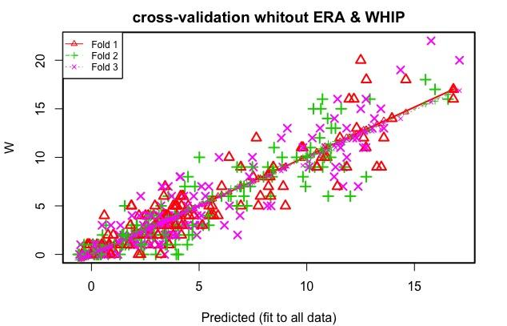
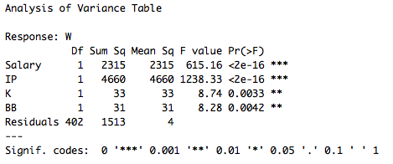
Cross Validation without ERA and WHIP
Finally we did a 3-fold cross validation to validate the model:
?cv.lm

Slide 14
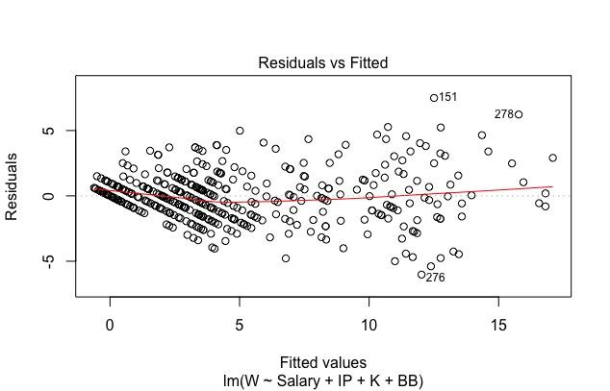
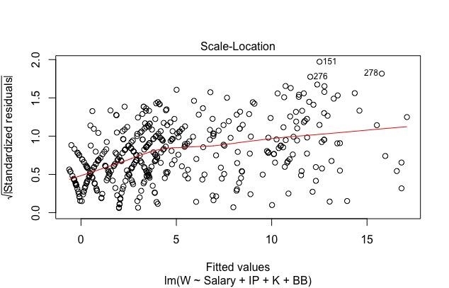
Good model & Homoscedasticity ~ constant variance
(W ~ pSal + IP + K + BB)
The model correctly represents the trend of the data and the variance of the residual is constant.
?plot(lm())

Slide 15
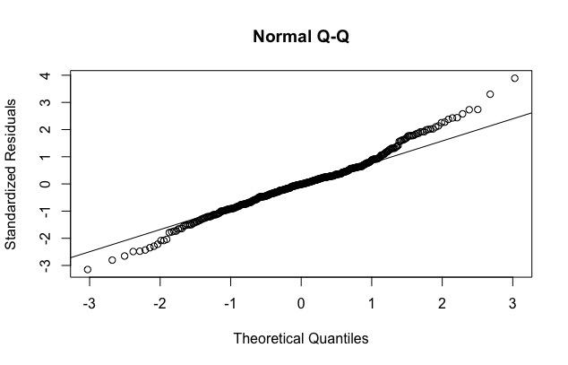
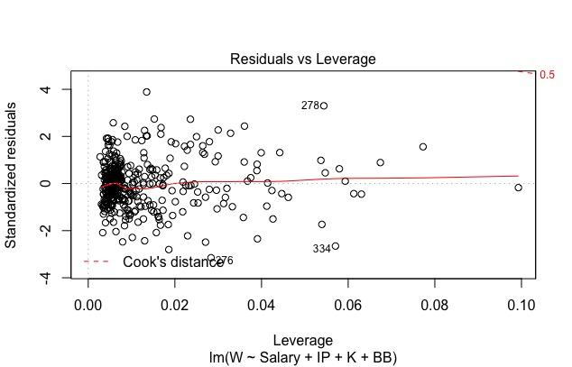
Normality & Influence of outliers
(W ~ pSal + IP + K + BB)
The model’s distribution correspond mainly to a normal distribution and the outliers don’t have a great influence on the model.
plot(lm())

Slide 16
Conclusion
Even though our Goodness of fit measurement (Multiple R²) is marginally better with our first model including ERA and WHIP (.8241) compared to our model with all significant values (.8231) by (.0002). Leaving out the variables makes our whole model statistically significant thus stating that at a at a 95% confidence level, Strikeouts, Walks, Innings Pitched, and Salary are good determinants on whether a pitcher is going to win a game.

