Slide 1
Data Security in Insurance

Slide 2
Introduction and Industry Background
Kindell Holst, William McGuire, Denesha Record – Group 13
The Insurance Industry
The main service of the insurance industry is insurance, which provides compensation in cases of sudden or unexpected loss to those willing to pay a premium.
Massive industry, with nearly 3 million employees in the US alone.
5900 US insurance companies with combined premiums totaling more than 1 trillion dollars annually, making insurance one of the largest industries in the nation
When ranked by asset holding, many of the top insurance companies are holdings companies that happened to be classified as insurance, for example Warren Buffet's Berkshire Hathaway.
Top insurance companies should be looked at by market share for specific insurance types.

Slide 3
Introduction and Industry Background
Technology
Increased technology on vehicles
Virtual estimating via smartphone
Developing personalized packages through machine learning
AI chatbots to file claims
Monitoring customer driving for more personalized rates
Monitored driving provides valuable databases
Notes:
Technology is playing a large role in how the car insurance industry is growing and changed. Increasing amount and variety of technology on vehicle has raised repair cost significantly, leading to higher rates of vehicles being deemed total losses and higher premiums. Most companies have introduced virtual estimating via smartphones which can provide more efficiency in the beginning but does lead to more missed damage. Companies are using machine learning to develop personalized packages and using ai chatbots to file claims. For several years, companies have offered monitored driving through devices installed in the vehicle or their apps. Premiums have historically been set based on demographics and location, so this monitoring technology allows the company to offer better rates for better drivers and creating valuable databases of customer driving habits.

Slide 4
Threat Trends
Personal info breaches
Ransomware attacks
Advanced Persistent Threat (APT) groups sponsored by countries such as Iran and North Korea
Notes:
The most common data threat in the insurance industry is a personal info breach. This can involve hackers accessing customer or employee information including names, phone numbers, social security numbers, bank account info, even life insurance records and policies. Companies are often legally required to provide costly services to customers in the wake of a data breach, but they still cost time and energy from the customer to clean up.
Another area of concern is hackers targeting IT systems directly in ransomware attacks. A ransomware attack involves locking a company out of its computer systems and requiring them to pay a ransom to regain access. Companies often pay the ransom because it is cheaper than trying to get around the hacker’s systems.
Companies also face threats from Advanced Persistent Threat (APT) groups sponsored by countries such as Iran and North Korea. These groups often target organizations for financial gain. For instance, North Korean group Lazarus completed a cyerheist against a Federal Reserve Bank of New York account that belongs to Bangladesh Bank.

Slide 5
Threat Trend Sources
What You Need to Know About the MOVEit Data Breach - Experian
What is SIM swapping & how does the hijacking scam work? – Microsoft 365
What is SIM swapping & how does the hijacking scam work? – Microsoft 365
11 biggest financial sector cybersecurity threats | CSO Online
Notes:
We researched these threat trends using articles from Experian, Microsoft 360 and CSO online

Slide 6
Critical Assets
Customer Information
Propriety data and models
Investment Portfolio
IT Infrastructure
Reputation
Notes:
Customer Information
Customer information is one of the most valuable and vulnerable assets of an insurance company. Accurate customer information databases are critical to correct and competitive pricing and risk assessment. They allow the company to ensure premiums are competitive but high enough to offset claim costs while maintaining a reasonable profit. If customer information is compromised, the company is at risk of great financial harm. Additionally, the company has an ethical obligation to protect customer information. This asset is used by employees across the company as well as third party agents and vendors to set pricing and work claims, so it is essential that all employees and outside parties are properly trained on appropriate safeguards.
Propriety data and models
Proprietary data is used to develop models and risk assessment tools used to set pricing, assess risk and minimize claim cost, among other uses. If these models are not kept private, the company may lose competitive advantages which can lead to higher costs. These models are used by analysts to find ways to improve the company’s competitiveness and profitability.
Investment Portfolio
Most companies maintain a robust investment portfolio to offset financial risk and maintain solvency in the face of catastrophic events. These events ebb and flow but can happen many times a year with some degree of unpredictability, so the company needs to be able to finance fluctuating costs. The investment portfolio is accessed by the company finance department and the financial institutions holding the investments, leaving it vulnerable to the same threats banking institutions face, such as hackers.
IT Infrastructure
The IT infrastructure, including hardware as well as cloud services, is essential to company operations. Without it, there would be no company, no way to perform work, to service customers, to process claims. It is the backbone of the organization. It is accessed by every employee and third party vendor, from the CEO to the IT technicians to the janitor. The infrastructure is vulnerable to hackers at every level and any breach has the ability to cripple the company.
It is essential for the company to have a proactive cyber security threat operation to protect the infrastructure from hackers attempting to damage the company.
Reputation
The company’s reputation is everything. While not a tangible asset, it is a critical one. Customers make their decisions largly based on how much they trust a company. It takes a long time to establish a good reputation, but it can be destroyed in an instant. If the company is victim to a data breach, many customers will leave the company and never consider returning. Every employee must be committed to protecting customer information and maintaining a good reputation for the company.

Slide 7
Threat Scenario 1 - Customer Information
Adversary: Organized cybercriminal groups that focus primarily on the insurance sector.
Capabilities: These attackers excel in social engineering and phishing techniques and are adept at exploiting vulnerabilities in third-party vendor systems which are often less tightly regulated, allowing them to bypass standard security measures.
Infrastructure Exploited: They target compromised IT systems at the broker or agency level, using malware and spyware to infiltrate and extract data from vulnerable vendor networks.
Victim: The direct victim is the customer data managed by our company and its third-party vendors. A successful breach here could lead to identity theft, fraudulent claims, and a significant loss of customer trust.

Slide 8
Threat Scenario 2 - Proprietary Data and Models
Adversary: Nation-state sponsored groups or corporate espionage actors motivated by a desire for strategic advantage.
Capabilities: These groups are proficient in advanced persistent threat tactics. They can perform sophisticated network intrusions and lateral movements within secure environments to access highly guarded information.
Infrastructure Exploited: They exploit vulnerabilities in our internal networks, often through zero-day exploits, to breach secure data repositories and systems that process our proprietary actuarial, pricing, and historical claims models.
Victim: Our proprietary data and models critical for maintaining our competitive edge are at risk. A compromise can undermine our operational accuracy and strategic positioning in the market.

Slide 9
Threat Scenario 3 - IT Infrastructure
Adversary: Hacktivists or nation-state actors employing ransomware and denial-of-service (DoS) tactics.
Capabilities: These adversaries are known for exploiting unpatched systems and misconfigured cloud environments. Their methods include launching large-scale distributed denial-of-service (DDoS) attacks and deploying ransomware, which can severely disrupt operations.
Infrastructure Exploited: They target our critical servers, network devices, and cloud infrastructure, particularly legacy systems that lack modern security standards.
Victim: Our overall IT operational environment becomes vulnerable, and disruptions here can lead to significant service outages, loss of data, and collateral damage to interconnected systems essential for day-to-day operations.

Slide 10
Intelligence Buy-in
Cyber Threat Intelligence (CTI)
Proactive investment
Vulnerabilities from 3rd party vendors
Quickly evolving digital landscape
Potential for enormous loss
Identify and counter threats before they escalate into full-blown breaches
Better decision making
Notes:
Cyber Threat Intelligence (CTI) is more than just another line item on our budget, it is a smart proactive investment for our insurance business. We deal with sensitive customer information, proprietary underwriting models, and sizable investment portfolios every day. In an era where cyber adversaries are constantly refining their tactics, our industry is in the crosshairs not only because of our own systems but also through our brokers and agencies, which often have less strict oversight. With nearly 60% of data breaches linked to third-party vendors, having a robust CTI strategy is not a luxury; it is a necessity.
The digital landscape is evolving quickly, with cybercriminals using ransomware, phishing, and advanced persistent threats to target not just our IT infrastructure but also the valuable data we hold. When attackers hit an insurance company, the damage is enormous due to lost customer trust, heavy financial penalties, and exposure of our critical actuarial and risk models. Past incidents in our sector have seen breaches costing millions, and these events drive up insurance premiums and operating costs, affecting our bottom line.
By integrating CTI into our security strategy, we are not waiting for an attack to happen. Instead, we are positioning ourselves to identify and counter threats before they escalate into full-blown breaches. This approach allows us to make smarter, more informed decisions, invest effectively in our most vulnerable areas, and fine-tune our incident response plans. In the competitive insurance market, this proactive stance not only shields our invaluable assets but also protects our reputation and ensures long-term profitability.

Slide 11
Dataset Identification and Justification
Protecting against Phishing attacks in the insurance industry
The Problem
Why Phishing Matters?
Phishing accounts for over 90% of data breaches
Phishing is the top form of social engineering today
Attacks mimic trusted websites to steal private data
Manual detection is slow and prone to error
Machine-driven protection is needed
Notes:
To address the growing threat of phishing in the insurance industry, we selected two datasets that support different, but complementary, approaches to detecting and preventing these attacks.
Let’s start with some context. As mentioned in our first milestone, phishing remains the most dangerous form of social engineering today. These attacks often come in the form of emails or messages that link to fake but convincing websites designed to steal credentials or sensitive information. Given how easily these attacks can bypass human judgment, we need to shift toward machine-driven solutions that flag threats before they reach employees.

Slide 12
Dataset Identification and Justification
Dataset 1
Phishing Websites (University of Huddersfield)
Dataset 2
VirusTotol
Built from PhishTank, MillerSmiles, Google search data
Created to fill the gap in quality phishing detection datasets
Captures commonly observed and inferred phishing traits
Enables website classification using ML (no human/manual scanning required)
Scans URLs with 70+ antivirus engines
Used across cybersecurity industry
Screens emails to alert users of suspicious links
Real-time protection at point of click
Why these two?
Complementary Datasets for Comprehensive Defense
Dataset 1
Builds predictive model to detect phishing websites
Total has high reliability; Dataset 1 adds automation
Dataset 2
Flags dangerous links before they’re opened
Together, they offer layered protection against phishing
Notes:
Speaker Notes: Dataset One: Phishing Websites
Our first dataset was created by researchers Rami M. Mohammed and Lee McCluskey at the University of Huddersfield. They pulled data from sources like PhishTank, MillerSmiles, and Google search operators to compile a robust list of phishing sites. The dataset was specifically built to train machine learning models to detect phishing using basic domain, URL, and website features.
While the dataset doesn’t include every possible feature because realistically, that’s not possible it captures the most commonly observed indicators. The goal here is to train a model that can automatically classify websites as phishing or legitimate, helping companies avoid the need for manual reviews or costly scanning tools.
Dataset Two: VirusTotal The second dataset comes from VirusTotal, a trusted platform that scans URLs using over 70 antivirus engines. VirusTotal has been a cybersecurity mainstay for the last 20 years and is now part of Google’s Chronicle division.
We plan to use VirusTotal to screen email links received by employees. If a suspicious URL is detected, the system can alert the recipient before they click. This adds an essential layer of protection right at the inbox level, stopping phishing attempts in real time.
Why These Two? Together, these datasets allow us to build two protective tools. The first uses machine learning to evaluate websites directly. The second leverages VirusTotal to intercept bad links before users interact with them.
We do want to point out that the VirusTotal data offers higher reliability due to its industry-wide adoption and proven accuracy. While we have strong confidence in the phishing websites dataset, our model’s performance will depend heavily on the features it captures. That said, both datasets are valuable, and together, they support a proactive strategy to keep our customer data safe from advanced phishing threats.

Slide 13
Collecting & Parsing Phishing Website Data
Data Set is free to download off Irvine Machine Learning Repository
Originally an ARFF file meant for WEKA software
It was converted to a csv for our analysis
Already clean and ready to go for modeling
Notes:
Let’s talk about how we accessed and prepared our two datasets.
First, the phishing websites dataset—we sourced it from the UC Irvine Machine Learning Repository, which is a trusted platform hosting over 600 publicly available datasets for machine learning applications. One of the benefits of this dataset is that it also comes with a detailed Word document that explains the rationale behind each feature, helping us understand how it contributes to phishing detection.
Originally, the dataset was stored in an ARFF file format. That’s a format typically used with WEKA, an open-source machine learning tool. Since we’re not using WEKA for this project, we converted the ARFF file into a CSV format.
We used Python to do this. A simple script allowed us to read the ARFF file into a pandas DataFrame, convert the data types to integers for consistency, and then export the DataFrame to CSV. This format allowed us to easily begin preprocessing and modeling using our preferred machine learning tools.

Slide 14
Collecting & Parsing VirusTotal Data
Utilize free API key to collect data
The data has restriction on the amount of request that can be made, i.e. 4 per minute
Produces a JSON file
Needed to parse through using Beautiful Soup to get the necessary statistics
Notes:
Now for the VirusTotal dataset—this one is accessed through their API. We’re using the free API key available to account holders for the purpose of testing and demonstration. But it’s important to note that this free version has strict limits: only 4 requests per minute. For a real-world deployment, a paid API subscription would be required to support enterprise-scale use.
We’re using Python’s requests library to make API calls. The data returned comes in JSON format, and we focus primarily on two parts of the response: the metadata and the statistics reported by malware scanners. These fields give us insights into how likely a URL is to be malicious.
Parsing the JSON is straightforward—we treat it like any dictionary or nested object in Python, and extract the fields we need. While the free version does limit the number of results, it still includes the key security indicators that we care about.
So, with both datasets prepared—one cleaned and formatted from ARFF to CSV, and the other retrieved in real time via API—we’re ready to move forward with building and testing our phishing detection models.

Slide 15
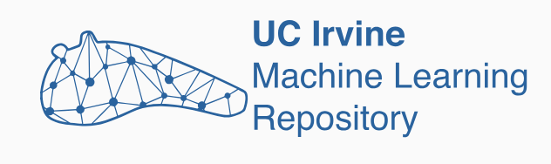
Phishing Websites Data Set
Collected from the UC Irvine Machine Learning Observatory
Created by Rami M. Mohammad and Lee McCluskey at The University of Huddersfield
Made for Machine Learning models
Can be used to identify phishing websites early and prevent possible breaches of sensitive customer and business information
Notes:
Let’s take a closer look at the structure and features of each dataset.
Starting with the phishing websites dataset from the UCI Machine Learning Repository— It contains a total of 11,055 website records, with 4,898 confirmed phishing sites and 6,157 legitimate ones. This gives us a fairly balanced classification problem, which is ideal for training models without needing to overcompensate for class imbalance.
There are 30 features in the dataset, each one representing a specific trait of the website or URL. These include indicators like whether the domain uses an IP address, the presence and validity of an SSL certificate, the length of the URL, and other structural characteristics of the page. All the features are represented as integers, and importantly—there are no missing values in the dataset, which makes preprocessing much simpler.

Slide 16

VirusTotal
Uses over 70 antivirus scanners on provided URLs or files
Has an API that can be used to automate URL scans and add additional features
Serves a similar purpose as the first data source, as it can be used to protect against breaches in security through phishing websites
Gives us flexibility for scans to be made on parsed emails
Notes:
Now on to the VirusTotal data. This data is pulled dynamically using their public API. For every URL we query, the API returns a structured JSON response. We focus on two main components:
The metadata, which includes things like timestamps and total detection counts.
And the malware scanner results, which come in the form of a nested dictionary where each participating engine gives its verdict.
Each engine can label a site as malicious, suspicious, undetected, or harmless. These labels become the core features for our analysis.
While most responses are complete, we may encounter a few edge cases—for example, a field called filescan_id may be null if the URL hasn’t been scanned before. Similarly, some engines might not return a result if they haven't assessed that particular link.
Despite these occasional gaps, the VirusTotal dataset gives us rich, real-time indicators of a site's threat level, making it a strong complement to the more static phishing dataset from UCI.

Slide 17
Phishing Website Data Set Dictionary
There are 11055 instances with 31 attributes
Attributes consist of Address Bar, Abnormal, HTML and JavaScript, and Domain based features
All attributes are categorized as:
1 = Legitimate
0 = Suspicious (not in all attributes)
-1 = Phishing

Slide 18
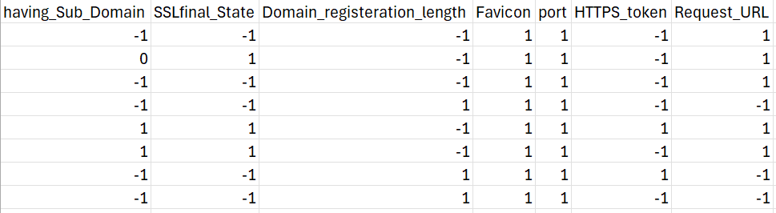
Phishing Website Data Set Example
Visualized sample of phishing website example with attributes categorized as:
1 = Legitimate
0 = Suspicious (not in all attributes)
-1 = Phishing
:

Slide 19
Virus Total Data Summary
The data we care about lies in the data
Attributes
Stats portion of the JSON file
The returned attributes of importance are the number of scans for:
Malicious
Suspicious
Harmless
Undetected
Timeout

Slide 20
VirusTotal Data Example
JSON Output:
{'data': {'id': ‘api-key’, 'type': 'analysis', 'links': {'self': 'https://www.virustotal.com/api/v3/analyses/api-key', 'item': 'https://www.virustotal.com/api/v3/urls/dd014af5ed6b38d9130e3f466f850e46d21b951199d53a18ef29ee9341614eaf'}, 'attributes': {'stats': {'malicious': 0, 'suspicious': 0, 'undetected': 26, 'harmless': 71, 'timeout': 0}, 'date': 1745282536, 'status': 'completed', 'results': {'Artists Against 419': {'method': 'blacklist', 'engine_name': 'Artists Against 419', 'category': 'harmless', 'result': 'clean'} …
{'data': {'id': ‘api-key’, 'type': 'analysis', 'links': {'self': 'https://www.virustotal.com/api/v3/analyses/api-key', 'item': 'https://www.virustotal.com/api/v3/urls/dd014af5ed6b38d9130e3f466f850e46d21b951199d53a18ef29ee9341614eaf'}, 'attributes': {'stats': {'malicious': 15, 'suspicious': 1, 'undetected': 25, 'harmless': 56, 'timeout': 0}, 'date': 1745282536, 'status': 'completed', 'results': {'Artists Against 419': {'method': 'blacklist', 'engine_name': 'Artists Against 419', 'category': 'harmless', 'result': 'clean'} …

Slide 21
Observations on Data Patterns

Slide 22
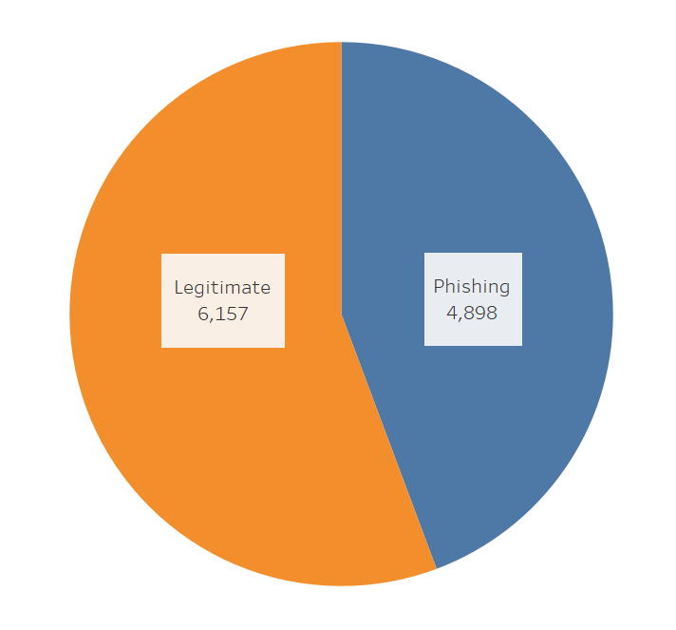
Phishing Results Distribution
When creating a machine learning model, the target variables distribution matters
The distribution is decently even, with the majority class having 56%
No need for stratified sampling

Slide 23
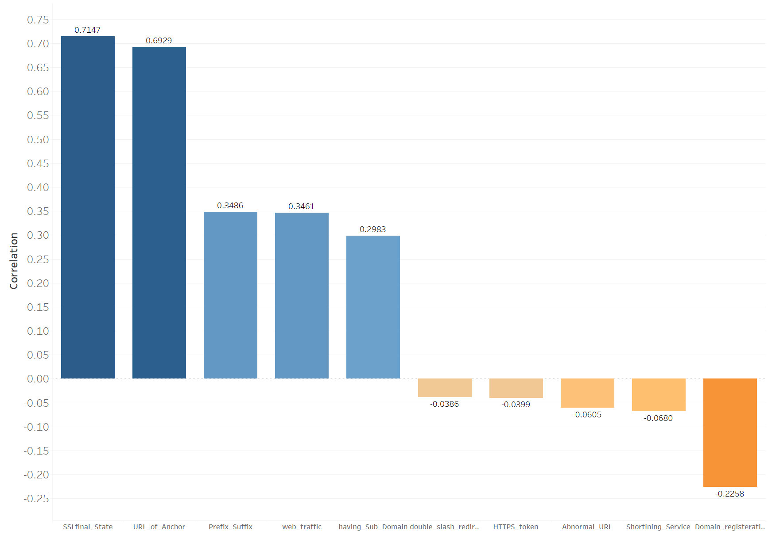
Attribute Importance
To gauge how important each attribute is, we found the correlation with results
HTTP with SSL and URL of Anchor are the most correlated
Some are negative

Slide 24
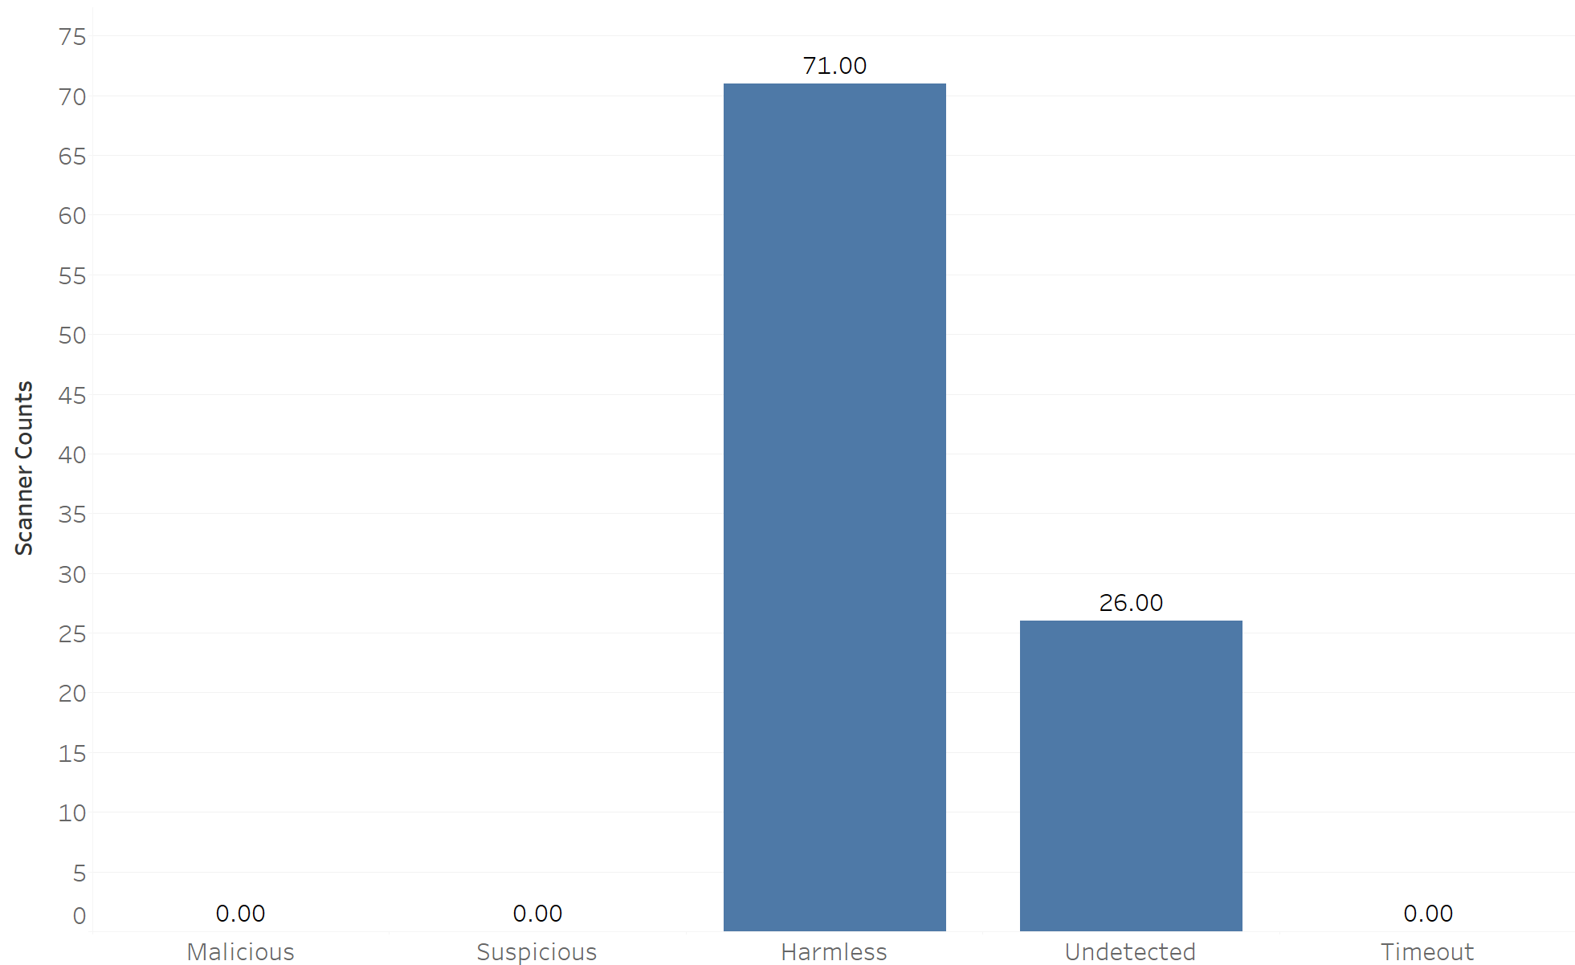
Google Scan
Returns no Malicious or Suspicious
Undetected does occur a decent amount

Slide 25
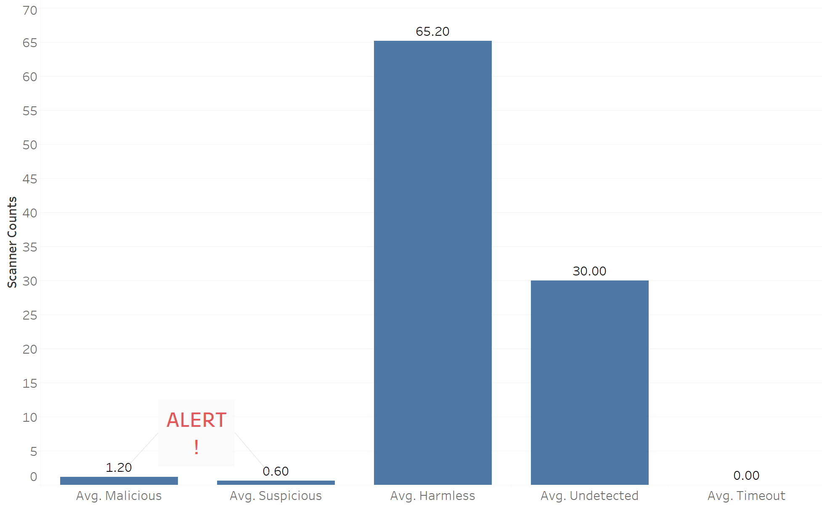
Phishing Scan
Scan of many websites considered phishing websites on phishtank
On average, only returns 1.2 for Malicious and 0.6 for Suspicious
A single alert should stop a user from accessing the site

Slide 26
Artifact Selection

Slide 27
Artifact Selection
For the Phishing Website Data Set, we chose a random forest model to predict website legitimacy
For the Virus Total Data, we developed a software tool to parse through emails and return URL legitimacy
Both artifacts are to protect our company from phishing attacks

Slide 28
Choosing Tools
Phishing Website Prediction Model
Programmed in R using randomForest package
Email Checker
Programmed in python using BeautifulSoup and requests packages

Slide 29
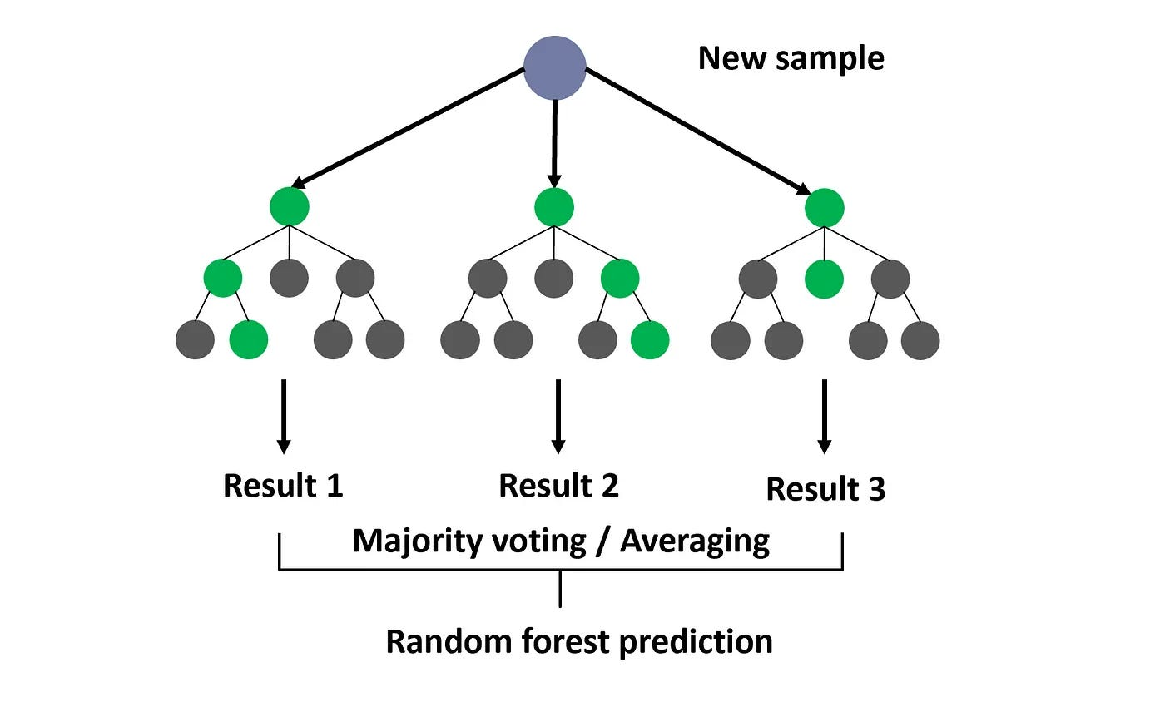
Choosing Random Forest
A Decision Tree is a machine learning technique that works well for classification
Random Forest produces several random decision trees that each get to vote on the result
Works very well with large datasets
Image from Medium article "10 Must-Know Model for ML Beginners: Random Forest" By Dagang Wei

Slide 30
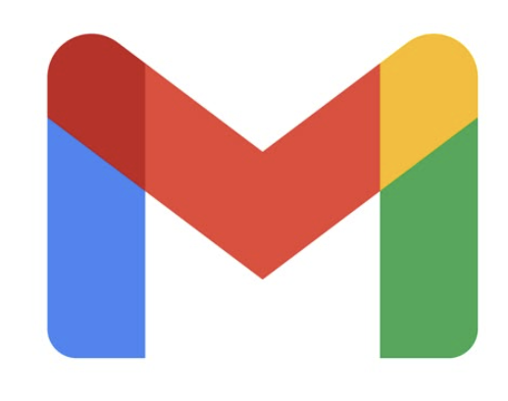
Choosing Email Checker
Most phishing attacks occur through messaging applications
Email is the most predominant in the space
To protect employees from phishing attacks, we need to protect their emails
We will need to be able to parse URLs from emails for this task

Slide 31
Artifact Presentation with Findings

Slide 32
Phishing Website Prediction Model
We have a model that can predict if a website is legitimate or not
Accuracy: 97.1% -> Very effective
Well above our goals

Slide 33

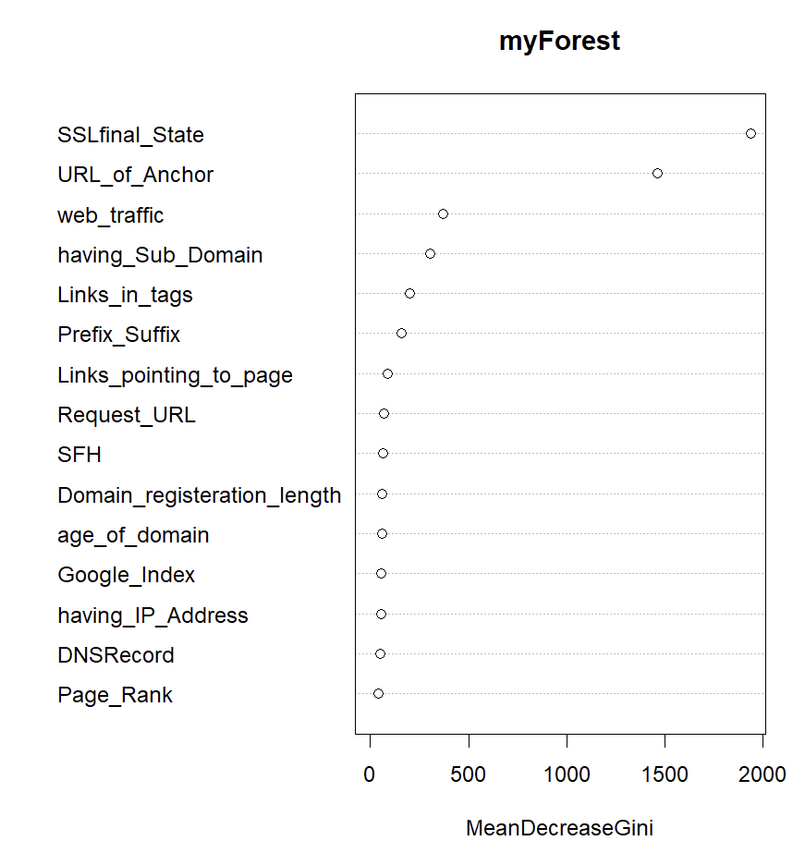
Phishing Website Prediction Model
Random Forest model provides a plot of variable importance
SSLfinal_State and URL_of_Anchor are the most important by far
Same as correlation plot provided earlier

Slide 34
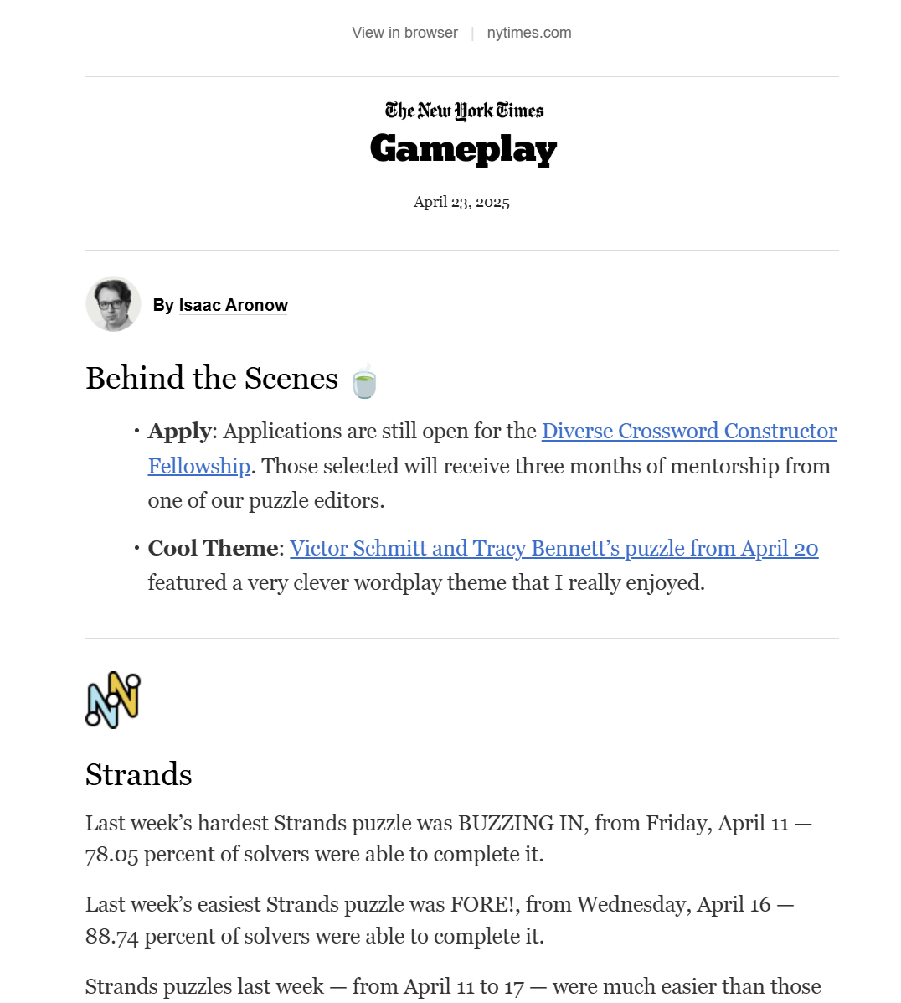
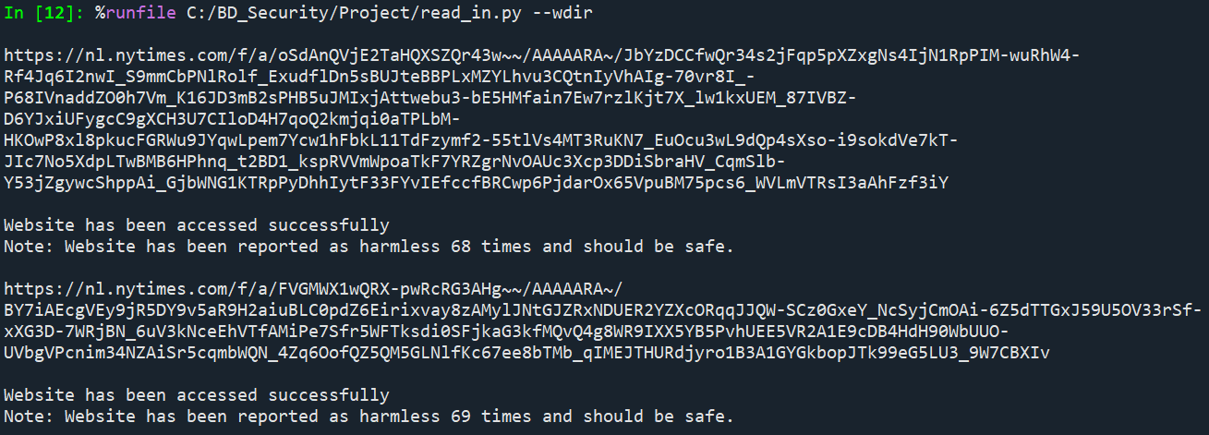
Email Checker

Slide 35
Further Steps for Artifacts
Phishing Website Prediction Model
Developing a tool to get all the attributes of the website
Email Checker
Develop a way to connect to a user email directly

Slide 36
The Impact
Both artifacts deal with one thing
Identifying phishing websites
Better phishing protection
Better overall security
Less losses due to breaches

Slide 37



Group Roles
Kindell Holst – Milestone 1
Denesha Record – Milestone 2
William McGuire – Milestone 3

Slide 38
Thank you for listening!

