Slide 1
What features or aspects of personal finance and budgeting apps cause users to leave positive versus negative reviews?
- Will Murray

Slide 2
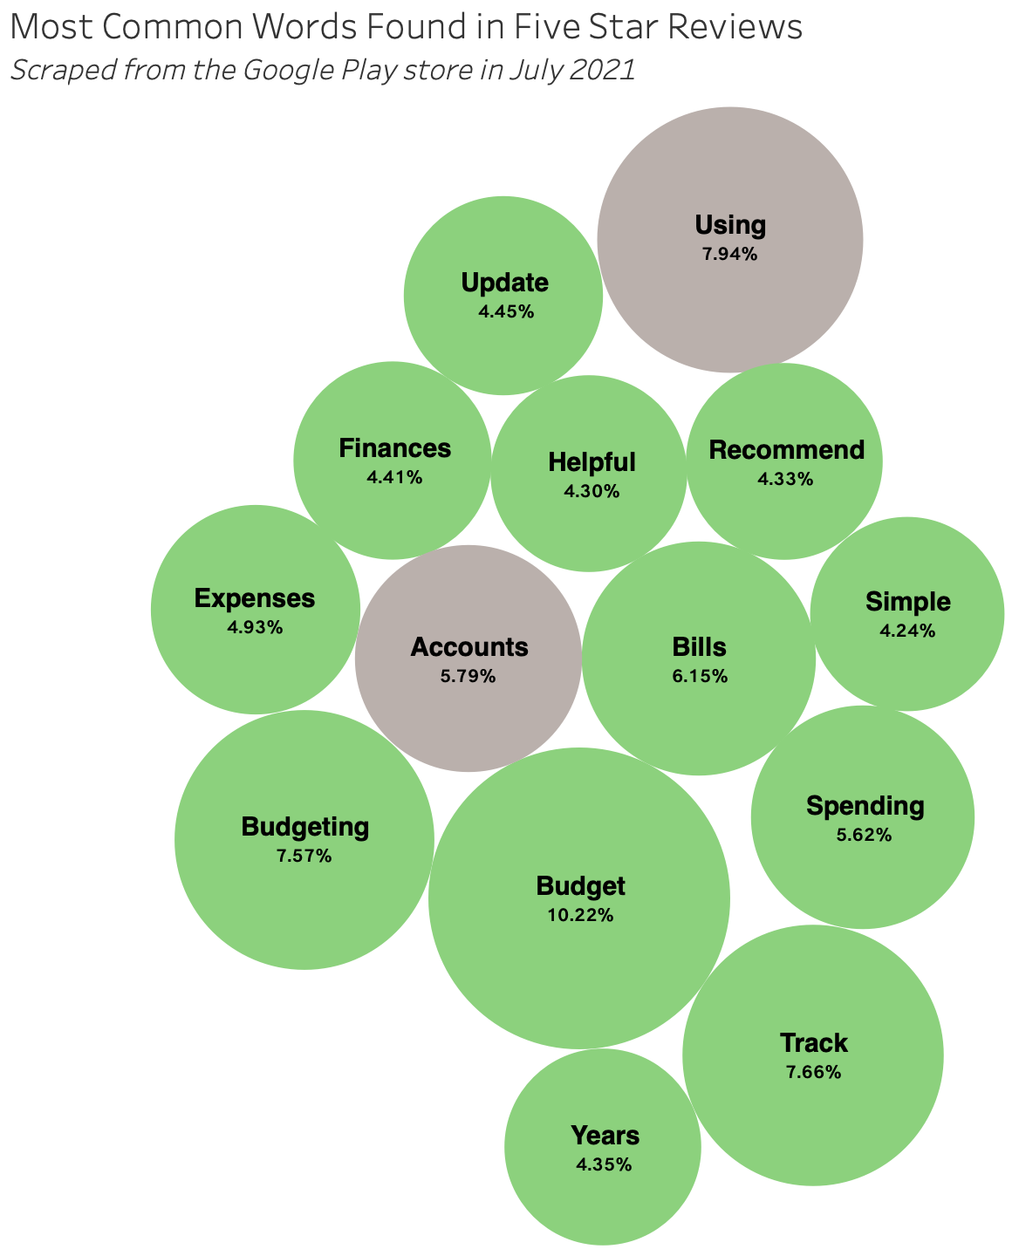
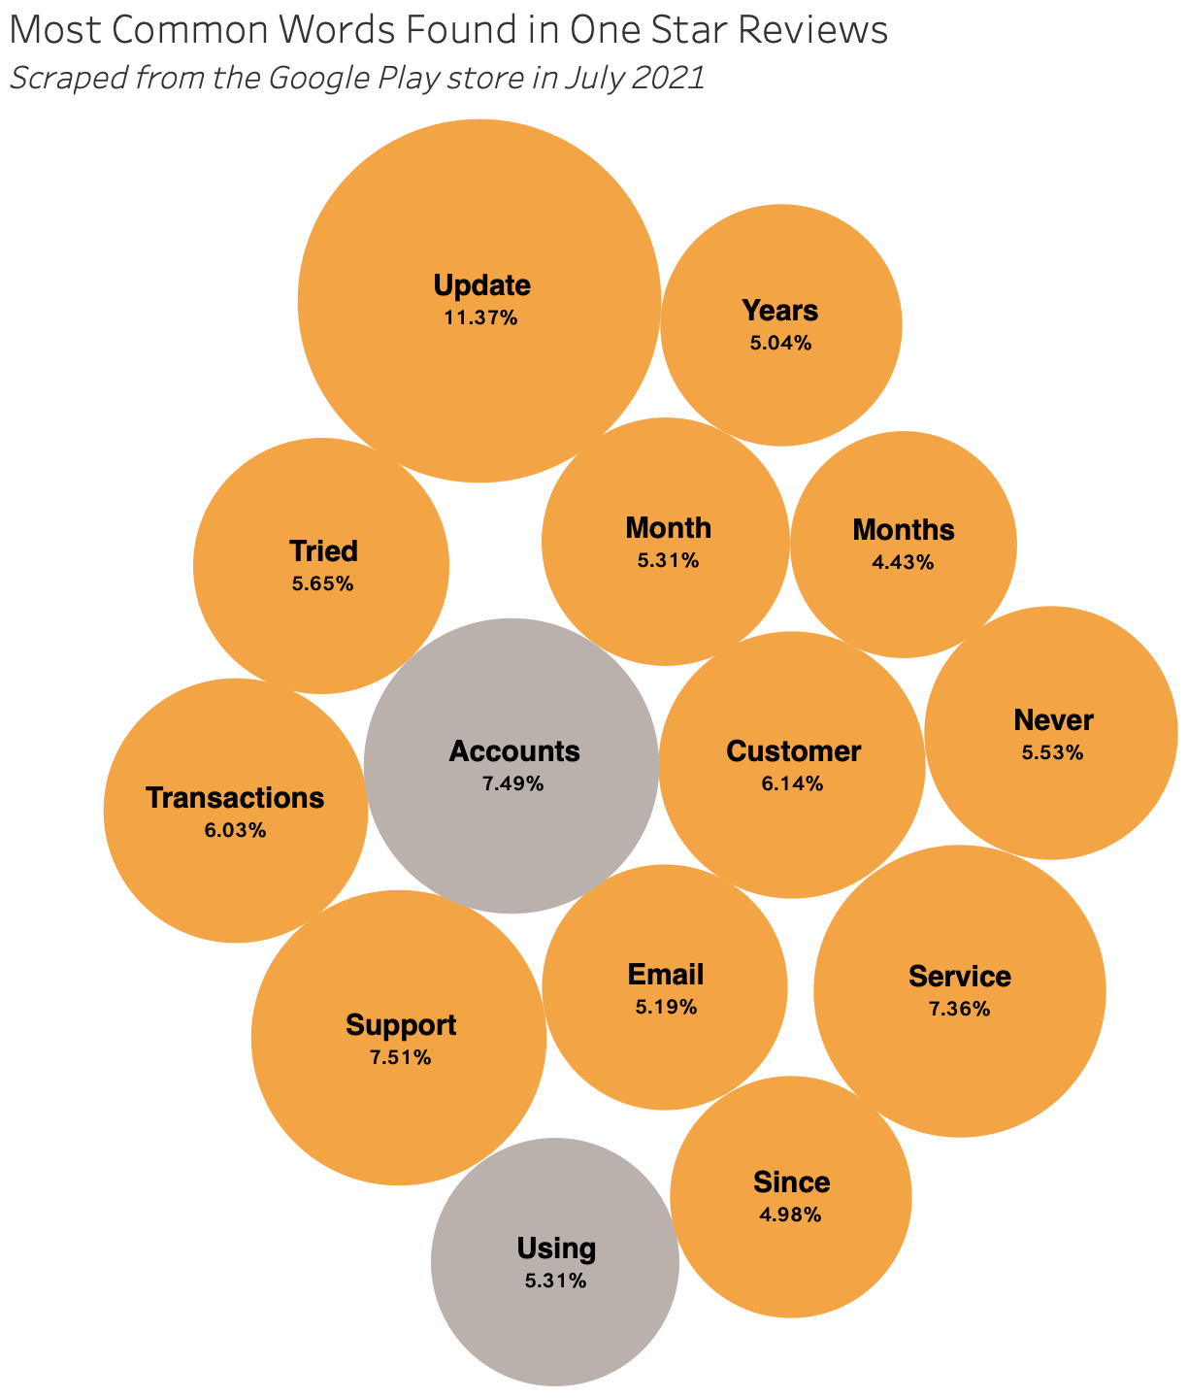
Users appreciate being able to simply track their expenses and personal finances, and they particularly despise being kept waiting by customer service
Sources: FiveStarReviewOnly.csv, OneStarReviewOnly.csv

