Slide 1

Aeon Findings
Group 2: Marshal Will, Miko wieczorek, neil callahan

Slide 2
Aeon Project Overview
Association Rules
Positive and Negative Reasons for moving out
Classification Tree and Predictions
Analytics
Recommendations

Slide 3
Association Rules
Rules are meant to find correlations in values
Example: If someone moved out and their reason was that it was for a new job. This could be marked as a positive reason and have a check for employment
Association rules help find one piece of information by relating to and predicting another piece of information
Our group focused on if the type of resources had an effect of someone moving out

Slide 4
Support, Confidence, and Lift
Support is a percentage out of all the reasons someone may move out
Confidence is the degree when a rule predicts if a person moves out for a positive or negative reason
Lift is a measurement of association
When Lift is above 1 then there is a positive association
When Lift is below 1 then there is a negative association
When Lift is 1 then there is no association

Slide 5
Positive Reasons For Moving Out
Reason for Move out | Type of Move out | Support | Confidence | Lift
Household Goods | Positive | 4.7% | 32% | 1.4
Household Goods and Income | Positive | 1.3% | 100% | 4.4
Employment and Safety | Positive | 1.3% | 80% | 3.5
Furniture and No Toys for Tots | Positive | 3% | 39% | 1.7
Computer Assistance and Life Skills | Positive | 1.3% | 67% | 2.9

Slide 6
Interesting Observations for Positive Reasons to Moving Out
Having household goods was associated with having a positive reason to move out
Household goods compared to other rules made it one of the top reasons a person would move out
People moving out for employment was also common and had one of the highest lift values when combined with safety
Having a combination of life skills and computer assistance was a large predictor for a positive move out
We think this is because they were able to learn new skills and apply those to better themselves

Slide 7
Negative Reasons For Moving Out
Reason for Move out | Type of Move out | Support | Confidence | Lift
Life Skills and No Food | Negative | 1.7% | 50% | 2.5
No Back to School supplies and No employment | Negative | 18.6% | 22.4% | 1.11
Housing and No Family/Social Relations | Negative | 4.3% | 36% | 1.8
Education and No Employment | Negative | 2% | 40% | 2
Education and No Bus cards | Negative | 2% | 36% | 1.8

Slide 8
Interesting Observations for Negative Reason to Moving Out
Overall having no food had a likelihood of moving out despite being combined with life skills
Having no family or social relations had a high connection to moving out
When a person had education but no employment there was a strong chance of a negative moveout
An interesting observation we found was that Mental Health and Substance Abuse had no association to being a Negative or Positive reason to move out

Slide 9
Classification Tree
Use machine learning algorithms to help predict future connections
Works with association rules and can be used on future data to make predictions of behavior
By using an existing data set we can "train" an algorithm to make a better prediction
Rent is a large predictor to find out what led to negative moveout reasons followed by and the income and the age of the person

Slide 10
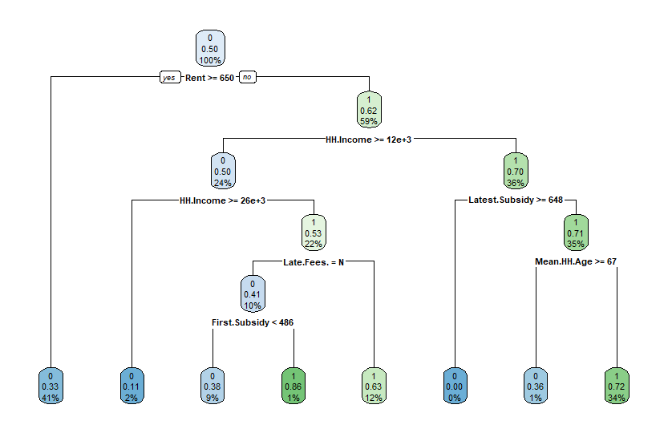
Negative Classification Tree

Slide 11
Interaction Tree Top Negative Reasons for Moving Out
Top Determinants/Predictors
Rent
Income
Latest Subsidy
Age
Fees

Slide 12
Analytics
Our rule classifies Negative Reasons to Move-out as correct and Positive Reasons to Move-out as incorrect
Negative Move Outs that are correctly classified as Negative Move Outs are called true correct and all Positive Move Outs that are correctly classified as Positive Move Outs are called true incorrect
We used a confusion matrix to demonstrate our algorithms model success rate

Slide 13




Analytics
All misclassified values are either False Correct or False Incorrect
Misclassification rate or the "Error rate" tells us how often our model is wrong
Our model's misclassification rate is about 33%
Actual Outcomes | Predicted Outcomes
Type of Moveout | Positive MO | Negative MO
Positive MO | 679 | 327
Negative MO | 115 | 203
203 True Correct
327 False Correct
679 True Incorrect
115 False Incorrect

Slide 14
How can we address reasons to move out?
Mission Statement: Aeon's mission is to create and sustain quality affordable homes that strengthen lives and communities

Slide 15
Recommendations
Provide career services to reduce the high association moving out of unemployment and educated individuals
Increase neighborhood gathering events to encourage more community interaction
Provide more Bus Cards and public transit resources for residents
Increase security and provide a safe environment for tenants
Develop community services for IT help and provide better access to educational materials
Help unemployed residents find programs that sponsor/help fund back to school supplies and provide career services

