Slide 2
super_mario_learning/ | |── 00_env_test.ipynb |── 01_wrappers_test.ipynb |── 02_random_agent.ipynb |── 03_cnn_forward_pass.ipynb |── 04_dqn_agent_parts.ipynb |── 05_training_loop.ipynb | |── mario_agent/ |── wrappers.py |── model.py |── replay_memory.py |── agent.py

Slide 3
State = 4 Frames to get context of movement
Notes:
When you're training an RL agent to play Super Mario Bros., stacking multiple frames to form a single "State" is actually the secret sauce that makes the game playable for the AI.
Here is exactly how we reconcile those frames, why it works, and how to handle color.
1. How We Reconcile 4 Frames into 1 State
To turn four separate frames into a single state, we stack them along the channel dimension.
Instead of feeding the neural network a single image, you feed it a "3D volume" or a tensor of images. If you are using PyTorch, the frames are concatenated so that the shape changes from (Channels, Height, Width) to (4 * Channels, Height, Width).
"What if the frames are different?"
They must be different! That is the entire point. If you give the AI a single, static snapshot of Mario mid-air, it has no way of knowing:
Is Mario moving up or falling down?
How fast is that Goomba walking?
Did Mario just jump, or is he about to land?
By stacking four consecutive frames, you are giving the network temporal context (time). The differences between Frame 1, Frame 2, Frame 3, and Frame 4 allow the convolutional layers in your neural network to calculate velocity, acceleration, and direction of motion.
💡 Analogy: Think of it like a flipbook. A single page is just a still picture. But when you look at a sequence of pages together, you instantly perceive motion. Stacking frames gives the AI the ability to "see" motion.
2. Can We Use Just One Color Channel (Grayscale)?
Yes, absolutely. In fact, you should use grayscale. It is standard practice in RL for retro games.
If you keep the game in full RGB color, your state shape for 4 stacked frames would be:
$$\text{Shape} = (12, \text{Height}, \text{Width})$$
(4 frames $\times$ 3 color channels = 12 channels total)
If you convert the frames to grayscale first, your state shape becomes:
$$\text{Shape} = (4, \text{Height}, \text{Width})$$
(4 frames $\times$ 1 color channel = 4 channels total)
Why Grayscale is Better Here:
Massive Speedup: You cut the amount of data the neural network has to process by 66%. This means faster training times and less memory usage.
Color Doesn't Matter: Mario doesn't need to know that he is wearing red or that the sky is blue to clear a level. He just needs to know where the platforms, pits, and enemies are. Grayscale preserves all the structural geometry and contrast needed to play perfectly.
How It Looks in Python (The Implementation)
You don't usually have to code this frame-stacking logic from scratch. The gymnasium (or older gym) library provides built-in "wrappers" that handle this automatically.
Here is a quick look at how you would set this up in Python using standard RL wrappers:
Python
import gymnasium as gym
from gymnasium.wrappers import GrayScaleObservation, FrameStack
# 1. Create the Mario environment
env = gym.make("SuperMarioBros-v0") # or using specialized libraries like gym_super_mario_bros
# 2. Convert to Grayscale (reduces channels from 3 to 1)
# keep_dim=False changes shape from (H, W, 3) to (H, W)
env = GrayScaleObservation(env, keep_dim=False)
# 3. Stack 4 frames together (creates a state of shape (4, H, W))
# This automatically handles the "flipbook" effect for you
env = FrameStack(env, num_stack=4)
# Now, when you call env.reset() or env.step(),
# 'state' will automatically be a stack of 4 grayscale frames.
state, info = env.reset()
print(state.shape) # Output will be (4, Height, Width)
One Last Tip: Frame Skipping
When stacking frames, developers often pair it with Frame Skipping (usually skipping every 4 frames). Because Mario moves at 60 frames per second, four literal consecutive frames are almost identical. By skipping frames (e.g., taking frame 1, 5, 9, and 13), you give the AI a much wider, more useful window of time to see what's actually happening!

Slide 5
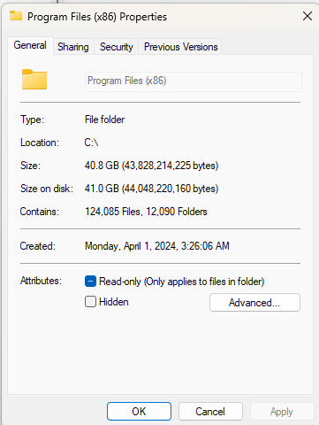
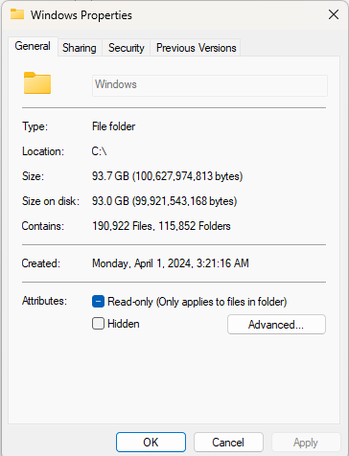
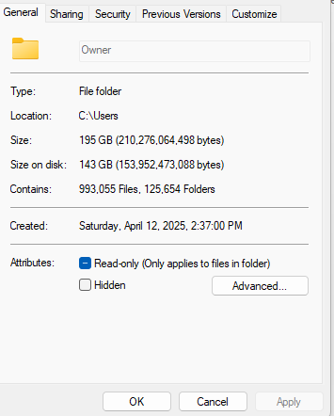
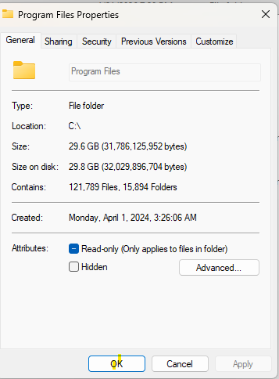

Slide 6
