Slide 1
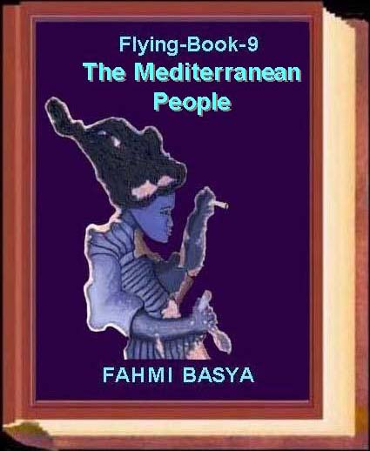
Flying-Book-9
The Mediterranean People
KH FAHMI BASYA

Slide 2
Prakata.
In 1994 I made a pilgrimage to Mecca, but since 1993 I have consintrated abaout Ka’ba
I was impression by the name of ka’ba which means ankle
So by that name I found the scheme as:

Slide 3
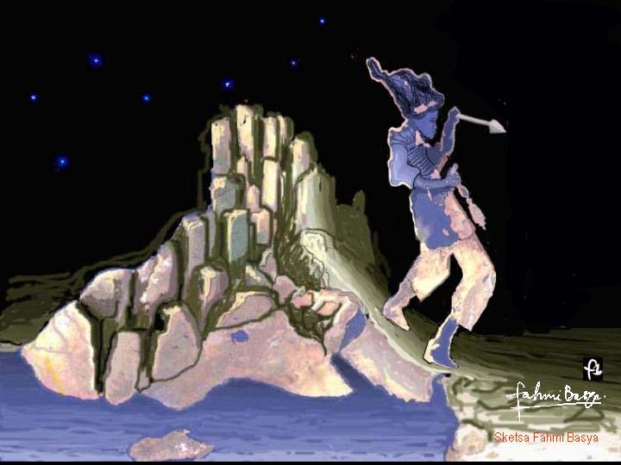
Ka’ba = ankle are there
In Africa there is tribe who bandage their head since-they are smale (children) to make their head long as the head of the Mediterranean people.

Slide 4

If there were a Qur-an with which mountains were moved, or the earth were cloven asunder,
or the deat were made to speak,
(This would be the one!)
(Al-Quran, surat Ar-Ra’du, text 13 note 31)

Slide 5
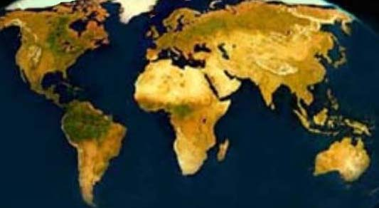
First-of-a-kind Portrait from space
This dazzling
Image is based
On data recorded in
The late 1980s by
Satellites scanning
Earth’s surface in
Four-sequare-kilometer
Sections.
Artist Tom Van Sant
And scientist Van Warren
Chose scenes from different times
Of the year to ensure the best lighting
And maximum vegetation. Drainage
And relief are enhanced in the almost
Cloud-free composite image.
TOM VAN SANT
SANTA MONICA
CALIFORNIA
AND L.VAN WARREN,
NASA/JET PROPULSION
LABORATORY,
PASADENA, CALIFORNIA
DATA COURTESY NOAA
This is the first photo the map of the earth

Slide 6
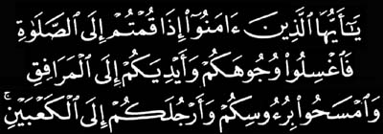
O ye who believe! When ye prepare for prayer, wash your faces, and your hands (and arms) to the elbows; rub your heads (with water); and (wash) your feet to the ankles.
(Al-Quran, surat Al-Maidah, text 5 note 6)
Here we see the word ka’bain that means too ankle

Slide 7
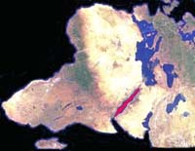
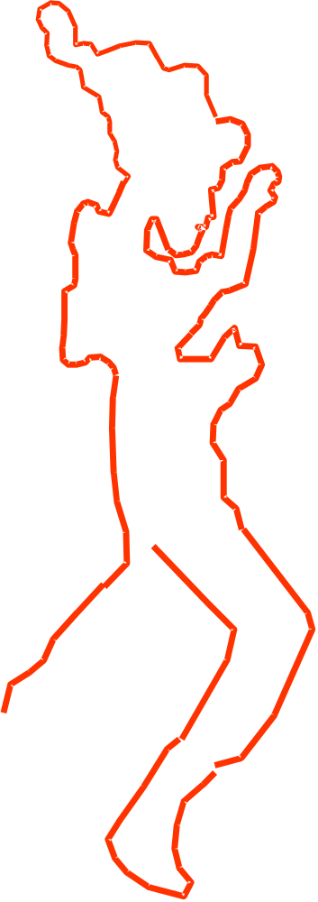

AFRICA
At the side of red sea there
is a place named ankle
(ka’ba)
Europe
Mediterranean Sea
If we draw the feet it seems that ka’ba is at the ankle, and we can see the picture of a people that his body at the Mediterranean Sea
ARABIA
ASIA

Slide 8
So ka’ba is the ankle which proclamed since period of Abraham , that bring message to us

Slide 9
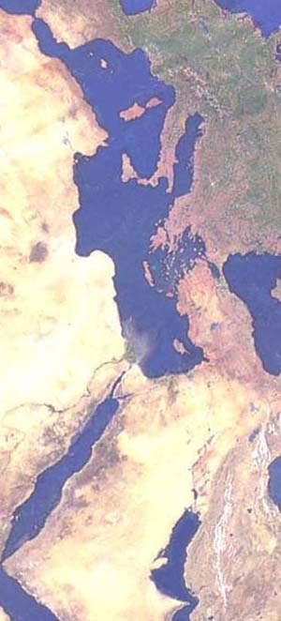
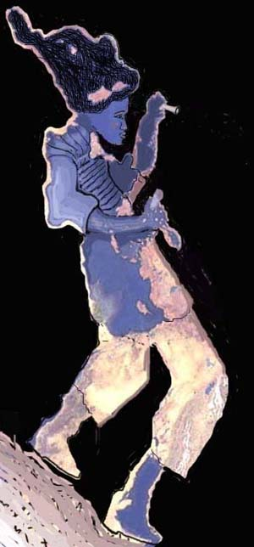


Mediterranean People
Then return from the place whence it is usual for the multitude so to do,
(Al-Quran, surat Al-Baqarah, text 2 note199)
Europe
Mediterranean Sea
Africa
Red Sea
QATAR
Arabia
Asia

Slide 10
If the Mediterranean people kneel down, we can see as
Left foot
Left knee
Left palm
Head and nose
Right knee
Right palm
Right foot
QATAR

Slide 11
Yaman Side
Syam Side
KA’BA
Isma’il’s stone
Iraq Side
Qatar Side
Black Stone

Slide 12
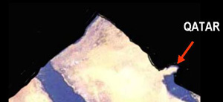
Jabal Rahmat,
Gunung tempat bertemu
Adam dan Hhawa

Slide 13
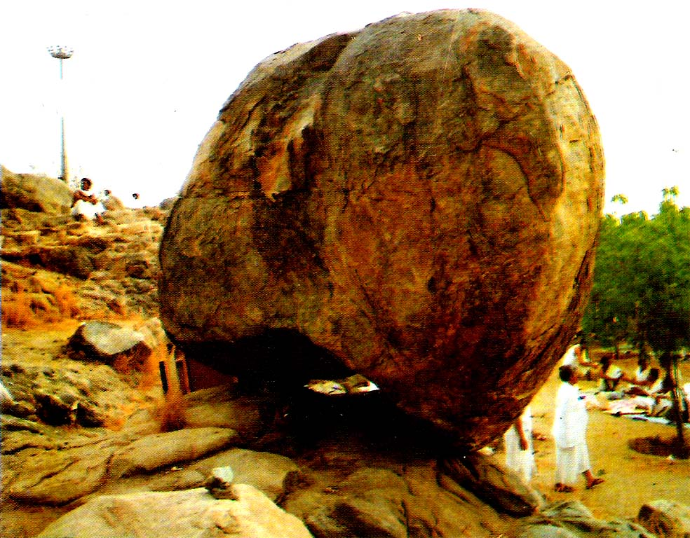

Slide 14
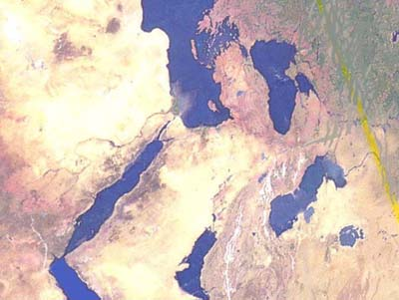
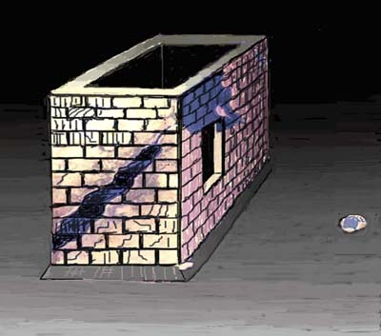
If we make the picture of ka’ba in arabian peninsula, there are Yaman at yaman side, Iraq at iraq side, and Syam at syam side, so the picture can be see as
Aral sea represents Maqom Abraham and Qatar represents Black Stone
Syam
Black Sea
IRAQ
Caspian Sea
YAMAN
Maqom Abraham
Aral Sea
Black Stone
Qatar
KA’BA

Slide 15
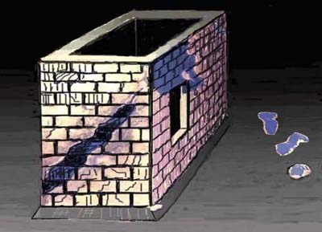
Caspian sea and Black sea shown of the moving thawaf between ka’ba and maqom Abraham.
Caspian Sea dan Black Sea = picture of feet
Maqom Ibrahim

Slide 16
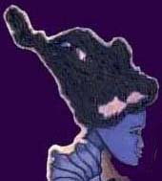
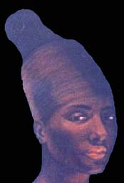
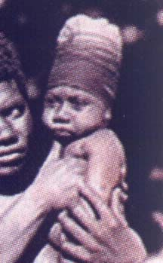
(headbinding)
Tribe Mangbetu (Kongo) in Africa
In Africa there is tribe who bandage their head since-they are smale (children) to make their head long as the head of the Mediterranean people.

Slide 17
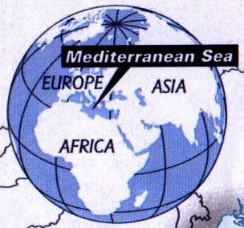
Continued to Flying-Book-9e0
He Who created the seven heavens one above another: no want of proportion wilt thou see in the Creation of The Most Gracious. So turn thy vision again: seest thou any flaw ?. Again turn thy vision a second time: (thy) vision will come back to thee dull and discomfited, in a state worn out.
(Al-Quran, surat Mulku, text 67 notes 3-4)
Ramadhan 1424
KH.FAHMI BASYA

