Slide 1
Why grid frequency falls
Inertia, governors, and fewer spinning machines
An example deck

Slide 2
Four questions
What sets frequency? The balance of power in and out
How fast does it fall? The gap divided by inertia
What stops the fall? Governors, then slower reserves
What changes with less inertia? Faster fall, deeper low
Running example: a 60 Hz system loses 3% of its generation at t = 0

Slide 3
Frequency measures the power balance
In balance
A plant trips
Generation 100%
spinning machines
Load 100%
Generation 97%
spinning machines
Load 100%
60 Hz
falling
lost plant: 3%
3% from kinetic energy
Frequency is the speed of the synchronized machines
Any gap is paid from their kinetic energy, so they slow
Band widths are to scale: a 3% gap looks small, and it is enough

Slide 4
Swing equation: the gap sets the slope
$$\underset{\text{inertia}}{\underbrace{\frac{2H}{f_{0}}}} \underset{\text{slope}}{\underbrace{\frac{df}{dt}}} = \underset{\text{the gap}}{\underbrace{P_{\text{gen}}−P_{\text{load}}}}$$
H: stored kinetic energy per unit of capacity, in seconds
Governors have not moved yet, so at first the gap acts alone
$${\left.\frac{df}{dt}\right|}_{t=0}=\frac{f_{0} ΔP}{2H}=\frac{60×(−0.03)}{2×5}=−0.18 \text{Hz/s}$$
One-machine equivalent of the whole system; powers are per unit of capacity
Kundur, Power System Stability and Control (1994)

Slide 5
Four questions
What sets frequency? The balance of power in and out
How fast does it fall? The gap divided by inertia
What stops the fall? Governors, then slower reserves
What changes with less inertia? Faster fall, deeper low
Running example: a 60 Hz system loses 3% of its generation at t = 0

Slide 6
Who responds, and when
Inertia
kinetic energy, no control
Primary
governors sense frequency
Secondary
control restores 60 Hz
Tertiary
re-dispatch
0.1 s
1 s
10 s
1 min
10 min
1 hr
Each layer buys time for the next
Only inertia acts with no sensing or control
Log time scale. Typical orders of magnitude; boundaries vary by interconnection

Slide 7
The model in eight lines
def simulate(H, T, loss=0.03, R=0.2, D=1.0, f0=60.0, dt=0.01, t_end=60.0):
df, pg = 0.0, 0.0 # deviation, governor power (pu)
out = []
for t in np.arange(0, t_end, dt):
pg += dt * (-df / R - pg) / T # governor: droop with a lag
df += dt * (pg - loss - D * df) / (2 * H) # swing equation with load damping
out.append((t, f0 * (1 + df)))
return np.array(out)
Two states: frequency deviation and governor power
Every number in this deck comes from this function
R = 20%: 5% droop on the quarter of capacity that responds. H and T are set per run

Slide 8
Less inertia
Same physics, less stored energy

Slide 9
Less inertia: a faster fall and a deeper low
both settle at 59.70 Hz
H = 5 s: low of 59.53 Hz at 5 s
59.5 Hz reference
H = 2 s: low of 59.37 Hz at 3 s
Same lost power, same final frequency
Steeper start (0.18 vs. 0.45 Hz/s), and an earlier, deeper low
Illustrative model: 3% loss, 20% effective droop, governor lag 4 s

Slide 10
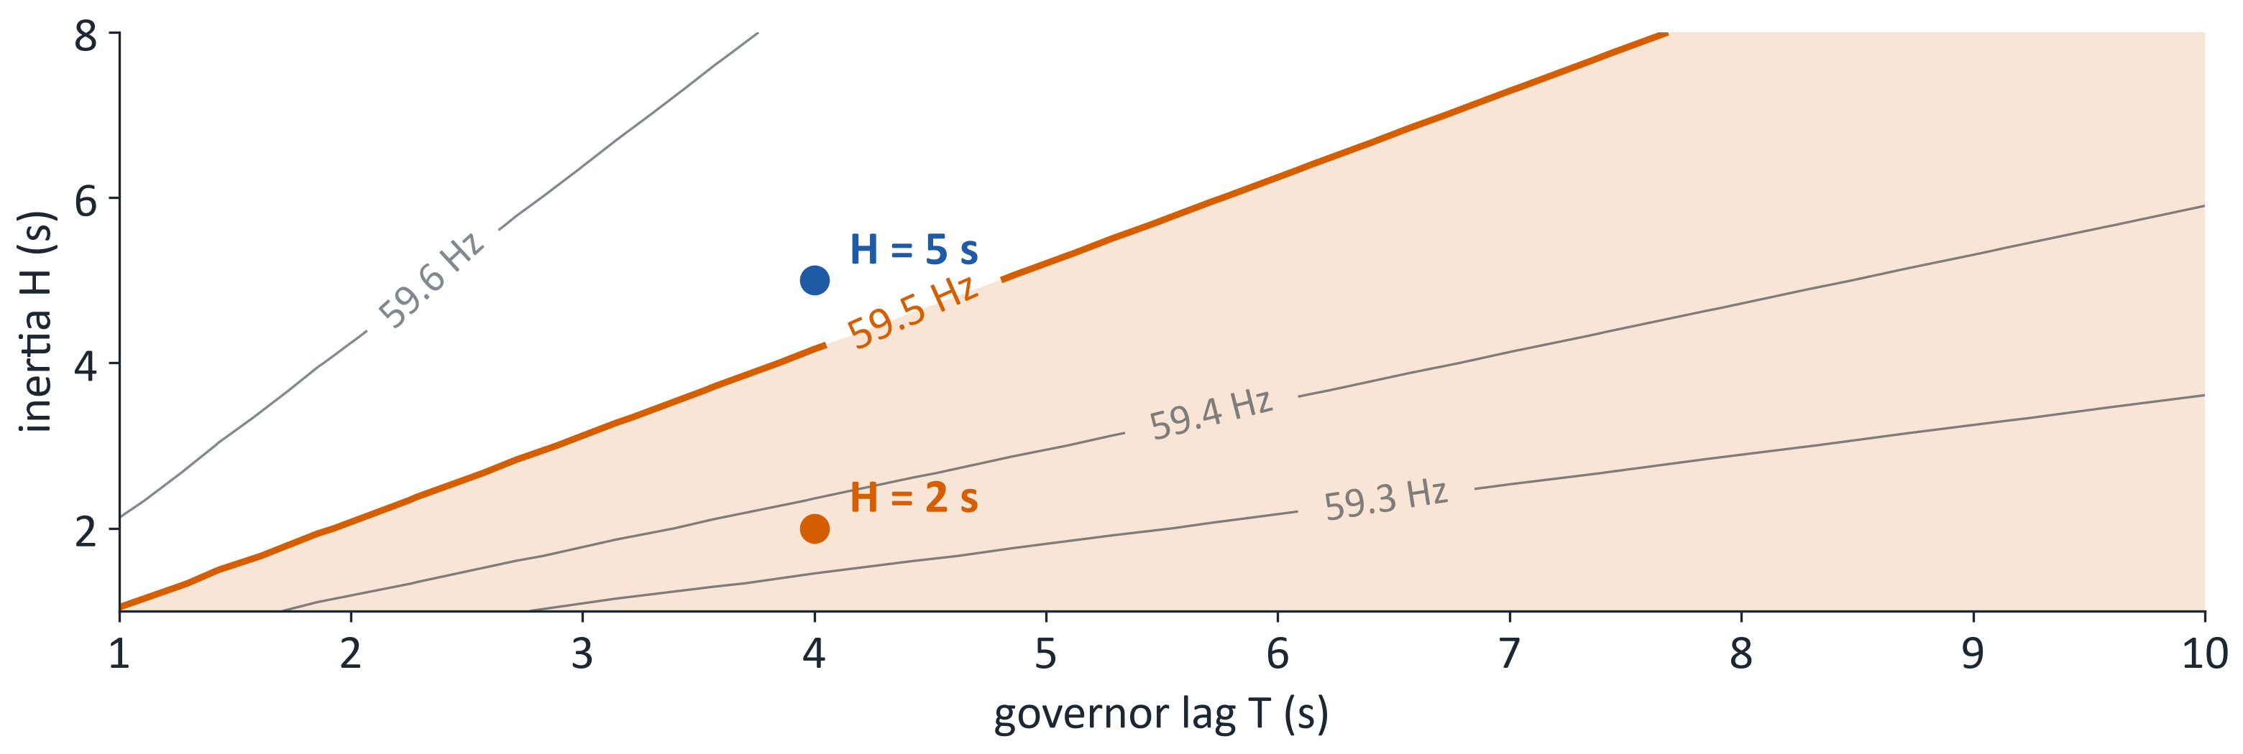
Inertia and response speed trade off
Lines show the lowest frequency reached
Faster response can stand in for lost inertia
59.5 Hz is a reference line; under-frequency load-shedding settings vary by region
Notes:
This plot is an image because PowerPoint has no contour chart. To change it, edit tradeoff_picture() in grid_frequency.py and re-run.

Slide 11
Recap
Question | Answer | Example
What sets frequency? | Power balance | 3% gap
How fast does it fall? | Gap ÷ inertia | 0.18 vs. 0.45 Hz/s
How low does it go? | Inertia vs. response speed | 59.53 vs. 59.37 Hz
Where does it settle? | Droop and damping, not inertia | 59.70 Hz both
H = 5 s vs. H = 2 s, from the same illustrative model

