Slide 1
Can you guess where I am? Geolocation through Text Classification
Will Potter
Advised by David Kauchak
Spring 2014

Slide 2
Goal
To predict the location of
text-based media
based on its content

Slide 3
Goal
“The Empire State Building is red, white and blue tonight!”
“Just arrived in San Francisco for the week”

Slide 4
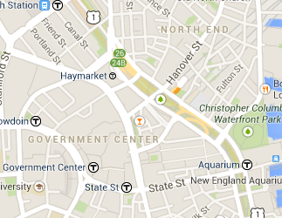

Goal
+
ML
=

Slide 5
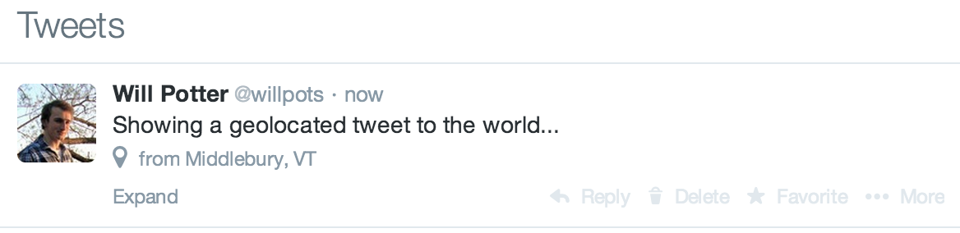
Geolocation
Contains embedded Latitude/Longitude

Slide 6
Why
~2%
at any given moment are geotagged

Slide 7
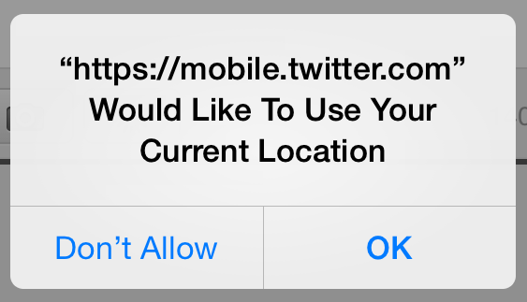
Why

Slide 8
Why
241 million monthly active users
500 million tweets per day
Ad Revenue
Data Analytics

Slide 9
Plan
Design a text classification system
Train on lots of geotagged tweets and look for similarities between tweets that don’t have locations

Slide 10

Text Classification
1
2
2
?
2
1
2

Slide 11
Data
Feb. 13, 2014 collection date
144,546 geotagged tweets
84,860 unique users
1.7 tweets per user

Slide 12
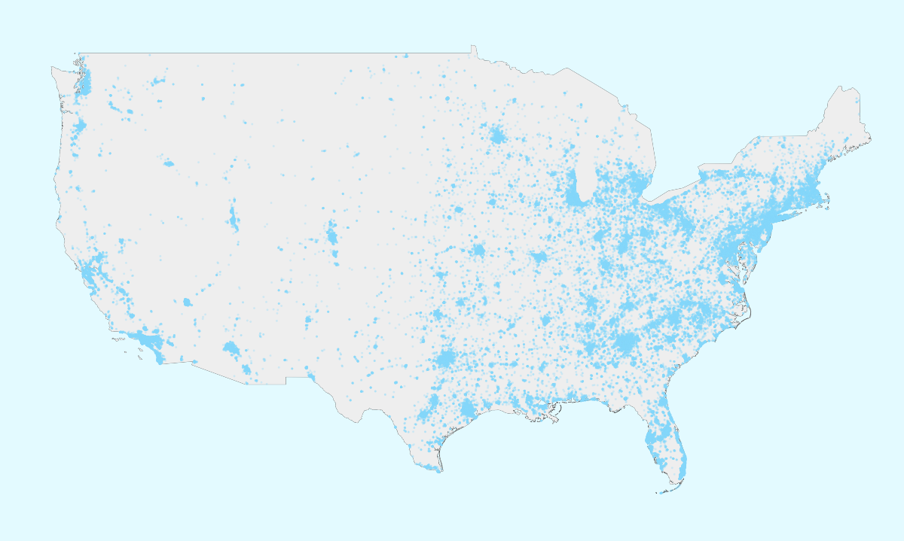
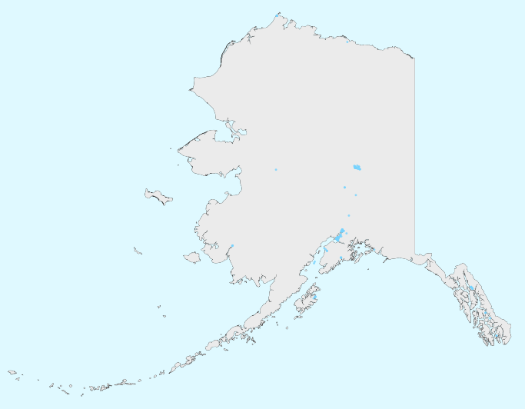
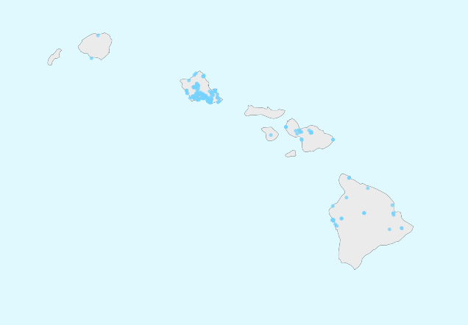
Data

Slide 13
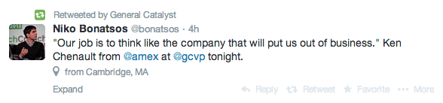
Text Classification

Slide 14
Features

Slide 15
Labels

Slide 16
Labeling
(42.354792, -71.065793)
to
USA
Massachusetts
Suffolk County
Boston
Beacon Hill

Slide 17
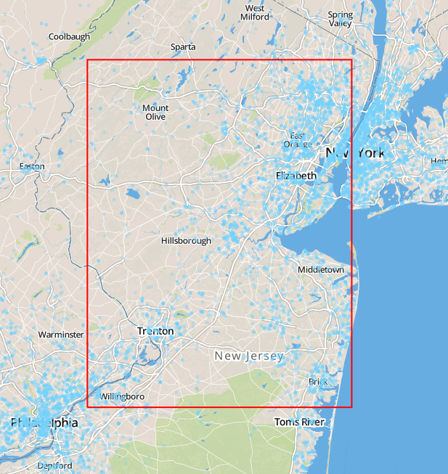
Labeling
1 degree
x
1 degree

Slide 18
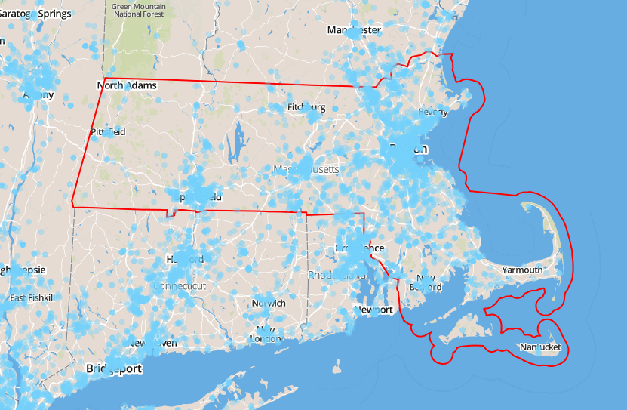
Labeling
51
State-Level
Labels

Slide 19
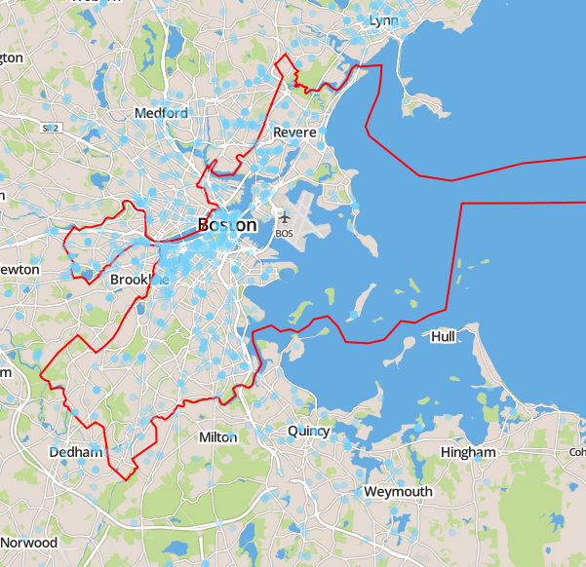
Labeling
2570
County-Level
Labels

Slide 20
Classification
Multinomial Naïve Bayes
Bernoulli Naïve Bayes
K-Nearest Neighbor

Slide 21
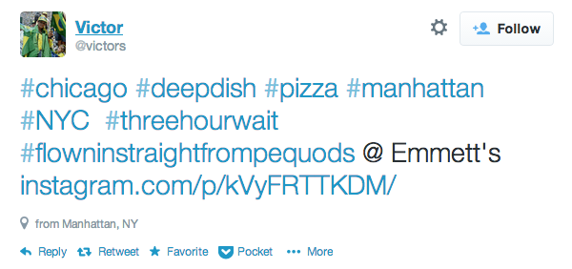
Feature Extraction

Slide 22
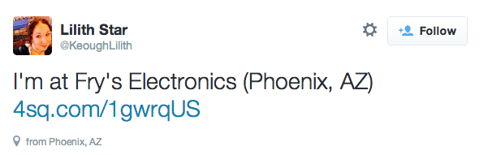
Feature Extraction

Slide 23
Preprocessing
Convert to lowercase
Remove @usernames
Remove links (http://t.co/asd1234asf9)
Remove all non-alphanumeric characters (excluding spaces)
Remove stopwords (me, the, a, you…)

Slide 24
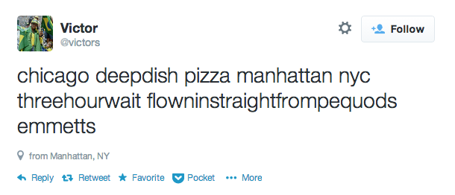
Preprocessing

Slide 25
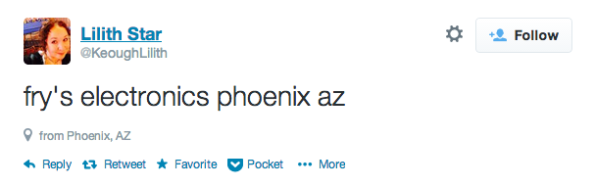
Preprocessing

Slide 26
Baseline
Pure Random Guessing
For all possible labels, pick 1 randomly
or
Majority Label Guessing
For all labels in training set,
pick most popular label

Slide 27
Classification
~2.20%
better than picking the majority label

Slide 28
Classification
“I'm at the Empire State Building”
New York
“Baton Rouge is nice!”
California, Texas, New York, Oregon

Slide 29
Classification
Multinomial NB | No Preprocess | Tweets | State | 2.196% | 6.93E-41
Multinomial NB | Preprocess | Tweets | State | 2.109% | 5.39E-38
Bernoulli NB | No Preprocess | Tweets | State | 1.442% | 7.03E-36
Bernoulli NB | Preprocess | Tweets | State | 1.422% | 2.42E-38
Multinomial NB | Preprocess | Tweets | County | 0.427% | 3.69E-27
Bernoulli NB | Preprocess | Tweets | County | 0.416% | 1.29E-30

Slide 30
Labeling
State Labels
County Labels
Grid Labels

Slide 31
Labeling
2.032%
state labels are better
than county labels
with MultinomialNB

Slide 32
Preprocessing
0.3%
preprocessing is better
with county labels
with MultinomialNB

Slide 33
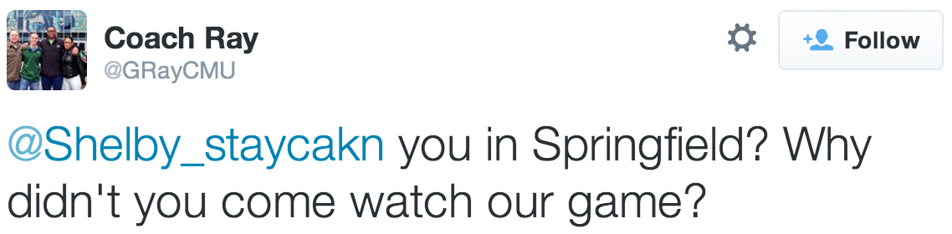
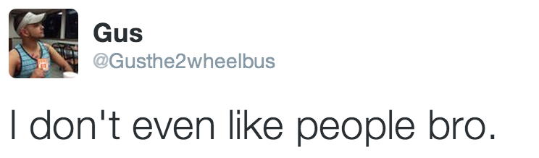
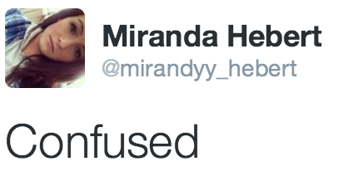
Difficulties

Slide 34
Further Work
Larger sample size
Metropolitan Area Boundaries
Filter tweets containing toponyms
Integration with Wikipedia

Slide 35
Thanks
David Kauchak, Advisor
Matt Dickerson
Daniel Scharstein
Amy Briggs
Amy Rose
CS Department
Friends + Family

Slide 36
Questions?
Will Potter
wspotter@middlebury.edu
781-439-2878

Slide 37
Images
Slide 4
Twitter Image - https://g.twimg.com/Twitter_logo_blue.png
Map Image – http://maps.google.com
Slide 5
http://twitter.com
Slide 7
Permission Image – http://mobile.twitter.com
Slide 10
Document Image - http://icons.iconarchive.com/icons/visualpharm/icons8-metro-style/512/Very-Basic-Document-icon.png
Slide 13,14,15
http://twitter.com
Slide 17,18,19
http://mapbox.com and Will Potter
Slide 21,22,24,25
http://twitter.com
Slide 34
http://twitter.com

