Slide 1
Can you guess where I am? Geolocation through Text Classification
Will Potter
Advised by David Kauchak
Spring 2014

Slide 2
Goal
To predict the location of
text-based media
based on its content

Slide 3
Goal
“The Empire State Building is red, white and blue tonight!”
“Just arrived in San Francisco for the week”

Slide 4
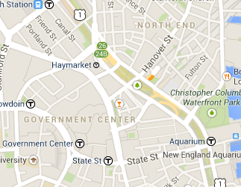

Goal
+
ML
=

Slide 5
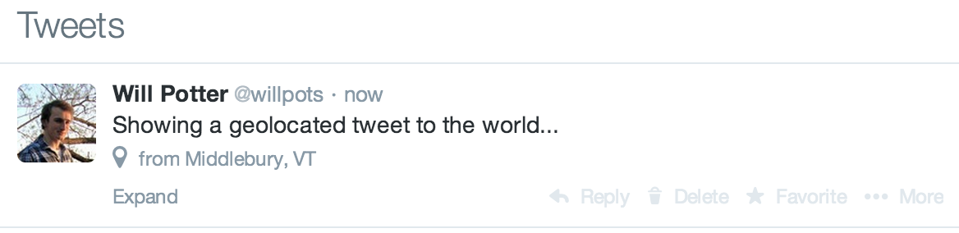
Geolocation
Contains embedded Latitude/Longitude

Slide 6
Why
~2%
at any given moment are geotagged

Slide 7
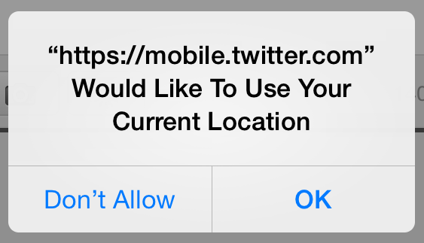
Why

Slide 8
Why
241 million monthly active users
500 million tweets per day
Ad Revenue
Data Analytics

Slide 9
Why
~2%
at any given moment are geotagged

Slide 10
Plan
Design a text classification system
Train on lots of geotagged tweets and look for similarities between tweets that don’t have locations

Slide 11

Text Classification
1
2
2
?
2
1
2

Slide 12
Data
Feb. 13, 2014 collection date
144,546 geotagged tweets
84,860 unique users

Slide 13

Text Classification

Slide 14
Features

Slide 15
Labels

Slide 16
Labeling
(42.354792, -71.065793)
to
USA
Massachusetts
Suffolk County
Boston
Beacon Hill

Slide 17
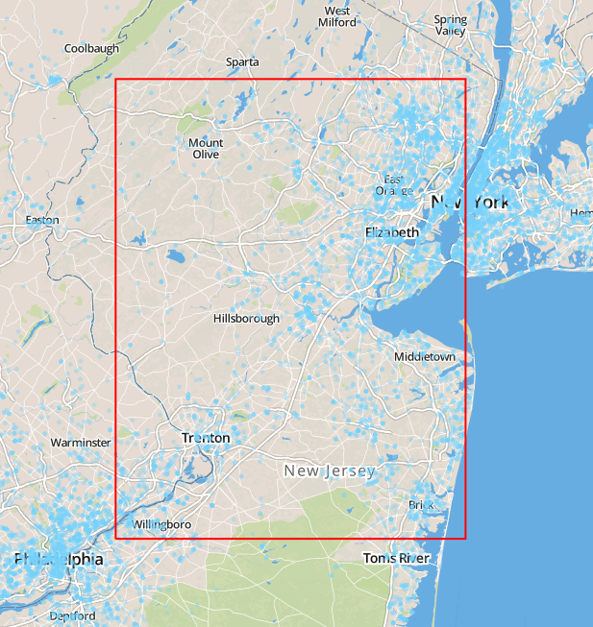
Labeling
1 degree
x
1 degree

Slide 18
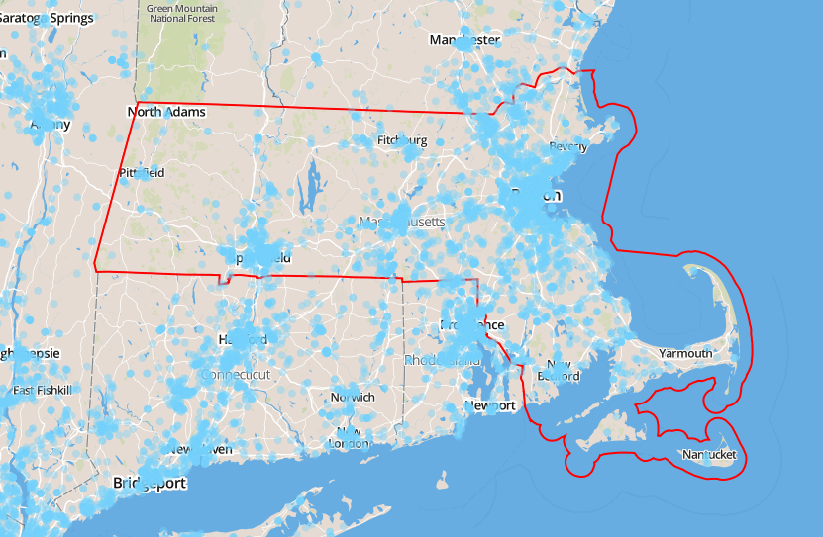
Labeling
51
State-Level
Labels

Slide 19
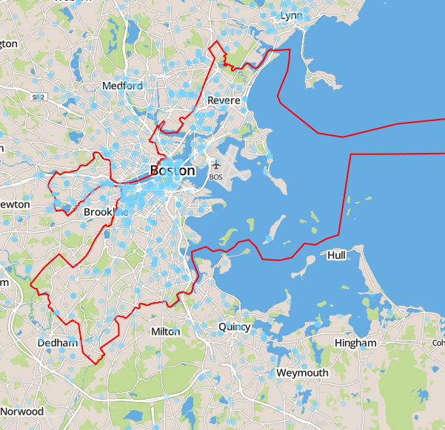
Labeling
2570
County-Level
Labels

Slide 20
Classification
Multinomial Naïve Bayes
Bernoulli Naïve Bayes
K-Nearest Neighbor

Slide 21
Multinomial Naïve Bayes

Slide 22
Bernoulli Naïve Bayes

Slide 23
K-Nearest Neighbor

Slide 24
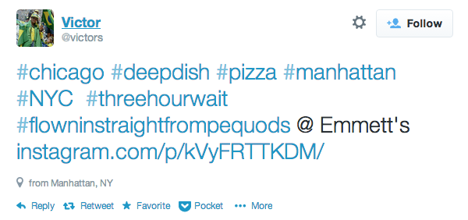
Feature Extraction

Slide 25
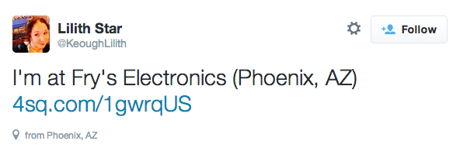
Feature Extraction

Slide 26
Feature Extraction
Outline Process HERE!
Briefly mention vectorization…not that important because I didn’t really experiment with it

Slide 27
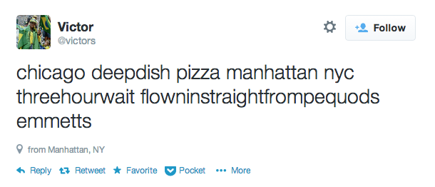
Feature Extraction

Slide 28
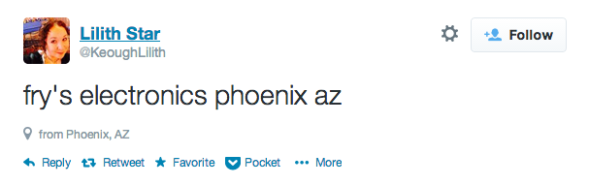
Feature Extraction

Slide 29
Results

Slide 30
Images
Slide 2
Twitter Image - https://g.twimg.com/Twitter_logo_blue.png
Map Image – http://maps.google.com
Slide 7
Permission Image – http://mobile.twitter.com
Slide 11
Document Image - http://icons.iconarchive.com/icons/visualpharm/icons8-metro-style/512/Very-Basic-Document-icon.png

