Slide 1


Welcome TO the privacy and security training session
Willrock R. Herrera

Slide 2


Table of contents
3 – Introduction
4 – HIPAA Security Rule
5 – Terms
7 – Safeguarding
9 – Disclosures
10 – References

Slide 3


Introduction
Thank you for participating in today’s training designed to cover some updates to our HIPAA Basic Training for Privacy and Security course. We will be going over the HIPAA Security Rule and the information that we must familiarize ourselves with. To include Personable Identifiable Information (PII), Personal Health Information (PHI), and electronic Personal Health Information in order to comply with federal regulations. Let’s begin…

Slide 4

HIPAA security rule
Sets national standards for the security of Protected Health Information (PHI) and electronic Protected Health Information(ePHI) that may be held and or transferred digitally.
Requires administrative, physical, and technical safeguards.

Slide 5
Defining important terms
Health Insurance Portability and Accountability Act (HIPAA)
The Health Insurance Portability and Accountability Act came into effect in 1996 as federal law as the national standard for health care agencies to protect and not disclose sensitive patient health information without the consent of the patient. The Privacy Rule and the Security Rule are critical facet of HIPAA.

Slide 6
Defining important terms
Personal Identifiable Information (PII)
Personal Health Information (PHI)
Electronic Personal Health Information (ePHI)
Personal Identifiable Information is any information that may directly or indirectly identify an individual
Personal Health Information that is held, maintained, and transmitted between health care organizations
electronic Personal Health Information

Slide 7
safeguards
Administrative
Physical
Technical
Actions, policies, and procedures to detect, contain, and ultimately prevent security intrusions and violations.
Risk Management
Staff Training
Implementing methods to protect electronic information and relatable buildings and equipment from environmental hazards and unauthorized entries.
Alarm and Security Systems
Policies and procedures that maintain ePHI to allowing access only to authorized personnel or softwares and to prevent unauthorized access to information. Unique user identification, emergency access procedures.
Data encryption
Antivirus software

Slide 8
safeguards
Culture
Training
Emphasizing a nurturing environment for employees to value and prioritize protecting patient information without fear of reprimands.
Treating all patient information with great importance.
Maintaining up-to-date annual trainings
Urgent mandatory trainings when policies, procedures, infrastructures and more are updated.

Slide 9
Disclosures
HIPAA
SECURITY RULE
PRIVACY RULE
Through its Security Rule and Privacy Rule, prevents the disclosure of PII, PHI, and ePHI of any patient information to anyone or anything without consent of said patient.
supports the Privacy Rule’s prohibitions against improper uses and disclosures of PHI
“A covered entity may not use or disclose protected health information, except either: (1) as the Privacy Rule permits or requires; or (2) as the individual who is the subject of the information (or the individual's personal representative) authorizes in writing.”

Slide 10
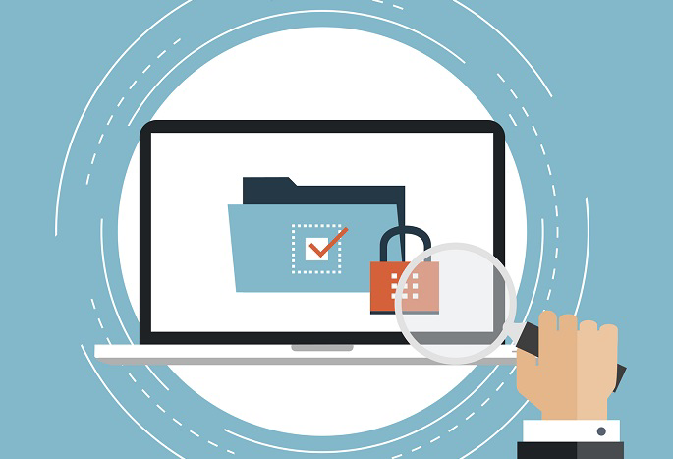
Thank you
References
Security rule
https://www.hhs.gov/hipaa/for-professionals/security/laws-regulations/index.html
Safeguarding
https://www.ecfr.gov/current/title-45/subtitle-A/subchapter-C/part-164
Safeguarding
https://leocontent.umgc.edu/content/umuc/tus/cmit/cmit320/2235/learning-resource-list/educating-and-training-your-workforce.html?ou=767085
Disclosures
https://www.hhs.gov/hipaa/for-professionals/privacy/laws-regulations/index.html

