Slide 1
Angular js
By Koushik M L N

Slide 2

What is angular?
AngularJS is a JavaScript-based open-source front-end web application framework mainly maintained by Google to make development of web applications easier, faster and cleaner.

Slide 3
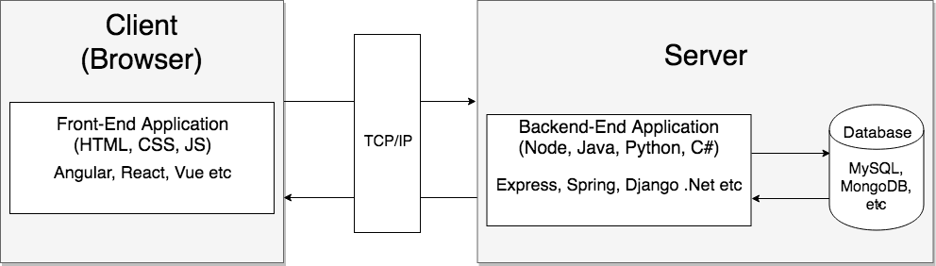
Components of a web application

Slide 4
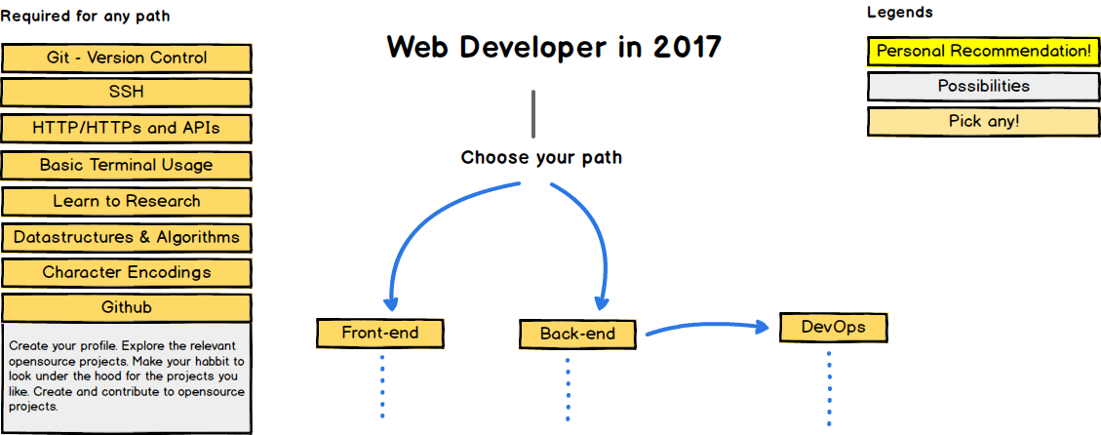
Path to Becoming a web Developer

Slide 5
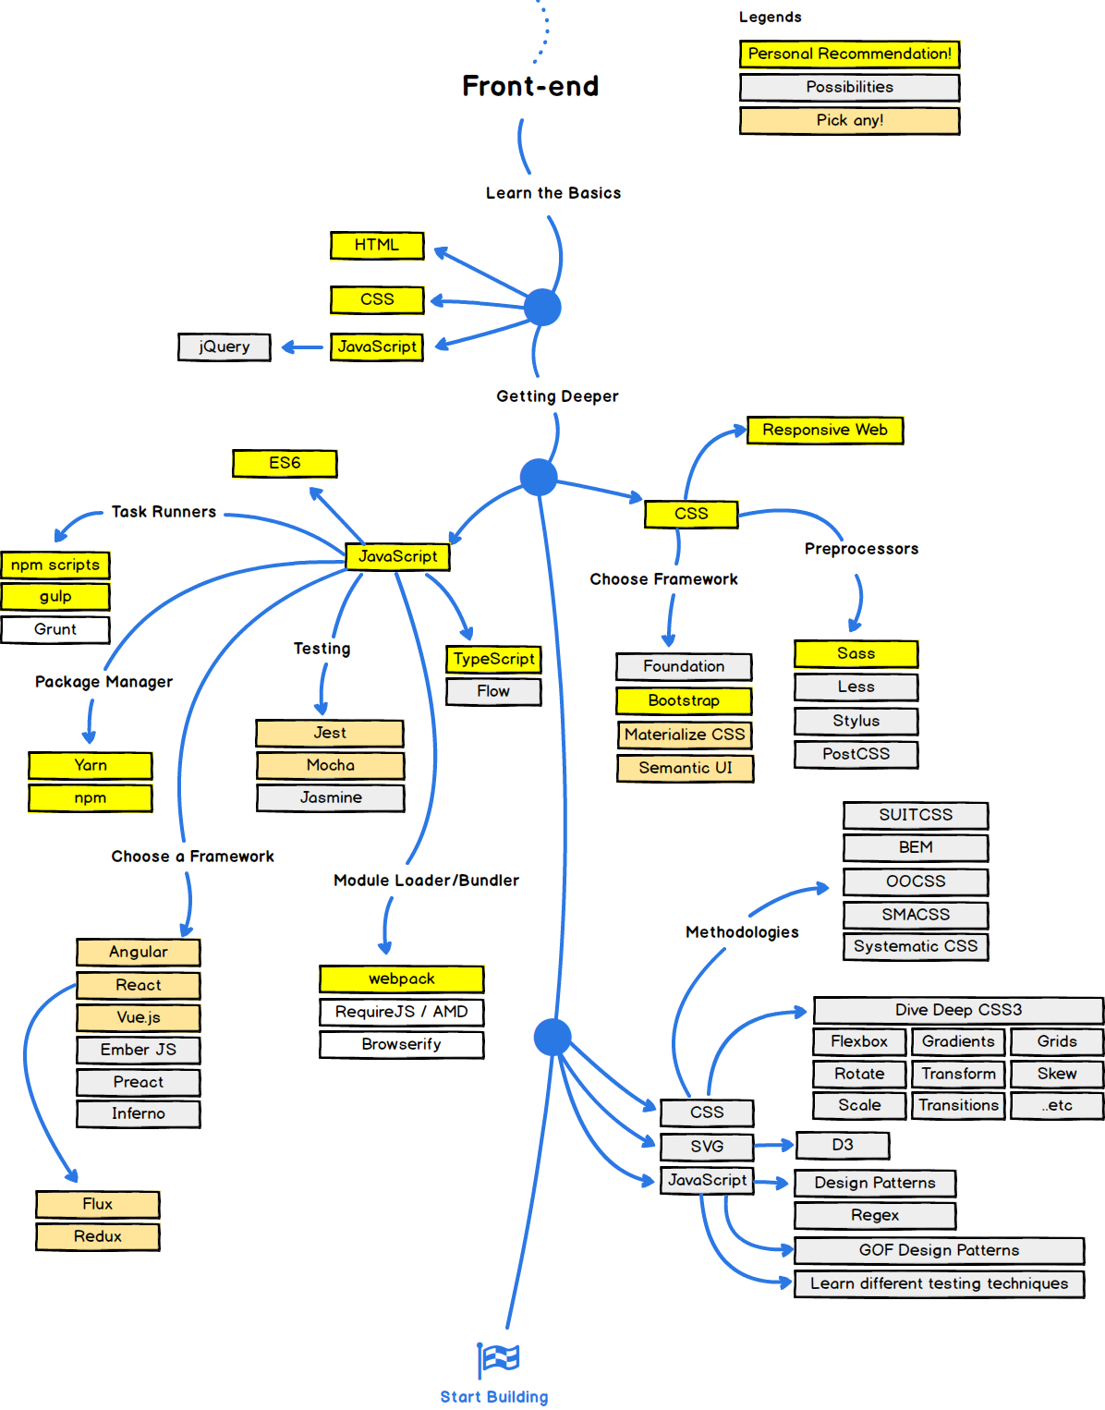

Slide 6
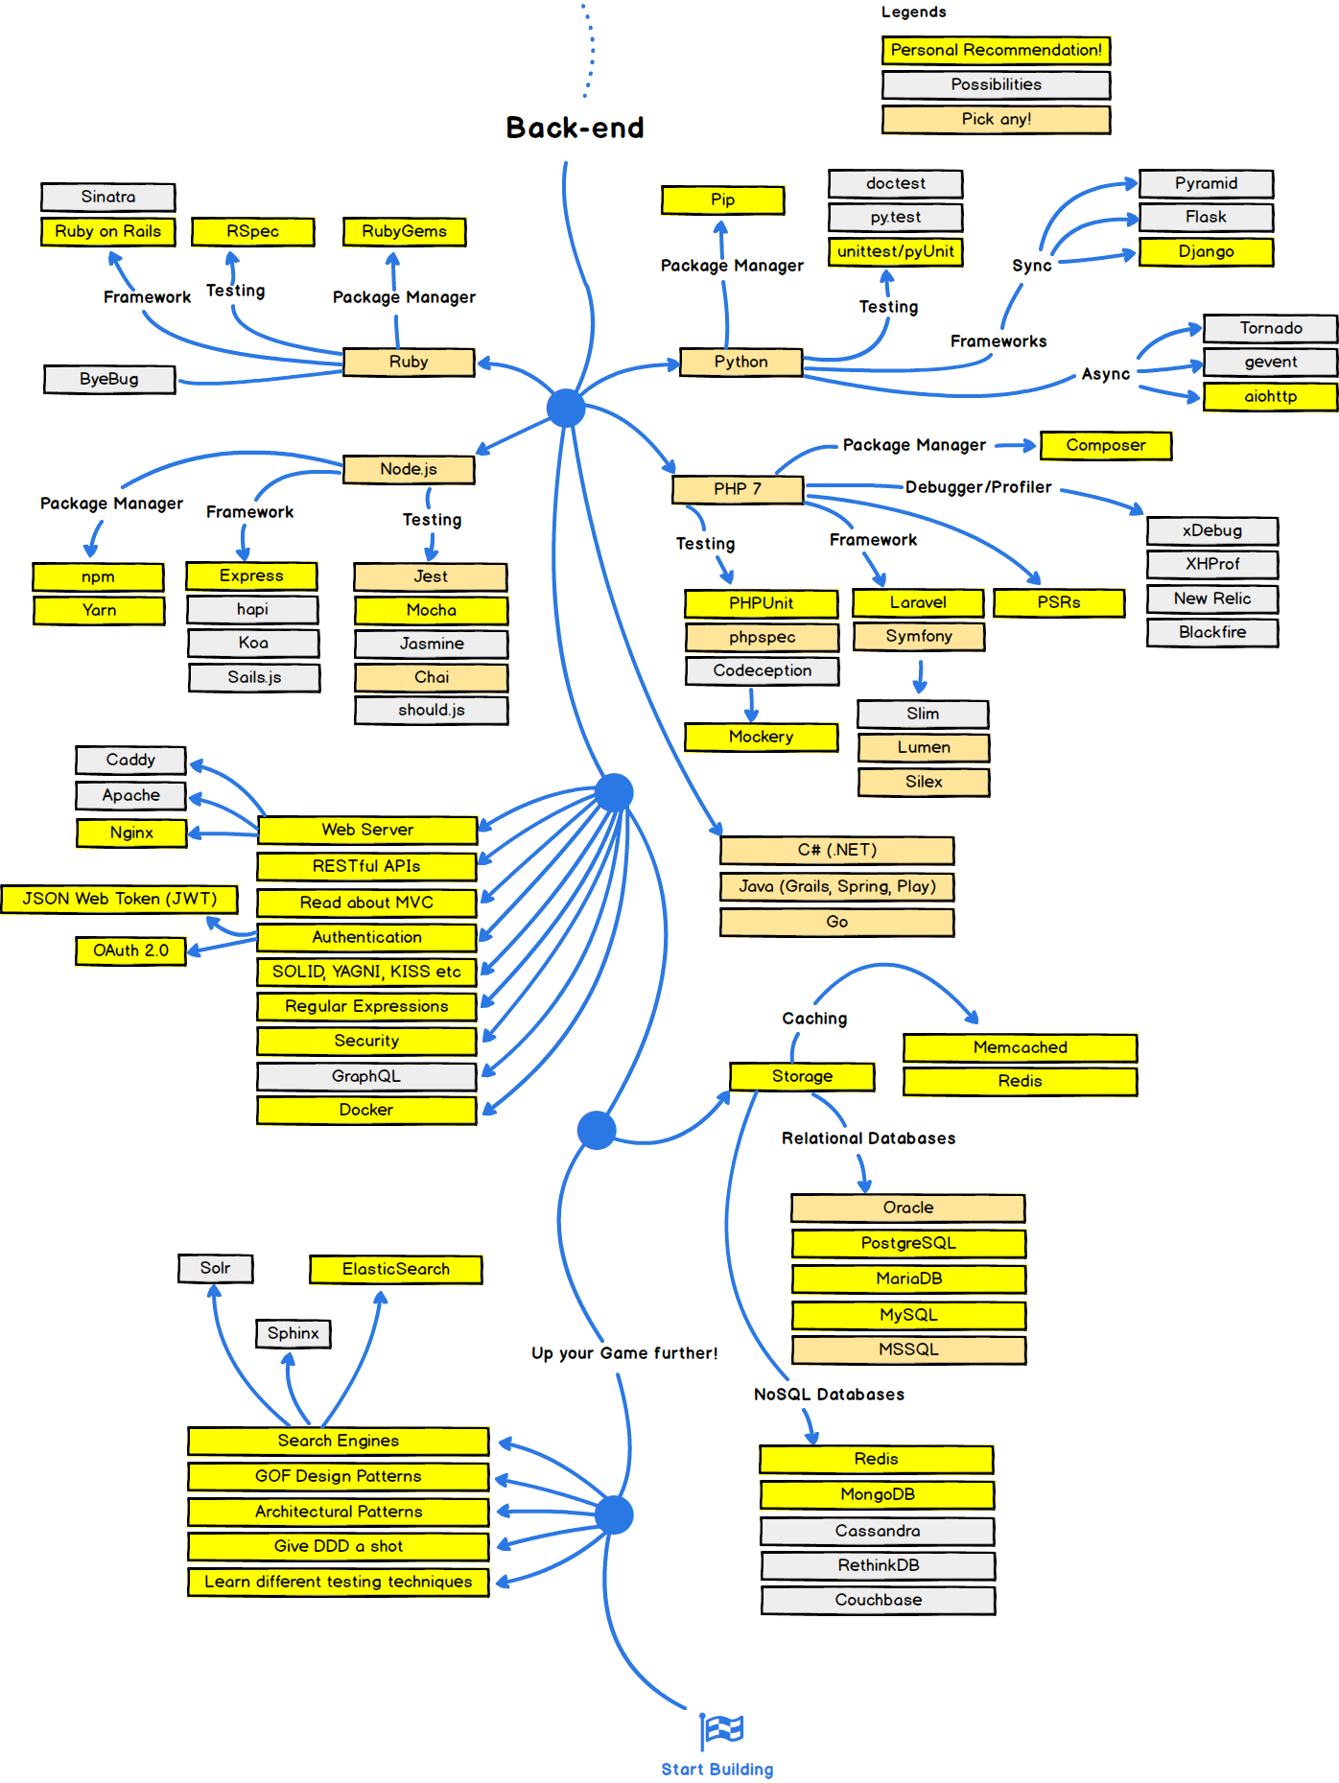

Slide 7
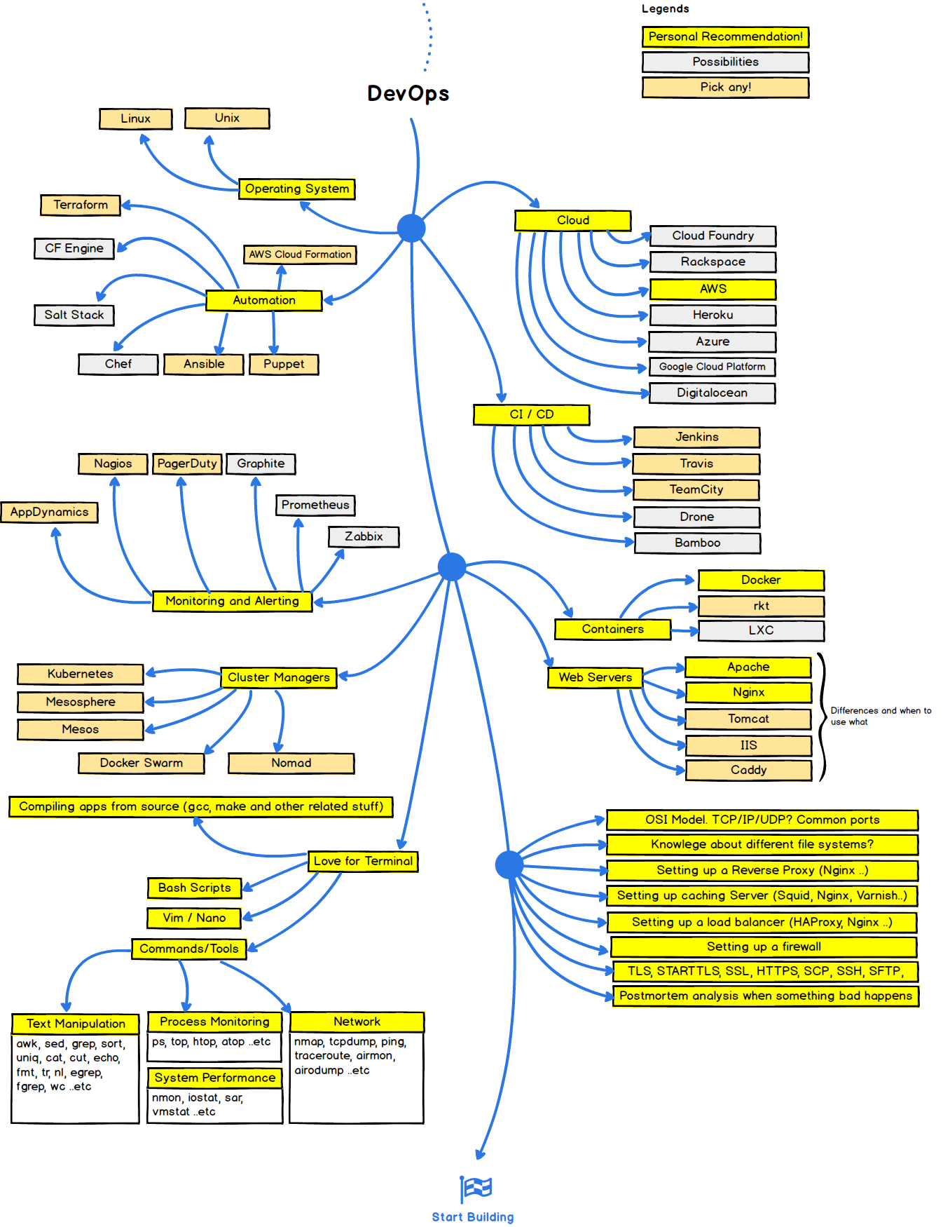

Slide 8
Development of Chatbot using angular
Basics of Angular
Modules
Components
Routes
Services
Models
Develop Blog using Angular
Development of Chatbot using DialogFlow

Slide 9
Installing angular-cli
Angular CLI is a command line interface for angular which can be used to generate boiler plate code and run and deploy angular applications. Prerequisites for angular-cli: node.js and npm
npm install -g @angular/cli

Slide 10
Project Structure
ng new my-first-application This generates an angular application with some base code
tree -f -L 1
├── ./README.md // ReadMe File ├── ./e2e // End to End Testing ├── ./karma.conf.js //Unit Test Config ├── ./node_modules // Installed Dependencies ├── ./.angular-cli.json // Angular Config File ├── ./package.json // npm Config File ├── ./protractor.conf.js // End to End Test File ├── ./src // Source Files ├── ./tsconfig.json // TypeScript Config └── ./tslint.json // Linter File

Slide 11
Module & Component
In Angular, a module is a mechanism to group components, services that are related, in such a way that can be combined with other modules to create an application.
ng new creates a single module app module.
Component is used to add new functionality to the browser by creating new tags that have custom functionality attached to them
We have a default app.component defined when we create our angular application

Slide 12
Routing
Angular applications are single page applications. We use the RoutingModule to switch between components to navigate to different pages(components) inside our application.
We can generate a application with routing using ng new blog --routing

