Slide 1
I am functional OO and You can Too!
Will Pleasant-Ryan

Slide 2
Functional Programming is great
Functions!
first-class citizens
partial application / currying
composition

Slide 3
Functional Programming is great
Immutability!
No side effects
deep equality
reduce surprises / hidden complexity
easier to analyze & test

Slide 4
Functional Programming is great
But Wait there’s more!
Algebraic data types – expressively constrain valid states
Monads – control data flow
Homoiconicity – code-as-data, METAPROGRAMMING

Slide 5
But sometimes Functional programming isn’t the right choice
Explicit customer requirement
Customer ecosystem
Eventual maintainers
Existing libraries / ecosystem in problem domain

Slide 6
What if I Told YOU…

Slide 7
Functional OO
We’ll Examine techniques for writing more functional code in:
Ruby
C#
Javascript

Slide 8
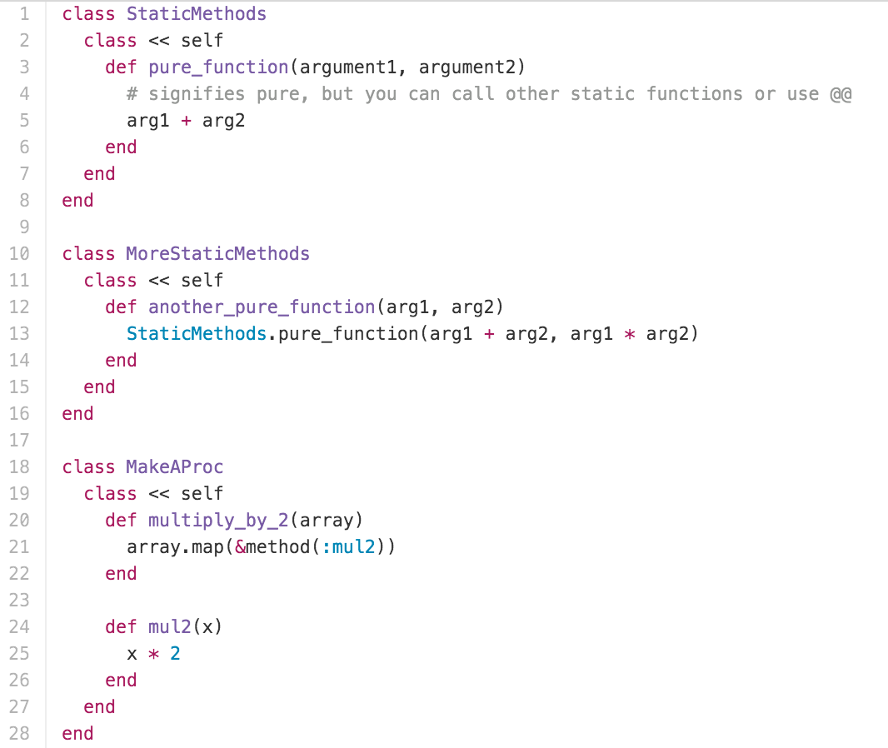
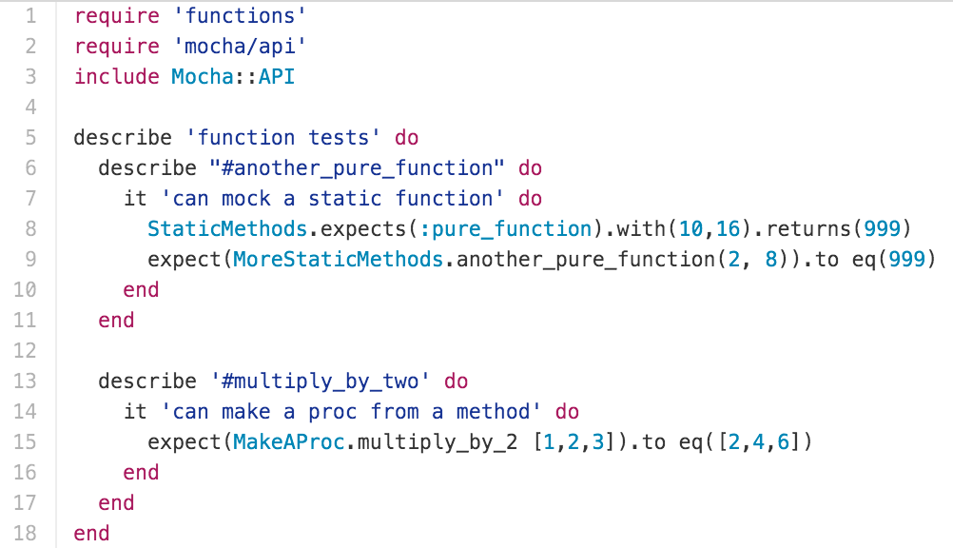
Functions As First-Class Citizens
Ruby

Slide 9
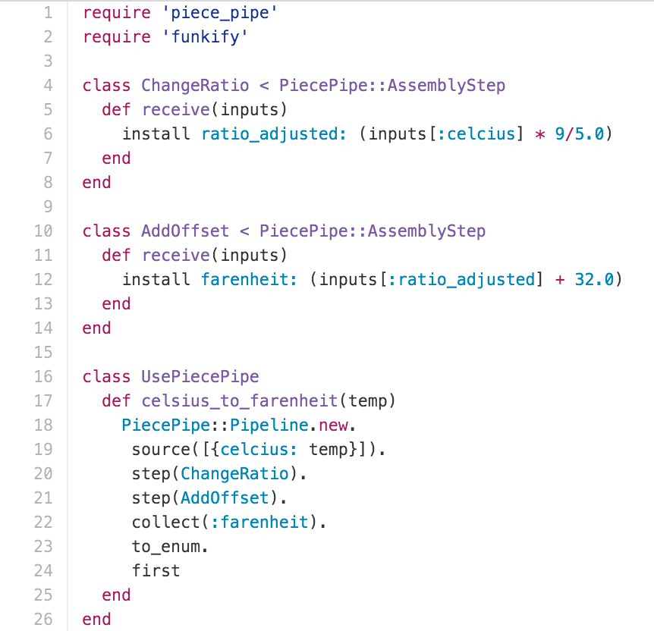
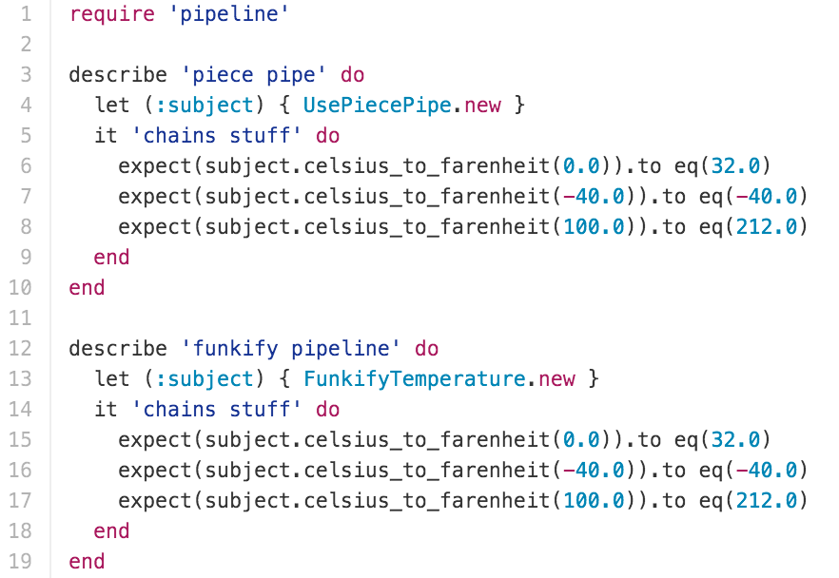
Partial Application / CURRYING / Function Composition

Slide 10
Partial Application / CURRYING / Function Composition
Ruby

Slide 11
Functions As First-Class Citizens
C#

Slide 12
Partial Application / CURRYING
C#

Slide 13
FUNCTION COMPOSITION
C#

Slide 14
Functions As First-Class Citizens
Javascript

Slide 15
Partial Application / CURRYING
Javascript

Slide 16
FUNCTION COMPOSITION
Javascript

Slide 17
IMMUTABILITY
Ruby

Slide 18
IMMUTABILITY
C#

Slide 19
IMMUTABILITY
Javascript

Slide 20
ADTs
Ruby

Slide 21
MONADS
Ruby

Slide 22
ADTs
C#

Slide 23
MONADS
C#

Slide 24
ADTs
Javascript

Slide 25
MONADS
Javascript

Slide 26
METAPROGRAMMING
Ruby

Slide 27
METAPROGRAMMING
C#

Slide 28
METAPROGRAMMING
Javascript

Slide 29
CONCLUSION

Slide 30

GOOD LUCK AND GOOD NIGHT
Will Pleasant-RYan
will.ryan@atomicobject.com
@KreliAnodos
https://github.com/willryan/functional-oo

